Slide 1

MA Grid Modernization
Restructuring Roundtable
September 25, 2015

Slide 2
DPU Grid Modernization Order
10 Year Comprehensive Grid Mod Plan
GMPs updated every 5 years
DPU Objectives
Reduce the effect of outages
Plan Elements
Cost Recovery
First filing due August 5th
Integrate distributed resources
Improve workforce and asset management
Timing and priority for all grid mod planning and investment over 10 years
Tracker for incremental STIP CapEx; if Company is proposing to achieve AMF, then other incremental capital investments in the first 5 years can be included in CapEx tracker
Optimize demand, including reducing system and customer costs
5-year STIP which includes advanced metering functionality; must analyze STIP using business case cost-benefit model from DPU
Marketing, education and outreach plan; statewide and company-specific
Infrastructure and performance metrics (statewide and company-specific); RD&D; cybersecurity, privacy, and meter data access
Stakeholder engagement required

Slide 3
Overall GMP Approach
What modernization approaches provide financial and qualitative value for customers?
What investments should be the immediate focus?
What is the value of the distribution utility in a distributed energy future?
Reviewing rate design essential to understanding the effect of grid mod cost on individual customers

Slide 4
Core GMP Components
Automated Metering Functionality (AMF)
  TVR compatible Smart Meters, Communications interfaces
  Head End / Meter Data management System (MDMS) / Outage Management System (OMS)
Grid Field Devices:
  Advanced Distribution Automation (ADA)
  Volt VAR optimization / Conservation Voltage Reduction (VVO/CVR)
  Remote Feeder Sensors
Customer Outreach, Education, Demand Response
  Customer Load Management devices and programs
  Marketing/Outreach/Education efforts

Slide 5
Core GMP Components
Internal Infrastructure Investments:
  Field Communications Network (Supports AMI and Grid Devices)
  Data Storage and Service/ Cyber Security services
  Support Services (Call Center, Additional Staff)
  Advanced Distribution Management System (ADMS) and Distribution Supervisory Control And Data Acquisition (DSCADA) system

Slide 6
Summary of GMP Scenarios (1)
Funding Source | Cat-egory | Plan Component | “Balanced Plan” Option 1 | “AMI Focused” Option 2
STIP | Field Deploy-ment | AMI Meters | 100% Opt-out deployed in 5 Years | 100% Opt-out deployed in 5 Years
 |  | CLM | Customer Portal and DRMS, Devices through Energy Efficiency Programs | Customer Portal and DRMS, Devices through Energy Efficiency Programs
 |  | ADA, VVO, Feeder sensors | ADA / VVO to 30% of customers, Feeder sensors | VVO to 15% of customers
 | Enabling Infra-structure | ADMS/DSCADA | Yes | No
 |  | Telecomm | To support AMI, and Grid investments | To support AMI, and Grid investments
 |  | IT/OT investments | Incl. data lake, MDMS, Integration services, Integrated network Operations Center and Apps. | Reduced IT/OT to support AMI data integration only
 |  | Cybersecurity and Billing | As necessary | As necessary for reduced scope
 |  | Workforce and Training | Training and mobility services | Training Only
 |  | Marketing, Outreach and Education | Yes: Opt-Out Focused | Yes: Opt-Out Focused
DER Tariff / Inter-connection | DER | DER | Application Tools, Analytic investment, Proactive substation upgrades | Application Tools, Analytic investment, Proactive substation upgrades
RD&D Tracker | RD&D | RD&D | Joint projects with EPRI/CEATI, Pilots which include ES, microgrids, EV, etc | Joint projects with EPRI/CEATI, Pilots which include ES, microgrids, EV, etc.
Plan STIP Costs: |  |  | US $830.5M | US $657.1M
Benefit-Cost Ratio: |  |  | .90 | 1.02
Notes:
Opt in assumes 1-2% adoption rate
Opt-out assumes 6% opt-out rate based on SES [although research shows more of a 0.5%-1% opt-out]
Option 5 – assumes 400K customers are offered opt out around feeders with ADA /VVO

Slide 7
Summary of GMP Scenarios (2)
Funding Source | Cat-egory | Plan Component | “Grid Focused” Option 3 | “Opt In AMI” Option 4
STIP | Field Deploy-ment | AMI Meters | 30% Opt-out deployed in 10 Years, 70% Opt-in (cell) | 100% Opt-In (cell) in full territory in 10 years
 |  | CLM | Customer Portal and DRMS, Devices through Energy Efficiency Programs | Expansion of SES
 |  | ADA, VVO, Feeder sensors | ADA / VVO to 30% of customers, Feeder sensors | ADA and VVO to 30% of customers, Feeder sensors
 | Enabling Infra-structure | ADMS/DSCADA | Yes | Yes
 |  | Telecomm | To support AMI, and Grid investments – 30% territory | Cell based AMI and Grid investments
 |  | IT/OT investments | Reduced IT/OT to support AMI data integration only | Expansion of SES infrastructure
 |  | Cybersecurity and Billing | As necessary for reduced scope | Expansion of SES
 |  | Workforce and Training | Training Only | Training Only
 |  | Marketing, Outreach and Education | Yes: Both Opt-Out and Opt-In | Yes: Opt-in Focused
DER Tariff / Inter-connection | DER | DER | Application Tools, Analytic investment, Proactive substation upgrades | Application Tools, Analytic investment, Proactive substation upgrades
RD&D Tracker | RD&D | RD&D | Joint projects with EPRI/CEATI, Pilots which include ES, microgrids, EV, etc. | Joint projects with EPRI/CEATI, Pilots which include ES, microgrids, EV, etc.
Plan STIP Costs: |  |  | US $573.1 | US $225.3M
Benefit-Cost Ratio: |  |  | .57 | .54
Notes:
Opt in assumes 1-2% adoption rate
Opt-out assumes 6% opt-out rate based on SES [although research shows more of a 0.5%-1% opt-out]
Option 5 – assumes 400K customers are offered opt out around feeders with ADA /VVO

Slide 8
GMP: RD&D Proposal
Project | Total Cost over 10 Yrs
1. Analytics for Asset Management | $ 400,000
2. Microgrid | $ 5,000,000
3. Fault Location Analysis | $ 400,000
4. Renewable-Integrated DES (Distribution Energy Storage) Demonstration | $ 7,077,500
5. Targeted inverter conversion | $ 690,000
6. High Density CES | $ 14,372,500
7. Short Term Renewable Forecasting | $ 400,000
8. Sensor Development Program | $ 280,000
9. DC to DC Charging | $ 580,000
10. V2G Study and Demonstration | $ 75,000
RD&D Total | $29,275, 000
National Grid’s RD&D Program will focus on the following areas:
Integration of Distributed Energy Resources (DER)
Alternative Fuel Vehicles
Cost Savings / Environmental Benefits
Workforce and Asset Management Savings
The cost of baseline projects that are part of collaborative efforts with the JU are not included in our proposal.
Notes:
Opt in assumes 1-2% adoption rate
Opt-out assumes 6% opt-out rate based on SES [although research shows more of a 0.5%-1% opt-out]
Option 5 – assumes 400K customers are offered opt out around feeders with ADA /VVO

Slide 9
Grid Mod Plan: Cost Recovery
  Recovery of all incremental capital and O&M for Grid Mod including ongoing Run The Business costs
  Propose concurrent recovery and immediate recovery of previously incurred incremental costs to date
  Requesting 5 year recovery on RD&D capital projects
Notes:
-

Slide 10
Grid Mod Plan: Time-Varying Rates
  Proposal follows Smart Energy Solutions pricing approach
  Variable Critical Peak Pricing
  Basic Service re-designed into CPP using ISO-NE energy prices and Forward Capacity Market value for generation
  Peak events with highest prices called max of 175 hours or 30 days with no more than 8 hours at a time
  Peak event prices can be 5 times the onpeak rate for other hours
  Investigating potential to have suppliers bid to provide this type of pricing structure
Notes:
-

Slide 11
Rate Design Proposals
Rate designs are proposed to move towards fair and equitable recovery of costs for a sustainable future grid
  Inclining customer/minimum charge for Residential and small commercial to reflect size of customer
    Limit impact to +/-5% on bills
  No change to G-2 and G-3 demand rates
  Stand-alone Distributed Generation tariff proposal
    Reflects fair allocation of costs based upon value from DG using grid for market access
    Distribution costs, not interconnection costs (Tracker issue)
    Long-term fold these customers into the rate class as appropriate and assess interconnection costs through Contribution In Aid of Construction policies.
Notes:
-

Slide 12
Appendix

Slide 13
Development of GMP - Stakeholder Feedback
The key themes that stakeholders focused on included:
Keeping the environment at the forefront: However, customer research suggests otherwise
Enabling third party participation through vendors and other partners by designing a modernized grid that allows third parties to interact with the utility and with customers
Focus on the importance of marketing, outreach and education
Leveraging energy efficiency programs to incorporate smart devices
Providing customers with pricing signals
Building trust by improving outage response and sharing accurate estimated times of restoration
Developing demonstration projects and phasing deployment.

Slide 14
Development of GMP –
Pilot Lessons Learned
In developing the GMP, the Company took into account relevant pilot lessons learned such as:
Worcester Smart Energy Solutions:
  Vendor management
  RF/Cell Wireless Communications design is important
  Efficiency of Part Time resources vs. Full Time
  Strong Project Management Office necessary
  Importance of a strong Outreach and Education plan
  Criticality of Over the Air (OTA) software updates
Rhode Island VVO/CVR Pilot:
  Integration of RF and grid design stages
  Phased design and deployment from inside out.

Slide 15
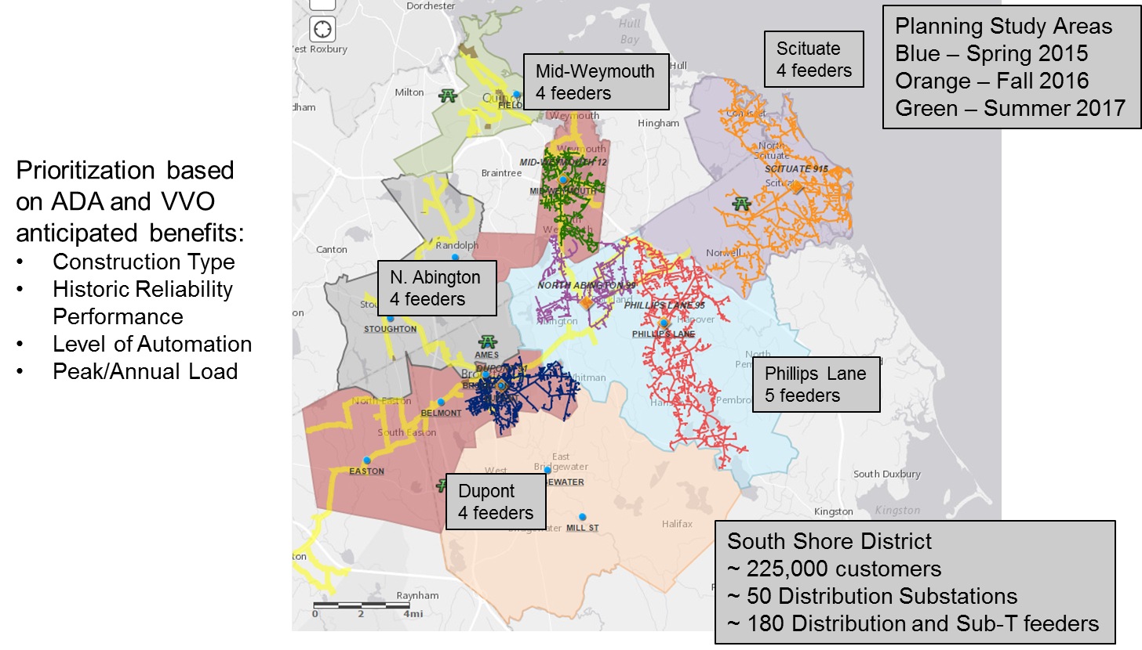
Grid Deployment Prioritization: Example District

Slide 16
Flexible GMP Components
Research, Development and Demonstration (RD&D)
  Potential examples include Microgrids, Energy Storage, Next Generation technologies
  Joint Utility knowledge sharing mechanism
  Leverage work through other organizations such as EPRI and CEATI
  Separate tracker
Distributed Generation Investments (DG)
  Proactive System upgrades to accommodate more DG
  Application Management Tools
  Advanced Analytics and Forecasting Capabilities
  Customer Portals and Outreach
  Not included in the STIP; will ask for rate changes that allow for recovery

