Slide 1
November 21, 2014 | Boston, Massachusetts
The Future of Demand Response in New England
New England Electricity Restructuring Roundtable
Henry Yoshimura
Director, Demand resource strategy

Slide 2
Demand Resources Have a Strong History But Uncertain Future in the New England Wholesale Market
Today
Future
Demand resources include:
Demand response
Energy efficiency (EE)
Distributed generation (DG)
Demand resources (DR) participate in the Forward Capacity Market (FCM)
Markets provide opportunities for demand response providers to sell demand reductions at wholesale energy prices
Unless otherwise directed by FERC, the ISO intends to fully integrate demand response into other wholesale markets, including:
Energy
Reserve
FERC jurisdiction over DR is uncertain
Grid modernization (including time-varying rates) opens up new approaches to DR and coordination between wholesale-retail planning, operations, and pricing

Slide 3
Forward Capacity Market Has Helped Stimulate DR in the Region
Enrollment in ISO programs
before the start of FCM
Resources Cleared in the FCM 
Passive DR (energy efficiency)
Active Real-Time DR
Real-Time Emergency Generation
Notes: Total real-time emergency generation (RTEG) capped at 600 MW
Cap reached for FCAs #1 – #6 (2010/11–2015/16); RTEG cleared below cap over last two auctions
Source: ISO-NE FCA Auction Results Filings

Slide 4
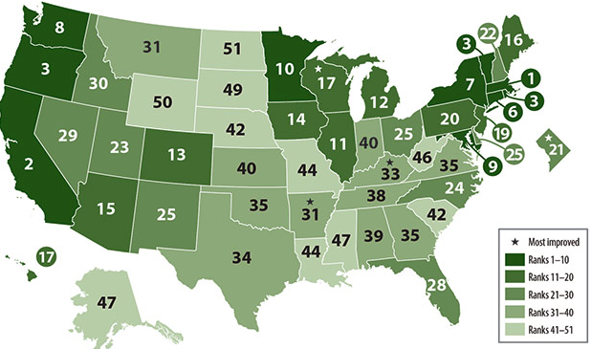
Energy Efficiency is a Priority for New England State policies and regional capacity market have produced robust EE investment
2014
Ranking of state EE efforts by the American Council for an Energy-Efficient Economy :
Massachusetts 1
Vermont 3
Rhode Island 3
Connecticut 6
Maine 16
New Hampshire 22
In New England, billions spent over the past few years; more on the horizon
2009 to 2012 = $2.3B
2017 to 2023 states are projected to spend $6.3B
EE flattens annual energy usage in New England for the foreseeable future

Slide 5
Demand Response Has Shed FCM Obligations
Aggregate Capacity Supply Obligations (CSO)
of Demand Response Resources (MW)

Slide 6
Primary and Reconfiguration Auction Price Differences Encouraged Shedding of Capacity Supply Obligations
ARA =
Annual
Reconfiguration
Auction
A participant could make money by selling a CSO acquired in a primary auction
Price differences shrink as the FCA floor price disappears and as surplus capacity diminishes

Slide 7
ISO is Moving to Fully Integrate Demand Response in Wholesale Markets If Order 745 is ultimately vacated, everything below will be impacted
In response to Order 745, ISO proposed to fully integrate demand response into the energy markets by June 1, 2017
August 2011
ISO issued a paper describing how demand response could provide reserves and participate in the forward reserve market by June 1, 2017
September 2013
April 2012
ISO proposed to modify capacity market rules to make capacity obligations of generators and demand response resources comparable by June 1, 2017
October 2014
ISO proposed market rules allowing demand response to provide reserves and participate in the FRM;
Legal issues currently underway make status of DR uncertain

Slide 8
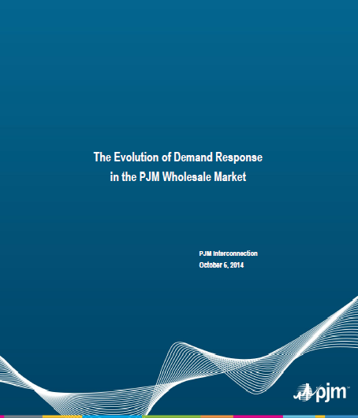
PJM Whitepaper Recently Released An approach to DR to mitigate lengthy litigation risk and uncertainty
Demand response would no longer participate as a supply resource
Load-serving entities (LSEs) could submit load curtailment bids into the capacity market
LSEs with a cleared load curtailment bid receive no capacity or energy payments – rather, the LSE’s capacity obligation and energy bill is reduced
Loads providing ancillary services (i.e., regulation and operating reserve) could receive payment for providing those services
Transition rules are needed to allow for the conversion of demand resource obligations to load curtailment obligations
Will LSEs have the incentive to submit load curtailment bids?

Slide 9
Grid Modernization Can Be the Platform that Preserves Demand Response in New England
New England states are considering advanced metering infrastructure and associated tools to facilitate customer response to price and improve the integration of distributed generation
Current default service in New England is based on a uniform rate
Customers cannot benefit from changing their consumption levels in response to changing real-time wholesale energy prices
Smart grid technology is not fully utilized under uniform retail rates
Current lack of retail customer data limits the ability of:
Load serving entities to offer other retail products
Customers to evaluate other retail products such as dynamic retail offers, distributed resources, and/or other smart grid opportunities
On November 5, 2014, the Massachusetts DPU ordered utilities to implement default time-varying retail rates (see D.P.U. 14-04-C) following deployment of advanced metering functionality to facilitate demand response

Slide 10
The Growth of Distributed Generation Will Impact Both Wholesale and Retail Markets
If customers both produce and consume power, net demand becomes less predictable and operations more complex
Nameplate PV generation expected to more than triple (1,800 MW by 2023)
The ISO does not have direct access to distribution system data, or control over distributed generation
A distribution system operator (DSO) that operates and administers localized systems and retail markets may be needed
DSOs and ISOs would need to share system and market information to optimally balance supply (including potential surplus energy from distribution systems) and demand in real time
Many complexities:
Role of DSO, utilities, LSE?
Operations, trade and pricing?
Settlement?
Communication standards?
DG interconnection standards?
Long-term planning?

Slide 11
Legal Action Creates Uncertainty for DR in the Wholesale Markets
The ISO’s existing tariff provisions are still in effect and the ISO is moving ahead in preparations for the next Forward Capacity Auction
Unless otherwise directed by FERC, the ISO plans to integrate DR into energy and reserve markets
Will FERC maintain jurisdiction over DR? How will FERC respond to the court order vacating Order 745?

