Slide 1
New England Governors’ Regional Energy Infrastructure Proposals
New England Electricity
Restructuring Roundtable
April 11, 2014
Tom Welch

Slide 2
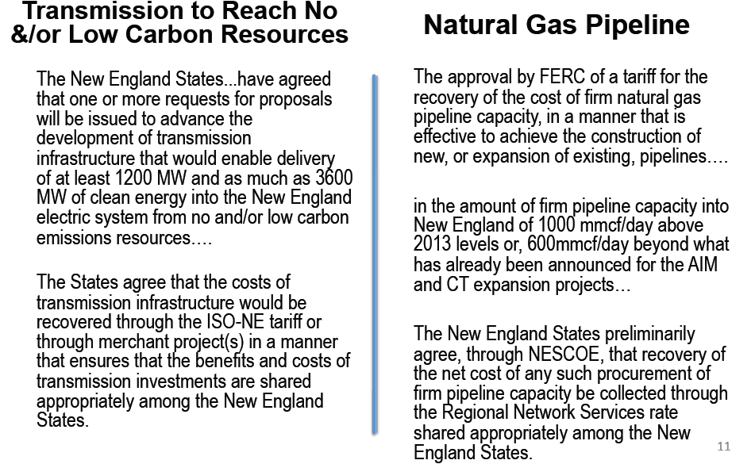
NESCOE Initiative

Slide 3
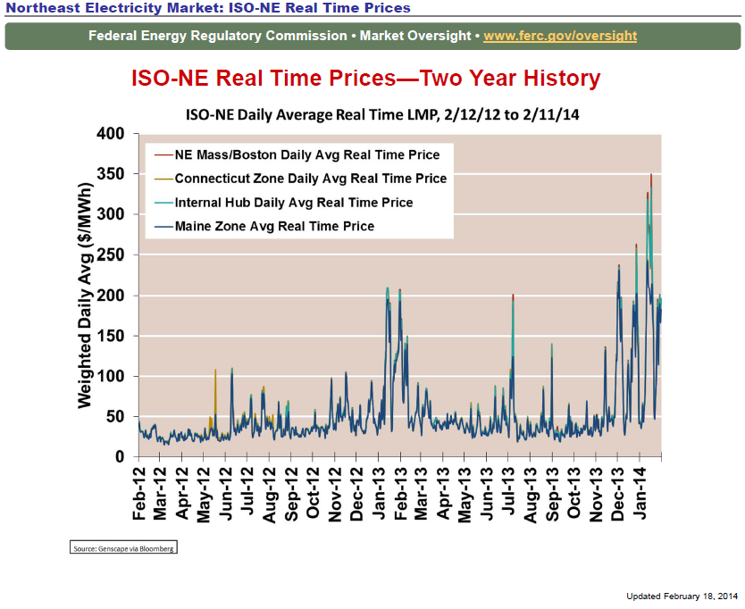

Slide 4
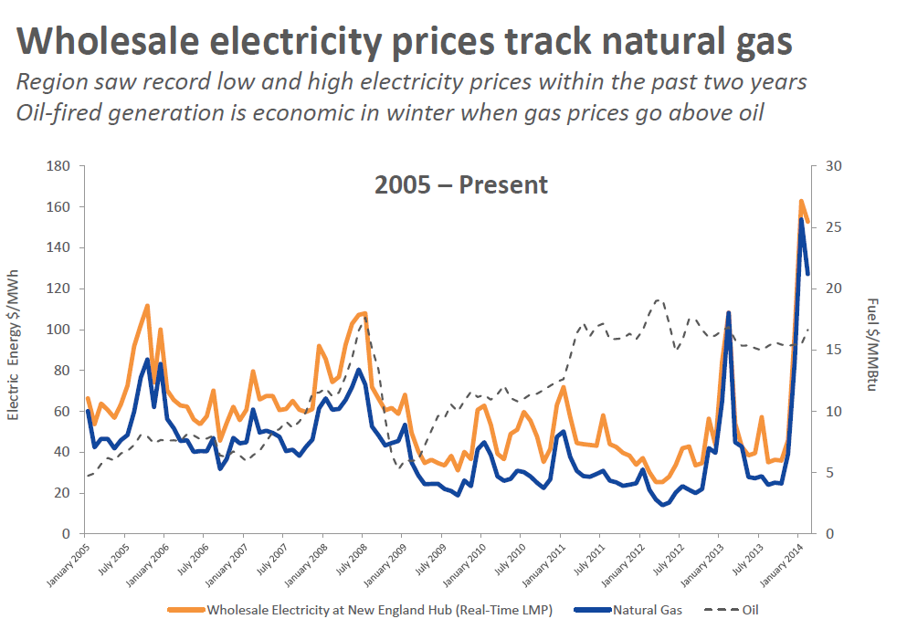
Source: ISO-NE

Slide 6
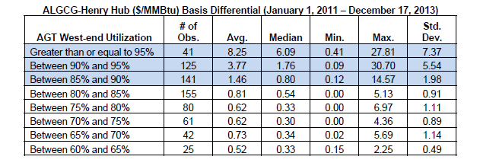
Basis and Utilization
Source: Sussex PUC Study

Slide 7
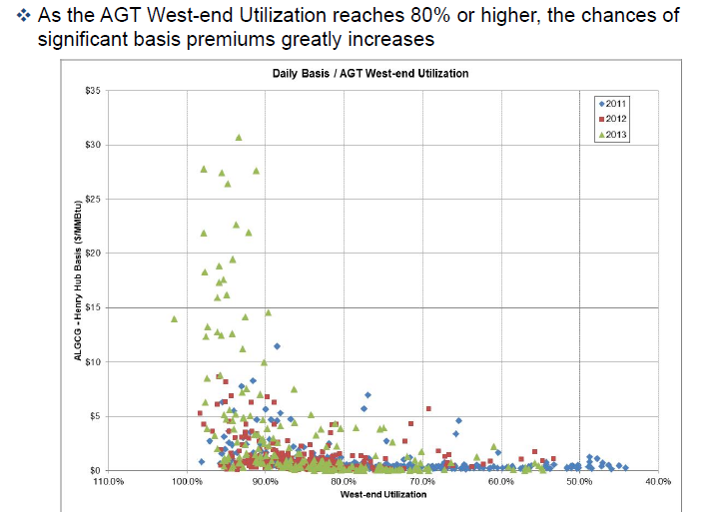
Impact of High Utilization on Basis
Source: Sussex PUC Study

Slide 8
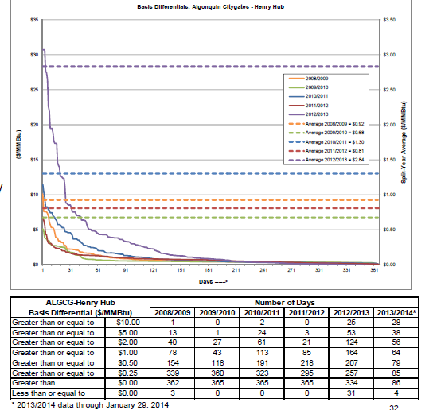
Basis Differentials are Increasing
Source: Sussex PUC Study

Slide 9
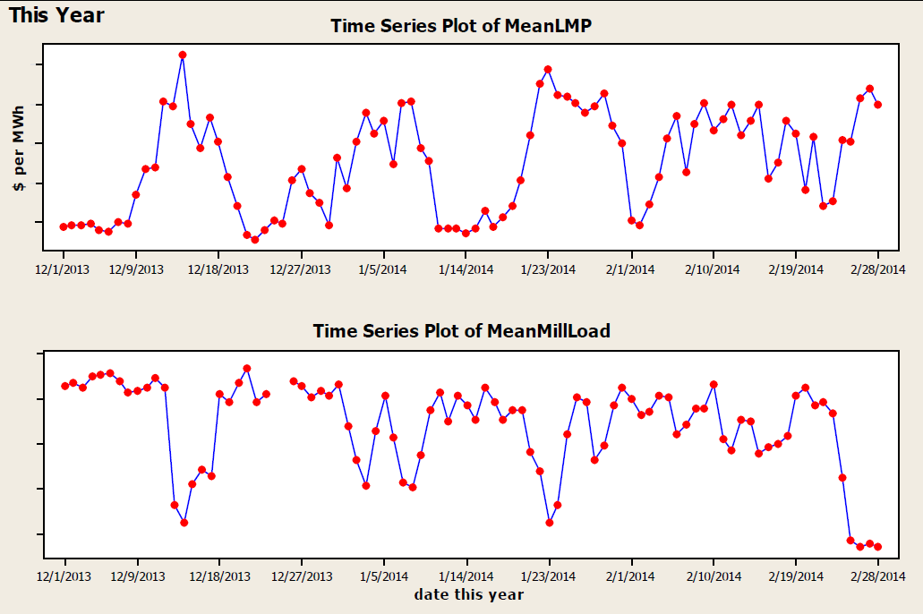

Slide 10
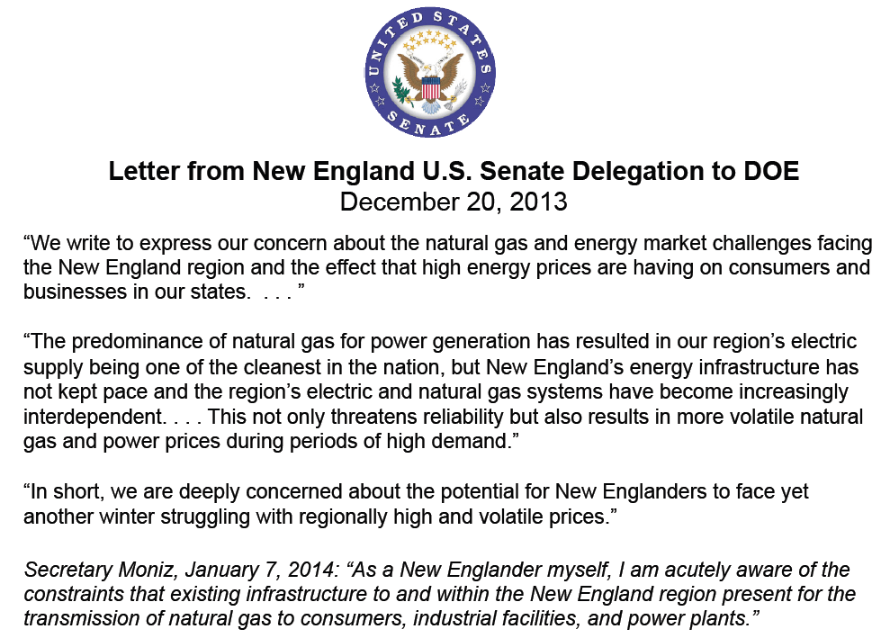

Slide 11


Slide 12
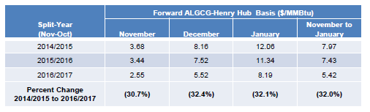
Observed Impact of AIM on Forward Prices
Source: Sussex PUC Study

Slide 13
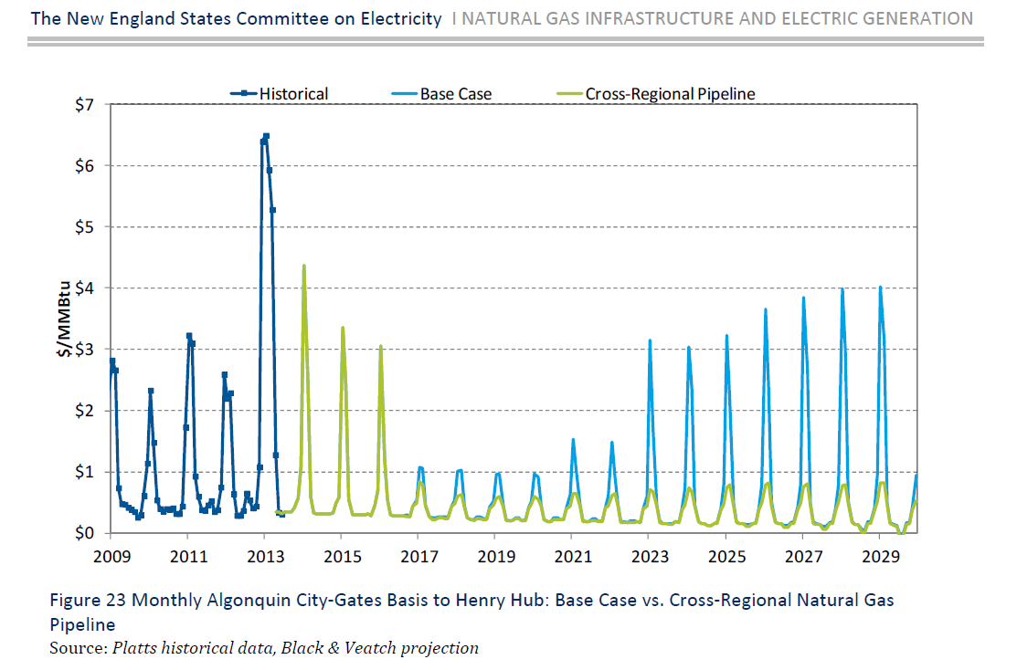
Estimate of Impact of AIM Plus 1.2 bcf

Slide 14
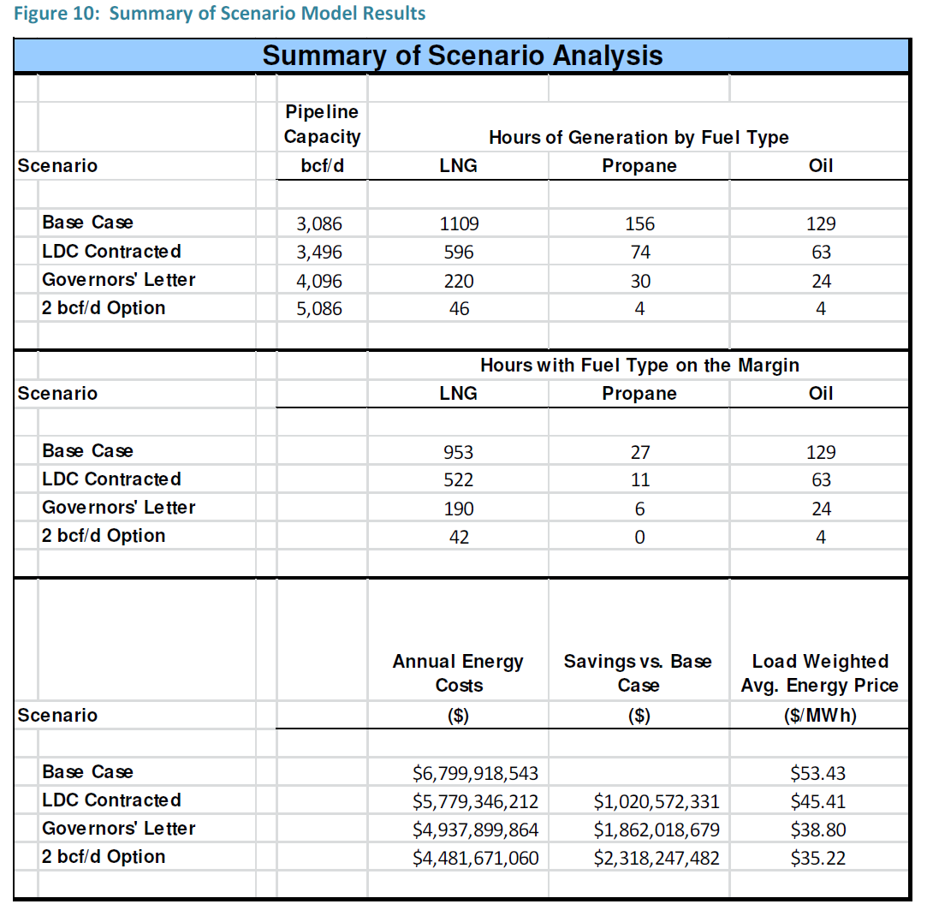
How Much?
Source: CES analysis

Slide 15
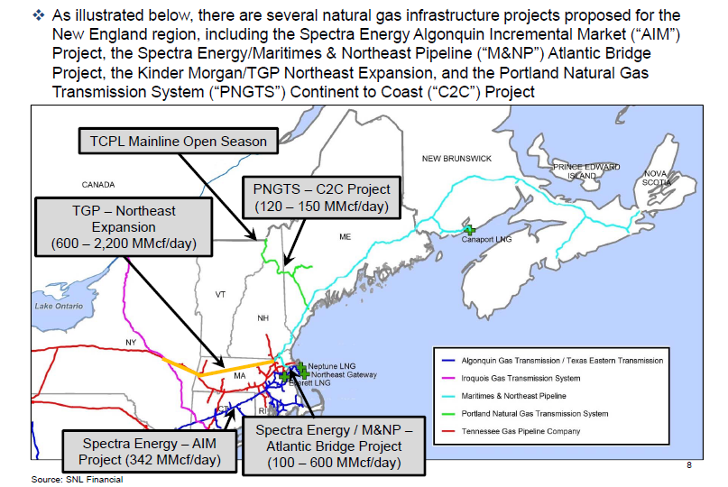
Candidates
Source: Sussex PUC Study

