Slide 1
Massachusetts Forest Biomass
Sustainability and Carbon Policy Study
Presentation to:
Electricity Restructuring Roundtable
Tom Walker
Manomet Center for Conservation Sciences
17 September 2010

Slide 2
Forest Biomass Carbon Accounting
What’s the Issue?
What is the greenhouse gas (GHG) impact of substituting renewable forest biomass for fossil fuels in the Massachusetts energy sector?
Why interesting?
  From a GHG perspective, forests provide a number of potential mitigation benefits.
    Growing trees remove GHGs from the atmosphere.
    Using woody biomass can displace fossil fuels.
  Tradeoffs: is it better to let the trees continue to grow and sequester carbon or harvest them and displace fossil fuels?
  Historically, it has generally been assumed that biomass energy is ‘carbon neutral’ but the story is more complex and better represented by a ‘debt-then-dividend’ model.

Slide 3
Biomass Carbon Accounting
How do you analyze the GHG problem?
Manomet ‘Debt-then-Dividend’ Framework: Compare a ‘Business as Usual’ Baseline with Biomass Energy Scenario.
  BAU assumes continued burning of fossil fuels and continued sequestration in forests harvested for timber but not biomass.
  Biomass scenario assumes GHG emissions from energy generation and BAU forest management plus additional biomass removals (logging residues and live whole trees).
What’s different about Manomet’s approach?
  Focus on atmospheric rather than forest carbon levels—just because carbon inventories continue to increase in forests doesn’t mean the atmosphere won’t be higher than in BAU.
  Manomet framework does not allow credit for carbon sequestration that would have occurred anyway under a business as usual scenario.
  Consequently considers incremental carbon sequestration occurring only on acres that have been harvested for biomass.

Slide 4
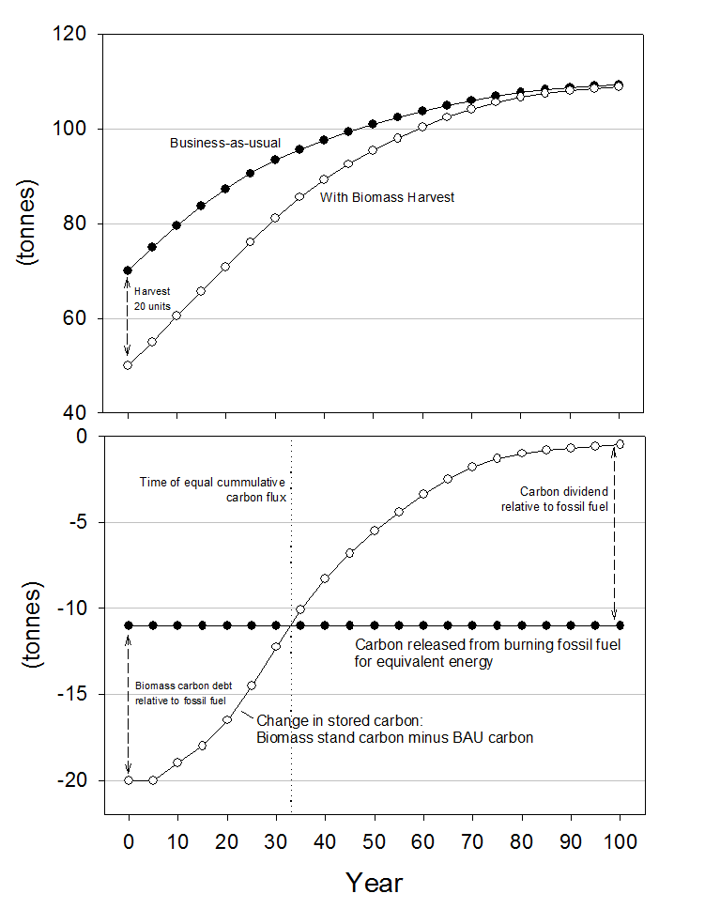
Biomass Carbon Modeling Framework

Slide 5
Modeling Scenarios
Harvest Scenarios
  Scenario 1: Heavy BAU, moderate biomass
  Scenario 2: Heavy BAU, light biomass
  Scenario 3: Heavy BAU, heavy biomass
  Scenario 4: Average BAU, light biomass
  Scenario 5: Average BAU, moderate biomass
  Scenario 6: Average BAU, heavy biomass
Technologies
  Biomass Electricity
  Biomass Thermal
  Coal Electricity
  Natural Gas Electricity
  Oil Thermal
  Natural Gas Thermal

Slide 6
Carbon Recovery Rate Results
Harvest Scenario 1
(Heavy BAU with Moderate Biomass Removal)

Slide 7
Aggregation of Stand-Level Plots

Slide 8
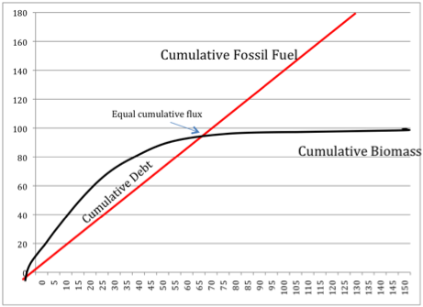
Landscape Scale Cumulative
Carbon Debts & Dividends

Slide 9
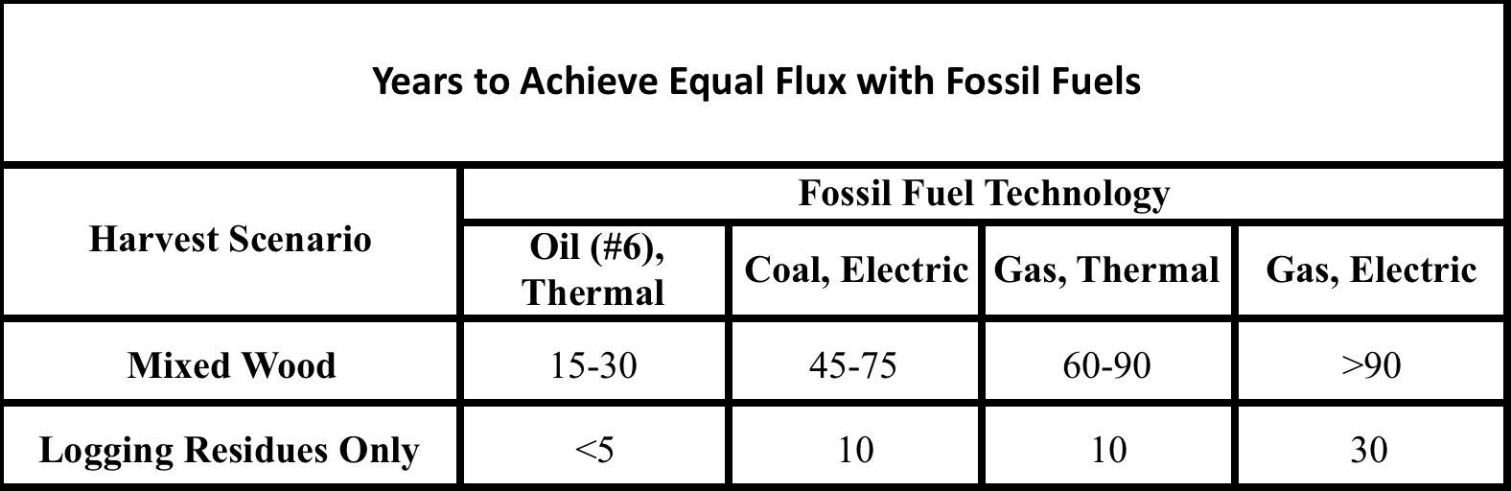
Massachusetts Carbon Recovery Summary
Emissions from Continuous Operation

Slide 10
Carbon Recovery Summary
Emissions from Multiple Years

Slide 11
What’s it all mean?
Projected forest biomass harvesting from MA forests would not be immediately carbon neutral – generally GHGs will be higher for a time before the benefits of biomass begin to accrue. Policy makers will need to weigh these short-term increases against longer term gains.
For waste material (logging residues) carbon recovery can be relatively rapid regardless of the harvest or technology assumptions.
Where live trees are harvested, carbon recovery profiles are longer – at least a couple of decades and potentially much longer.
Scenarios sensitive to many factors—multiple harvests will slow recovery, low thinnings that don’t accelerate growth can delay recovery.
To the extent feasible, use of biomass with technologies with the lowest carbon debts is most ‘climate friendly’ (e.g., thermal or thermally-led CHP).

Slide 12
Broader Policy Implications?
More generally, each state or region’s situation is likely unique.
  Baselines will be different – Maine is not Massachusetts.
  Different sources of biomass have different GHG profiles.
  Biomass technology choices affect carbon recovery times.
  Fossil fuel replaced is a key determinant of the timing of carbon recovery.
  Forest management choices by landowners can either accelerate or decelerate carbon recovery.
To assess the ‘carbon friendliness’ of biomass policies and projects, stakeholders should consider the implications of these various factors within the context of their own forest and energy situations.

Slide 13
Carbon Emissions by Technology & Fuel

Slide 14
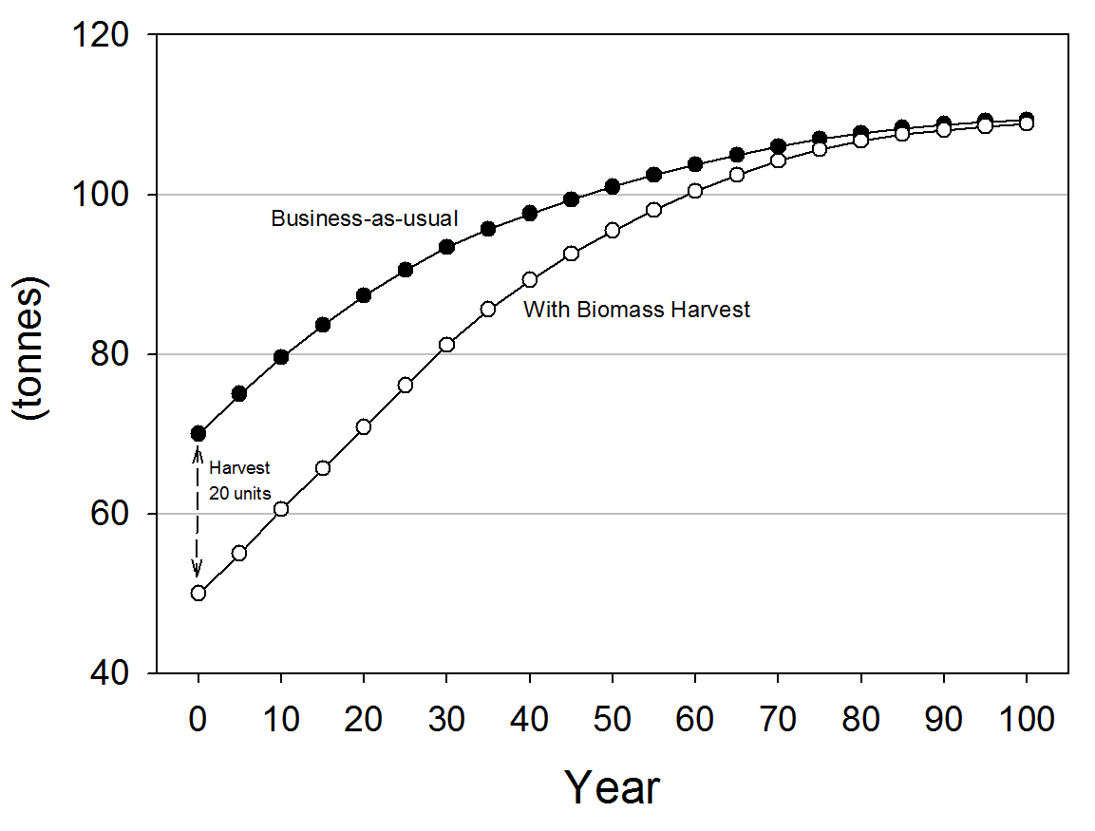
Forest Stand Dynamics

Slide 15
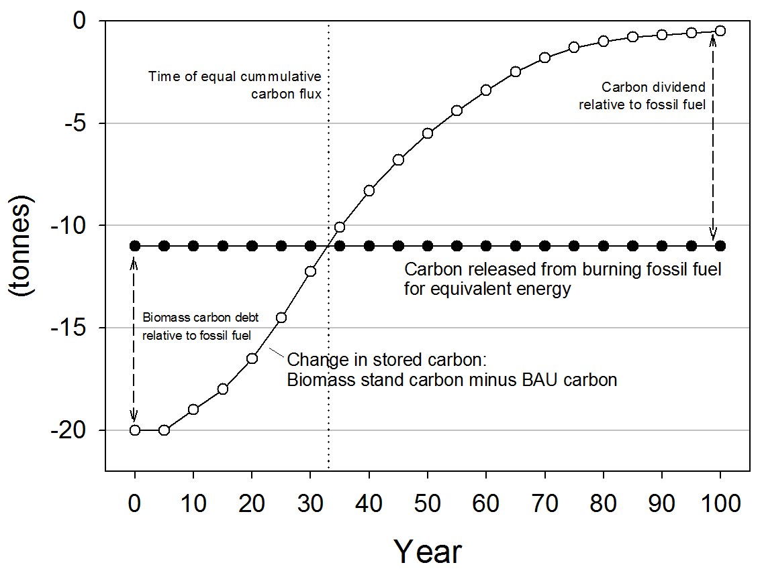
Biomass Carbon Recovery Profile

Slide 16
Carbon Recovery Summary
Single Year Emissions

