Slide 1

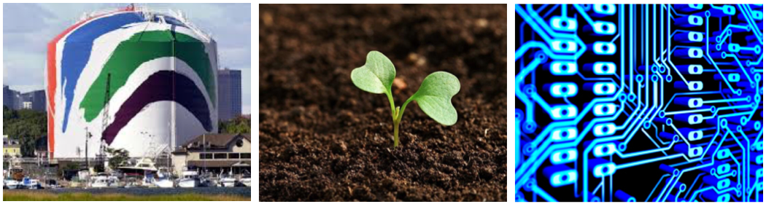
The Role of Public Participation
in Energy Project Approval

Slide 2

A DECADE AGO…
2007
June 29, 2007 –
The First iPhone Was Released
Video Marketing was Only TV Commercials
15% of Adults were Using Social Media
Most Website Platforms were HTML Based
2017
77% of population uses smart phones & are used as main source of information
Anyone Can Use Video Marketing with YouTube, Snapchat, Facebook Live
78% of Adults Have at Least 1 Account
Website Creation is Intuitive, More User Friendly Platforms

Slide 3
Project + Campaign
=
The Road
to Success!

Slide 4
BENEFITS OF A CAMPAIGN
Employ Strategies and Tactics that are Designed to Mitigate Opposition
Organize in Advance to Win Support for Good Projects Long Before Opponents Can Respond
Define Project Benefits Before Opponents Can Criticize a Proposal
Allows Campaign to Anticipate and Address Opponents’ Claims (“hot button issues”) Before a Project is Unveiled
Identify and Engage Key Opinion Leaders (KOLs) and Activists in Local Communities to Ensure Strong 3rd Party Validation of Proposed Project

Slide 5

CAMPAIGN RISKS
  Accusations of Undue/Unfair Influence on Local Decisions
  Claims of Undisclosed Corporate Influence/Lobbying
  BENEFITS
  OUTWEIGH THE RISKS

Slide 6
IDENTIFY CAMPAIGN ROLES
Build a Campaign Staff (internal personnel and external staff)
Campaign Manager
STRATEGIC COMMUNICATIONS
Polling / Message Development
Press Secretary
New Media
STAKEHOLDER OUTREACH
Content
Creation
SUBJECT MATTER EXPERTS
COMMUNITY OUTREACH
Government Relations
Environmental Advocates
Business Leaders

Slide 7
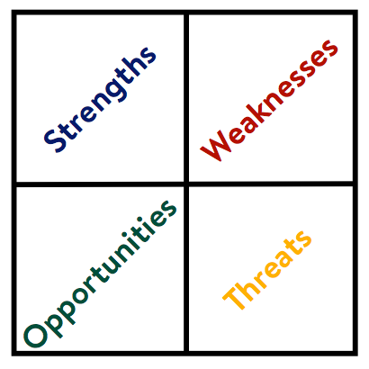
RESEARCH
Develop Strategy & Message
Poll Research
Focus Group
Intelligence Gathering
    Political Climate
    Community Issues
Opposition Research
Utilize SWOT Method Analysis
- Strengths
- Weaknesses
- Opportunities
- Threats

Slide 8

MATERIALS
Communications & Collateral Development
Develop Campaign Materials (Fact Sheets, Presentations, Talking Points, Other Content)
Website Creation
Build Social Media Platforms
- to provide a voice to project supporters/ combat aggressive opposition
Digital Advertising
E-mail Marketing
Radio and TV Advertising
Media
    Press
    LTE’s/Op-Ed’s
    Editorial Board Meetings

Slide 9
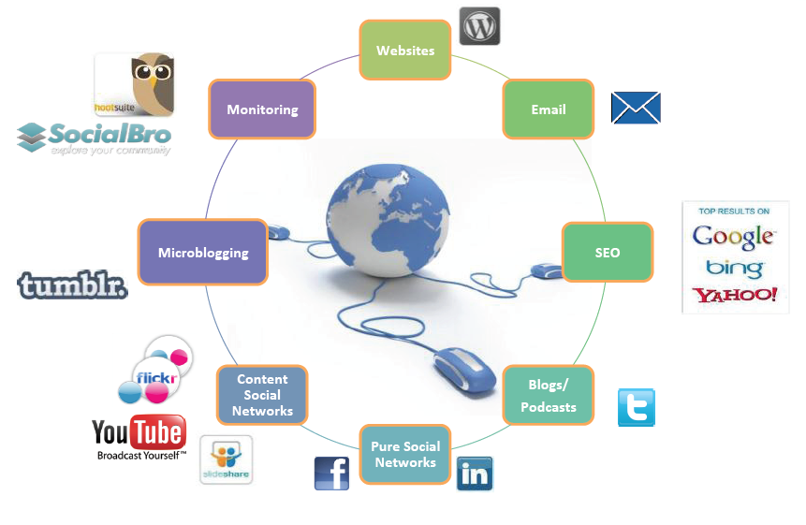
RULES OF ENGAGEMENT

Slide 10
SET THE TONE
Ask vs. Tell
Promote proposal as a community-centric and locally-driven opportunity (opposed to selling a vision of project benefits)

Slide 11
GALVANIZE THE PUBLIC
Community Outreach
Develop a Proactive Strategy
Host an open house – not a town meeting
Follow-up on every phone call, inquiry or communication
Provide informational interviews and tours of the proposed routes or sites for every media type
Address local community needs/concerns in meaningful way through complementary community benefits.
Organize citizen advocates to influence others during process to ensure highest possible level of local community acceptance and approval
Be prepared for the inevitable opposition to your project
When the project is completed, remember to say “thank you” - become a good neighbor

Slide 12
EDUCATE STAKEHOLDERS
Opportunities
Identify a list of potential project supporters - Be Inclusive or Be Neutral
Engage high-level government officials on the proposed location or route
Engage local, politically active residents and KOL’s in positive manner
Create structure to secure votes needed for approval (Planning Board - Zoning Board - Historic Commission - Environmental Board - City council/Selectmen/Aldermen)
Lay groundwork for long-term beneficial relationships with stakeholders- promote project as part of positive, responsible local growth that ensures jobs, tax revenue, etc.
Provide cover for stakeholders to effectively support “controversial” projects
Validate stakeholder approval in manner that allows for long-term positive relations

Slide 13


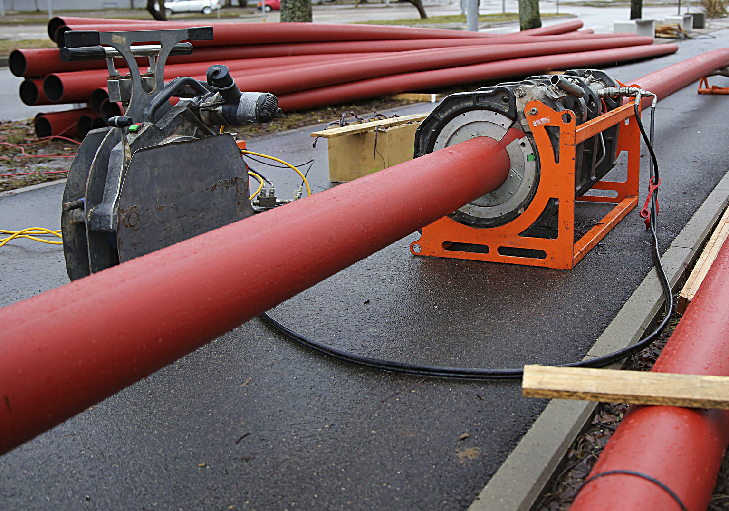
ABOUT MU CONNECTIONS
MU Connections is a consulting firm that provides integrated services to the energy, environmental and infrastructure markets. MUC serves a broad range of clients in government and industry, implementing projects from concept to delivery.
Mary Usovicz, Principal
musovicz@gmail.com

