Slide 1
Microgrids and District Energy
Whitepaper Highlights
Dan Leonhardt
Senior Energy Policy Analyst
Pace Energy and Climate Center

Slide 2
Whitepaper Outline
Case for Microgrids
Design
Financing
Coalition Building
Policy
Legal & Regulatory
Case Studies

Slide 3
Site Selection
Anchor Users help provide access to capital and ensure future loads (hospitals, universities, industrial parks, prisons, office centers, water treatment)
Alignment of Capital Plans
Energy Planning Process – where will the growth be?
Complementary Loads and Economy of Scale

Slide 4
Site Selection – Building Separation
Distance matters when connecting buildings:
Trenching/Excavation costs!
Thermal loss: ideally, building separation is measured in dozens, perhaps low 100’s, of feet between them
Electrical interconnection can go substantially farther: thousands of feet. Costs of trenching tends to eclipse electrical losses
Notes:
Sites with existing interconnection (trenches, conduit, corridors, etc.) are ideal.
Thermal and electrical connections to microgrids do not, necessarily, need to be all to the same buildings.

Slide 5
Technical Considerations
Energy efficiency is key
CHP will likely play a central role
  Note: Steam can become cooling resource in summer through absorption chillers
Resilient wiring
Notes:
Conduct EE retrofits and other measures during, or ideally before, microgrid deployment. Otherwise you risk designing for a load that’s never there.
Current technology mix means CHP. Renewables and storage aren’t there yet and won’t be cost effective in the near future.
Buildings might now get ALL of their electricity needs met during a grid outage. That means new buildings with this wiring scheme and retrofit of existing buildings to handle critical loads.

Slide 6
Quantification
Having a dollar value (or range) for some of the “intangible” benefits will aid in benefit-cost analyses
Carbon Reduction
Value of “Lost Process”
  Loss of Critical Services
  Business Disruption/Economic Losses
  Quality of Life
Notes:
One key thing to bear in mind, even if the project doesn’t place a value on carbon reduction, this shouldn’t be discounted entirely. Carbon reduction can have value on the secondary market (carbon credits) in some circumstances. Since M&V is already being done for billing and usage tracking, there’s virtually no additional overhead in tracking carbon reduction.

Slide 7
Municipal Involvement
Low
General planning assistance and project support*
Medium
Participating customer in a microgrid
High
Construction and operation of a district energy system
*Project Champions are key, especially in these situations. Multi-stakeholder microgrids will have difficulty getting traction without dedicated support from somewhere. Few potential customers are willing to supply the manpower. Municipal government can be the glue that holds the initiative together.
Notes:
Project champions do not have to be an FTE. May not need that much time, but the more continuity on offer, the better.

Slide 8
Proactive Steps
Pass legislation endorsing microgrids
Review zoning regulations
City planning
Coordinate local infrastructure and transport agencies
Notes:
Review zoning regulations to insure that high efficiency, environmentally superior onsite power generation and cogeneration is permitted in commercial, industrial and multifamily areas
Utilize zoning measures to encourage development and re-development to be district energy ready
Anecdote – certain types of generation may only be possible in industrial zones with changes to local code (noise, emissions, etc.). Natural gas, not #6 oil.
Incorporate the analysis of microgrid opportunities as a routine component of city planning and economic development activities.
Coordinate the activities of local infrastructure and transportation agencies so that new capital projects take account of and don’t preclude future linking of community or neighborhood energy systems. For example, when digging up streets for water, sewer or road construction consider opportunities to lay thermal pipes and electric conduit.

Slide 9
Proactive Steps (cont.)
Create maps proactively: site maps, heat maps
Lead by example – connect public buildings
Development rules
Notes:
Provide maps to site owners and developers of the infrastructure under the streets, to identify sites that are favorable / unfavorable, for trenching
Create and make public a heat map for your community. A heat map is a tool to visualize and identify block and building heat demand, inventory potential sources of heat at the block, neighborhood and community level and from and assess how sources of supply and areas of demand can be connected in an efficient manner to improve efficiency and lower energy costs.
Lead by example conducting an analysis of district energy with CHP at municipal facilities. If developing a municipal community energy system require publicly owned or controlled buildings to connect to heating, cooling and power services
Require that development and redevelopment projects greater than 250,000 sq. ft. conduct a district energy feasibility analysis
For development projects receiving public support, make such sites “district energy ready”, leaving space for thermal and electric connections
For new and redeveloped sites with public support encourage central distribution systems for heat, hot and chilled water.
Municipalities can offer additional development rights (higher densities, more floors) in exchange for the development of low (or net zero) neighborhoods.

Slide 10
Microgrid Case Studies
Case & Location | Sector | District Cooling | Energy Storage | Renewable Energy
Princeton University, Princeton, NJ | University | Y | Thermal | Photovoltaics
Coop City, Bronx, NY | Residential | Y
Markham District Energy, Markham , ON | Downtown | Y | Thermal
University of Massachusetts , Amherst, MA | University | Y
New York University, New York, NY | University
District Energy St. Paul, St. Paul, MN | Downtown | Y | Thermal | Photovoltaics, Solar Thermal
Marine Corps Air Ground Combat Center, Twentynine Palms, CA | Military | Y |  | Photovoltaics
Veolia Energy North America, Boston-Cambridge, MA | Downtown
Hamilton Community Energy, Hamilton, ON, Canada | Downtown | Y
Helen Ltd. (Helsingin Energia), Helsinki, Finland | Municipal | Y | Thermal
Notes:
Range from residential campus to complete municipal energy districts
All cases
Utilize combined heat and power (CHP)
Can island from the electricity grid
Possess black start capability
Mix of thermal storage, cooling, and renewable energy
8 are domestic, 1 Canadian, 1 Finnish

Slide 11
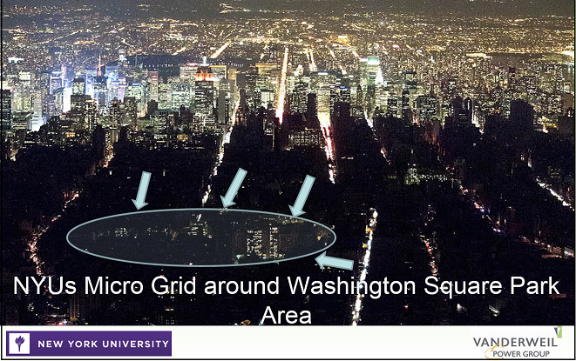

Slide 12
Dan Leonhardt
Senior Energy Policy Analyst
dleonhardt@law.pace.edu
(914) 422-4063

