Slide 1
What, Me, Worry? The New Outlook for Natural Gas in New England
Susan Tierney
How Will Natural Gas Impact New England's Electricity Markets and Reliability
New England Restructuring Roundtable – June 15, 2012

Slide 2
Some Upsides and Downsides: Impacts of the New Outlook for Natural Gas in New England
Shale Gas Development
Generating Fleet Modernization
Gas/Electric Market Interactions
Natural Gas’ Air Emissions
Renewables

Slide 3
Shale Gas Development:
Strong outlook for low gas prices – assumes and depends upon:
Continued access to the abundant unconventional natural gas resource base
huge resource base is well established
Continuous improvement in production practices/techniques
and strong regulatory supervision (especially by states)
Technological and business model that supports fast-to-market production process
positive implications for dampening some of the historical price volatility experienced in natural gas prices

Slide 4
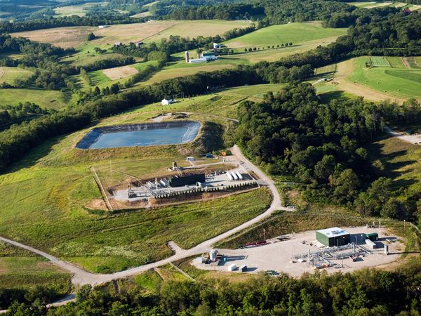
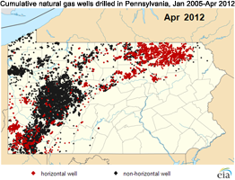
What’s to Worry About?
Public trust issues associated with shale gas development/production:
Significant community impacts with intense development pressures
Wide gap between perceptions on both sides of the issues
Industry is in a defensive posture, with slow and reactive responses to local concerns
Further erosion of public trust = potential source of disruptive impact on industry’s access to the resources

Slide 5
The Generating Fleet Modernization: The Role of Gas
New England’s next chapter of generation investment
Retirements: ISO-NE estimate of 5+ GW of existing generation to retire over next decade (out of ~28.6 GW total)
Queue: ~6 GW MW of gas-fired capacity
Gas plants: typically short permitting / siting processes

Slide 6
What’s to Worry About?
Adequacy of signals for capacity additions – especially regarding
Capacity value in forward capacity market
Type of technology (and capacity) added (e.g., CC, CT)
Transmission constraints that affect deliverable capacity
Plant retirements affecting load pockets
Value afforded to firm fuel supply and delivery
Timely regulatory reviews – especially regarding
EPA GHG rules
Fights over ‘need’, in light of energy efficiency, DR, DG
Ending up with ‘too much of a good thing’ (gas) – especially given
Adequacy of pipeline capacity
Distance to nearby storage capacity

Slide 7
Gas/Electric Market Harmonization
Developments:
Growing public discussion of electric sector ‘becoming too dependent on natural gas’
Nationally: varied comments on implications for price, reliability
New England: decade of experience with significant gas use
Growing appreciation for the need to better align gas and electric markets’ procedures, rules, processes:
National Petroleum Council – Prudent Development
ISO-NE – study of gas/electric reliability issues
FERC – docket to examine issues
NAESB – “Gas/Electric Harmonization” committee

Slide 8
What’s to Worry About?
Potential clusters of issues to be addressed in different venues – with differing levels of support for and timing of resolution:
Commercial (e.g., bilateral agreements between pipelines & customers)
Differentiated product/service offerings by pipelines (e.g., different timing of movement of gas in pipes and from storage)
Regional practices (e.g., RTO market rules)
E.g., valuing electric capacity differently according to firmness of natural gas deliverability and supply
National:
Standards (e.g., NAESB) – where broader inter-regional arrangements would benefit from common standards (e.g., timing of nominations across multiple pipeline systems)
Policy (e.g., FERC) – where broader inter-regional arrangement

Slide 9
Natural Gas: Lower Air Emissions
Lower emissions at the stack relative to coal
Operational compatibility with zero-emissions renewables
NPC, Prudent Development, 2011

Slide 10
Natural gas can help lower GHG emissions
Deep reductions require CCS or other zero-carbon technologies
NPC, Prudent Development, 2011

Slide 11
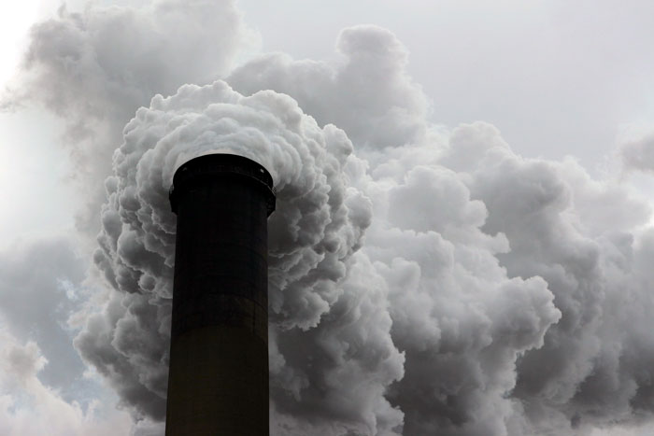
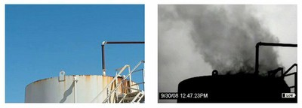
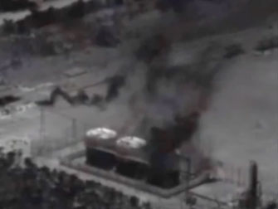
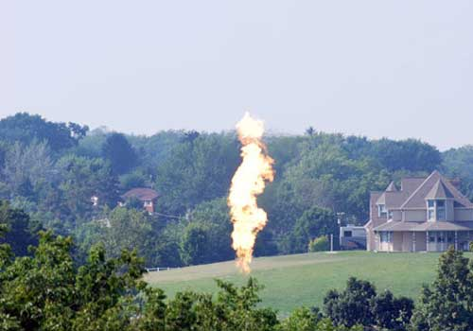
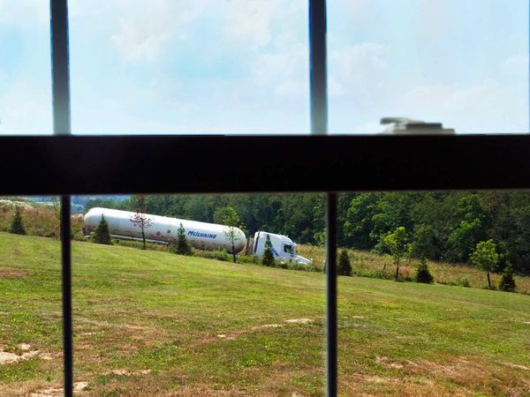
What’s to Worry About?
Methane
Ozone precursors

Slide 12
What’s to Worry About?
How Much Methane?
Variation in total footprint
is largely due to uncertainty
in methane
Source: Armond Cohen, Clean Air Task Force, “Natural Gas and Climate Bridge, Highway, or Destination?” EUEC presentation, 1-30-2012

Slide 13
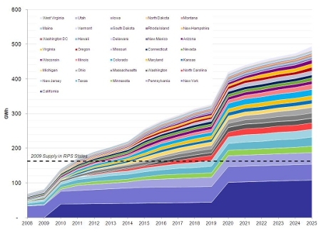
Renewables:
RPS ramp-up through 2025:
Gas provides flexible resources for balancing services
Connecticut
Vermont
Maine
Rhode Island
NH
Massachusetts
2011
Pennsylvania
New York
California
2x
3x
http://www.emerging-energy.com/content/press-details/State-RPS-Policies-Will-Drive-250-Increase-in-Renewable-Energy-Generation-by-2025/32.aspx

Slide 14
What’s to Worry About?
Renewables may be stuck in the starting gates due to low natural gas prices (combined with PTC/ITC woes):
Wind as a price taker:
2008:
2011:
Wind selling at:
$32/MWh @10 GW load
$95/MWh @20 GW load
$158/MWh @25 GW load
Wind selling at
$37/MWh @10 GW load
$40/MWh @20 GW load
$95/MWh @25 GW load
Much higher REC prices? Potential for fatigue? But needed for climate goals

Slide 15
Susan F. Tierney, Ph.D. Managing Principal Analysis Group 111 Huntington Avenue, 10th Floor Boston, MA 20199 stierney@analysisgroup.com 617-425-8114

