Slide 1
New England's Electricity "Restructuring”: Successes, Disappointments, and What’s Next?
Sue Tierney
N.E. Electricity Restructuring Roundtable
150th Roundtable Meeting
May 18, 2016

Slide 2
Successes . . . a few notables
Managing transitions without reliability problems
Electric industry restructuring; implementation of RGGI
Fleet turnover, with increasing dependency on gas-fired power plants
Integration of new technologies (wind, solar, demand response)
Adopting many market-based policies (RGGI, ISO-NE power markets)
Significant “at risk” capital investment in generation since ~2000
Increasing electricity productivity (economic value for electricity dollar)
High electricity prices, but more efficient use of energy – with relatively low electricity expenditure per median income
Use of RGGI proceeds for local investment
Introducing relatively clean energy supply
Entry of central-station and distributed renewables
Dramatically lower SO2 and NOx, less robust reductions in CO2

Slide 3
“Electricity productivity” – State rankings of
Gross State Product per electricity dollar (1997 v. 2014)
MA
CT
RI
US
NH
VT
ME
MA
CT
RI
US
NH
VT
ME
EIA, 826 data; Bureau of Economic Analysis data on gross state product.

Slide 4
Residential Electricity Bill as Percent of Median Income (‘97-’14)
ME – 2.2%
VT – 2.0%
CT – 2.3%
NH – 2.3%
VT – 2.2%
MA - 1.9%
US - 1.6%
CT – 2.6%
US – 2.6%
VT – 2.3%
NH – 1.9%
MA – 2.3%
ME – 2.0%
VT – 1.9%
EIA, 826 data; Census Bureau, State Median Income data.

Slide 5
New England power sector air emission reductions (‘01-’14)

Slide 6
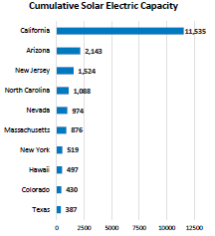
Cumulative solar installations: state rankings as of 2015
In Massachusetts is now ranked third in annual solar PV installations
Massachusetts is 26th among the states in terms of electricity demand
SEPA Solar Report, 2015; EIA for state rankings on electricity use

Slide 7
Some disappointments . . .
The politicization of all things energy
The tendency to react to the latest problem with a short-term fix without sufficient adherence to longer-term policy principles (and anticipation of unintended consequences)
Pursuing packages of inconsistent policies affecting the electric industry:
Promotion of large-scale delivery infrastructure projects to reduce energy commodity costs, with costs socialized and with the likely effect of undermining the region’s power market
Letting nuclear plants go away too soon.
Loss of any safely operating existing nuclear plant will unfortunately raise CO₂ emissions (and electricity costs) in the near term

Slide 8
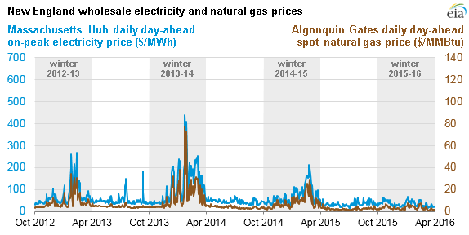
The headline images about natural gas
“Natural gas prices in region spike,” Boston Globe
“New England governors vow to boost natural gas capacity,” Commonwealth Magazine
http://www.eia.gov/todayinenergy/detail.cfm?id=25672

Slide 9
Trends in MA Natural Gas Market Conditions: (‘97-’15)
Payments, Consumption, Weighted Average Price
$/Mcf
Bcf
500,000
450000
400000
350000
300000
250000
200000
150000
100000
50000
Consumption
Price
Total payments by end-use customers for natural gas
(residential, commercial, industrial, power plants)
EIA data for Massachusetts natural gas use and prices

Slide 10
Where to go from here? A few ideas
Address carbon with a meaningful economic signal, such as
By internalizing carbon into prices in all fossil fuel markets (e.g., carbon fee-and-dividend policy)
By compensating clean energy supplies for the service they provide in helping to decarbonize energy systems (e.g., clean energy standard)
Maintain market-based discipline in electric industry
By resisting the focus on lowering electric commodity costs (e.g., natural gas, large-scale hydro imports) without telling the whole story about total costs (i.e., socializing the cost of related delivery infrastructure)
By evolving utility planning, tariffs, pricing models, and utility business models to recognize customer-driven (and policy-driven) interest in clean energy resources
By developing a vision/pathway(s)/role(s) for natural gas in a decarbonizing energy system, and then aligning policies to accommodate a transition
By establishing complementary policies that align with and don’t undermine markets

