Slide 1
Brian R. Swett, Chief of Environmental and Energy Services, City of Boston
email EnvironmentalEnergy@cityofboston.gov web www.cityofboston.gov/environmentalandenergy/ & www.greenovateboston.org

Slide 2
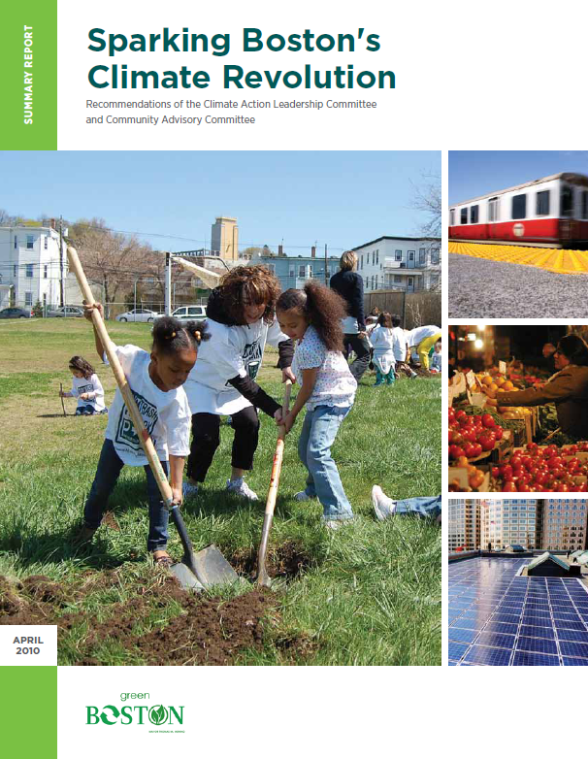
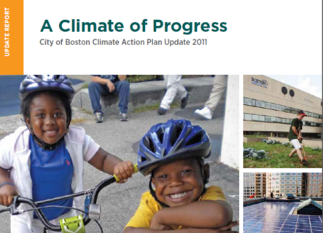
Boston’s Climate Action Plan
First plan in 2007
Update in 2011 based on recommendations from community wide task force
Plan addresses mitigation, adaptation, community engagement and social equity

Slide 3
Boston
1630
Greenovate Boston 3

Slide 4
Boston
1630 -2012
Greenovate Boston 4

Slide 5
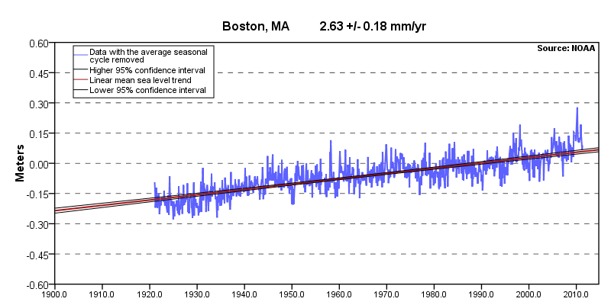
SEA LEVEL R SE
Greenovate Boston 5
Notes:
Record of Sea-Level Rise in Boston Harbor (NOAA Data)
US NOAA operates a series of sea-level gauges, including a station in Boston Harbor located in the Fort Point Channel. With records going back to 1920, NOAA data indicate that, over the past century, the relative sea level has risen about 10 inches. Scientists estimate that about half of this is from rise in the absolute sea level, and half from land subsidence

Slide 6
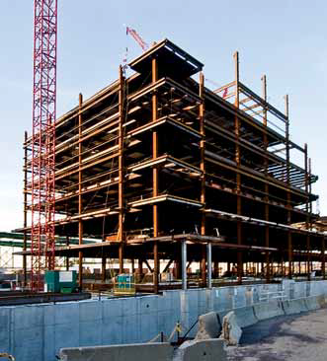
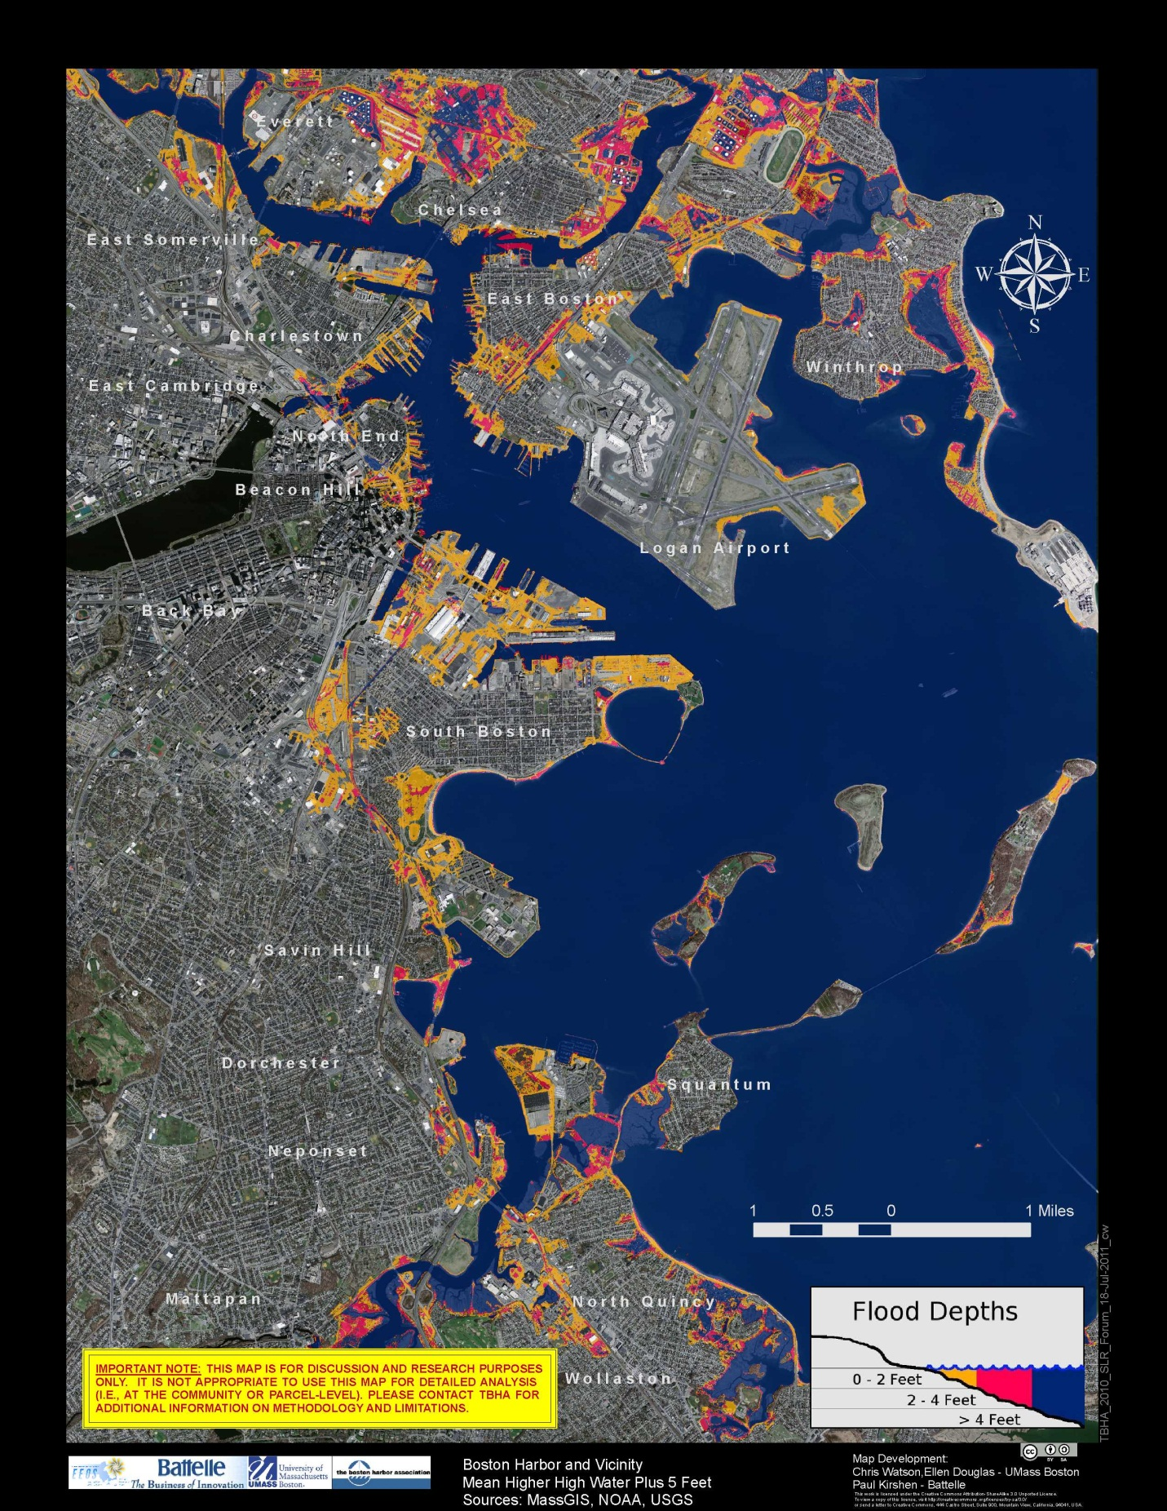
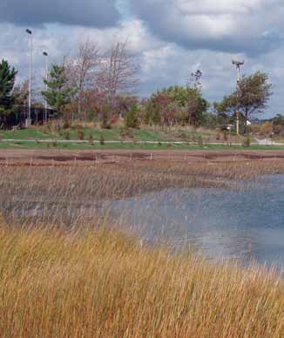
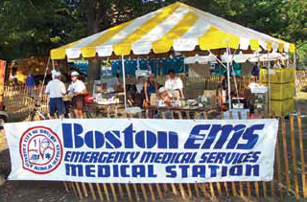
Preparing for Change:
CLIMATE ADAPTATION
Mean High Water + 5’ : Projected to occur by mid to late century
Equivalent to flooding from Hurricane Sandy if it hit during high tide!
Notes:
SLR Projections 6” to 16” by 2050 and 11” to 79” 2100

Slide 7
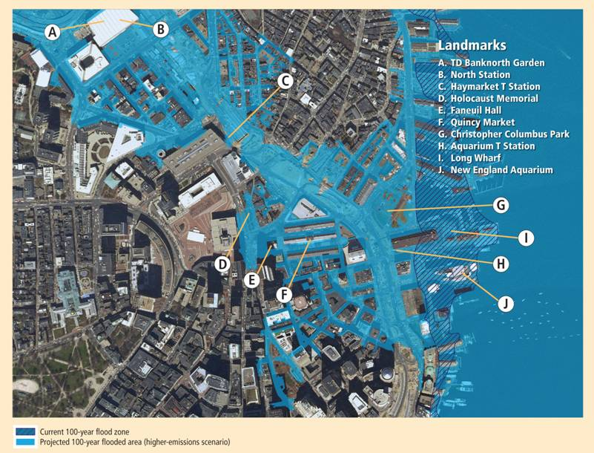
2100 100-year Flood
Greenovate Boston 7
Notes:
This image shows the current Federal Emergency Management Agency (FEMA ) 100-year flood zone (hatched darker blue) as well as the extent of the projected 100-year flood zone in 2100 (lighter blue) under the higher-emissions scenario for the waterfront/Government Center area of Boston. Important Boston landmarks (such as Faneuil Hall) and transportation infrastructure currently not at great risk of flooding could witness repeated flooding in the future unless protected from such events. Flood elevations under the lower-emissions scenario are roughly half a foot lower than the flooding depicted here (but still two feet higher than the current 100-year flood).
By Mid-Century:
Substantial increases in the maximum elevation of major coastal floods are projected
The frequency of today’s 100-year floods are expected to increase to every two to three years in Boston on average (under the higher- and lower-emissions scenarios, respectively)
By 2100:
the significance of emissions choices for sea-level rise and coastal flooding become more apparent as both the maximum heights and recurrence intervals of coastal floods increase, particularly under the higher-emissions scenario.
Current 100-year-flood elevation projected to increase roughly 2.5 feet under the higher-emissions scenario and roughly two feet under the lower-emissions scenario.
Today’s 100-year coastal floods are projected to recur every year or two in Boston under both scenarios
These projections are based on changes in sea-level rise alone and do not include other potential changes such as shifts in shoreline position or changes in storm frequency, intensity, or track. If storms strike the Northeast’s coast with greater frequency and intensity, for instance, the frequency of coastal floods (and associated damages) would be expected to rise even more.

Slide 8
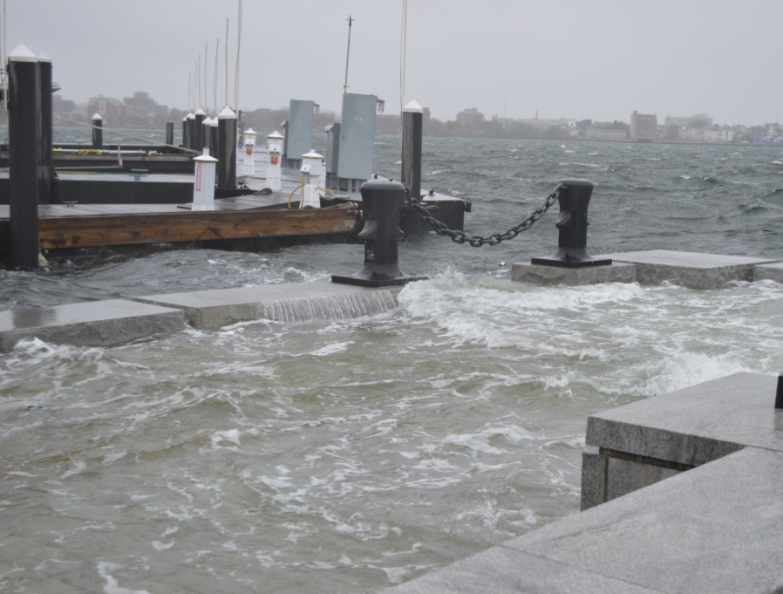
Infrastructure
Buildings
BWSC 25-year Asset Management Plan
Climate Adaptation Questionnaire
Local Energy Assurance Planning
Complete Streets
Internal Adaptation Working Group
Neighborhoods
Tree Planting
Hazard Mitigation Plan Update
TBHA Sea Level Rise Forum and Community Meetings
ENERGY
Notes:
Three ‘buckets’ – A resilient energy system is a critical element of three of these aspects of climate preparedness.
BWSC 25-year asset management plan:
Project will look at impacts of climate change over 100-year timeframe.
Just completed first year of three-year planning process. Climate change is an explicit component of the scope of work
Local Energy Assurance Planning:
incorporate SLR, heat waves, and extreme storms into the project's analysis of vulnerability and incorporate renewable energy in its planning for mitigation
Completed 2012--did not do a good job of considering climate issues
Complete Streets Initiative:
City has developed guidelines that call for more trees for shade and the use of permeable pavers and rain gardens
Internal Adaptation Working Group:
A working group of 8 city agencies and departments coordinates municipal adaptation efforts "to ensure that the work of individual departments coalesces into a comprehensive city-wide plan."
Grow Boston Greener
Plant 100,000 trees by 2020. Since 2007 over 4,000 new trees planted but progress towards goal has slowed. BNAN will develop interim goals and an implementation plan for meeting the goal. City will work to identify new funding sources and to reinvigorate the initiative Grow Boston Greener Grant Program
Update Hazard Mitigation Plan
Draft; final plan due spring 2013
Forum and community meetings
Over 450 people participated in the "Boston Harbor Sea Level Rise Forum," held on November 9-10, 2010 at the New England Aquarium and the John Joseph Moakley U.S. Courthouse.
More than 100 people participated in two community meetings on November 22, 2010 at Maverick Landing in East Boston and on November 29, 2010 at the Harbor Point Community Center in Dorchester. All four events included open mike sessions that allowed for insightful comments and questions from the public.
Questionnaire:
Under Article 80, the BRA has begun asking developers of projects that may be subject to more frequent coastal flooding due to SLR to analyze the effects of climate change
Questionnaire adopted summer 2012. Requires information, though not necessarily action, for new projects
Online form

Slide 9
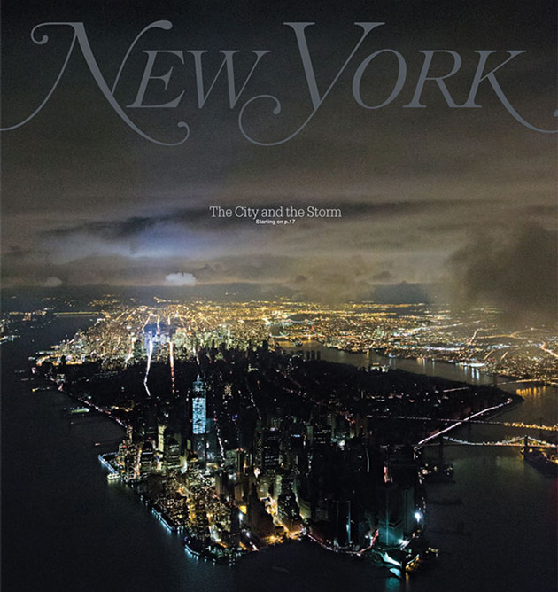
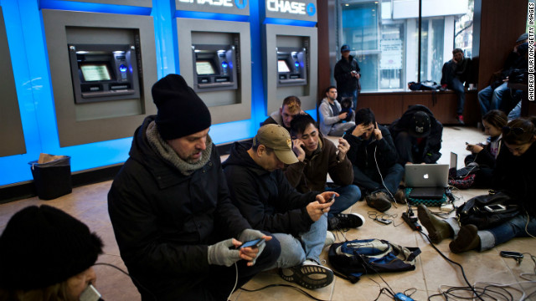
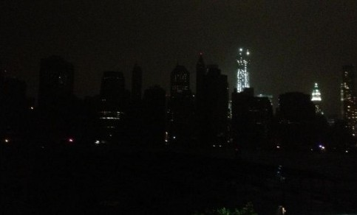
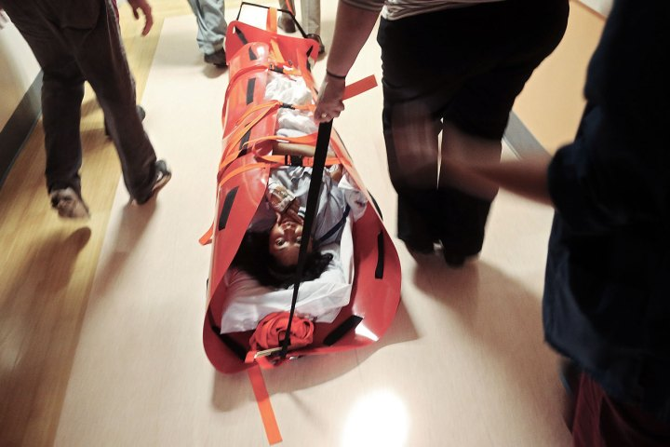
Production
Grid
Buildings
Notes:
Talk about lessons from NYC, need for resiliency at different scales. When the grid comes back on, will the buildings be ready?

Slide 10
Efficient
Redundant
Flexible
Durable
Resilient
The Goal
Notes:
Goal is to have a resilient energy system—one that is flexible, redundant, efficient and Durable.

Slide 11
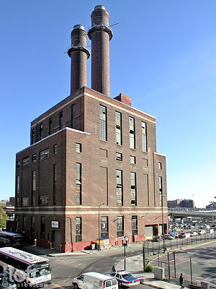
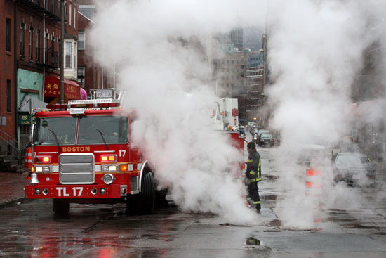
The Challenges
Private Developers
Utilities
State
City
Notes:
Private developers have the right to build if they go through the process, we can’t make them wait for district energy or other new green energy infrastructure
Numerous stakeholders and parties involved in the process
Ex: in Innovation District there are multiple governmental jurisdictions including City, MassPort, and Mass Convention Center Authority along with a combination of private and public parcels including the BCEC and BRA’s Marine Industrial Park.
Aging infrastructure (also opportunity)
Kneeland St steam plant is nearing the end of its useful life, what will replace it?
Boston Medical Example – they want to build new CHP plant but the existing natural gas infrastructure is not suitable – pipes brining in the gas must be enlarged
Dec. 12th 2008 A flood of rainwater trigged a powerful burst of steam that that erupted from a manhole in downtown Boston. No one was injured in the blast at 8:30 a.m. at intersection of Harrison Avenue and Kneeland Street.

Slide 12
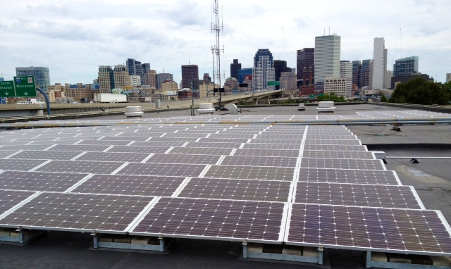
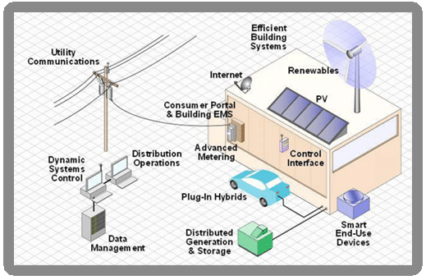
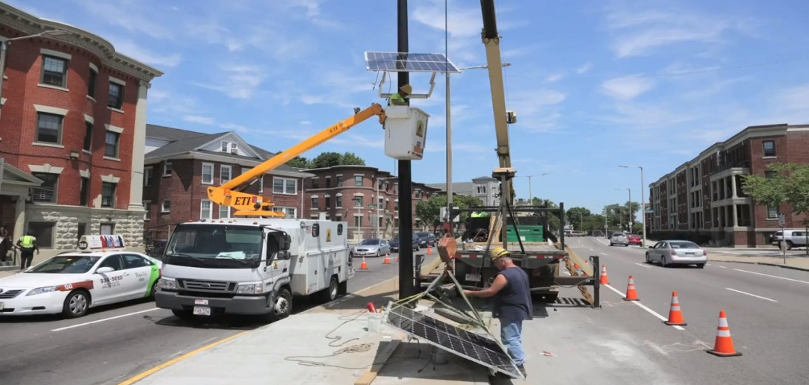
Opportunities
On-Site Renewables
Smart Grids
Solar Powered Fueling Stations for Emergency Vehicles at 400 Frontage Road
Solar Powered Traffic Signals Along Evacuation Route
Notes:
Technology is creating new opportunities that are both resilient and clean/green
City of Boston has started utilizing on site renewables to power emergency facilities including 400 frontage road and traffic signals along an evacuation route
Funded through an ARRA grant to demonstrate the us of PV technology in emergency preparedness.
This competitive grant was only available to Solar American Cities in 2007, of which there were 25.
Boston received the largest grant
Funded the PVs at Frontage road so that the fuel pumps for emergency vehicles would be functional in the event of the loss of power
Also funded battery backups for traffic signals along evacuation routes. PVs were installed on four of them – would have installed them on all but it was cost prohibited.
Smart Grids

Slide 13
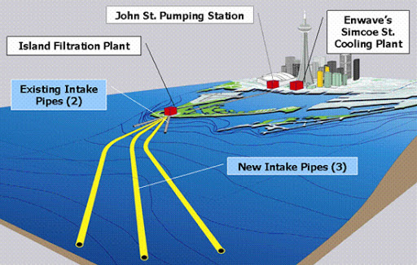
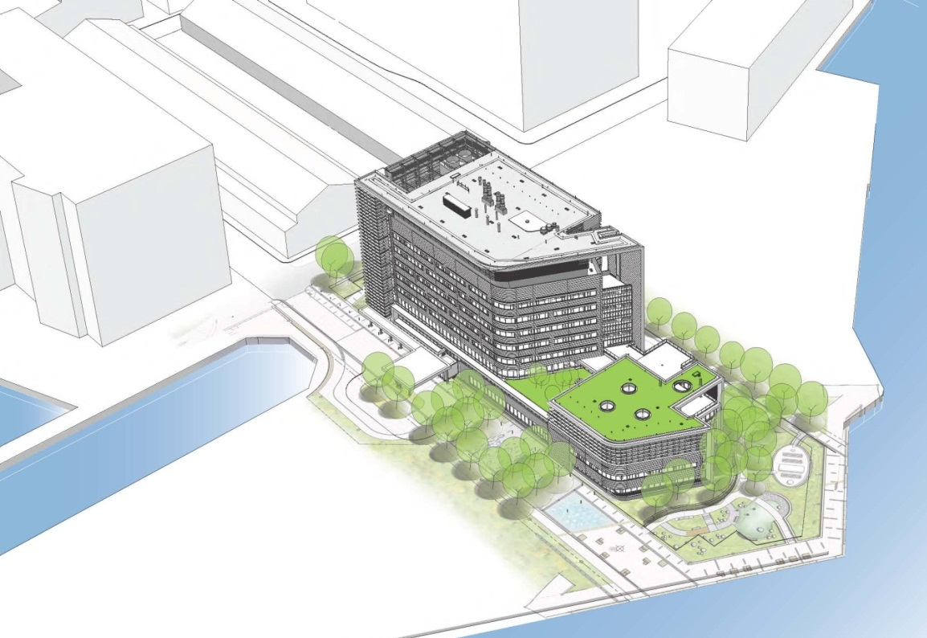
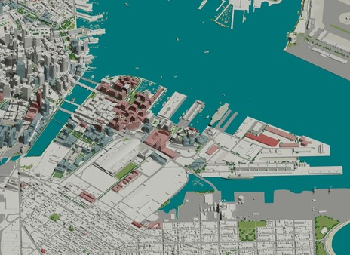
Opportunities
Building Improvements
District Energy and innovative energy generation
Toronto’s Deep Water Cooling System
Mechanical, electrical and emergency services on roof out of harm’s way
Key floors above 2085 High Estimate 100-year Flood
Operable windows keyed open in event of systems failure
Critical patient programs above ground floor
The Innovation District
Spaulding Rehabilitation Hospital
Notes:
Climate Adaptation Questionnaire
Spaulding Rehabilitation Center
Boston Redevelopment Authority Article 80: Ask developers of projects that may be subject to more frequent coastal flooding due to sea-level rise to analyze the effects of climate change
BRA modifying Development Review Guidelines to provide more explicit direction in effects of climate change
2009 Partners Healthcare raised the base elevation of proposed Spaulding Rehabilitation Center (in construction) by 2 feet at its new location in Charlestown Navy Yard
District energy for appropriate locations including Marine Industrial Park, Innovation District and Newmarket
Potential for innovative approaches such as Toronto’s Deep Water Cooling system which uses cold water to air-condition high-rise buildings in downtown Toronto. The system reduces energy consumption by up to 90 per cent (compared to conventional chillers)
How the system works three intake pipes draw water (4 degrees Celsius) from 5 kilometres off the shore of Lake Ontario at a depth of 83 metres below the surface. Naturally cold water makes its way to the City's John Street Pumping Station. There, heat exchangers facilitate the energy transfer between the icy cold lake water and the closed chilled water supply loop.
The water drawn from the lake continues on its regular route through the John Street Pumping Station for normal distribution into the City water supply. Only the coldness from the lake water, not the actual water, is used to provide the alternative to conventional air-conditioning.

Slide 14
Thank You
Brian R. Swett
Chief of Environment and Energy
EnvironmentalEnergy@cityofboston.gov
Like us on Facebook – Greenovate Boston
Follow us on Twitter - @GreenovateBos

