Slide 1
Planning and Building the Grid of the Future – Maine’s New Collaborative Process
Michael D. Stoddard, Efficiency Maine Trust
December 13, 2019

Slide 2
The Efficiency Maine Trust
Mission -- To lower the cost and environmental impacts of energy in Maine by promoting energy efficiency and other distributed energy resources.
Independent, Quasi-State Agency
Managed by Board of Trustees
Oversight from the Maine PUC
Subject to the “All Cost-Effective” standard for funding electricity and natural gas programs
Responsible for managing funding from:
Electric and natural gas utilities
Regional Greenhouse Gas Initiative (RGGI)
ISO New England (Forward Capacity Market)
Grants, contracts, settlement funds

Slide 3
Recent History of “Smart Grid” and Non-Wires Alternatives in ME
2009 CMP installs 622,000 smart meters (effectively 100% of meters) using ARRA grant and ratepayer funds
2009 Legislature establishes Smart Grid Policy Act (35-A MRS §3143) to promote development of smarter grid and DERs
2011-16 Boothbay Pilot and consideration of Mid-Coast Pilot
2013 Legislature adopts Omnibus Energy Act clarifying requirement that Non-Wires Alternatives (NWA) must be analyzed by independent consultant before approving Transmission CPCNs
2013 GridSolar proposes Smart Grid Utility; PUC declines
2016-18 Two PUC dockets consider if independent NWA Coordinator is in the public interest, process for selection of coordinator and developing NWAs
2018 PUC Commissioners reject Staff recommendation to establish independent NWA Coordinator, direct utilities to address NWAs through rates
2019 LD 1181 enacted to establish independent, NWA Coordinator and new process for planning and approval of investments for small T projects and D projects

Slide 4
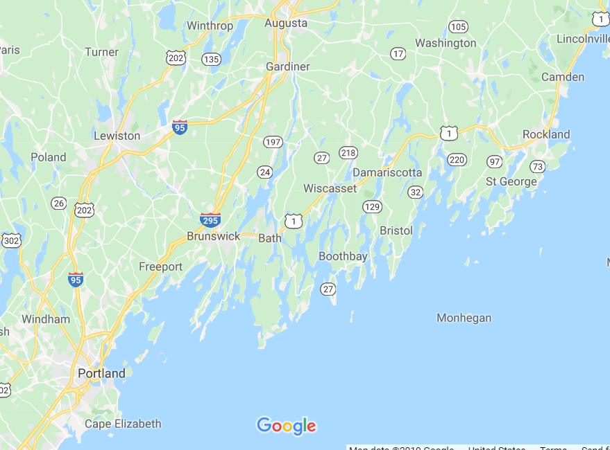
NWA Pilot Areas Initially Identified in Maine: Boothbay Pilot: - 2 MW need - 30 MW radial circuit - rapid develop’t horizon

Slide 5
Boothbay Pilot – NWA Resources Delivered
Source: GridSolar, “The GridSolar Pilot Project for Grid Reliability,” 2/8/2016

Slide 6
Boothbay – Projected NWA Cost Savings
Source: GridSolar, “The GridSolar Pilot Project for Grid Reliability,” 2/8/2016

Slide 7
LD 1181: An Act To Reduce Electricity Costs through NWAs
Developed by Efficiency Maine and Office of the Public Advocate, with input from utilities, environmental advocates, Industrial Energy Consumer’s Group (IECG)
Sponsored by Rep. Berry; Signed into law by Gov. Mills 6/14/2019
Establishes an independent NWA Coordinator (NWAC) operating under contract to the Office of the Public Advocate
The RFP for Maine’s NWAC has been awarded to DNV GL

Slide 8
LD 1181: An Act To Reduce Electricity Costs through NWAs
Directs the NWAC to collaborate with Efficiency Maine, utilities, and interested parties to:
Review annual planning studies for small transmission project and distribution projects;
Investigate and make recommendations regarding NWAs to proposed capital investments in the transmission and distribution system;
Conduct benefit-cost analyses to evaluate the cost-effectiveness of NWAs and make recommendations regarding procurement of recommended NWAs; and
Track and issue quarterly reports on NWA projects' progress.

Slide 9
Preparing for NWAs -- Efficiency Maine DER Pilots
Residential DER
ReVision Energy and Virtual Peaker control the fleet of DER to demonstrate value of load shifting across a variety of use cases
B.Y.O. Device initiative (for HPWH; EVs; batteries; ASHP) that are fully programmable and subject to either autonomous control or control by central dispatch
Refrigerated Space as Storage
Energy Solutions, Inc. and Viking Cold Solutions, Inc.
Demonstrating peak load shifts using controls and phase change material in refrigerated commercial/industrial spaces
Transactive Energy (TE) Using Thermal Storage
Isle au Haut Electric Power Company (IaHEPC) and Introspective Systems
Installing controls for the edge-based management of heat pumps, relying on price signals, to move excess solar energy to evening and nighttime hours using efficient and inexpensive thermal storage

Slide 10
Thank you!
CONTACT:
Michael Stoddard Executive Director Efficiency Maine Trust michael.stoddard@efficiencymaine.com
efficiencymaine.com

Slide 11
Additional Reference:
Process and Roles for Maine’s New Non-Wires Alternative Law

Slide 12
Planning Studies Must Be Filed Annually
Each IOU T&D in Maine must annually submit a planning study for small transmission projects and distribution projects for review by the NWAC
Large transmission projects are evaluated and compared with NWAs through the traditional Certificate of Public Convenience and Necessity process
The IOUs must develop and use system planning models for the study, which must:
Analyze system needs for the next 5 years
Provide a schedule of proposed projects and associated costs
Describe system capacity and load by substation and circuit, and
Identify corresponding planned and anticipated growth-related investments

Slide 13
NWA Investigation & Recommendations
The NWAC will investigate NWAs in coordination with Efficiency Maine
Small T projects or D projects costing $500,000 or above
Proposed wires solutions are excluded from review if needed:
For redundant supply to a radial load
For maintenance, asset condition or safety issues
For stability or short circuit problems, or
To be in service within 1 year
Utilities must provide data to NTAC and Efficiency Maine for the investigation
Efficiency Maine shall use utility data to identify cost-effective NWAs behind-the-meter
Investigation must deliver total projected costs and annual carrying costs of wires project and NWAs and benefit-cost analysis comparing wires project and NWAs
NWAC will develop and provide recommendations with a plan for procurement for NWAs

Slide 14
Decisions on Small Transmission Projects and Distribution Projects
For small T projects and D projects, NWAC makes recommendations to utility regarding feasibility and economics of NWAs
Utility and NWAC must attempt good faith agreement to adopt NWAs that are most cost-effective:
If NWA is recommended and agreement reached, utility contracts for the NWAs
If not, utility shall petition PUC to resolve dispute
Dispute Resolution -- PUC will:
Review utility planning study and recommendation of NWAC
Give preference for NWAs if more cost-effective and address the reliability need

Slide 15
Procurement of NWAs
The utility contracts for the NWA resources
Behind-the-meter (BTM) NWAs – shall be delivered through procurement and programs administered by Efficiency Maine
Grid-side NWAs
For small T projects and D projects where the utility has voluntarily accepted the NWA recommendations, the utility decides how the NWA will be delivered
Otherwise, the PUC select an entity (which may be the utility) to deliver the NWAs
Prudently incurred costs to deliver NWAs, including under contract to Efficiency Maine or a 3rd party, are recoverable in rates

