Slide 1
New Frontiers
Restructuring Roundtable
4-13-12
Stephen Cowell
Conservation Services Group

Slide 2
Conservation Services Group (CSG)
Founded in 1984
No capital-100% bootstrapped
Nonprofit corporation
~800 staff responsible for 7,000+ field jobs nationwide
Over 2 million homes and facilities served
Manage the delivery of over $250 million in energy efficiency and renewable energy investments and projects annually

Slide 3
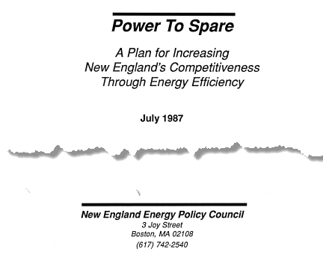
25th Anniversary

Slide 4
Power to Spare
Many credit this report with spearheading energy efficiency efforts in New England
New England Energy Policy Council
  Collaborative effort among several organizations with input and inspiration from EE experts
    Doug Foy, Armond Cohen, CLF; Joseph M. Chaisson, technical analysis; Timothy Stout, Energy Scientist, CLF
    Lawrence Berkeley Laboratory, ACEEE; Rocky Mt. Institute, Energy Systems Research Group, Fred Davis Corp., Mass. Fair Share (Steve Cowell), Vt. Natural Resources Council (Clare Moorhead), Mass. Audubon Society (Steven Nadel), NRDC (Ralph Cavanagh), Natural Resources Council of Maine, Mass. PIRG (Alan Nogee), and Rachel Greenberg

Slide 5
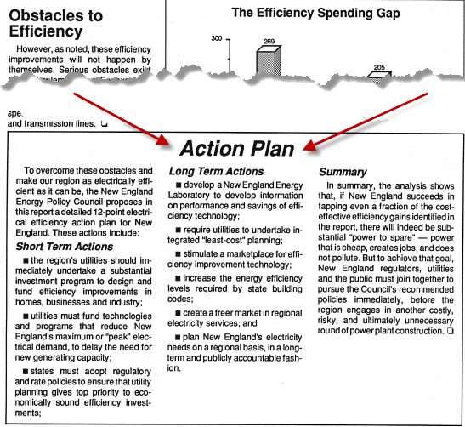
Power to Spare – Pub. 1987
“To overcome these obstacles . . .

Slide 6
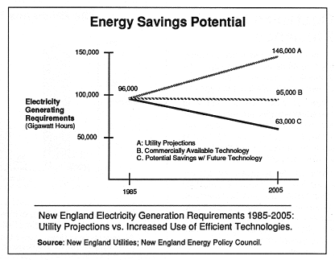
Source: Power To Spare, New England Energy Policy Council

Slide 7
Source: Synapse Energy Economics
Restructuring with DSM and Renewables
DSM Introduced
Notes:
7

Slide 8
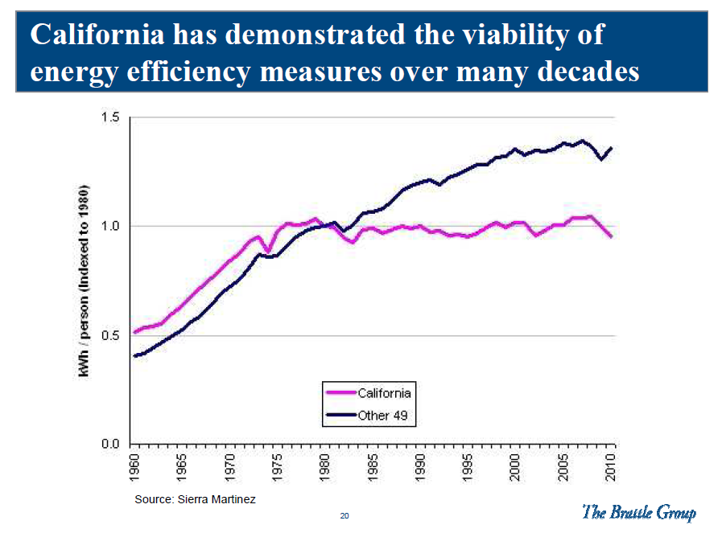

Slide 9
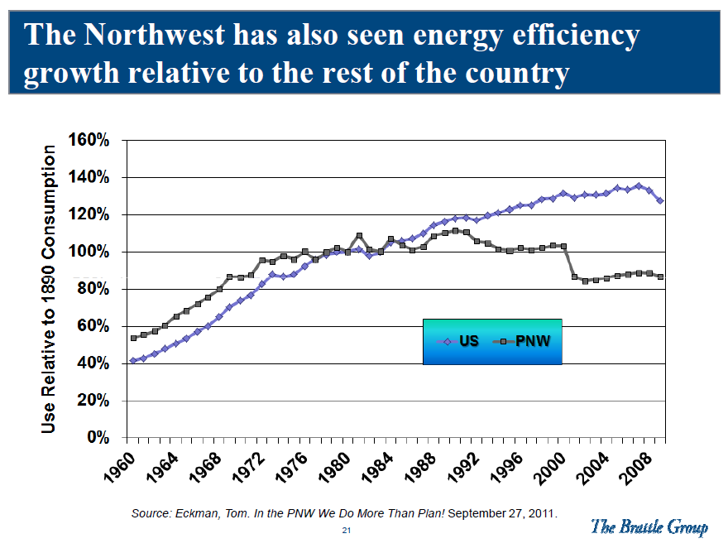

Slide 10
2005 NEEP Estimate of EE Potential
Existing and New EE Strategies Can Offset ISO
Forecasted Energy Requirements (GWH) and Beyond
150,000
ISO GWh Forecast (w/out DSM)
145,000
1.2% Avg. Annual Increase at
140,000
135,000
Addt'l EE Can Offset Growth
130,000
GWh
125,000
Actual Energy Requirement (2003)
120,000
115,000
Total Achievable Energy Savings Potential
110,000
-1.38% Avg. Annual Reduction
Total EE
Potential in
105,000
2013 Can
Reduce
Energy Req.
100,000
to 1993 Level
2004
2005
2006
2007
2008
2009
2010
2011
2012
2013
Source: Northeast Energy Efficiency Partnerships (NEEP)

Slide 11
Game Changing Policy Breakthroughs
2000-2010
“All cost effective” energy efficiency
ISO-NE Forward Capacity Market
  “Comparable access” for demand resources
RGGI: Cap and Invest strategy
Green Communities Act: 2008
Vt. Efficiency Utility
Stimulus funding
  Getting cities and towns involved

Slide 12
2006 ISO-NE Forward Capacity Market
Demand Resources
Active
Demand Response
Emergency DG
Passive
Energy Efficiency
DG

Slide 13
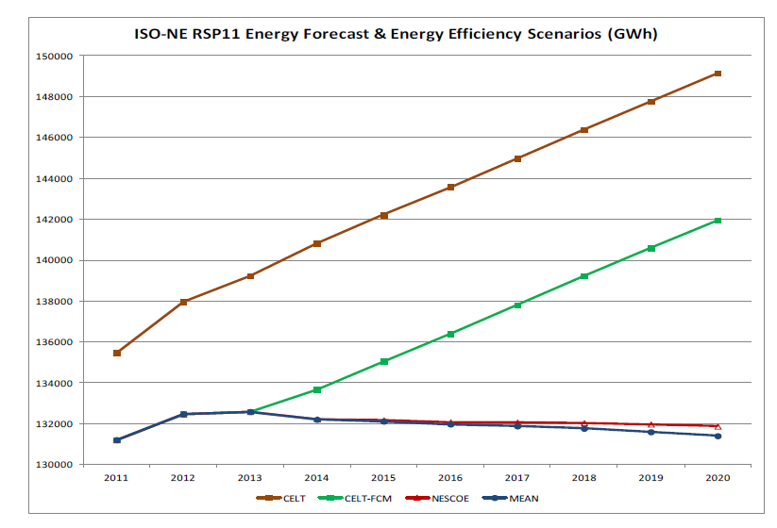
Baseline forecast – no intervention
EE only through third auction
Forecast with various EE options
Source: ISO-New England
13

Slide 14
New Frontiers
Adjust to a Post ARRA-stimulus world
Harness modern technology for M&V
Promote comparable treatment for EE in Energy Markets
Institute Rate and Regulator design
  EE investments on level playing field with generation and transmission – same incentives for utilities
Bring laggards along
Solve split incentive challenge
Persuade and influence web-based behavior
  Marketing initiatives

Slide 15
More Challenges and Opportunities
Senate 2200
  Progress with pitfalls
Total Resource Cost Test and Net to Gross Ratio
  Keeping up with the times
Rates vs Costs* (Massachusetts 2008-2011)
  Rates: from 4th highest to 11th highest
  Costs: Residential costs dropped from 17th to 29th highest!
*Source: U.S. Energy Information Administration: Table T5.a

Slide 16
All Fuels: An Act Establishing the Cost Savings Oilheat and Propane Energy Efficiency Program
To fund energy efficiency in oil and propane heated buildings at levels comparable to buildings heated with natural gas or electricity
Based on successful CSG-run pilot 2010-2011
Backed by oil dealers’ professional association
In House Ways and Means Committee
Notes:
the first time such legislation was introduced, in 1982, the “oil dealers hooted us out of the room.”

Slide 17
Thank you!
        Steve Cowell
        stephen.cowell@csgrp.com
        508.836.9500
        www.csgrp.com

