Slide 1
New England Restructuring Roundtable The Innovation Journey
February 2016

Slide 2

Our Business Snapshot

Slide 3
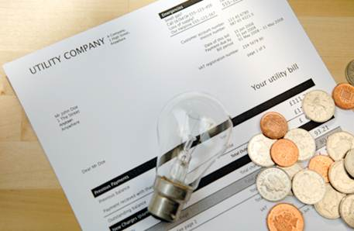
Is This Best We Can Do?

Slide 4
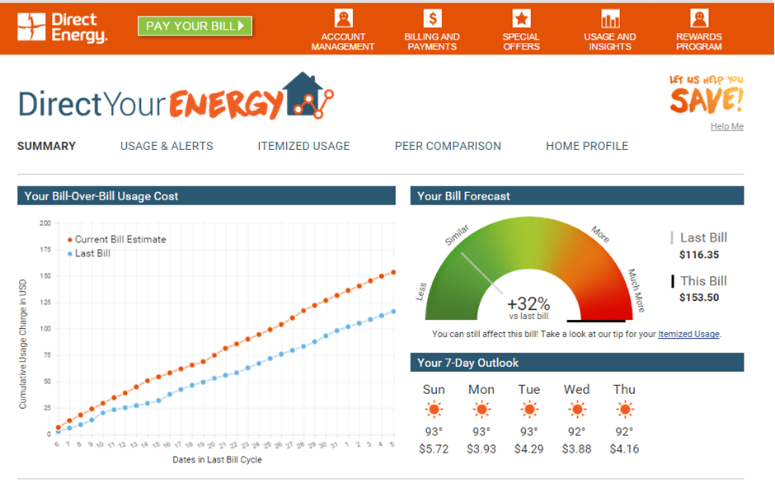
Direct Your Energy

Slide 5
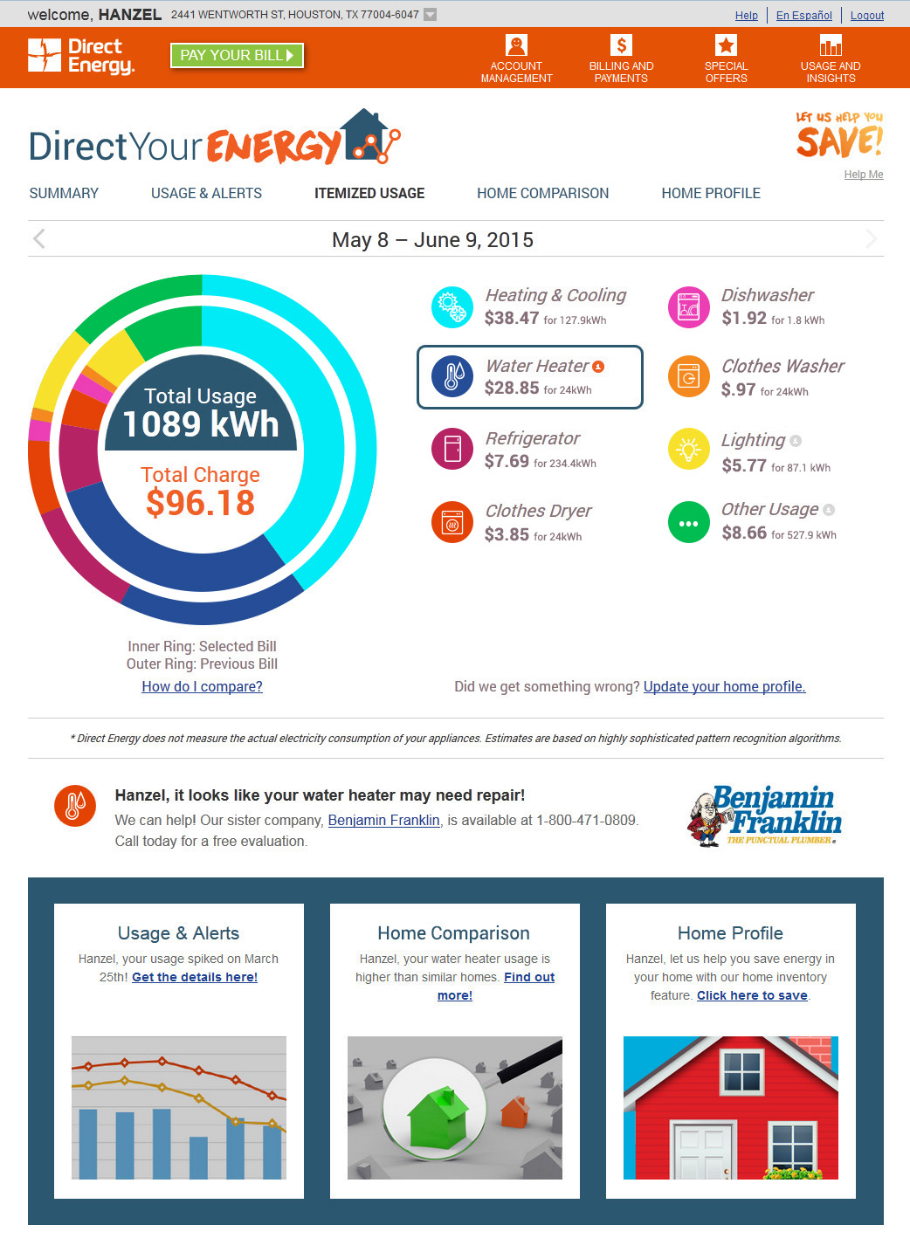
Appliance Level “Energy Grocery Bill”

Slide 6

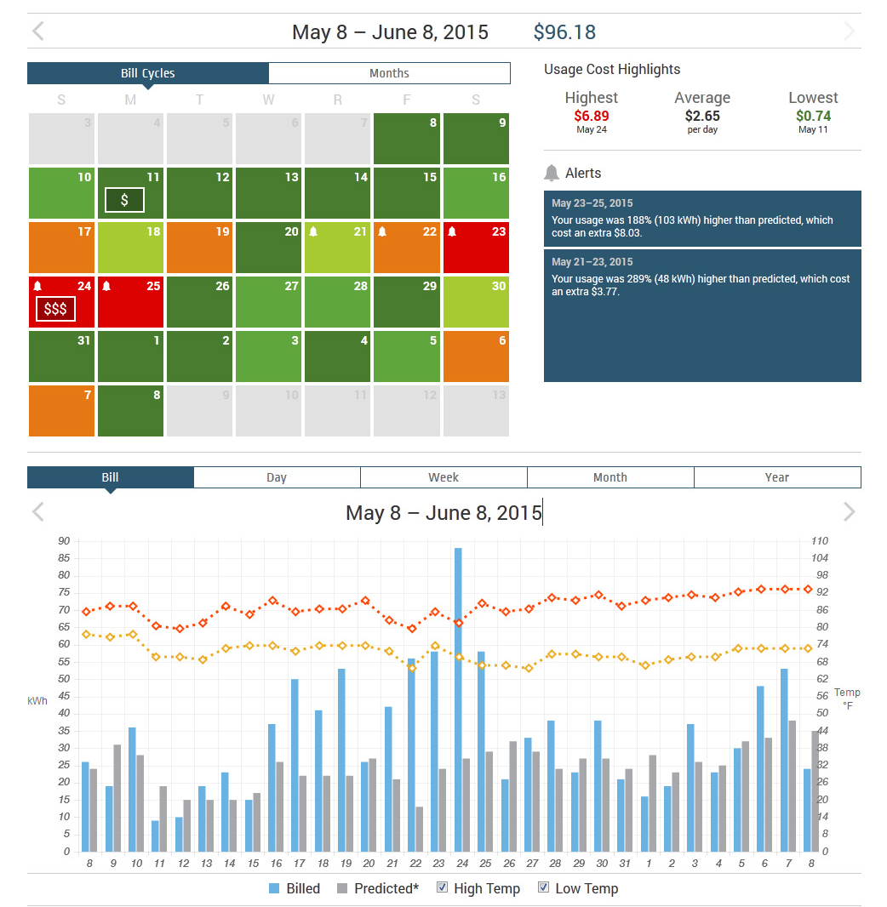
Comparison and Review

Slide 7
Platform For Progress – Smart Grid
SOURCE: 2015 FERC Staff Report on Smart Metering and Demand Response

Slide 8
What We Need to Do?
Take action on grid modernization plan filings
Establish protocols for automated, nondiscriminatory access (in real-time) to data from existing interval and smart meters and smart meters deployed pursuant to grid modernization plans
Facilitate tests of new smart-meter-enabled products and services cooperatively among utilities and third-party providers

