Slide 1
Maryland’s Grid Modernization Experience
Presentation for the New England Electricity Restructuring Roundtable
Kelly Speakes-Backman
Boston, MA
September 20, 2013
1

Slide 2
EmPOWER Maryland Energy Efficiency Act
Enacted: April 2008 (PUA § 7-211)
15% by 2015: per capita energy consumption reduction by 2015
  2117 MW
  5,475,000 MWh
Multi-faceted : Cost-effective programs for energy efficiency (EE), demand response (DR), distributed generation, CVR, and AMI/Smart Grid
Verifiable: §7-211(g)(1) requires projected & verifiable electricity savings
Three year plans: 2009-2011, 2012-2014 plans developed as Work Group recommendation of PSC Staff, OPC, MEA, Utilities and other stakeholders
Reporting: Quarterly data to Staff, semi-annual reports to the Commission

Slide 3
Scope of EmPOWER Maryland
Includes Energy Efficiency (EE), Demand Response (DR) & Smart Grid (SG)
2012 – 2014 program portfolios $695m in EE/DR Programs
2009 – 2015 projected to exceed $1b (not including SG)
Customer-Facing
  Lighting & Appliance rebates
  HVAC
  HPwES (existing homes, whole-house)
  Residential New Construction
  C&I prescriptive measures (lighting, HVAC, motors, VSD, custom retrofits, CHP)
  Low-income
  Multi-family housing (e.g., common-area EE measures)
  Direct Load Control
  Grid-Facing
  AMI (BGE, Pepco, DPL, SMECO)
  Conservation Voltage Reduction (Pepco, DPL, PE)

Slide 4
EmPOWER Maryland Progress
4
Notes:
4
4

Slide 5
Cost Recovery Mechanisms
Customer-Facing Portfolios: monthly surcharges
  2012 Residential Avg Monthly Impacts 2012 C&I Consumption Charge (per kWh)
Grid-Facing Programs: regulatory asset
  Smart grid utilities will use AMI reg asset
  Non-smart meter utilities will recover in rate base (PE)

Slide 6
Maryland Smart Grid Context
Introduced in the context of EmPOWER
No legislative mandate or specific guidelines set forth
BGE and Pepco each received up to $200m ARRA Smart Grid Investment grants
All Maryland AMI proposals were preceded by pilot projects, including:
  Technology pilots
  Multi-year peak pricing pilots
  Operational benefits pilot

Slide 7
Maryland Smart Grid Business Cases
BGE, Pepco, DPL proposals estimated strong cost-effectiveness
  Roughly half the benefit from operational savings and half from peak load reductions (mostly capacity benefits)
  Dynamic pricing using peak time credit approach to achieve usage reductions during critical peaks
SMECO cost effectiveness positive
  Includes operational benefits only
  Did not include peak load reduction savings
  Possible time of use rates in the future

Slide 8
Maryland Commission Decisions
Cost recovery contingent upon demonstrated cost-effectiveness
Smart grid expenditures may be requested in first rate case following full deployment and cost-effectiveness analysis
Plans and Metrics
  55 total metrics
  Metrics monitor deployment progress, costs/benefits, customer engagement
  Customer education plans
  Cyber-Security plans

Slide 9
Maryland Smart Grid Progress
BGE
  1.2 million electric & 660,000 gas meters
  Roughly 33% of installations completed, complete in 2014
Pepco-MD (PHI Affiliated)
  550,000 electric meters in Maryland (largest jurisdictional PHI utility)
  Preceded (one year) by full implementation in Pepco-DC
  98% complete by June 2013
DPL-MD (PHI Affiliated)
  210,000 electric meters in Maryland
  DPL-DE completed full implementation (electric and gas) in 2012
  Installations underway, complete late 2013/early 2014
SMECO
  160,000 electric meters
  Approved Summer 2013

Slide 10
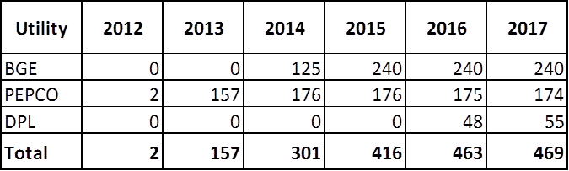
Maryland Smart Grid: AMI
AMI overall benefits
  Reliability (duration)
  Demand reduction
  Energy use information transparency
  New technology advances and applications
Forecasted Smart Grid demand reductions through 2017 (MW)

Slide 11
Leveraging EmPOWER and AMI
Dynamic Pricing
  Direct load control
  Peak time rebates
  Time of use pricing
  Real-time pricing
Conservation Voltage Reduction (“CVR”)
Behavior-based EE programs
Electric Vehicles and the Grid

Slide 12
Maryland Smart Grid: Dynamic Pricing
Dynamic pricing includes DLC, PTR, TOU, real time pricing
Peak event days
  Includes PJM DR days, high LMP days, and could include distribution problem days
  In most cases, declared for the following day
  Generally declared June – Sept.
  Maximum hours are 12pm – 8pm, usually actual is less
  Multiple customer communication streams in advance

Slide 13
Maryland Smart Grid: Direct Load Control
DLC program reductions approximately 700 MW
BGE “Smart Energy Rewards”
  Voluntary
  “Opt-in” for residential
  100%, 75%, 50% option
PHI “Peak Energy Savings Credit”
  Voluntary
  “Opt-in” for residential, small commercial
  100%, 75%, 50% option
$1.25/kWh during peak period
Reductions monetized in PJM capacity and energy markets
True-up in annual distribution surcharge/credit

Slide 14
Maryland Smart Grid: Peak Time Rebates
$1.25/kWh credit for reduction from customer-specific baseline
  Calculates usage difference from a comparable degree-day
Cash flow similar to DLC programs
  Peak load reductions monetized in PJM capacity and energy markets
  PJM payments fund customer credits
  True-up in annual distribution surcharge/credit
Can augment DLC programs
  If monthly reduction exceeds DLC commitment, customer receives end-of-season credit for the difference
No penalty for non-participation
Retail supply neutral – except for customers whose supplier provides their own PJM based load reduction program

Slide 15
Maryland Smart Grid: CVR
PE received approval to implement CVR program under its EmPOWER portfolio
  Recovery of program costs will be sought in rate base after full implementation
Commission Order No. 84569 directed other utilities to investigate feasibility of implementing CVR in respective service territories (Dec. 22, 2011)
  Directed recovery of program costs to be sought through rates

Slide 16
Maryland Smart Grid: Behavior-based EE
Behavior-based programs encourage direct customer engagement
April 2012: Commission authorized EmPOWER utilities to implement energy usage programs

Slide 17
Maryland Smart Grid: Electric Vehicles
Maryland Senate Bill 179 (2011)
  Establish “a Pilot Program for electric customers to recharge electric vehicles during off-peak hours.”
    Pilot Program in place June 30, 2013
    Report findings to General Assembly by February 1, 2015
  Increase efficiency and reliability of electric distribution system
  Encourage lower electricity use at times of high demand
BGE Pilot Program: voluntary, residential, TOU rate
  Based on whole-house TOU with lower off-peak pricing (400)
Pepco Pilot Program: voluntary, residential options
  Existing customers with EVSE: whole-house TOU or PIV rate (200)
  Existing customers without EVSE: PIV rate and bill, Level II charging station, second meter (50)
  New customers without EVSE: whole-house TOU (1000)

Slide 18
Maryland Smart Grid: Opt-out?
Jan. 7, 2013: Order No. 85294
  Commission concluded (3-2) that the public interest requires provision of additional option related to installation of smart meter
Additional proceedings held August 20, 2013
  Whether to allow option to retain existing meter, RF-free or “near RF-free” meter
  Associated costs, allocation and procedures for exercising option
  Treatment of “non-responsive” customers
  What percentage opt-out scenario to consider
  Low-income opt-out scenarios

Slide 19
Maryland Smart Grid: Cyber Security Plans
Company-specific AMI cyber security plans
  Plans apply to AMI, not utility-wide operations
  Work Group consensus support
Commission oversight plan applicable to BGE, Pepco, DPL
  Key feature is independent 3rd party consultant answerable to PSC to review all details of utility AMI cyber security activities and incidents
  Approved by Commission June 21, 2013

Slide 20
For more information…
www.psc.state.md.us
20

Slide 21
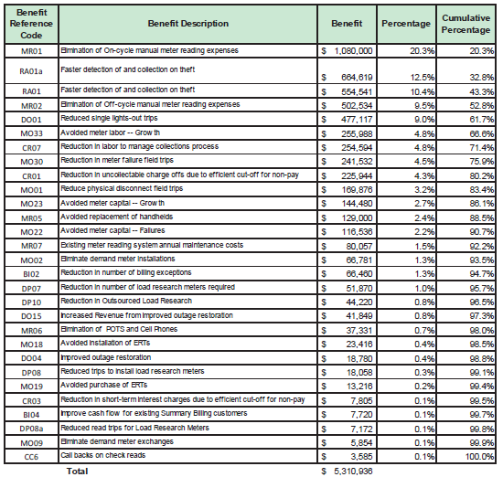
SMECO Operational Pilot Results

