Slide 2
New England Electricity
Restructuring Roundtable
March 24, 2017
Mary Sotos, Deputy Commissioner
Connecticut Department of Energy & Environmental Protection

Slide 3
CT Department of Energy and Environmental Protection
DEEP was established on July 1, 2011 with the consolidation of the Department of Environmental Protection, the Department of Public Utility Control, and energy policy staff from other areas of state government.
Environmental Quality Branch
Environmental Conservation Branch
Office of the Commissioner
Energy Branch
PURA
Energy & Technology Policy
Air Management
Materials Management and Compliance Assurance
Water Protection and Land Use
Natural Resources
Outdoor Recreation
Adjudications
Legal Counsel
Central Services
Notes:
DEEP was established on July 1, 2011 with the consolidation of the Department of Environmental Protection, the Department of Public Utility Control, and energy policy staff from other areas of state government.
The consolidation of these agencies and staff helps to integrate energy and environmental policies and programs in a more systematic, proactive and coherent manner to provide a better structure for decision-making and to build a sustainable and prosperous economic future.
The agency is organized into three main branches and the Office of the Commissioner.
The overarching goals of the agency are to:
Integrate energy and environmental policies and programs in a more systematic, proactive and coherent manner to provide a better structure for decision-making and to build a sustainable and prosperous economic future.
Bring down the cost of electricity to make Connecticut more competitive, promote energy efficiency, and encourage the development and use of clean energy technologies.
Unleash a renewed spirit of innovation for pollution control, conservation of natural resources, and management of Connecticut’s parks and forests.
The agency is organized into three main branches and the Office of the Commissioner. The Office of Climate Change, Technology and Research sits within the Bureau of Energy & Technology Policy.

Slide 4
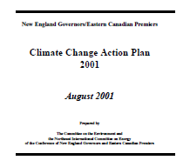


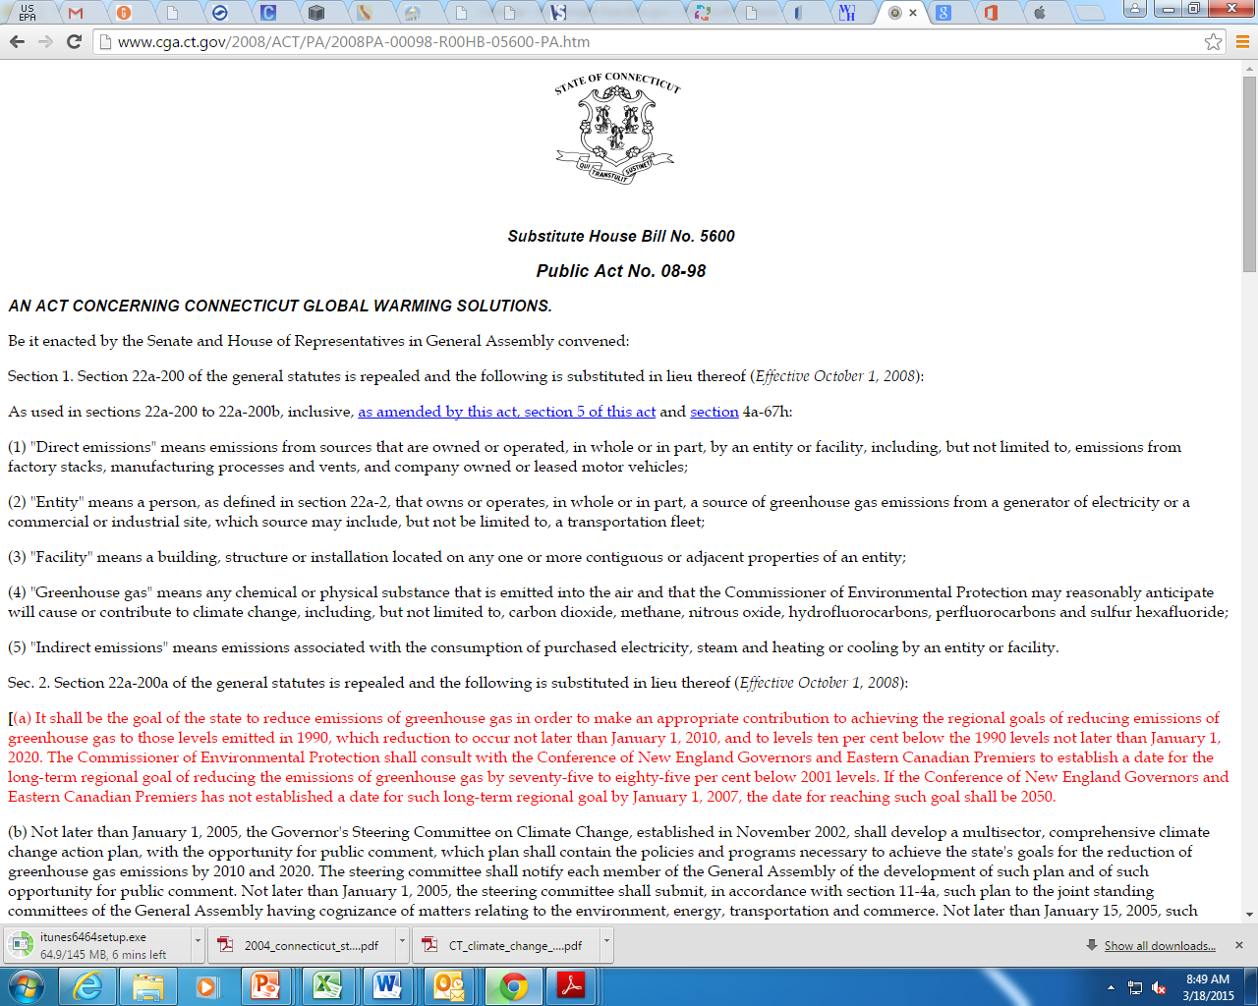
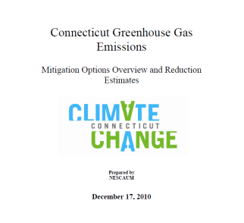
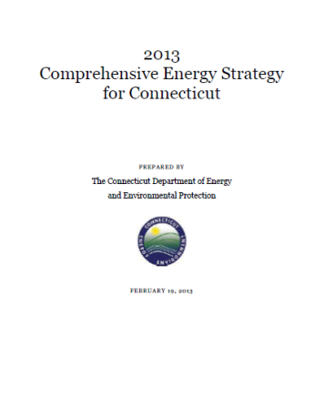

Connecticut’s Policy Framework
CT signs NEG/ECP 2001 Climate Change Action Plan
GSC finalizes CT Climate Change Action Plan
Executive Order 46 on Climate Change Creates the GC3
2007 Public Act 07-242 – Energy Efficiency and Expansion of the Renewable Portfolio Standard
2001
2004
2005
2008
2010
2013
2014
An Act Concerning Climate Change (Public Act 04-252) sets GHG goals that align with NEG/ECP regional goals
CT Global Warming Solutions Act (Public Act 08-98) reaffirms commitment to GHG targets for 2020 and 2050
ZEV MOU
CT ’s implementation of
1990 Amendments to
Federal CAA continues
2013 Comprehensive Energy Strategy
Regional Greenhouse
Gas Initiative
International ZEV Alliance
CT ’s implementation of
The RPS continues
Notes:
Connecticut has a robust policy framework across energy and environment recognizing that the two are inextricably linked when it comes to solving climate change.
CT has put forth proven strategies, programs, and policies that can be adopted by other jurisdictions that may have larger GHG reduction impacts.
As demonstrated in this timeline CT has been a national and even international leader in putting forth strategies, programs, and legislation to address climate change.
Individual and collective state actions have pushed the federal government to take action on climate change. The role that state’s like CT and its NE Counterparts play in setting the bar for others to live up to is critical.
While CT’s carbon footprint may be small, our impact is not!
For instance, when multiple states in a region work together to demonstrate leadership by making commitments to reduce statewide greenhouse gas emissions, as the New England states have done, then you start seeing the results of our leadership actions.
We spend a lot of time working with regional partners to identify climate leadership opportunities that are meaningful when collective action is taken.
A great example of this is the Regional Greenhouse Gas Initiative, also known as RGGI – this was the first in the nation multi-state market-based cap and invest program aimed at reducing carbon pollution. Since the program inception in 2009, collectively, the RGGI states have cut carbon pollution from the power sector 45 percent even as their economies grew 8 percent.
RGGI states – include NE states, NY, MD, and DE
Robust environmental and energy policy framework
Regionally we have aggressive RPS targets
Comprehensive energy strategy sets a broader strategic energy/environmental framework look broadly at energy consumption, environmental benchmarks and overall costs both rates and total costs and comparing strategies

Slide 5
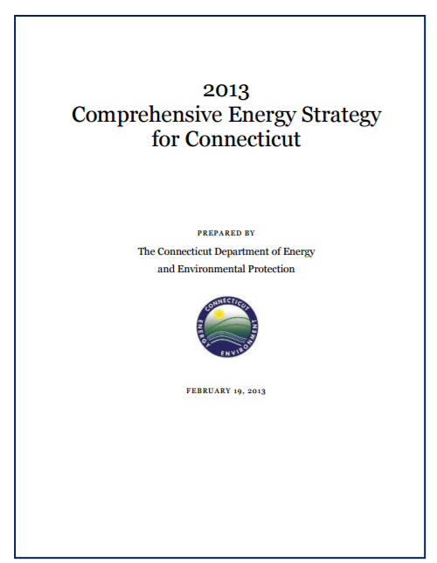
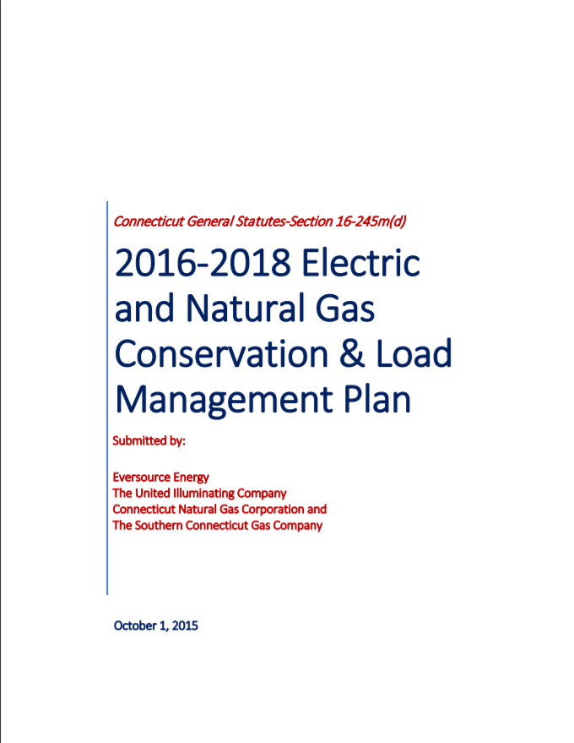
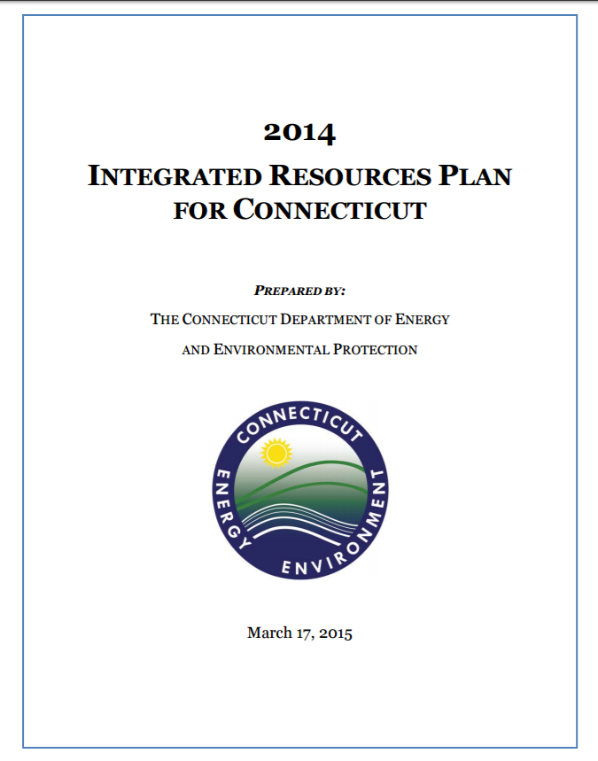
Energy Plans
Comprehensive Energy Strategy
The Department of Energy and Environmental Protection (DEEP) developed the first-ever Comprehensive Energy Strategy for the State of Connecticut – an assessment and Strategy for all residential, commercial, and industrial energy issues, including energy efficiency, industry, electricity, natural gas, and transportation.
Conservation & Load Management Plan
Every three years, Connecticut's utilities develop and implement an energy efficiency investment plan for the CT Energy Efficiency Fund (CEEF). The CEEF is funded by various sources, including customer contributions, the Regional Greenhouse Gas Initiative (RGGI) and the ISO New England Forward Capacity Market. The CT Energy Efficiency Board (EEB) advises and assists the utilities in the development of the plan. DEEP then reviews and approves or modifies the CEEF's plans and budgets in order to achieve cost-effective energy savings across the state.
Integrated Resource Plan
The Integrated Resource Plan is a biannual assessment of Connecticut's future electricity needs, and a plan to meet those needs through a mix of generation and energy efficiency.
Notes:
These trends frame the issues and policy drivers for the CES.
Tailored energy solutions for residents and businesses, low income, commercial, industrial, and government facilities.
DEEP has emphasized larger-scale cost effective renewables procured through an open, competitive and transparent process to balance costs across programs.
Focus on harmonizing siting of renewables with land use policies
Grid modernization pilots under (Grid side demonstration Projects Under Public Act 15-5)
Enabling on-site generation and two-way distribution and capturing locational benefits

Slide 6
Energy Planning Priorities
Advance Tailored Energy Efficiency Solutions to Achieve Cost Savings for All Consumers
Continue to drive down program costs
Support grid modernization initiatives
Continued focus on resiliency initiatives including microgrids and energy security
Continue progress towards 2020 greenhouse gas reduction goal (GHG) provide a foundation for achieving transformational 2050 GHG reduction goal.
Notes:
These trends frame the issues and policy drivers for the CES.
Tailored energy solutions for residents and businesses,, industrial, and government facilities.
low income, commercial businesses.
Chair Dykes addressed the issue of lowering costs, this administration has focused on deploying clean energy at least cost through competitive procurements DEEP has emphasized larger-scale cost effective renewable
Focus on harmonizing siting of renewables with land use policies
Grid modernization pilots under (Grid side demonstration Projects Under Public Act 15-5)
Enabling on-site generation and two-way distribution and capturing locational benefits (utilities can submit grid mod projects). Increase transparency for stakeholders in terms of knowing where load would be beneficial on the system. Help with locating DG (pilots enable that process – rate recovery for enhancing their IT systems). Through these pilots, the utilities would ideally come out with system mapping identifying areas that would be suitable. Other part is STORAGE. Add’l work needs to be done on cost-effectiveness of storage.

Slide 7
2008 Global Warming Solutions Act
Public Act No. 08-98
Reaffirmation of GHG reduction targets
10% below 1990 levels by 2020
Climate Action Planning
Framework for monitoring and reporting progress to meet mandated targets
Regional Greenhouse Gas Emissions Initiative
Implement CT’s participation in RGGI, nation’s first market-based regulatory program to reduce GHG emissions
80% below 2001 levels by 2050
Framework for engaging stakeholders
An Act Concerning Connecticut Global Warming Solutions Public Act No. 08-98
Notes:
Section 1
Codified 2010, 2020, and 2050 targets
Section 2
(b) Not later than January 1, 2005, the Governor's Steering Committee on Climate Change, established in November 2002, shall develop a multi-sector, comprehensive climate change action plan, with the opportunity for public comment, which plan shall contain the policies and programs necessary to achieve the state's goals for the reduction of greenhouse gas emissions by 2010 and 2020. The steering committee shall notify each member of the General Assembly of the development of such plan and of such opportunity for public comment. Not later than January 1, 2005, the steering committee shall submit, in accordance with section 11-4a, such plan to the joint standing committees of the General Assembly having cognizance of matters relating to the environment, energy, transportation and commerce. Not later than January 15, 2005, such committees shall convene a joint informational public hearing for the purpose of reviewing such plan. Not later than February 1, 2005, such committees shall meet for the purpose of consideration of endorsement of such plan. Not later than February 15, 2005, the steering committee shall submit a final plan to such committees.
(c) Not later than January 1, 2008, the steering committee shall develop an amended climate change action plan, with the opportunity for public comment, for achieving the state's contribution towards reaching the long-term regional goal established pursuant to subsection (a) of this section. The steering committee shall submit, in accordance with section 11-4a, such plan to the joint standing committee of the General Assembly having cognizance of matters relating to the environment.
(d) Not later than December 1, 2005, and annually thereafter, the Commissioner of Environmental Protection, in collaboration with the commissioners of other state agencies and the steering committee, shall submit a report to the joint standing committee of the General Assembly having cognizance of matters relating to the environment on the progress made in achieving the goals established in subsection (a) of this section and to evaluate the appropriateness of the climate change action plans developed pursuant to subsections (b) and (c) of this section in achieving such goals. ]
(b) On or before January 1, 2010, and biannually thereafter, the state agencies that are members of the Governor's Steering Committee on Climate Change shall submit a report to the Secretary of the Office of Policy and Management and the Commissioner of Environmental Protection. The report shall identify existing and proposed activities and improvements to the facilities of such agencies that are designed to meet state agency energy savings goals established by the Governor. The report shall also identify policies and regulations that could be adopted in the near future by such agencies to reduce greenhouse gas emissions in accordance with subsection (a) of this section.
(c) Not later than January 1, 2012, and every three years thereafter, the Commissioner of Environmental Protection shall, in consultation with the Secretary of the Office of Policy and Management and the Governor's Steering Committee on Climate Change, report, in accordance with the provisions of section 11-4a, to the joint standing committees of the General Assembly having cognizance of matters relating to the environment, energy and transportation on the quantifiable emissions reductions achieved pursuant to subsection (a) of this section. The report shall include a schedule of proposed regulations, policies and strategies designed to achieve the limits of greenhouse gas emissions imposed by said subsection, an assessment of the latest scientific information and relevant data regarding global climate change and the status of greenhouse gas emission reduction efforts in other states and countries.
Section 4
The Commissioner of Environmental Protection shall adopt regulations, in accordance with chapter 54, to implement the Regional Greenhouse Gas Initiative.
(b) The Department of Environmental Protection, in consultation with the Department of Public Utility Control, shall auction all emissions allowances and invest the proceeds on behalf of electric ratepayers in energy conservation, load management and Class I renewable energy programs. In making such investments, the Commissioner of Environmental Protection shall consider strategies that maximize cost effective reductions in greenhouse gas emission. Allowances shall be auctioned under the oversight of the Department of Public Utility Control and the Department of Environmental Protection by a contractor or trustee on behalf of the electric ratepayers.
(c) The regulations adopted pursuant to subsection (a) of this section may include provisions to cover the reasonable administrative costs associated with the implementation of the Regional Greenhouse Gas Initiative in Connecticut and to fund assessment and planning of measures to reduce emissions, [and] mitigate the impacts of climate change and to cover the reasonable administrative costs of state agencies associated with the adoption of regulations, plans and policies in accordance with section 22a-200a, as amended by this act. Such costs shall not exceed seven and one-half per cent of the total projected allowance value. Such regulations may also set aside a portion of the allowances to support the voluntary renewable energy provisions of the Regional Greenhouse Gas Initiative model rule and combined heat and power.
(d) Any allowances or allowance value allocated to the energy conservation load management program on behalf of electric ratepayers shall be incorporated into the planning and procurement process in sections 16a-3a of the 2008 supplement to the general statutes and 16a-3b of the 2008 supplement to the general statutes.

Slide 8
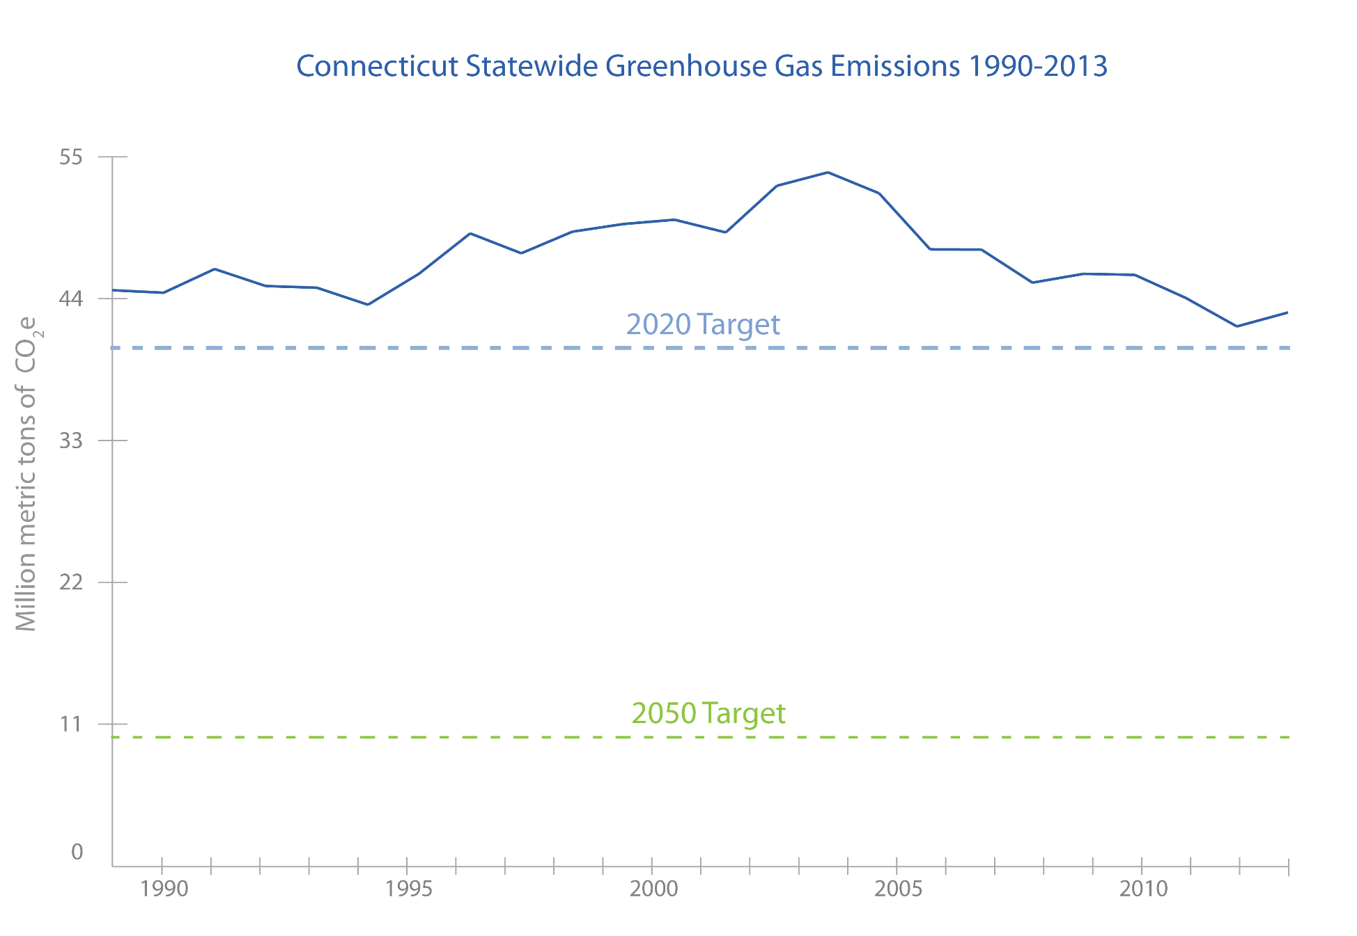
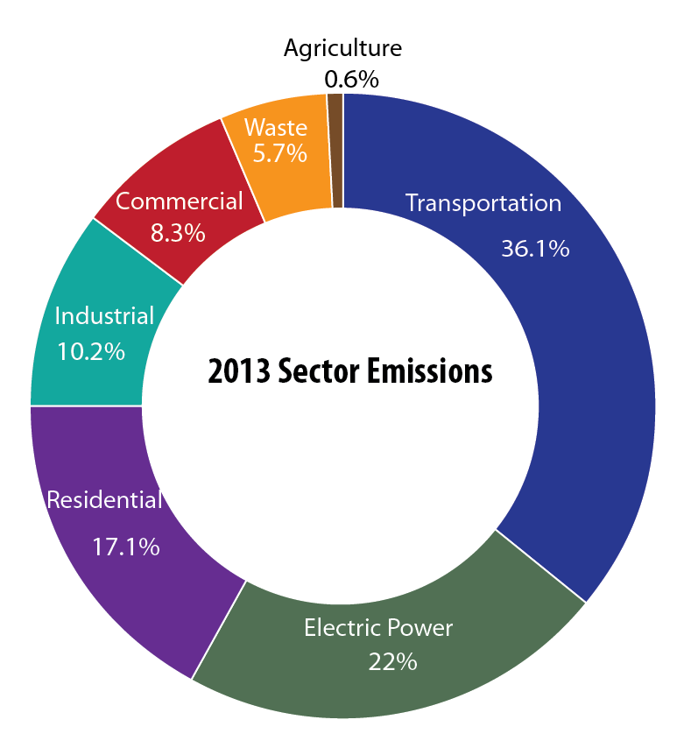
Progress: CT Greenhouse Gas Emissions
Notes:
As demonstrated in this slide, we are close to achieving the 2020 target, but we certainly have a long way to go to achieve the 2050 target.
The transportation sector continues to be the single largest source of emissions in the state, contributing 36 percent, principally from the use of fossil fuels in passenger cars and light-duty trucks.
Transformational change on how we generate and use energy will be necessary to achieve the 2050 target. This means generating electricity primarily from renewable energy sources, electrifying our transportation sector, and designing zero-impact buildings.
Government can’t achieve this type of transformation on its own. Voluntary actions, leadership, and innovation from communities, businesses, and non-profits will be critical to achieving the type of transformation that is required.

Slide 9
Hypothetical Emission Reduction Scenario
Year | % Reduction
2030 | 36%
2040 | 44%
2050 | 76%
Notes:
Here is one hypothetical emission reduction scenario. The measures and actions on the right add up to achieve a 36% reduction below 2001 levels by 2030. The scenario is just short of meeting the 2050 target demonstrating that more aggressive measures are needed.
Assumptions for this scenario: All nuclear retires at the end of current licenses (2035 & 2045) and is replaced with on-shore wind. Savings from current energy efficiency program are extended out to 2050 (also includes 34MW of energy efficiency from recent RFP). The grid evolves towards zero-carbon with roughly even split between utility-scale solar and on-shore wind.
In the next couple of slides we will take a closer look at the electrification of passenger car and light duty trucks and deployment of residential renewable thermal technologies. Both sets of measures are critical to achieving the 2050 target.

Slide 10
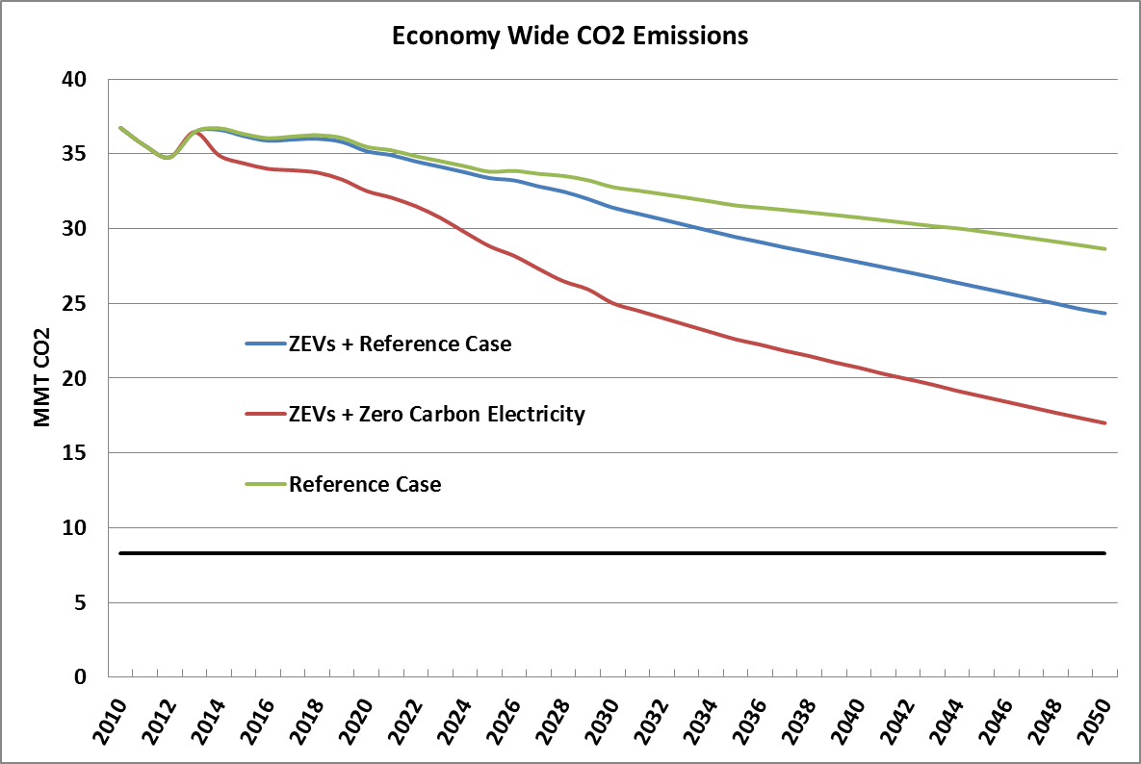
Hypothetical Zero Emission Vehicle Scenario
Regional Electric Grid BAU vs. Decarbonized Electric Grid
Reference Case:
On average 55% fossil fuel electricity generation 2030
2050 (AEO extrapolation)
ZEVs + Reference Case:
  70% of passenger cars and trucks electric by 2050
  Reference Case electricity generation
ZEVs + Zero Carbon Electricity:
  70% of passenger cars and trucks electric by 2050
  80% zero carbon electricity by 2050
2050 GHG Reduction Target
80% below 2001 by 2050 Target
Notes:
The point of this slide is demonstrate the difference between electrifying vehicles without decarbonizing the grid and decarbonizing the grid and electrifying vehicles. It makes a significant different in the net carbon reductions. Without decarbonizing our electricity grid you do not maximize the emission reductions from electrifying the vehicle fleet.

Slide 11
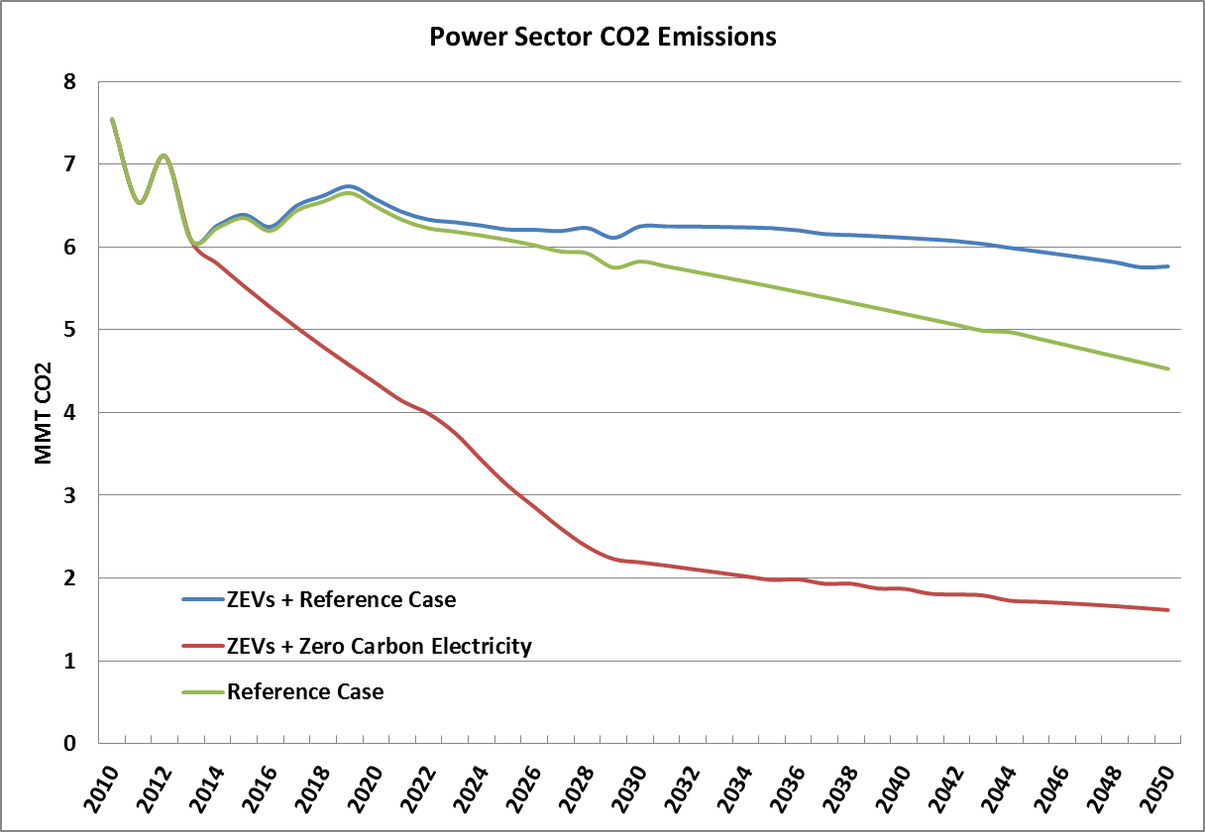
Hypothetical Zero Emission Vehicle Scenario
Electric Power Sector CO₂ Emissions
Electricity demand is 22% higher by 2050 in the ZEV scenarios
The grid mix has a large impact on the efficacy of vehicle electrification
Notes:
Here we are looking at the impact of electrifying the passenger vehicle fleet. By electrifying the fleet we will be increasing overall electricity demand. Without decarbonizing the our electricity grid we will see an increase in emissions in the electricity sector.
As demonstrated by this graph, to decrease overall emissions it is essential to decarbonize the electric grid in conjunction with electrifying the passenger vehicle fleet.

Slide 12
Average Regional Electric Rates
Average Price of Electricity to Ultimate Customers (c/Kilowatthour)
Connecticut | 16.73
New England | 15.85
National Average | 10.07
Table 5.6.A. Average Price of Electricity to Ultimate Customers by End-Use Sector,
by State, December 2016 and 2015 (Cents per Kilowatthour)
Notes:
Procurements always done in the context of impact to consumers
Connecticut has the highest electric rates in the contiguous states

Slide 13
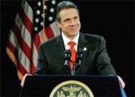
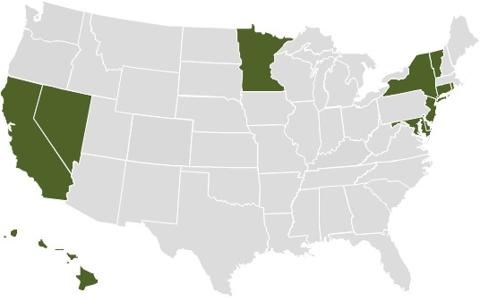
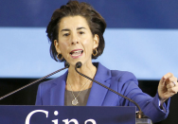

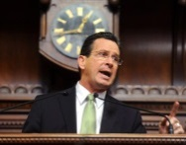
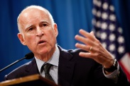
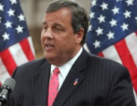

Green Bank Movement
United States Trends
2013
  To lead the green bank movement by accelerating private investment in clean energy deployment for Connecticut to achieve economic prosperity, create jobs, promote energy security and address climate change.
2015
2011
2014
2014
REFERENCES
Map provided by the Coalition for Green Capital
13
26

Slide 14
Connecticut Green Bank
Delivering Results for Connecticut
Investment – mobilized over $1 billion of investment into Connecticut’s clean energy economy so far
Jobs – created 4,710 direct jobs and up to an estimated 12,500 total jobs, translating to an estimated 7.5% to 20% of total job creation in CT over the Green Bank’s first 5 years.*
Energy Burden – reduced the energy burden on over 20,000 households and businesses
Clean Energy – deployed more than 200 MW of clean renewable energy helping to reduce 2.5 million tons of greenhouse gas emissions that cause climate change
REFERENCES
*62,500 private non-farm jobs created in the state over 5 years since Green Bank creation mid-2011. Green Bank statistics are in job-years; “total jobs” include direct, indirect and induced. CT DOL statistics are aggregated from monthly point-in-time estimates. CT Department of Labor - http://www1.ctdol.state.ct.us/lmi/privatesectoremployment.asp
Notes:
Energy Burden
Households paying more than 5% of their income on energy are paying too much – they can save money and reinvest in their family’s future
Businesses paying more than 2% of their operating expenses on energy are paying too much – they can reinvest that money in their employees, business, and community

Slide 15
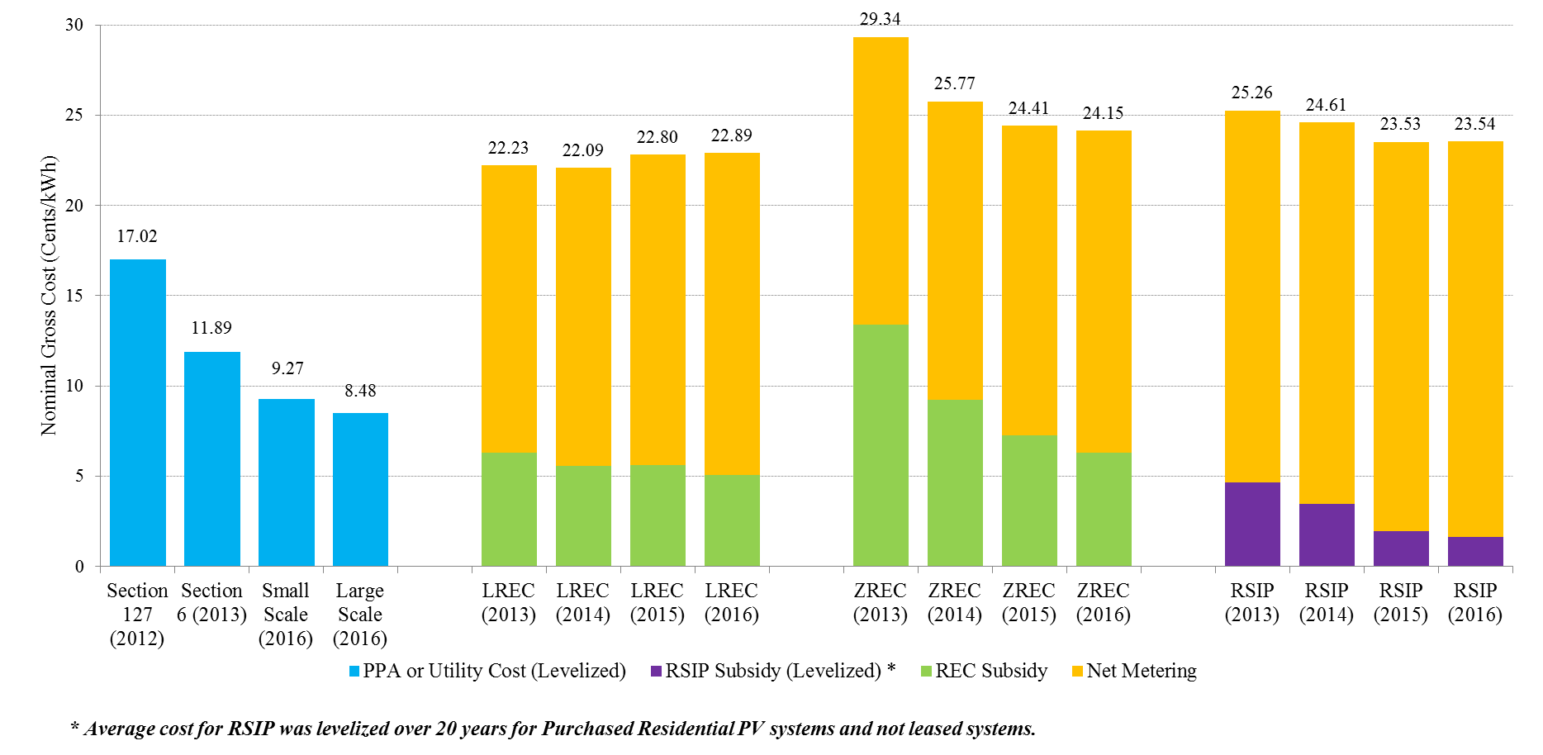
Cost of Clean Energy Programs
Notes:
We need to do more, as cost effectively as possible. This should inform the future of where we go on RE programs.
Cost of solar and wind have declined significantly over the past 5 years
Grid scale projects are less expensive than behind the meter programs
Small grid scale projects are competitive with large scale projects, makes smaller project footprints at low cost.
Trade offs, in terms of meeting climate goals, need lots of rooftop but don’t have issues with siting or concerns about procurements considered “out of market”. Our recommendation is to achieve a balance across these programs.
Utility-Scale Competitive Renewable Energy Procurements
DEEP requires the EDCs to enter into long-term PPAs through a competitive bidding process.
Large Scale Projects = “Energy + REC” and “REC only Projects” (only the projects we decided to take the costs for in the 3 state) → average. UP to 20 years
Section 127 (PA 11-80). 30 MW – 10 for eversource, 10 for UI to do on their own→ built their own projects, 10 MW PPAs we issued. Section 127 = Average 20 Year Cost of Utility Owned Projects
Section 6 = REC + Energy – just one procurement, one project. 20 MW solar (first 13-303)
SMALL SCALE – will speak more about this later, but we selected 25 projects all under 20 MW and 34 MW energy efficiency
LREC ZREC = Competitive reverse auction process (least cost). REC values declining, but look at overall programmatic costs
What’s Measured Here? REC Cost Over 15 Years + Projected Average NM Rate over 15 years. LREC/ZREC – C&I,utility-administered.
Estimated 2,000 projects
500 MW total from the 5 year program
(CAP on LREC/ZREC is dollar amount, not quantity).
LREC – 2 MW or less size req. (larger solar can compete here). ZREC – 1 MW or less. PURA requires certain percentage split between large, medium, small ZREC. Cost of small ZREC is higher, on balance can make ZREC seem more expensive.
RSIP = Connecticut Green Bank’s Residential Solar programs (330 MW)
18,000 solar homes and growing
RSIP Incentive + Projected Average NM Rate over 20 years (total past electric rates – customer charge. Escalated it by percentage increase). GB provides an incentive. Each year a cap for the incentive, GB takes the RECs.
CONCLUSION:

Slide 16
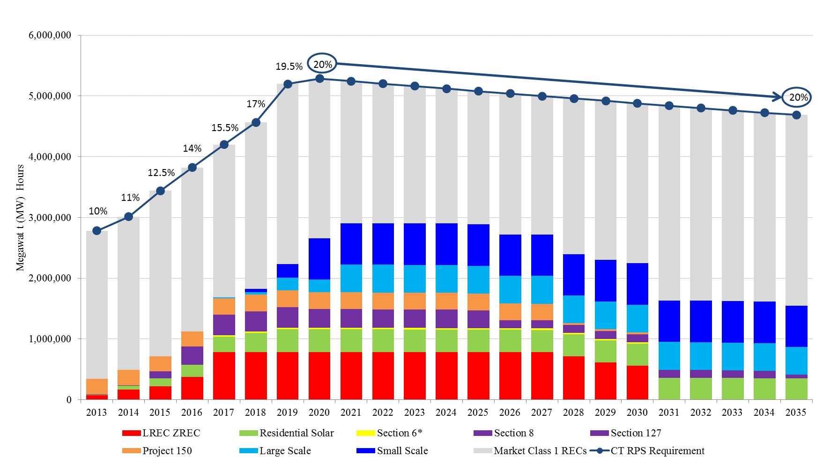
RPS Requirements (Thru 2035)
Notes:
The chart above shows the RECs that we are acquiring from each program. 1 REC = 1 MWH of generation from a Class 1 Resource. GB pre dev and project support (PPAs)
Once the contract expires, future RECs that are produced can no longer be claimed. DEEP assumes that our load will decrease by 0.80% each year.
Section 8 – biomass procurement
Project 150 – precursor, Clean energy fund, statutorily mandated program. 2008 or so, mandate to develop 150 MW worth of projects.

Slide 17
2016 Small Scale RFP
103 proposals for received for some 1,160 MW of clean energy generation
 | Wind (MW) | Hydro (MW) | Solar (MW) | Fuel Cell (MW) | Storage (MW) | AD (MW) | EE (MW)
Total MW | 80 | 2 | 715 | 200 | 120 | 10 | 5
CT | 10 (25) | - | 49 (480) | 12 (200) | 13 (90) | 2 (5) | 2 (5)
MA | 2 (20) | - | 1 (15) | - | - | - | -
ME | 1 (15) | - | 1 (20) | - | 1 (2) | 1 (2) | -
NH | - | - | 2 (40) | - | 1 (25) | - | -
NY | - | - | 2 (40 ) | - | - | - | -
RI | - | - | 2 (20 ) | - | - | - | -
VT | 2 (20) | - | 6 (100) | - | 1 (4) | - | -
Canada | - | 1 (2) | - | - | - | - | -
Notes:
Lots of solar projects again, lots located in Connecticut
We learned that economies of scale is not a large number of MWs (we can get good economies of scale even in the under 20 MW grid connected group).

Slide 18
Project Selections: Small Scale RFP
Project | Megawatts
Total Capacity | 401.99 MW
Energy Efficiency
 | 34 MW
Total Capacity | 367.99 MW
DEEP selected a total of 25 projects (wind, solar and energy efficiency) to move forward with contract negotiations.
Notes:
Negotiations are ongoing, contracts should be filed at PURA in the next few weeks

Slide 19
Shared Clean Energy Pilot
DEEP authorized to implement 6 MW pilot program (4 MW in Eversource; 2 MW in UI)
  Facility selection through a competitive RFP process
Status:
ACTION | TIMELINE
DEEP releases draft RFP | May 20, 2016
Public hearing | June 9, 2016
Written comments due | June 20, 2016
DEEP releases final RFP for bid | July 1, 2016
EDCs submit conforming Tariff to PURA | July 1, 2016
Bidders’ conference | July 21, 2016
Deadline for submitting written questions to DEEP | July 25, 2016
Deadline for DEEP to post responses to questions on DEEP’s website | August 10, 2016
Bid due date | September 1, 2016
DEEP selects winning bidders | Fall 2016
PURA issues a final decision on the Purchase Prices | Fall 2016
Notes:
Not just solar – all class I RE
Statute is as small as 500 kw – 6 MW
Max size of 2 MWs
Objective: learn what type of shared clean energy programs are sustainable for CT, how to structure making sure there are sufficient consumer protections. Subscriber, utility, developer.
Same concept as VNM. VNM is limited to specific consumer types. Set program parameters – purpose is to get renters and low-income customers. We require 40% residential, the rest could be C&I.

Slide 20
CES Informational Meetings
Information Meetings Held:
Demand Resources, October 27, 2016
Renewable Thermal Technologies, November 3, 2016
Grid Modernization, December 6th , 2016
Siting of Renewable Energy, January 10, 2017
Energy Efficiency in State Buildings, February 15, 2017
Shared Clean Energy, February 14,2017
Additional sessions
Electric Vehicles, April 2017
Procurement Process: Review of 13-303, and 15-107, April 2017
Notes:
EV workshop will include leveraging the VW settlement and the role of the utilities in EV deployment,

Slide 21
CES Public Process
March-April 2017-Release draft CES
Technical meeting to answer stakeholder questions
Public hearings to hear stakeholder comments
60 day written comment period
  PURA required to comment on natural gas and electric rates
Submit final CES to Energy & Technology Committee

