Slide 1
Notes:
Formerly ENE/ Environment Northeast

Slide 2
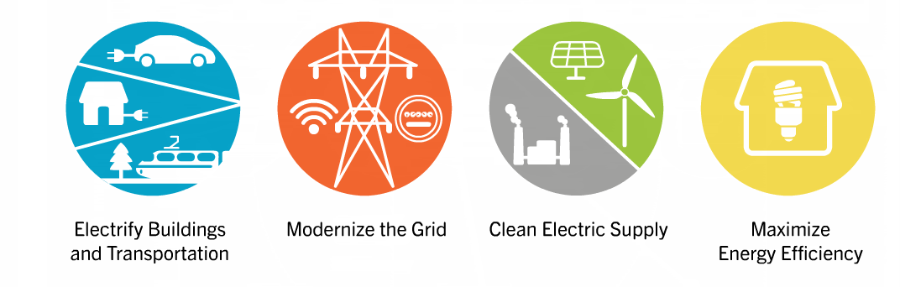
EnergyVision
Low Carbon Power + New Electric Technologies = Pathway to Deep GHG Reductions
Notes:
EnergyVision: Combine trends with existing technologies and rapidly changing markets, and get optimistic pathway to deep GHG emissions based on:
Electrifying buildings and transportation with low carbon electricity
Continue to clean up power supply through distributed and bulk RE
Modernize the Grid
Deep base of EE

Slide 3


Empowering the Modern Energy Consumer
Consumer control
Embrace innovation
Remove barriers to new technologies
Protect consumers
Fair rates
Notes:
Wanted to start with an issue we were concerned was getting glossed over or ignored in favor of more exciting elements of utility and regulatory reform-
That is- the new energy system must maintain and expand the consumer protections that are part of our current system- when we move towards markets, those markets should be well-regulated and provide a fair and safe system to protect consumers. Keep the fundamental consumer safety net in place.
We also want to expand on the traditional definition of consumer interests to include- greater freedom and control over energy costs, ability to adopt new technologies without unncessary barriers or burdens,

Slide 4
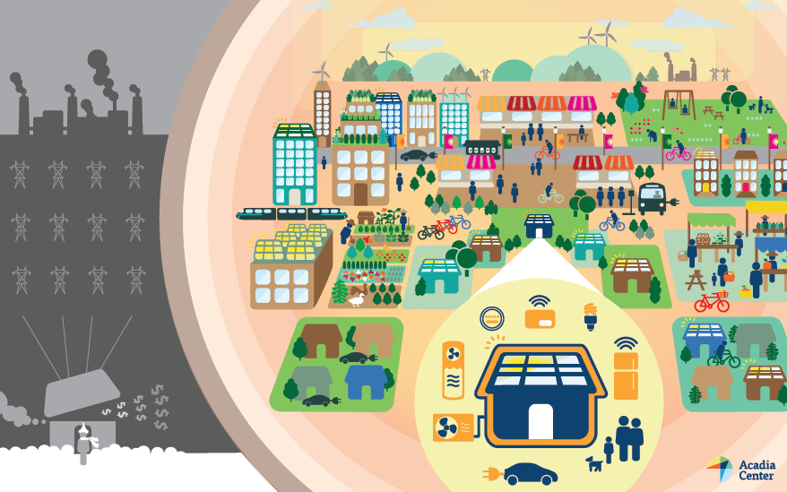
Changing how we think about the energy system:
Consumers/communities in the center
Notes:
Interests of consumers and a sustainable energy system have merged more than ever before
Smart & dynamic electric system should focus on giving consumers and communities greater freedom and control over their energy costs
Technology changes are causing the energy system to become increasingly decentralized.
Consumers deserve to reap the benefits of technology improvements and an efficient, clean and reliable energy system.
Isn’t just about Nests and Teslas-
Reduce the impact of infrastructure through deployment of customer-side energy resources
Electric cars, city buses reduce noise and diesel pollution
- Deep energy efficiency- set reasonable standards for efficency in rental housing

Slide 5
  Are the plans responsive to the DPU Order?
  Do the plans advance an EnergyVision future?
  Do the plans, if implemented, strengthen consumer benefits and allow consumers and communities the ability to choose clean, distributed energy resources?

