Slide 1
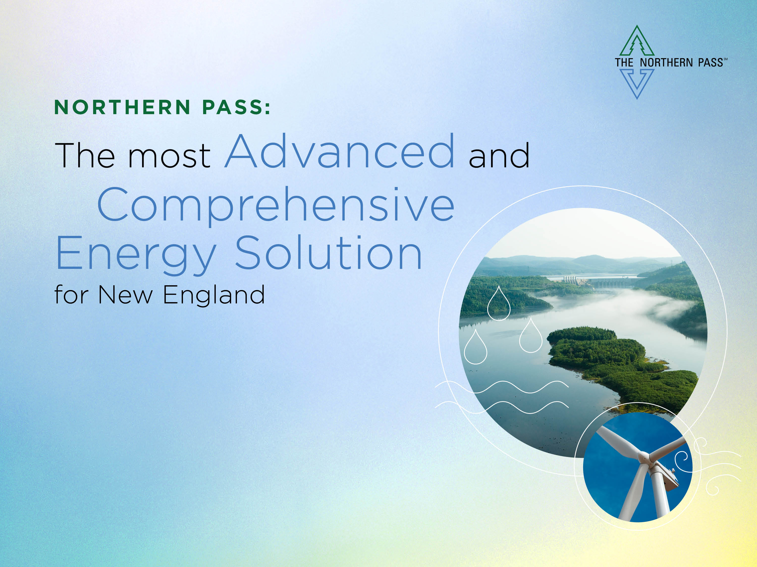
Patrick Smith, Vice President
Transmission Business Development
Eversource
October 6, 2017

Slide 2

Northern Pass Overview
Proposed by Eversource Energy and Hydro-Québec
1,090 megawatts
192 total miles (60 miles underground)
State-of-the-art converter and cable technology
Des Cantons
(Québec)
Franklin (New Hampshire)
Deerfield (New Hampshire)
HVDC line
345-kV AC line
HVDC line terminations
345-kV AC line termination

Slide 3
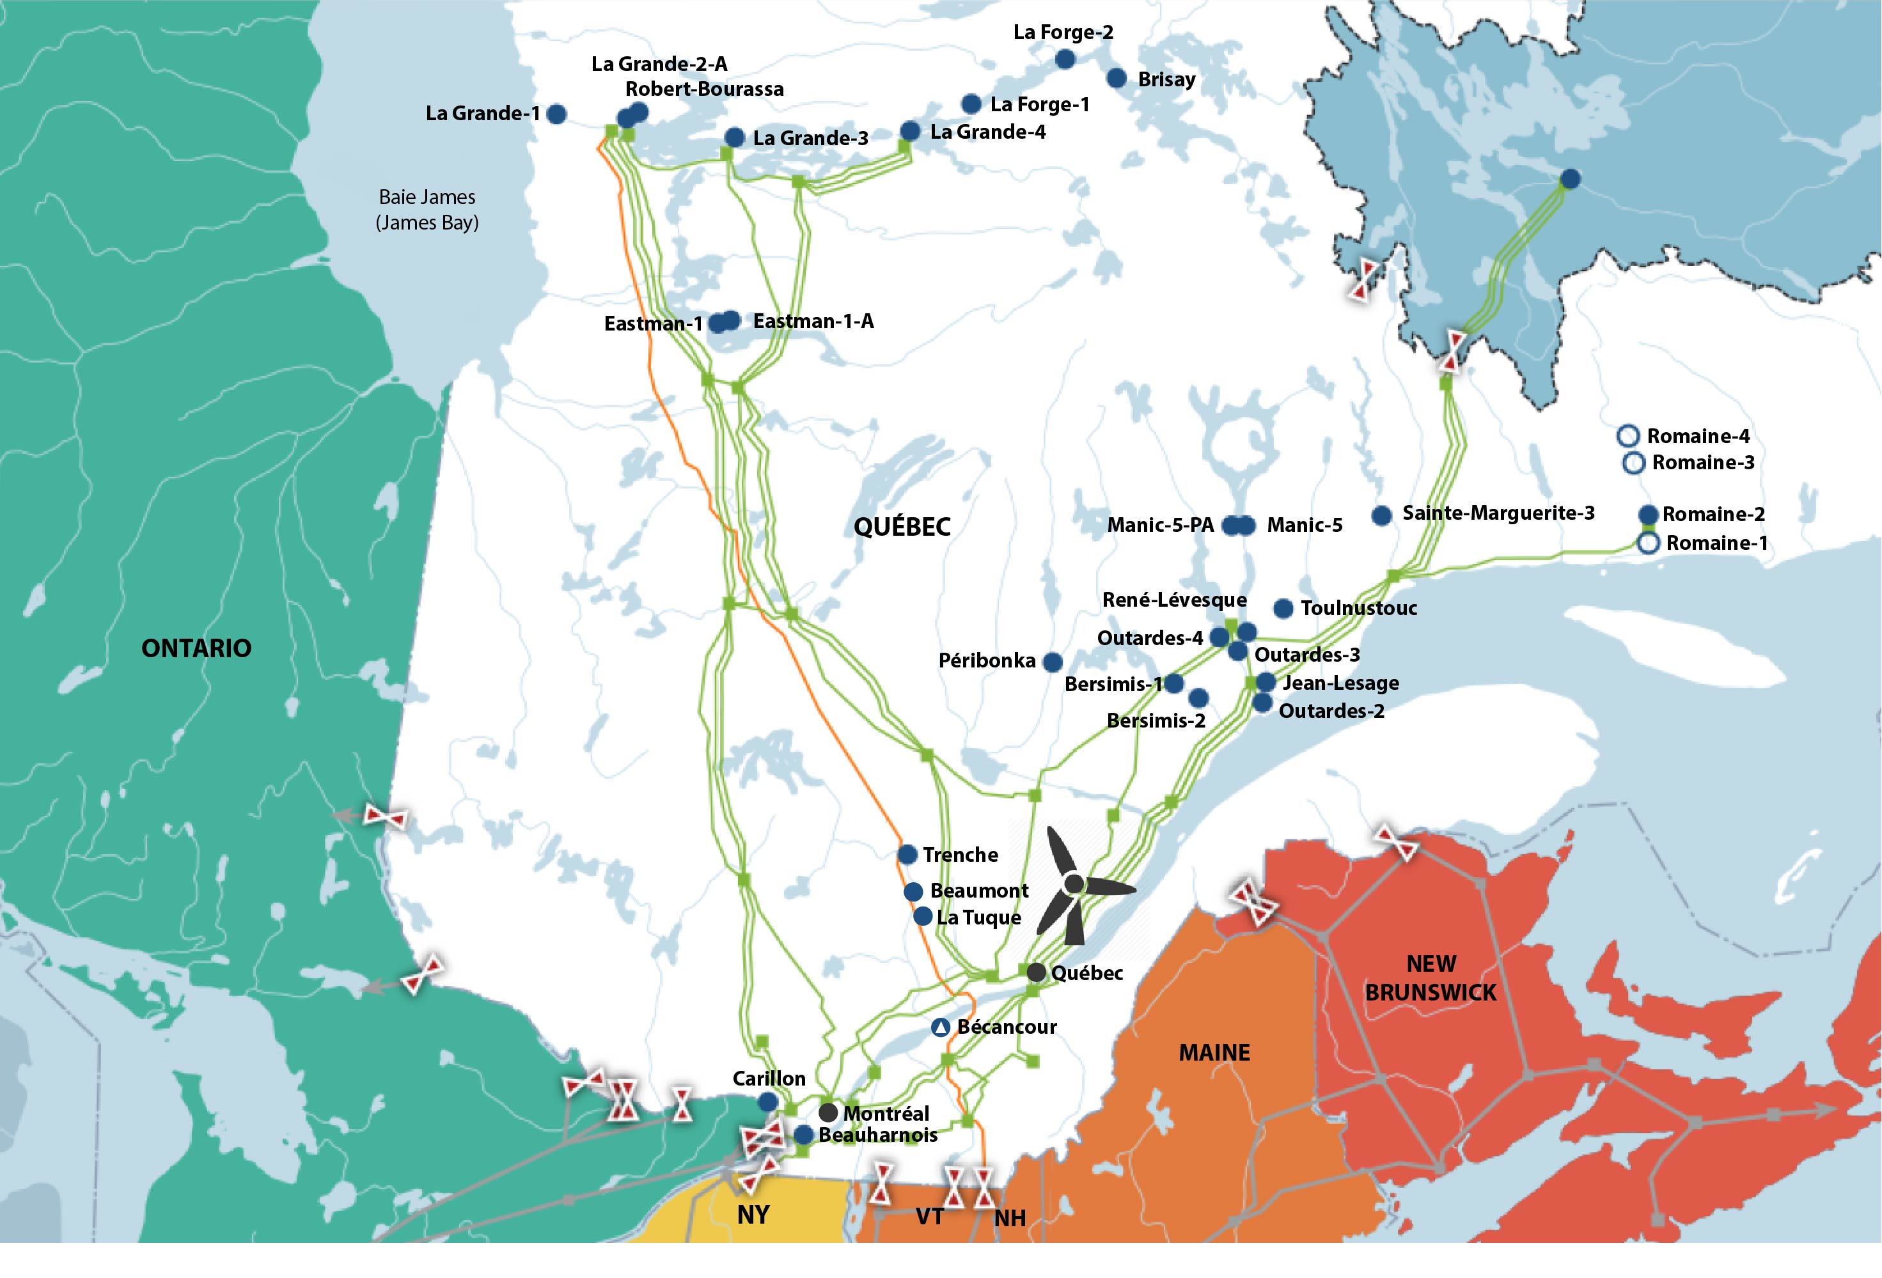
Hydro-Québec’s Clean Energy Proposal
HQ has 62 hydroelectric facilities, and a total installed capacity of over 36,000 MW
Long-standing energy partner to New England
Up to 9.4 TWhs of existing clean energy
All hydro OR on-shore wind with hydro
  Gaz Métro & Boralex
Firm energy at all times, all year round for 20 years
Delivered energy includes verified, generation specific, environmental attributes

Slide 4

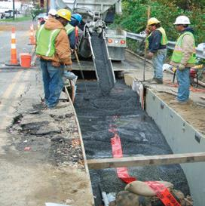



Shovel-Ready; Power to Flow in 2020
Fully executed contracts with all major equipment suppliers and contractors
Signed Project Labor Agreement with IBEW Locals 104 and 490
Construction on track to start in spring 2018
  All U.S. Federal and Canadian permits by year-end
  All NH approvals by early 2018
  ISO-NE System approvals secured
Strong support in NH

Slide 5
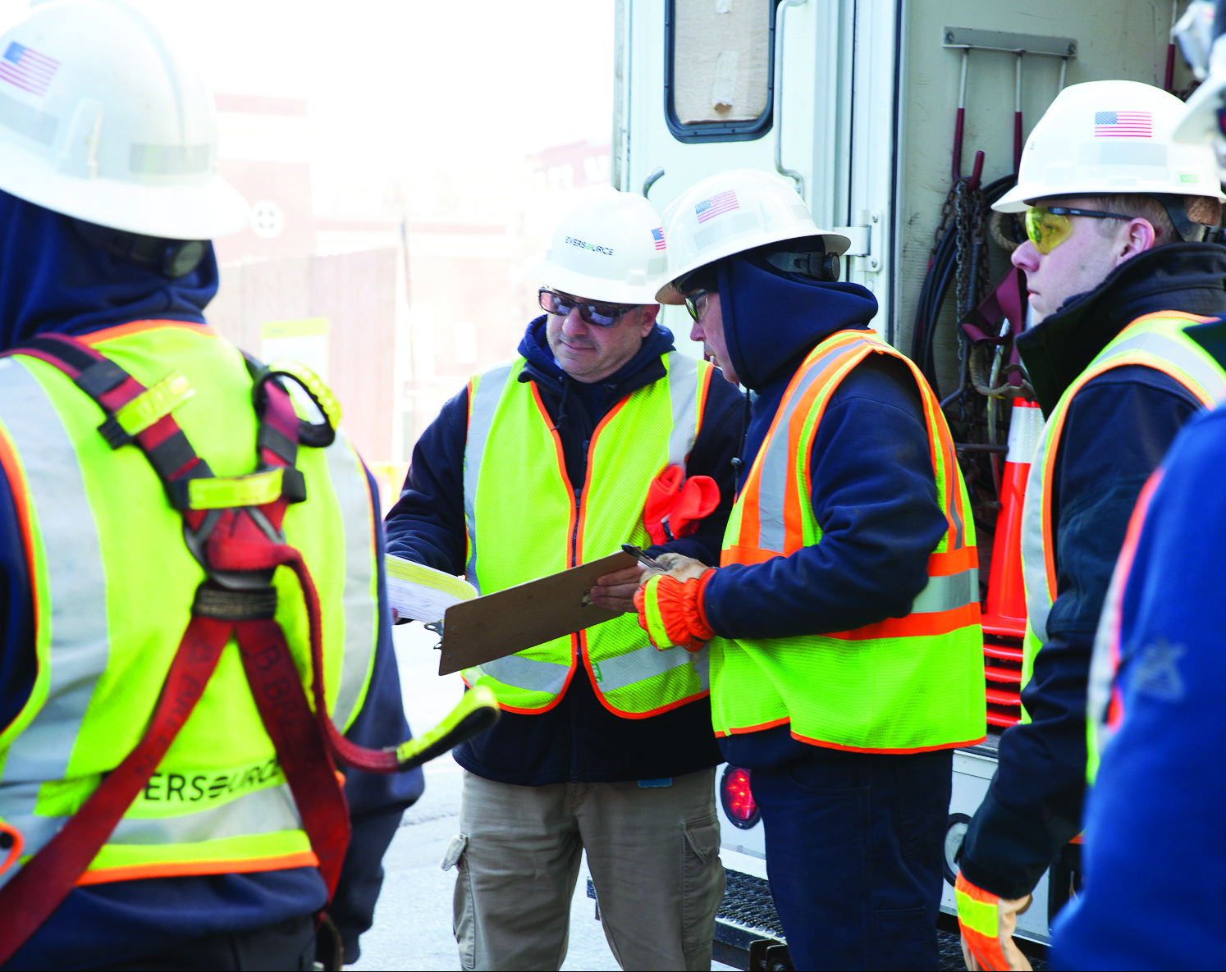
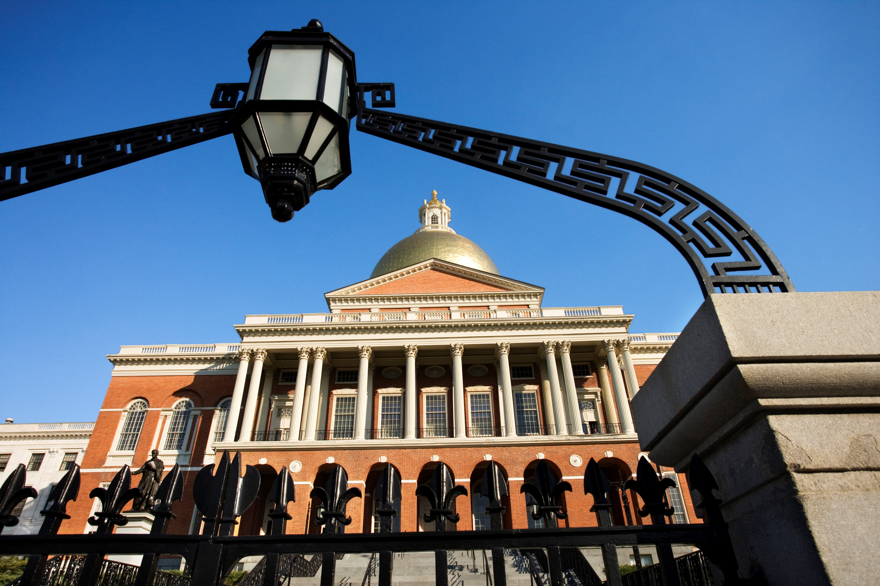

Robust Economic and Environmental Benefits
Jobs & Economic Benefits
Clean Energy
Reduced Energy Costs
Thousands of jobs during construction
Project Labor Agreement provides priority to New Hampshire & Massachusetts workers
Reduced carbon emissions in excess of 3 million tonnes a year
Up to 9.4 TWhs of new clean energy starting in 2020 - significant impact on achieving MA Global Warming Solutions Act goals
Lower wholesale market costs in New England
$10 million committed over 20 years to support MA low-income energy programs & services
5

Slide 6
Northern Pass: The most Advanced and Comprehensive Energy Solution for Massachusetts
Proven project partners
New, clean power supply –
will lower costs and improve reliability
Shovel-ready; power to flow in 2020
Helps achieve Global Warming Solutions Act goals ahead of others
Substantial economic benefits for Massachusetts and the region

