Slide 1
Footprint Power
®
New Salem Harbor Station
Overview
March 2015
Notes:
1

Slide 2
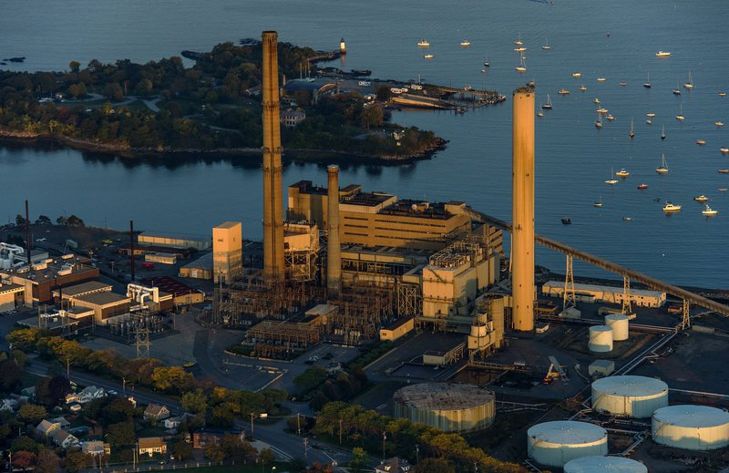
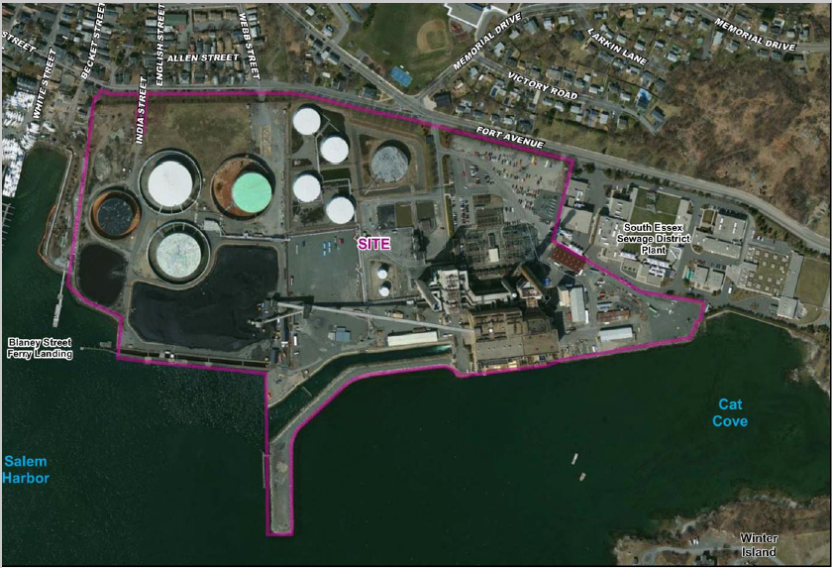
Salem Harbor Station – Old vs. New
 | Old | New
MW | 748 | 674
Land Area | 65 Acres | 23 Acres
Fuel | Coal/No. 6 Oil | Natural Gas
Start Up Time | 12-16 Hours | 10 Minutes

Slide 3

Footprint Power
Footprint Power was formed in October 2009 to provide solutions to problems of older, smaller coal- and oil-fired generation facilities through planned demolition, remediation and new development.
Principals each have over 18 years of experience in independent power sector.

Slide 4

Highstar Capital
Operationally focused, value-added investment management services
$7 billion managed for funds and co-investors
Invests in energy, environmental services and transportation infrastructure
Recently joined Oaktree Capital Management, L.P., a global investment management firm with more than $90 billion in diversified assets under its management

Slide 5
Salem Harbor Project Details
Existing Salem Harbor Station shut down May 31, 2014 and will be demolished with entire 65-acre site brought into environmental compliance with MCP
Only those structures being reused will remain, leaving approximately 40 acres available for future development
2-1x1 GE 7FA.05 Quick-Start CCGTs with Air-Cooled Condensers located on 23-acre portion of site
674 MW Cleared into ISO-NE Forward Capacity Auction to satisfy reliability need in NEMA/Boston – 692MW total with duct firing
Unit combines best-in-class efficiency of 58.5% and extreme operating flexibility – in normal start-up, full unit output in 60 minutes (with significant output in 10 minutes in quick-start mode) resulting in significant regional air quality benefits

Slide 6

Project Progress
Financing Completed
  Project reached Financial Close on January 9, 2015
    $730 Million Credit Facility w/10 Banks lead by MUFG Union Bank, BNP Paribas and GE Capital
    Highstar Capital subscribed to 87.5% of project equity
    Toyota Tsusho subscribed for the remaining 12.5%
Permitting Completed
  All permits final and non-appealable
  FERC granted one year deferral of capacity supply obligation from 2016 to 2017

Slide 7
Development Timeline
Interconnection Request Submitted
Begin Preparation of Permit Applications
Footprint Acquires Salem Harbor from Dominion
FCA 6 Conducted
6/30/2012
Cumulative Development Costs $400,000
1/12/2012
1/25/2012
4/2/2012
8/3/2012
Jan
Feb
Mar
Apr
May
Jun
Jul
Aug
2012
1/13/2012
Cumulative Development Costs $200,000
6/26/2012
7/25/2012
8/3/2012
FCA 7 Show of Interest Submitted
Agreement to Acquire Salem Harbor Executed
FERC Approves Salem Harbor Acquisition
MEPA ENF Filed and EFSB Petition to Construct Filed
Cumulative Development Costs $3.3 M
3/31/2012
Salem Planning Board Application Filed
12/31/2012
Chapter 91 Variance Application Filed
FCA 7 Conducted
Salem Con Comm Notice Filed
6/30/2013
Cumulative Development Costs $10.5 M
2/5/2013
4/8/2013
5/17/2013
6/13/2013
Oct
Nov
Dec
Jan
2013
Feb
Mar
Apr
May
Jun
2013
Cumulative Development Costs $1.7 M
Cumulative Development Costs $8.5M
12/21/2012
5/17/2013
5/29/2013
6/28/2013
Comprehensive Air Plan & PSD Permit Application Filed
3/31/2013
MEPA Certificate Issued
Salem ZBA
Variance Application Filed
Salem ZBA Approval Granted
09/30/2012

Slide 8
3/30/2014
Cumulative Development Costs $13.3 M
Cumulative Development Costs $25.8 M
9/30/2013
Salem ConComm Approval Granted
EFSB Certificate Petition Filed
EFSB Certificate Application Filed
CPA and PSD Permits Issued
EFSB Certificate Granted
PSD Permit Appealed to EAB
Planning Board and ZBA Appeals Dismissed
Chapter 91 Variance Granted
7/31/2013
8/5/2013
10/11/2013
11/1/2013
1/30/2014
2/20/2014
3/3/2014
3/27/2014
Jul
Aug
Sep
Oct
Nov
Dec
Jan
2014
Feb
Mar
2014
2/18/2014
7/17/2013
8/1/2013
8/20/2013
10/10/2013
10/30/2013
11/22/2013
Settlement with CLF
2/20/2014
3/17/2014
Salem ZBA Approval Appealed
Salem Planning Board Approval Granted
Salem Planning Board Approval Appealed
EFSB Approval of Permit to Construct
CLF Appeals EFSB Permit to SJC
Chapter 91 Approval Appealed
Comprehensive Air Plan Approval Appealed
Deadline Passes for Appeal of EFSB Certificate -- All State & Local Permits Final
12/31/2013
Cumulative Development Costs $22.3 M
Mass DEP ALJ Recommends Dismissal of State Air Appeal
Mass DEP Commissioner Dismisses of Chapter 91 and State Air Appeals
NEPOOL Participants Committee Consideration of ISO-NE Proposed Rule
Mass DEP Files Reponse to EAB Appeal
Footprint Files Motion to Dismiss State Air Appeal as Moot
EAB Status Conference
4/1/2014
4/8/2014
4/22/2014
5/16/2014
6/2/2014
6/26/2014
Apr
May
Jun
2014
Existing Salem Harbor Station Shuts Down
Cumulative Development Costs $29.0M
4/7/2014
4/10/2014
5/15/2014
5/31/2014
Footprint Files Response to EAB Appeal
Footprint Files Motion to Dismiss Chapter 91 Appeal as Moot
Mass DEP ALJ Recommends Dismissal of Chapter 91 Appeal
6/30/2014

Slide 9
1/9/2015
Cumulative Development Costs $72 M
EAB Directs EPA to File Supplemental Brief
FERC Approves ISO-NE Deferral Rule
Appeal of EAB Decision Filed
ISO-NE Issues Reliability Determination
CBA & Tax Agreements Signed
7/14/2014
8/18/2014
9/12/2014
11/26/2014
12/16/2014
2014
Jul
Aug
Sep
Oct
Nov
Dec
Jan 2015
2015
7/8/2014
7/16/2014
9/2/2014
10/7/2014
12/5/2014
1/9/2015
Footprint Seeks ISO-NE Reliability Determination for Deferral
ISO-NE Files New Deferral Rule With FERC
EAB Denies Petition to Review PSD Permit
Footprint Files to Defer CSO
FERC Approves Footprint Deferral
Project Reaches Financial Close with Equity and Debt

Slide 10
Significant Reduction in Regional Emissions
10 year average avoided emissions: NOx – 10% SOx – 8% Hg – 6%

Slide 11
Significant Avoided Regional CO₂ Emissions

Slide 12
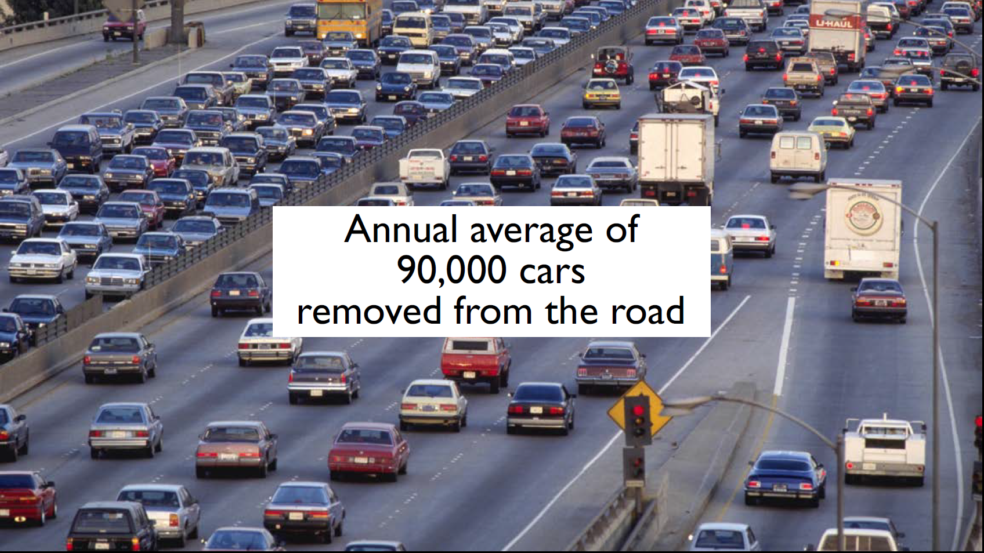
Significant Avoided Regional CO₂ Emissions

Slide 13
SHS GHG Emissions vs. GWSA Curve

Slide 14
CLF Settlement – Key Terms
  Annual CO2e emissions limits that start at the currently permitted level (2.3m CO₂e tons per year) and, beginning in 2026, decline annually (straight line) to 529k CO₂e tpy by 2050
  To the extent that the CO₂e emissions from SHS exceed the relevant annual limit, the excess emissions may be offset by:
      Utilizing excess emissions from a previous year credited at the following levels: 90% for offsets created from 2016-2021, 80% for offsets created from 2022-2026, 70% for offsets created from 2027-2031, 60% for offsets created from 2032-2036, 50% for offsets created from 2037-2046 and no credits for offsets created thereafter
      Offsets created by purchasing RGGI allowances at a rate of the actual price paid for such allowances divided by $30 (escalated at CPI)
      Offsets purchased on the market that verifiably reduce GHG emissions in Massachusetts or in connection with electricity supplied to Massachusetts customers

Slide 15
CLF Settlement – Key Terms
  If regulations are passed under the GWSA (or equivalent Federal legislation is enacted), such regulations would supersede the above modified CO₂e emissions limits
  The facility shall cease commercial operations by December 31, 2049
  After five years, the facility can reopen the settlement agreement in order to align with subsequently permitted facilities in Massachusetts so that the facility is not disadvantaged through this settlement

Slide 16
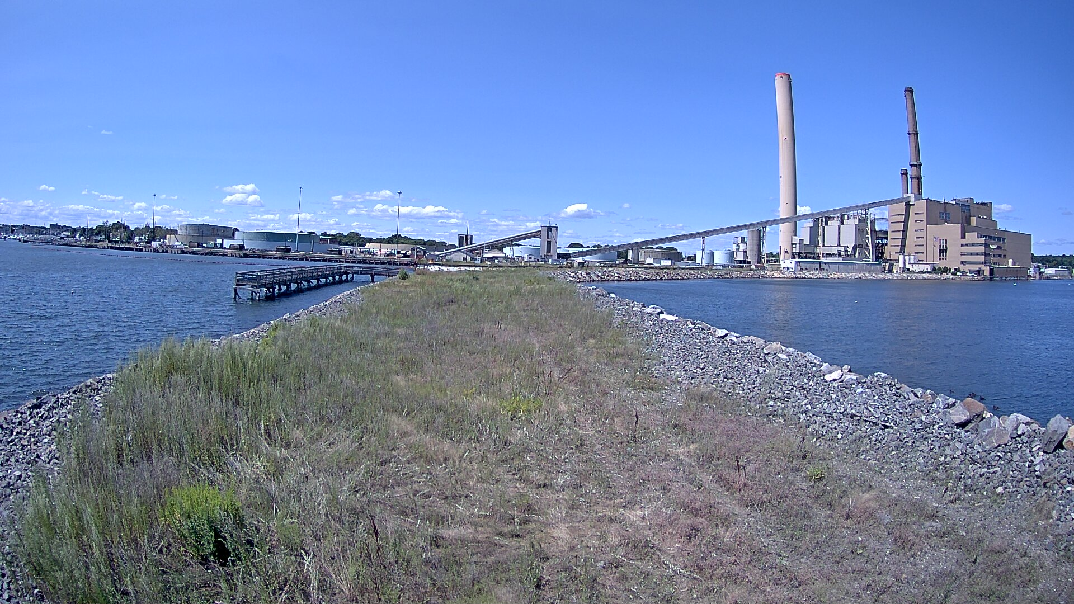
August 14, 2014

Slide 17
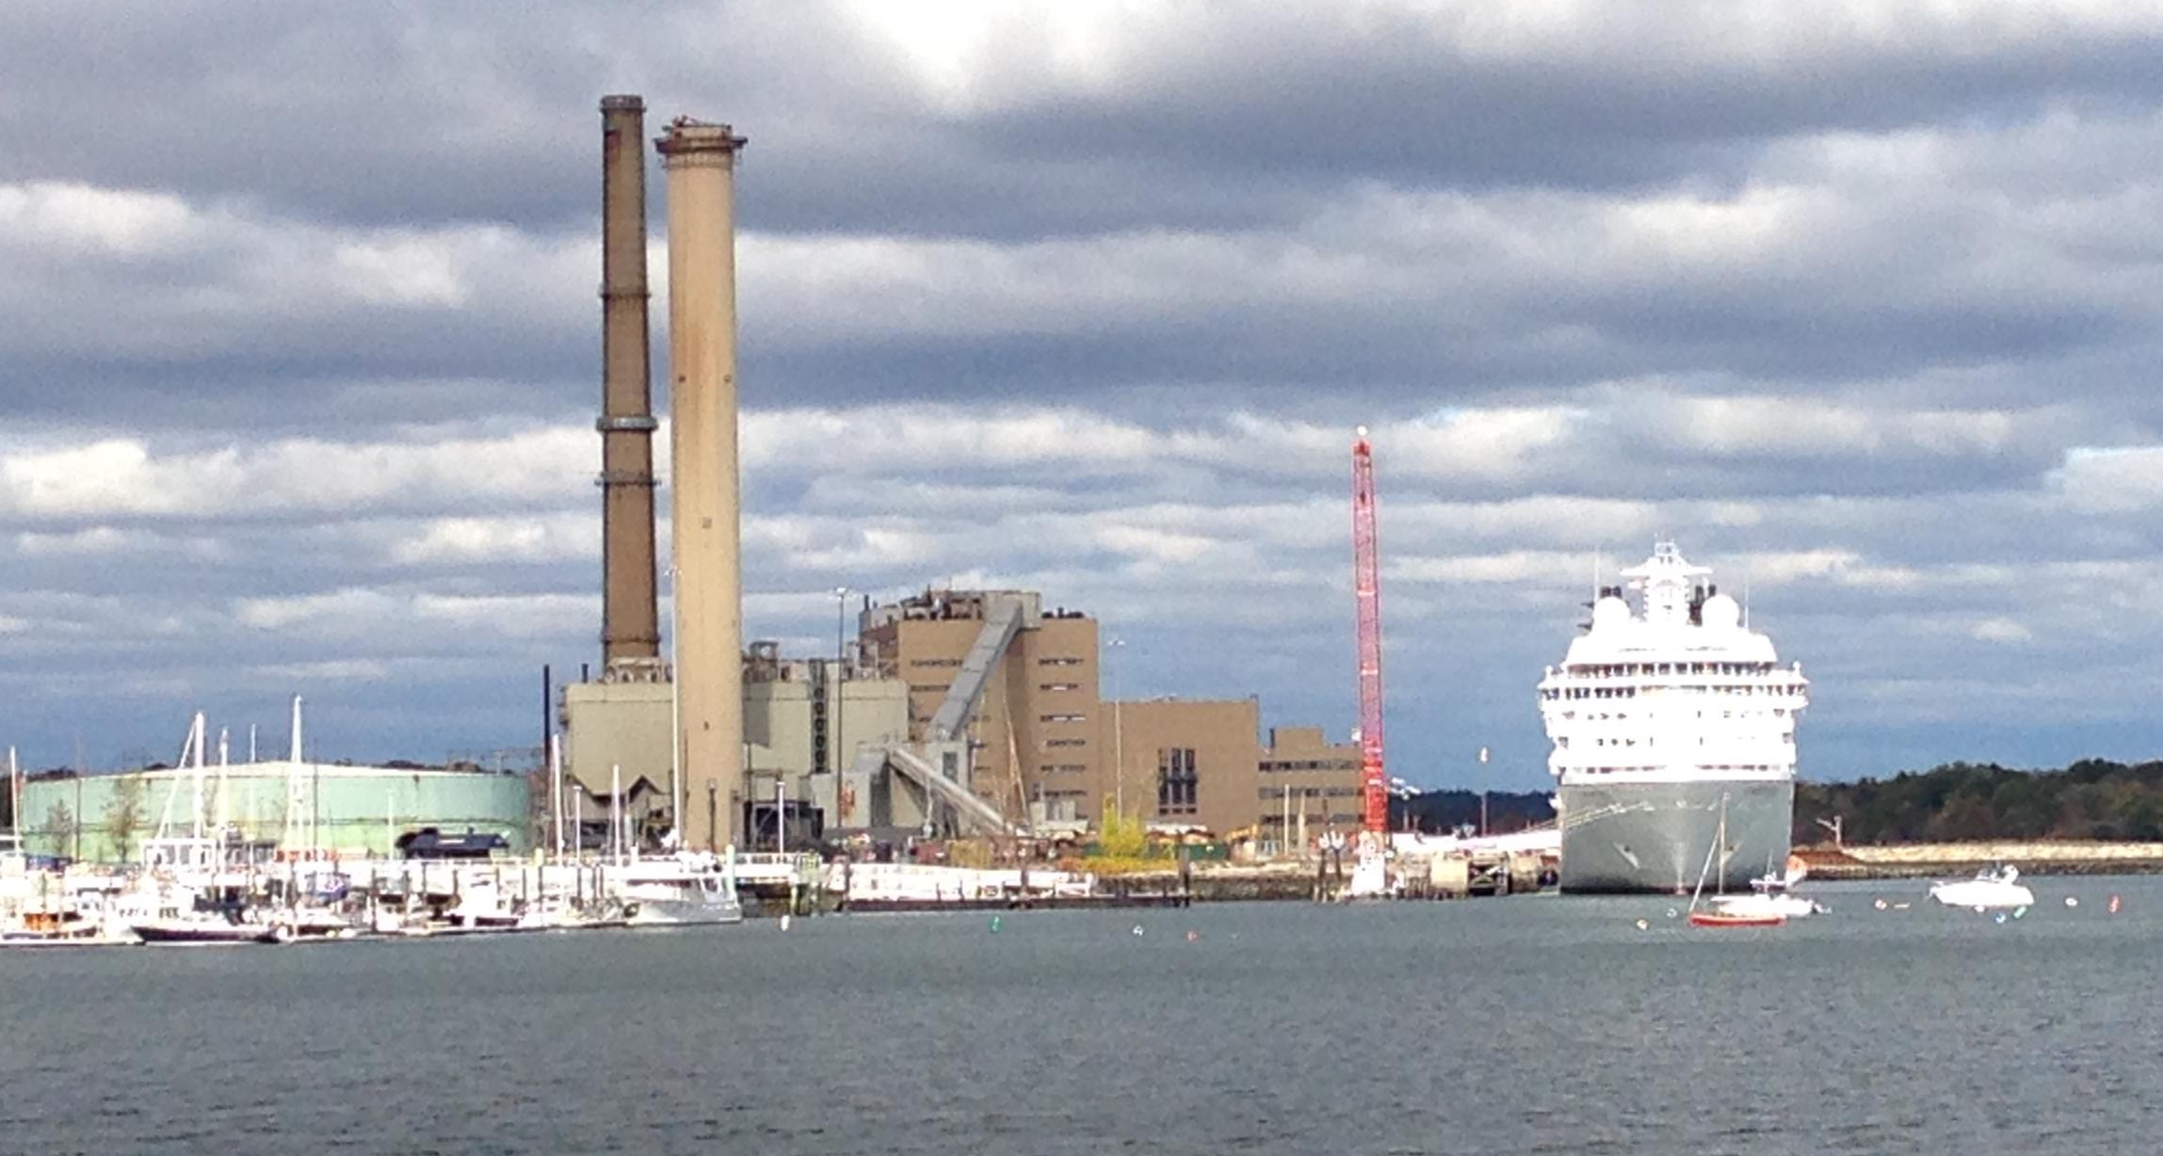
First Cruise Ship – October 19, 2014

Slide 18
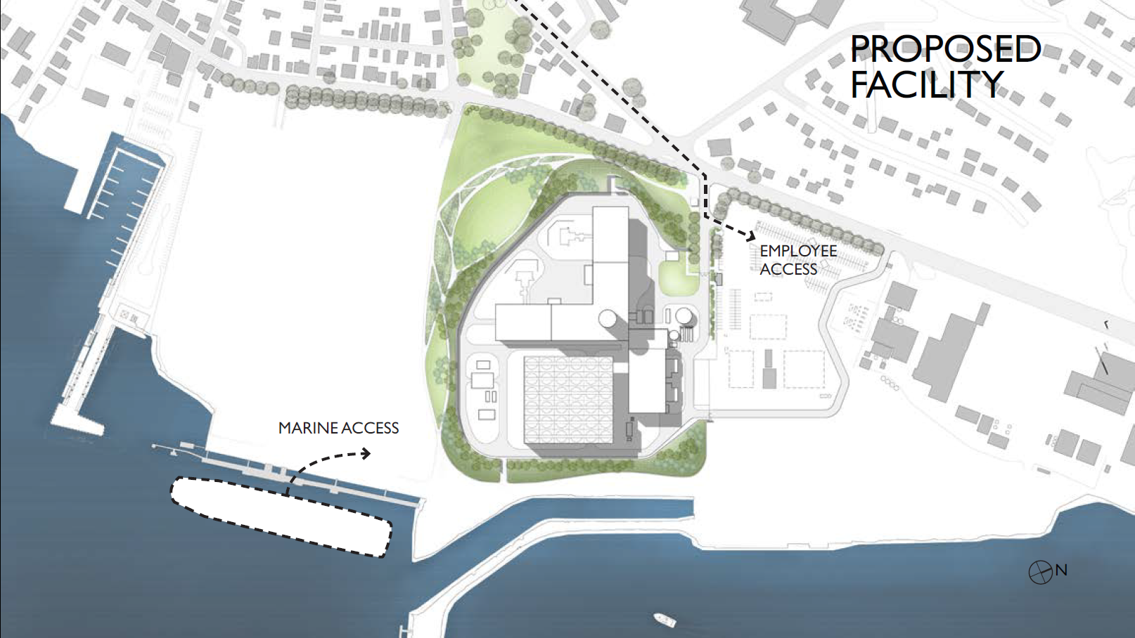
Salem Harbor -- Site Plan

Slide 19
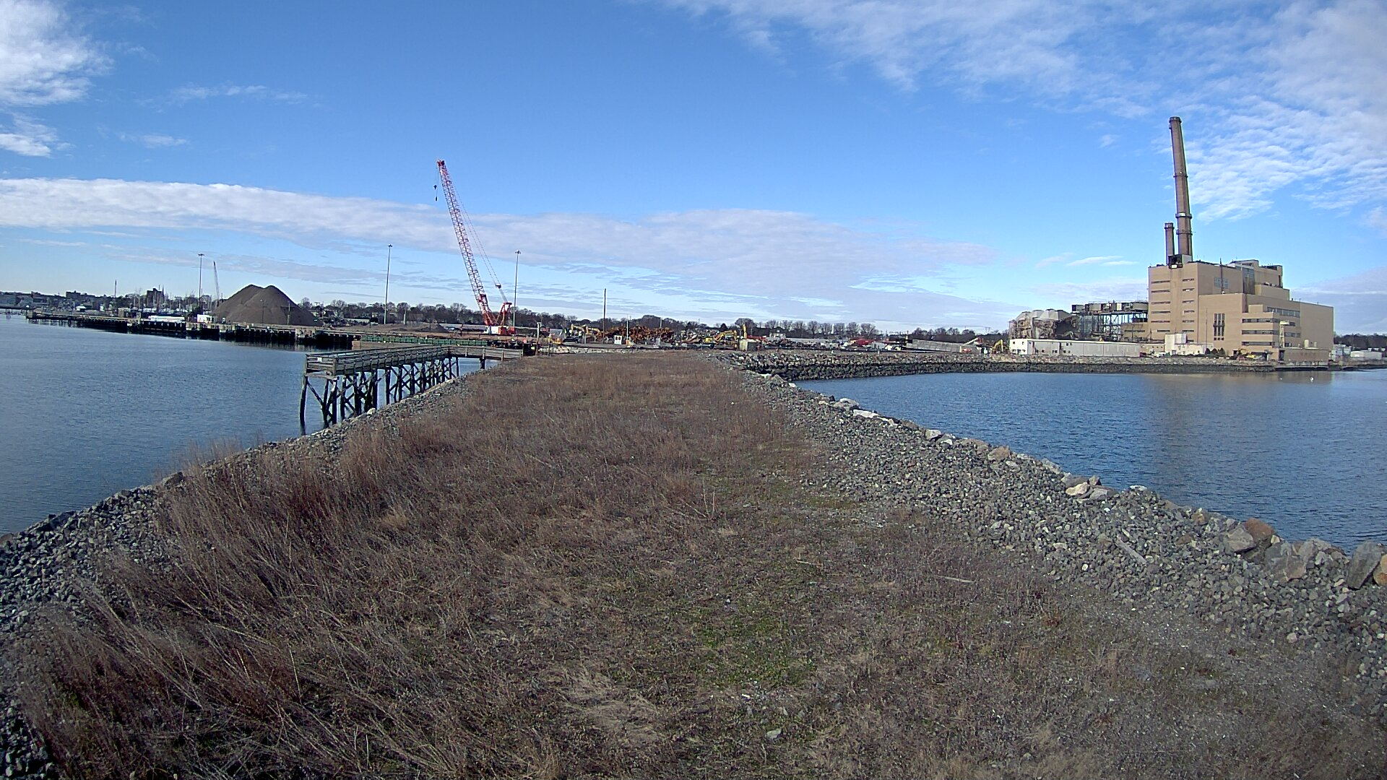
December 14, 2014

Slide 20
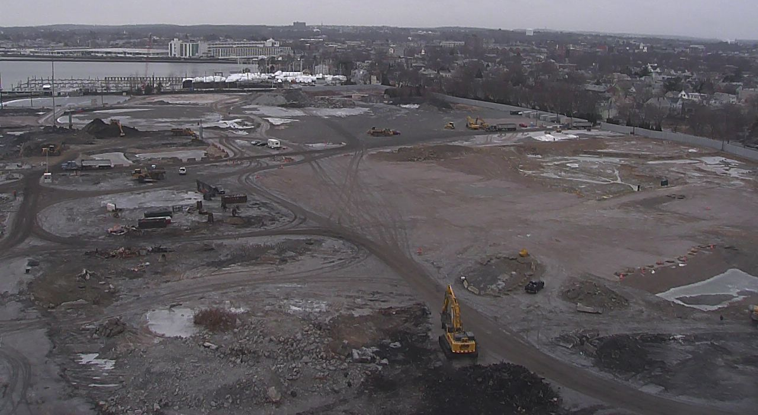
New Plant Site
January 15

Slide 21
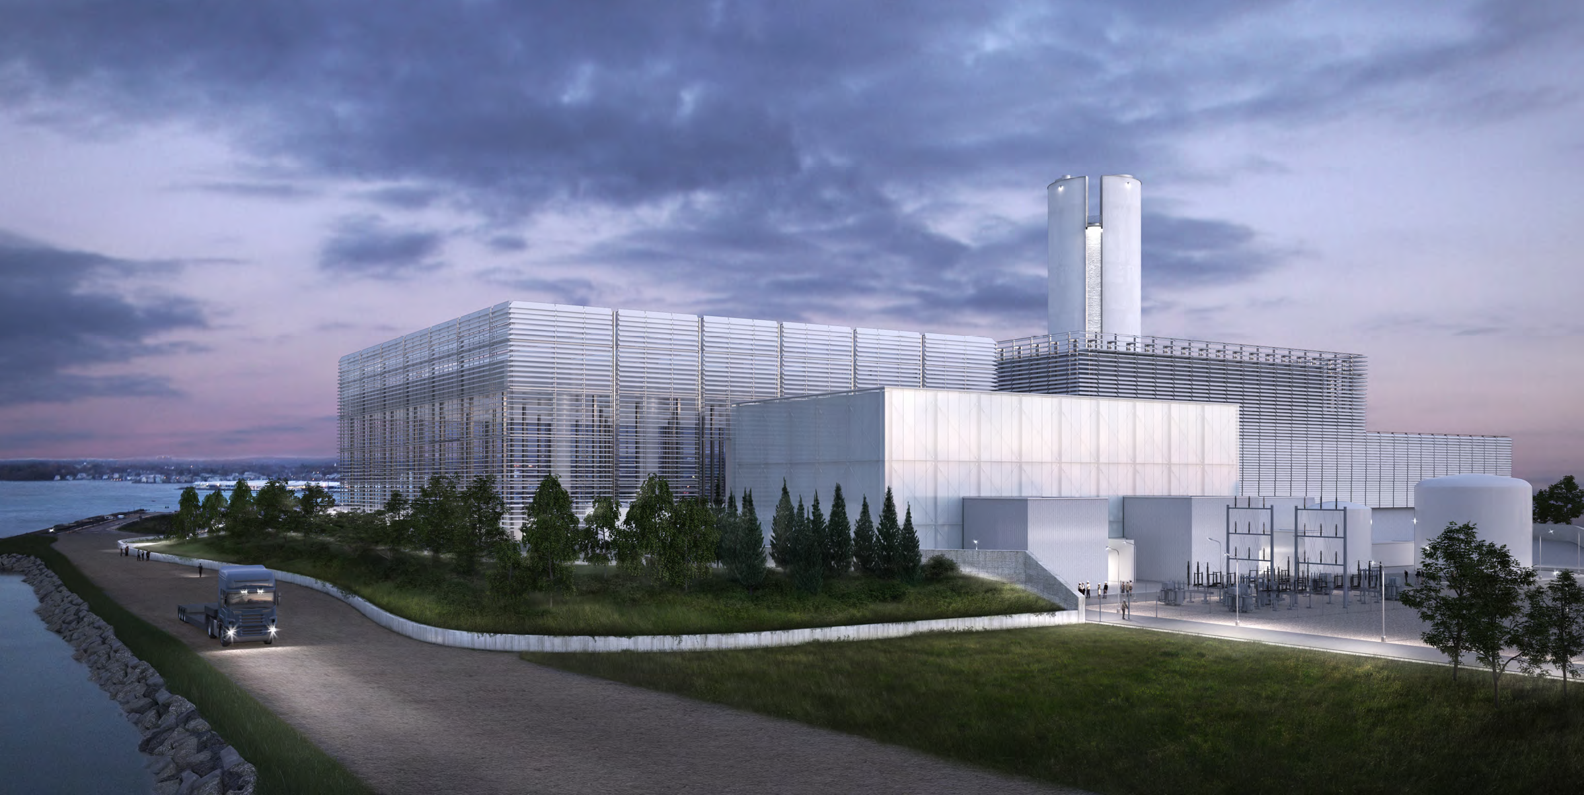
Salem Harbor – Harbor View

