Slide 1
Sustainable Rate Design for a Modern Grid
New England Electricity Roundtable
Presented by Richard Sedano
June 19, 2015

Slide 2
Introducing RAP and Rich
RAP is a non-profit organization providing technical and educational assistance to government officials on energy and environmental issues. RAP staff have extensive utility regulatory experience. RAP technical assistance to states is supported by US DOE, US EPA and foundations.
Richard Sedano directs RAP’s US Program. He was commissioner of the Vermont Department of Public Service from 1991-2001 and is an engineer.
Notes:
Mention Rich and Rick at NECPUC
And Dlittell joining RAP
I have been on the New England scene for 30 years

Slide 3
Principles for Modern Rate Design
Universal Service: A customer should be able to connect to the grid for no more than the cost of connecting to the grid.
Time-Varying: Customers should pay for grid services and power supply in proportion to how much they use and when they use it.
Fair Compensation: Customers supplying power to the grid should be compensated fairly for the value of the power they supply.

Slide 4
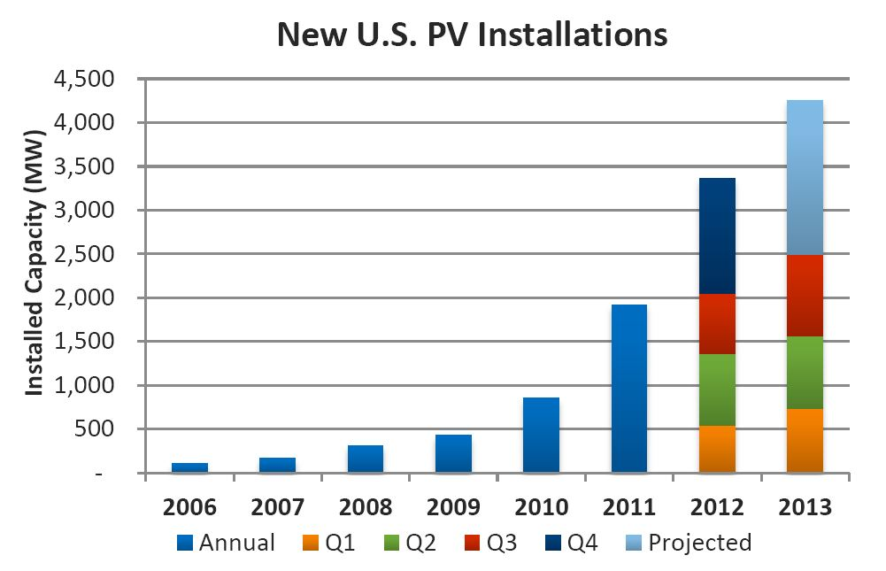
Distributed Generation is Growing
+ 30% per year
Since 2001
Cumulative: 11+ GW

Slide 5
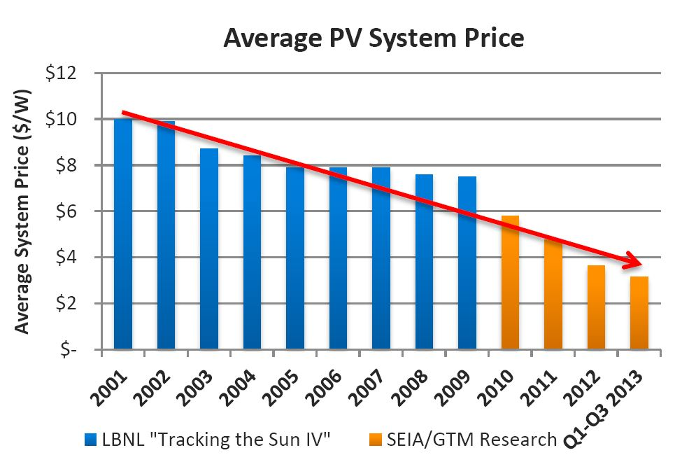
Costs Continue to Decline

Slide 6
Why Reassess? Why Change? Why Now? A Decentralized Grid Rising
On site generation
Prices to deploy are trending down
Electricity users value choice
To secure prices
To assure zero emissions, to do their part
To be cool
To cooperate with neighbors
Automation (comms, smart systems, stds) keeps it simple while chasing value

Slide 7
Consumer Perspective
Rates are Prices
Prices represent a message to consumers
Utility Prices signal system value
Consumers have new choices,
respond to value

Slide 8
Grid Value from DG – Differentiate by
Time
Peaks and managing predictable solar, CHP patterns
Location
High marginal cost places
Attribute
Unbundled energy, capacity, ancillary

Slide 9
Rate Design Options for a Modern Grid from forthcoming RAP paper
Time of Use (with critical peak)
Demand charge
Net metering
Minimum bills
High Customer Charges
Cost driven Customer Charge, DG & large houses
Subscription demand charges
Bidirectional rates
Value of solar
Fees imposed on DG users
Feed-in-tariffs
Notes:
Explain about the paper – these are topics the paper will cover
Now – value of TOU w critical peak

Slide 10
A Fixed TOU Rate in Use
On-Peak
Summer: weekdays 10 a.m. - 8 p.m.
Winter: weekdays 7 a.m. - 11 a.m. and 5 p.m. - 9 p.m.
Intermediate-Peak
Summer: weekdays 7 a.m. - 10 a.m. and 8 p.m. - 11 p.m.
Winter: weekdays 11 a.m. - 5 p.m.
Off-Peak
Summer: weekdays 11 p.m. - 7 a.m.
Winter: weekdays 9 p.m. - 7 a.m., Saturday, Sunday, holidays
Notes:
Note
This is a real rate
There is some attempt to reflect value by time of day, day of week and season

Slide 11
Sample Time of Use with Critical Peak:
Notes:
And you can add a critical peak element in the form of high cost kwhs

Slide 12
A Peak Time Rebate in Use
Delaware Delmarva Power and Light (DPL) has a critical peak rebate program for residential customers.
Customers receive a $1.25 credit for every kWh they reduce their usage below a baseline during an event.
Customers get this credit automatically; they do not have to enroll in the program.
DP&L: http://www.delmarva.com/Peak-Energy-Savings-Credit.aspx
Notes:
Or by creating a peak time rebate
Though technology, AMI, is really important in order to get the baseline from which to measure the deflected use, the response
Homily on value driven rate design

Slide 13
Rate Design Options
Time of Use (with critical peak)
Demand charge
Net metering
Minimum bills
High Customer Charges
Cost driven Customer Charge, DG & large houses
Subscription demand charges
Bidirectional rates
Value of solar
Fees imposed on DG users
Feed-in-tariffs

Slide 14
Demand Charge
Addresses system peak costs if it is a coincident peak
To motivate member response, use a short ratchet period (daily is best, monthly is better than annual
A daily demand charge and a well designed TOU rate with a critical peak converges in effect, latter may be easier to understand, manage

Slide 15
Lots of Diversity at the Transformer 26-Unit Apartment Complex, L.A. Area

Slide 16
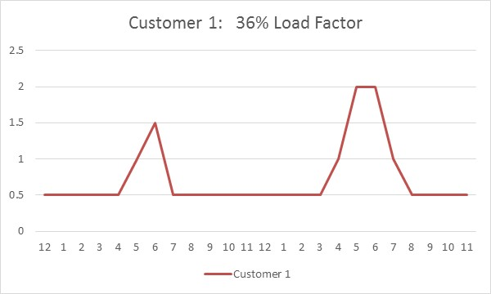
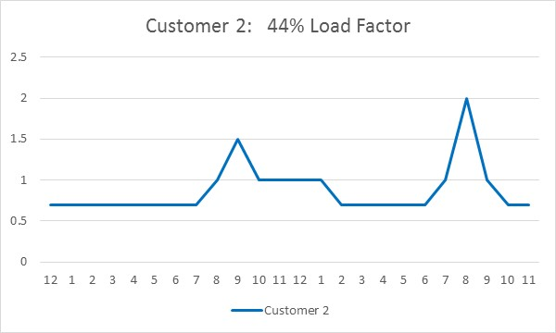
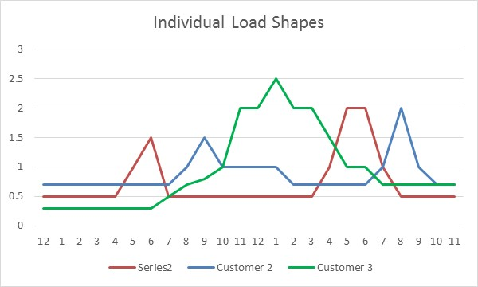
Individual Load Shapes Vary

Slide 17
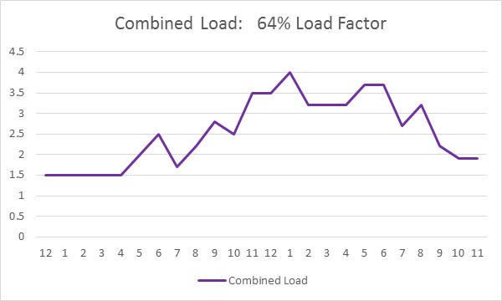
All the Utility Sees Is The Combined Load of Multiple Customers With Different Shapes

Slide 18
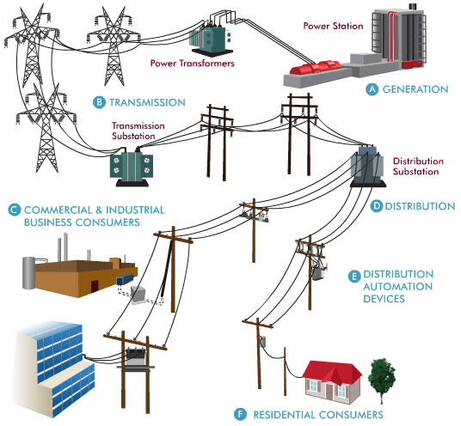
Which Parts of the System Are Designed Based on NCP Demand?
Only the line transformer and service drop must handle the customer Non Coincident Peak

Slide 19
Rate Design Options
Time of Use (with critical peak)
Demand charge
Net metering
Minimum bills
High Customer Charges
Cost driven Customer Charge, DG & large houses
Subscription demand charges
Bidirectional rates
Value of solar
Fees imposed on DG users
Feed-in-tariffs

Slide 20
Nearly Every State Authorizing Net Metering
Solar service industry growing
Making use of declining material cost
Making use of favorable federal fiscal policy
Some states supplement the deal
“Soft costs” declining slowly
Lease business model removes first cost barrier
Notes:
Net metering has been successful
Added to federal tax credit
Simple
Allows businesses to match willing customers with technology
Businesses improve their methods
Government sharpens its processes
Financing methods develop

Slide 21
Net metering growth
Notes:
Growth has continued

Slide 22
Maturing Solar: Changes Ahead for Net Metering?
Compensation method suited for infant industry
Emphasis of Simple compensation and interconnection
Rough compensation “close enough” at smaller numbers
When higher numbers create a financial effect on the utility, a more rigorous compensation method can be considered
Notes:
For all the positives about net metering,
Important to talk about its limitations
Value is important in rate design and can be better represented in DG compensation
When its numbers get large enough to make a difference – a matter for evidence
No need to do this preemptively as that can stifle growth in a state,
so states at less than 1% penetration in residential markets are far away from this

Slide 23
Rate Design Options
Time of Use (with critical peak)
Demand charge
Net metering
Minimum bills
High Customer Charges
Cost driven Customer Charge, DG & large houses
Subscription demand charges
Bidirectional rates
Value of solar
Fees imposed on DG users
Feed-in-tariffs

Slide 24
Rate Design Options
Time of Use (with critical peak)
Demand charge
Net metering
Minimum bills
High Customer Charges
Cost driven Customer Charge, DG & large houses
Subscription demand charges
Bidirectional rates
Value of solar
Fees imposed on DG users
Feed-in-tariffs

Slide 25
Revenue Assurance: Monthly charge increase or Minimum Bill
Raising assured monthly collection from members in order to reduce risk of revenue erosion from customer resources
Monthly charge increase - risks:
Lower usage rate below long run marginal cost adds demand, raises overall costs
Motivating consumers to bypass, or
Only partially solving revenue adequacy leaves problem in place

Slide 26
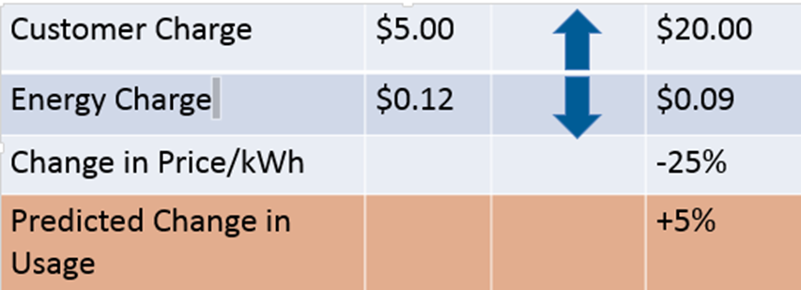
Price Elasticity at Work
Notes:
Lowering usage rates raises consumption
Room for debate on how much
But if consumption leads to pollution and increasing capital and risk, that is a problem

Slide 27
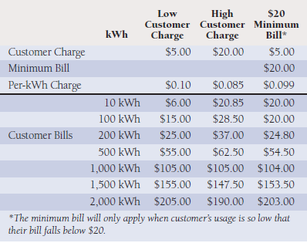

Slide 28
Customer Specific Costs Appropriate for the Monthly Customer Charge
Billing
Collections
Share of transformer and service drop

Slide 29
Rate Design Options
Time of Use (with critical peak)
Demand charge
Net metering
Minimum bills
High Customer Charges
Cost driven Customer Charge, DG & large houses
Subscription demand charges
Bidirectional rates
Value of solar
Fees imposed on DG users
Feed-in-tariffs

Slide 32
Rate Design Principles for DG Users
DG users should not experience discrimination
Time-varying rates are appropriate in both directions
PV user should be able to connect to the grid for no more than the cost to connect
PV user should be able to avoid the retail rate for all on-site consumption of on-site power
PV user should pay for T&D service at non-discriminatory rates for all power received from the grid
Recognize “value of solar” to the grid when establishing fair rates and compensation for DG users

Slide 33
Decoupling
A way to address revenue assurance without affecting rate design

Slide 34
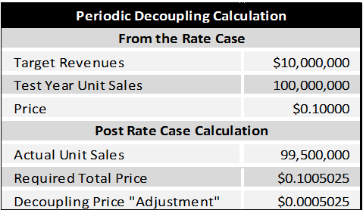

Slide 35
The System We Grew Up With

Slide 36
A Vision of A Future System
US DOE

Slide 37
Trends are Clear
More automation
More choices for individuals
Potential for more consumer interest for services
What happens if storage becomes more accessible to consumers?
What will utilities and their regulators do?
Notes:
Automation in end uses
On utility side
to manage the system and include customers
Customers who will have more choices
Choices that can help the system
Or enable the customer to bypass the system, or defect from it, if the system is not meeting needs, or is more expensive than it can be

Slide 38
rsedano@raponline.org
Notes:
I think efficient prices can be the result of all the lessons we have accumulated to date
And we can avoid a rate design regime that too heavily weighted to address the concerns of the utility companies
and are not sufficiently considerate of customers, their needs and their options

