Slide 1
ISO New England & Proposed EPA Rules
New England Restructuring Roundtable, Boston
October 29, 2010
Stephen Rourke, VP System Planning
ISO New England, Inc.

Slide 2
Overview
ISO NE is Working to Understand the Impact of New EPA Rules on the Region
Many Questions Need to be Addressed
Timing Will be Key

Slide 3
Upcoming EPA Rules
Clean Water Act: Section 316(b) Cooling Water Intake
Clean Air Act: National Emission Standards for Hazardous Air Pollutants (NESHAP)
Clean Air Transport Rule
Coal Combustion Residuals
Greenhouse Gas Tailoring Rule

Slide 4
New England On A Good Path
Compared to the rest of the nation, New England’s capacity surplus, fuel mix, project queue and push for renewable resources are favorable
  The fourth FCA was held in August 2010 to secure capacity for 2013-2014
  Auction results show 32,247 MW of generating resources cleared the auction along with 3,261 MW of demand resources and 1,993 MW of imports
  32,127 MW needed for reliability therefore there was approximately 5,374 MW of excess supply

Slide 5
Shift in New England’s Fuel Mix
New highly efficient natural-gas-fired generators have displaced use of fuel oil
Generator emissions rates have declined over the past decade
  SO₂ rate  67%
  NO_{X} rate  62%
  CO₂ rate  12%
Notes:
Sources:
2000 energy – System Planning archive
2009 energy – Based on preliminary RSP10 data

Slide 6
Generator Proposals in the ISO Queue
By Type
Total: Approx. 8,400 MW
As of October 1, 2010
Notes:
June 1, 2010, Master version of ISO queue. Only includes projects in the queue for the system administered by ISO-NE; does not include projects in affected systems.

Slide 7
ISO Projection of New England’s Renewable Portfolio Standards and Targets for Energy Efficiency to 2020
RPS energy and energy efficiency as a percent of total electric energy
30%
13%
Renewables provided approximately 13% of New England’s electric energy in 2009.
Notes:
Source: Draft RSP10 Figure 8-4. Based on state policies with specific plans to meet long-term goals.
The Energy Efficiency/CHP is only Connecticut’s Class III RPS energy efficiency and combined heat and power (CHP), and Massachusetts’ 25% EE goal.
2009 Energy from Renewables included hydro, landfill gas, other biomass gas, wood, refuse, wind, tires. (See RSP10 Fig. 7-2).

Slide 8

Transmission Projects to Maintain Reliability are Progressing
$4 Billion invested since 2002, $5 Billion on horizon
DOE highlights progress in New England
  In the Energy Policy Act of 2005, Congress directed the U.S. Department of Energy to conduct a study every three years on electric transmission congestion and constraints.
  In its latest (2009) study, DOE dropped New England from its list of “Congestion Areas of Concern” citing the region’s success in developing transmission, generation, and demand-side resources.
9
5
4
10
Southwest CT Phase I
Southwest CT Phase II
NSTAR 345 kV Project, Phases I & II
Northwest Vermont
Northeast Reliability Interconnect
Monadnock Area
New England East-West Solution
Southeast Massachusetts
  Short-term upgrades
  Long-term Lower SEMA Project
Maine Power Reliability Program
Vermont Southern Loop
6
In service
Under construction
3
Under study
7
8a
1
8b
2
© 2010 ISO New England Inc.
Notes:
8
Since 2000, ISO’s regional system planning process has identified the need for more than $8 billion of transmission investment. This has resulted in significant transmission development in each of the New England States. Approximately $4 billion of transmission investment has been completed (i.e., put into service) between 2002 and 2009; and additional $5 billion of transmission investment is active in the plan (i.e., under study or under construction).
Including in-service and future projects
Six major 345-kV projects have been successfully constructed and put into service in four states:
Northwest Vermont Reliability Project (VT)
NSTAR Reliability Project - Phase I (MA)
NSTAR Reliability Project - Phase II (MA)
Southwest Connecticut Reliability Project - Phase I (CT)
Southwest Connecticut Reliability Project - Phase II (CT)
Northeast Reliability Interconnect, a/k/a the Second New Brunswick Tie (ME)
The total cost of these major 345-kV projects is approximately $2.4 billion:
(1/07) Northwest Vermont Reliability Project (VT): $261.8 (no change)
(4/07 and 12/08) NSTAR Reliability Project - Phases I&II (MA): $307.9 M (No change)
(10/06) Southwest Connecticut Reliability Project - Phase I (CT): $343 M
(12/08) SWCT Reliability Project - Phase II (CT): $1,298 M (No change)
(12/07) Northeast Reliability Interconnect (ME): $144 M
Major projects currently in siting:
New England East-West Solution (NEEWS): $1,872 M (No change)
Maine Power Reliability Program (MPRP) : $1,545 M (No change)
Other major projects in the plan:
Vermont Southern Loop: $243 M (No change)
Greater Rhode Island Transmission Reinforcements (including Advanced NEEWS): $293 M (No change)
Long-term lower Southeast Massachusetts (SEMA) upgrades: $110 M (No change)
Monadnock Reliability Project: $76 M
Total cost of all transmission projects active in the plan: $5.4 B
The range for these projects is $4 billion to $6 billion NU and National Grid submitted siting applications for Greater Springfield (CT and MA sections) and RI Reliability Projects in the September – October 2008 timeframe.
CMP filed siting application in July 2008

Slide 9
Challenges Remain for New England
Some generating units are vulnerable to retirement
  Aging coal and oil fired generators face largest challenges
  Relicensing of Vermont Yankee and Pilgrim uncertain
Size, timing and location of retirements could create reliability issues
  Potential reductions to Installed Margin
  Existing oil and coal generators located at critical parts of the system
ISO does not have authority to require units to run

Slide 10
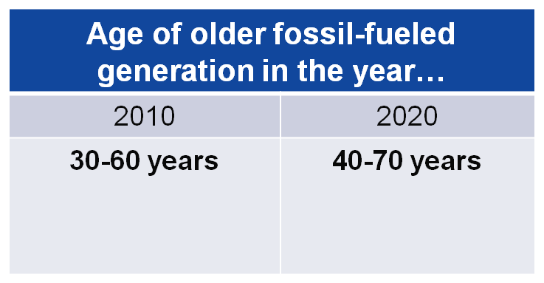
Challenges Remain for New England – Aging Fleet
Coal and oil-fired steam units built in the 1950s–1970s represent 25% of New England’s total system capacity
  Built pre-1980: 8,000 MW
  Built pre-1970: 4,400 MW
  Built pre-1960: 900 MW
Notes:
This data is consistent with the Governor’s study.
The report for the governors showed 8,600 MW of coal and oil units would be older than 50 years in 2030. That number is revised down this year since one of the older oil units reclassified itself for this year’s CELT Report as using natural gas as a primary fuel instead of oil (Mystic 7 @ ~600 MW).
So, going forward we can report approximately 8,000 MW of coal and oil units would be older than 50 years in 2030; older than 40 years in 2020; and older than 30 years today. If you consider the age range of these units (not just “older than” a given age) the 8,000 MW are 30-60 years old today and would be 40-70 years old in 2020. This is consistent with the list of generation assumed for RSP10, although neither the 8,000 MW nor these age ranges are highlighted in the report; RSP uses different snapshots of unit ages than the governors’ report.

Slide 11
Summary of NERC Report: Potential Retirements in New England from Combined Rules
 | 2013 |  | 2015 |  | 2018
 | Moderate | Strict | Moderate | Strict | Moderate | Strict
MW | 162 | 532 | 2504 | 3938 | 2970 | 3938
The Strict case assumed higher compliance costs and the more stringent requirement options in the proposed rules.
Source: NERC’s Potential Resource Adequacy Impacts of U.S. Environmental Regulations
October 2010
Notes:
NERC modeled both a moderate and strict versions of the proposed or planned rules to come up with the total MW of power that it determined was vulnerable for retirement. NERC assumed retirement would occur if the price of rule compliance (retrofits) was greater than the price of replacement power (from natural gas generation).
NERC assumed that the nuclear power plants would be exempt from the EPA rules, in particular the cooling water rule. VY has once-through and closed system water cooling (http://www.nrc.gov/reading-rm/doc-collections/nuregs/staff/sr1437/supplement30/s30-vol1.pdf)

Slide 12
EPA Rules Generate Questions and Need for Additional Analysis
What will be the role of transmission?
If the rules move the industry more towards natural gas generation, what will be the impact on supply & price?
The NERC analysis considered retrofit and replacement with natural gas; could DR provide an additional alternative in some circumstances?
Will imports increase under these rules?

Slide 13
EPA Rules Generate Questions and Need for Additional Analysis cont.
As these rules will heavily impact the coal-intensive Midwest, what will be the impact on wind development and transmission there?
Should ISO’s planning studies be amended to take into account potential retirements resulting from these rules?

Slide 14
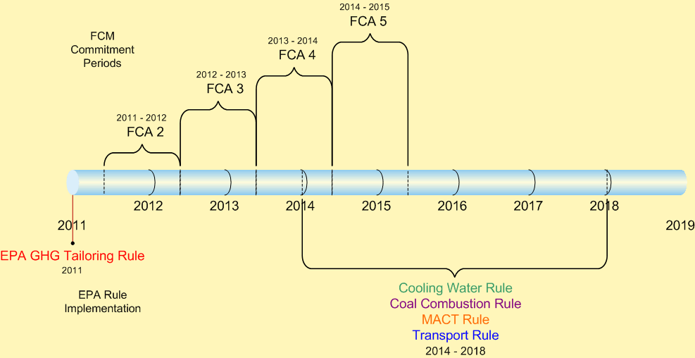
Timing of EPA Rules: Focus of Implementation 2014 – 2018
Notes:
GHG: http://www.epa.gov/NSR/documents/20100413fs.pdf & http://epa.gov/oar/pdfs/LPJ_letter.pdf

Slide 15
Timing, cont.
Can the market procure sufficient capacity in time for the implementation of the EPA rules and potential retirements?
  If so will the surplus capacity from FCA-4 (5,374 MW) for 2013/14 continue out into the future (2015) when NERC expects up to 3938 MW of retirements?
Can governments facilitate siting approvals for resources, especially wind & new transmission?
How will units that anticipate retirement bid in upcoming FCAs – will they be staggered or simultaneous?

Slide 16
Conclusions
At this point it is difficult to fully understand the planning & operating impacts of removing large central station resources from the grid
  Recent investments put the region in a stronger position to deal with retirements
The Forward Capacity Market sends market signals, three + years in advance, about specific future retirements
  Will that leave enough time to deal with significant resource retirements?

