Slide 1
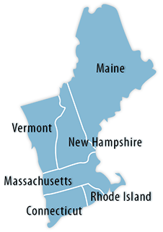
Perspective on New England
Jim Robb
President and Chief Executive Officer
New England Roundtable
March 22, 2019

Slide 2
What keeps me awake at night?

Slide 3
What keeps me awake at night?
Do they have enough flexibility?

Slide 4
What keeps me awake at night?
Do they have enough flexibility?
Do they have enough capacity?

Slide 5
What keeps me awake at night?
Do they have enough fuel?
Do they have enough flexibility?
Do they have enough capacity?

Slide 6
What keeps me awake at night?
Do they have enough fuel?
What about these guys?
Do they have enough flexibility?
Do they have enough capacity?

Slide 7
Focus on New England
There is a lot to admire about what New England has accomplished in repositioning its fleet to meet its environmental objectives.
However, the resulting fuel mix substantially changes the risk profile to the sector with the move away from on-site fuel (coal, petroleum and nuclear reductions) to just in time delivery of natural gas backed up by petroleum and weather dependencies of wind and solar.
While New England has ample capacity, energy security, especially, but not exclusively, in the winter is a major reliability concern.
Notes:
Industry and policy trends are changing the makeup of New England’s power system
ISO-NE is meeting its regional resource adequacy requirement for capacity based on expected summer peak demand, but is concerned about the region’s ability to overcome emerging energy security problems in the winter and’s power system
The challenge is assuring that the region’s resources, regardless of fuel or technology, are able to meet the demand for electricity and required operating reserves throughout the winter, i.e. energy security
The concern is whether there will be sufficient energy available during extended cold winter weather to satisfy electricity demand, given the system’s evolving resource mix and fuel delivery infrastructure
– While there has been no loss of load to date on the bulk power system attributable to these conditions, ISO-NE is concerned this emerging issue will worsen over time due to observed industry trends

Slide 8
Evolution of Generation Mix 1990-2017
60,000,000
2017
1990
59%
Energy Mix
MWh
50,000,000
40,000,000
30,000,000
20,000,000
10,000,000
8%
0
Imports: Canada
1990 Energy Production
2017 Energy production

Slide 9
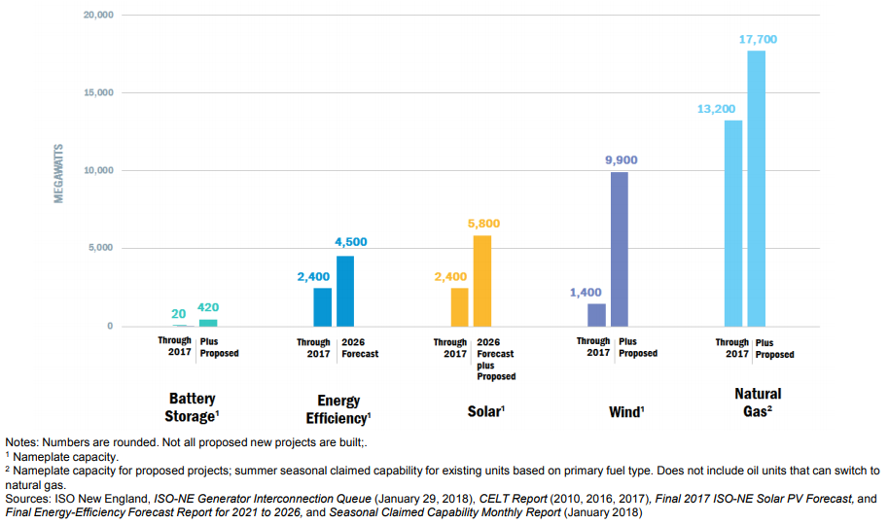
The Changing Grid: Wind, Solar, Energy Efficiency, & Energy Storage

Slide 10
Gas Infrastructure vs. Gas Generation Build Out
Source: Velocity Suite, FERC Form 2 Page 514
State Breakout of Miles of Transmission Lines

Slide 11
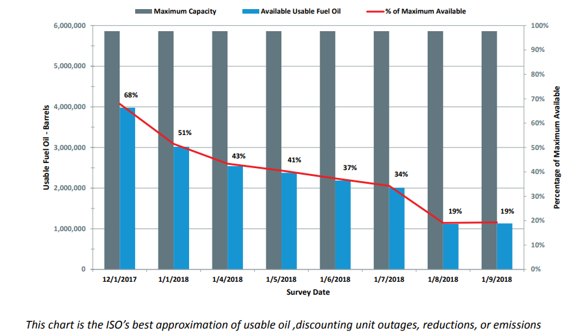
Performance in 2018 Cold Snap: Oil Inventories
Fuel Oil Inventories Declined Rapidly in Two Weeks
December 1, 2017, to January 9, 2018
Dec 1
Jan 1
Jan 4
Jan 5
Jan 6
Jan 7
Jan 8
Jan 9
H: 12° H: 28° H: 23° H: 12° H: 16° H: 36° H: 39° Temperatures in L: 0° L: 23° L: 7° L: 1° L: -2° L: 19° L: 32° Boston, MA
This chart is the ISO’s best approximation of usable oil, discounting unit outages, reductions, or emissions.

Slide 12
New England’s Own Waterfowl

Slide 13
Thoughts on these challenges
The New England system is very vulnerable to energy shortages and energy/fuel security need to be a top regional priority to preserve reliability
Gas infrastructure
Dual fuel capability
Resource diversity
Renewable additions aren’t keeping pace with traditional fuel retirements; a potential closure of Seabrook or Millstone could be very challenging due to loss of energy supplies
Battery deployment, with substantial renewable investments, would help mitigate but scalability is a key question
ISO-New England has managed this system well with innovative practices but will likely need more tools to work with.

Slide 14
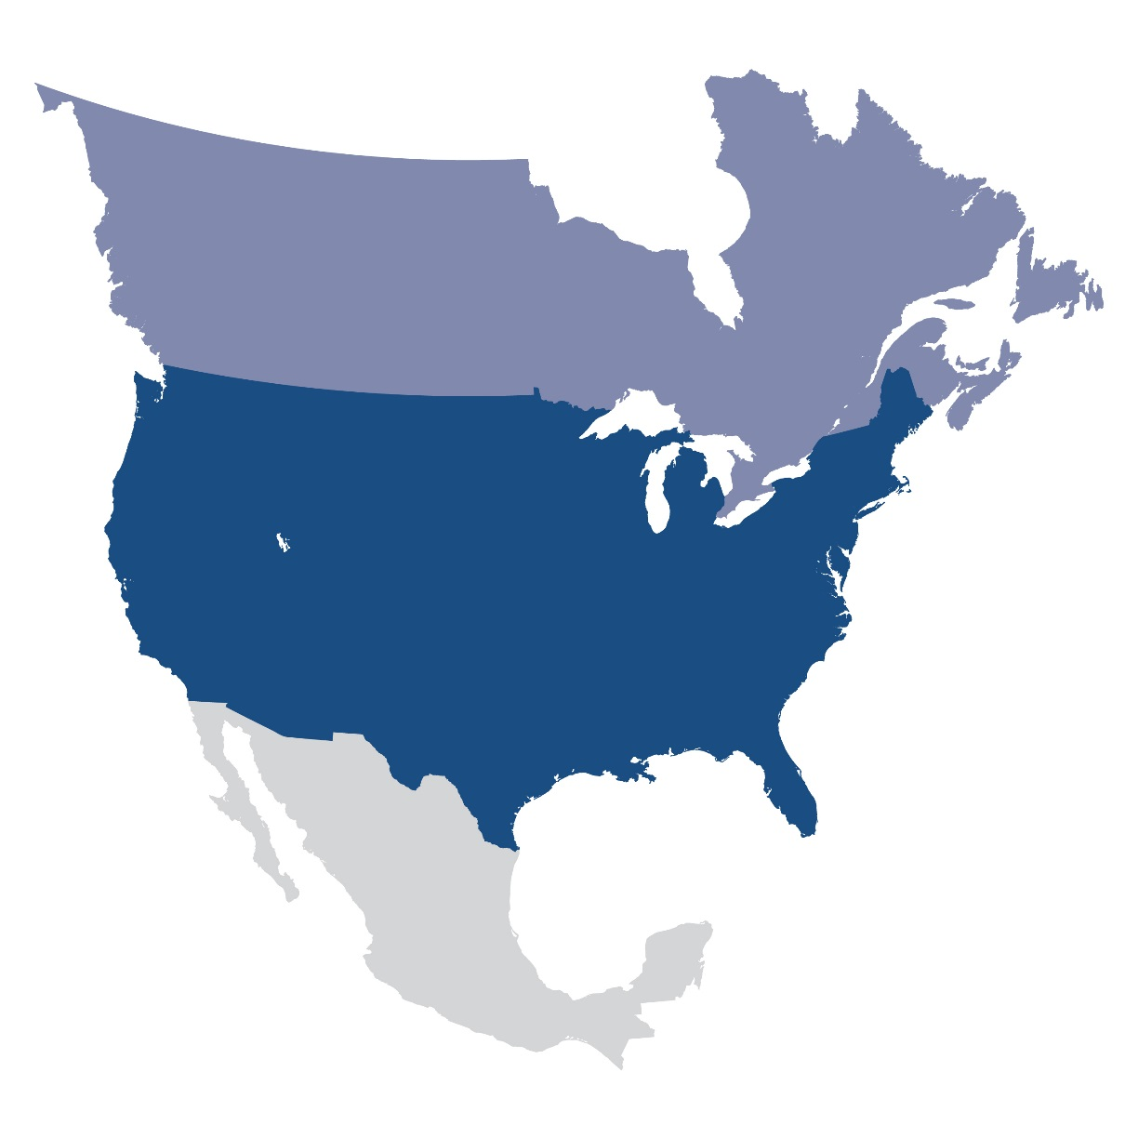
Questions and Answers

