Slide 1
Restructuring Roundtable
June 15, 2012
Robert A. Rio, Esq.
Senior Vice President and Counsel
Associated Industries of Massachusetts

Slide 2
Question to Ponder
What if our energy policies, renewable energy goals and focus on GHG reductions do not save the ice caps from melting, the polar bears from disappearing or stop the water from rising but rather speed these up and as a bonus bankrupt us along the way?

Slide 3

Wheel of Rationalization
Spin to rationalize any green energy program
(dollar figures are costs to ratepayers)
Bankrupt?
It’s for the children!

Slide 4
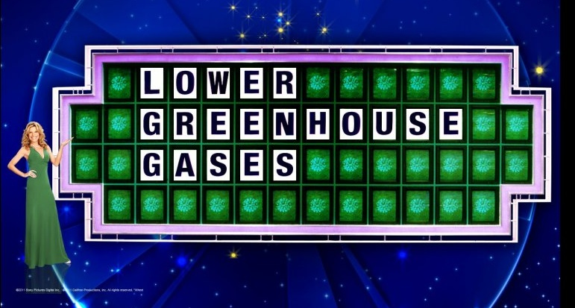
Don’t like the answer, Spin Again

Slide 5
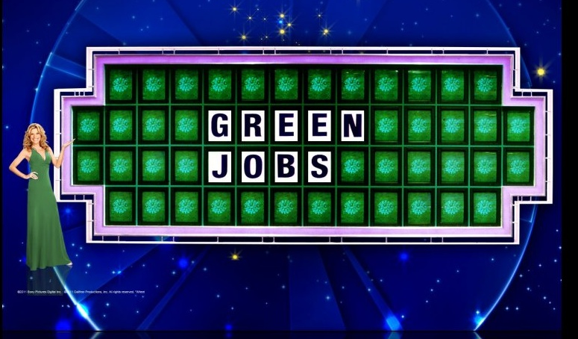
If this doesn’t work, Spin Again

Slide 6
What are the goals of the clean energy revolution?
Reduce GHG
  Here? US? Global?
  Life Cycle Analysis on Cape Wind
  Rare Earth Metals for renewables has huge GHG impact
Create green jobs/net jobs
  Who do you throw off the bus?
  Record not impressive (see BBJ article)
Get Cape Wind built at any cost
Keep money in Massachusetts
  But what if capital leaves Massachusetts
Awards/bragging rights/press releases
Meet GWSA/Governor Goals

Slide 7
Unsurprising result
Little gain, lots of pain
Uncoordinated programs
  See MASSINC study
“Facts” continually change to justify programs
  What exactly is a “green job”?
Political pressure to favorite projects/technologies
  Cape Wind poster child
No third party verification of results
Little likelihood of meeting goals at rational cost
  See MASSINC study

Slide 8
Solution
Transition to a low-carbon economy using all the tools in the toolbox
  Base decisions on sound economic principles
  Hydro, wind, gas should all be in the mix
Focus on RESULTS not headlines or awards
Merge environmental, clean energy, and economic development so customers can access all programs
  Too many silos that are too restrictive
Don’t be afraid to change course or change goals to reflect new realities
If it actually works, you’ll spend less time trying to justify it.

Slide 9
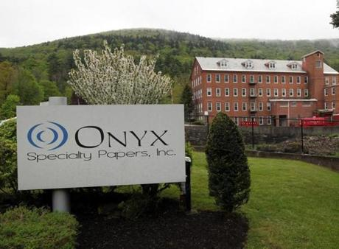
Case Study
Profiled in the Boston Globe, May 23
South Lee, Ma, 127 jobs
Number 6 oil, Converted to gas
  30% reduction in CO2 emissions
  90% reduction in SOX
  10% Reduction in NOX
No awards, no state incentives, no subsidies

