Slide 1
Natural Gas & Electricity Interface Challenges in New England: The Carbon Equation
November 15, 2013
Sue Reid
VP and Director, CLF-Massachusetts
Conservation Law Foundation

Slide 2
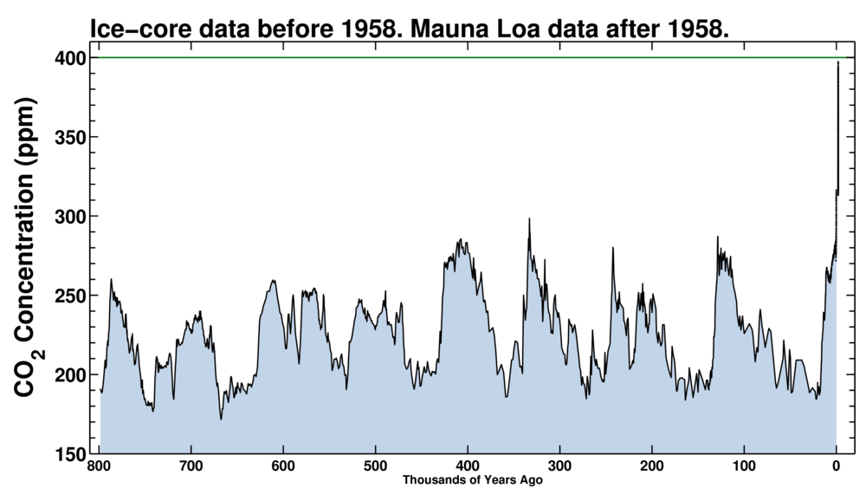
Big Picture: Atmosphere at ~400 PPM CO₂ for first time in millions of years. On trajectory to go ever higher.
You are here
Source: http://keelingcurve.ucsd.edu/

Slide 3

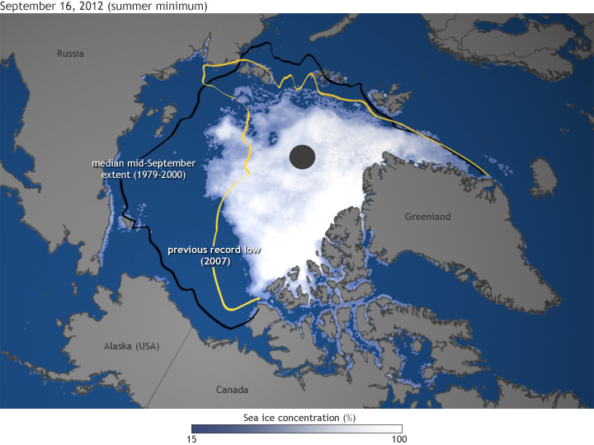
2012 Was Warmest Year on Record & Climate Effects Continue to Grow…
3

Slide 4
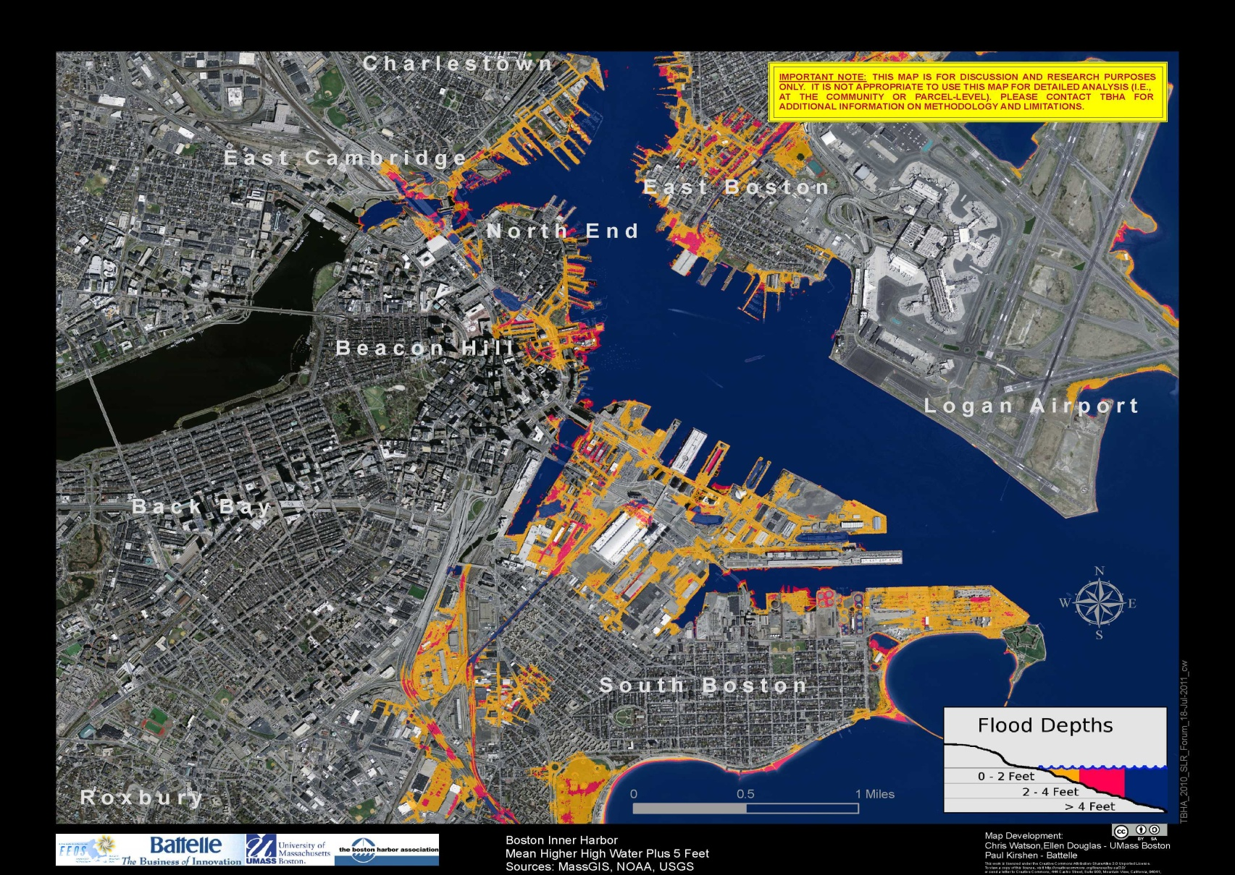
Extensive Vulnerability to Impacts of Climate Change
Just One Example: Boston + 5ft additional H₂O

Slide 5
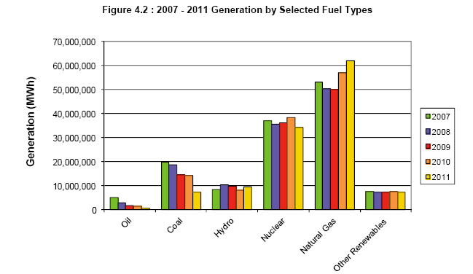
Gas has been replacing coal (and oil) in New England’s generating mix

Slide 6
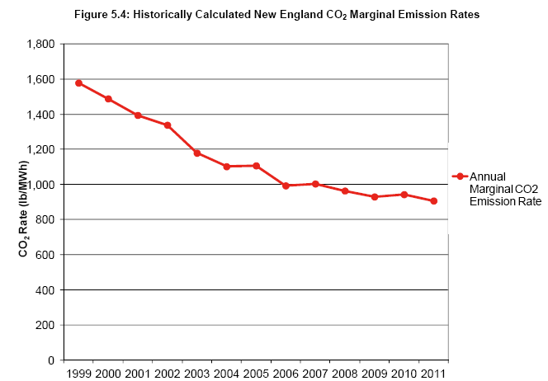
Shift away from coal and oil: short term CO₂ reduction benefits
(at the point of “hitting the wall” now in NE region…)

Slide 7
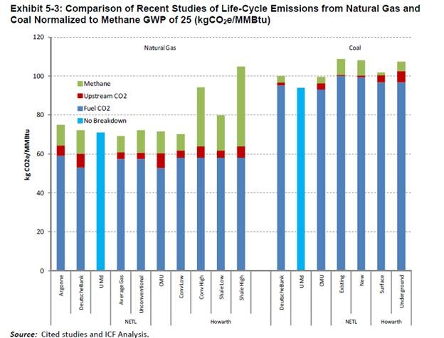
But Is Nat Gas Actually Reducing GHGs to Extent Claimed? [also runs headlong into 2050 GHG reduction imperative]

Slide 8
In the words of FERC Commissioner John Norris
(November 7, 2013):
“I am concerned, because we are making long-term investments in both pipeline and generation facilities for utilization of gas for base-load or intermediate-load generation and if we are to reach [the Obama] administration’s goals of an 80% reduction in CO2 by 2050, from 2005 numbers, you can’t have this.”
-Smart Grid Today, November 7, 2013

Slide 9
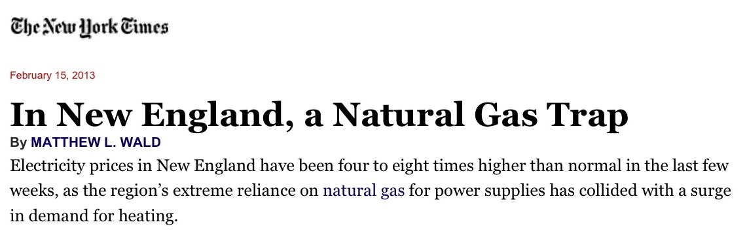
And What About Reliability & Price Volatility?

Slide 10
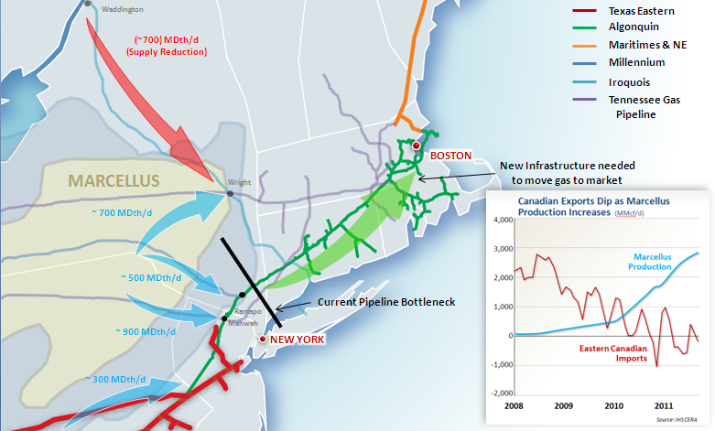
Perceived Need for New Pipeline
Source: Spectra Energy

Slide 11
Policy Considerations
Need to maximize benefits of existing system
  Enhance opportunities to utilize available capacity for electric gen (address illiquidity, coordination and deliverability)
  Fix leaks
  Ramp up energy efficiency programs
Expand renewable energy (electric/thermal), including DG
Carefully scrutinize GHG impacts of new infrastructure
  Ensure consistency with GHG reduction req’ts throughout useful life
  Must include fugitive emissions, including upstream
  Bottom Line: Substantial deployment of long-lived new natural gas pipeline & power generation infrastructure is not consistent with 80% reduction in GHGs by 2050 & would create significant stranded asset risk.

Slide 12
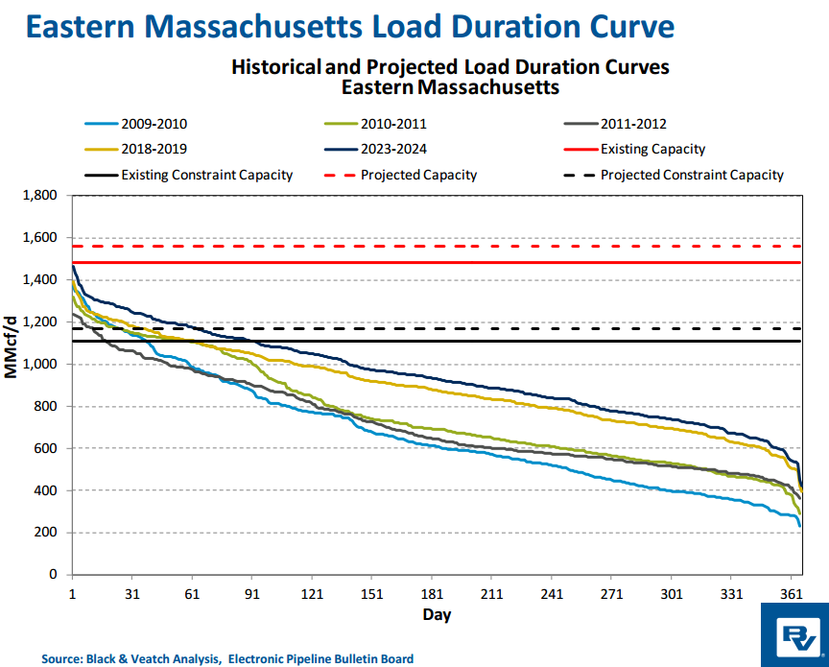
Cannot Ignore Big Opportunities From Simply Maximizing Use of Existing Infrastructure
Current situation: Pipeline truly “full”
only a small
part
of the year

Slide 13
Even during the times of greatest stress on the system it is very rare for physical use of the pipelines to go over the 85% level
when counting East to West in the mix

Slide 14
Better Use of Existing Infrastructure Avoids Cost
Reality
Perception
Pipes are fully utilized
Capacity release/renomination opportunities are sufficient
Basis problem = need for more capacity
75% utilization threshold = basis spikes
Needle peaks cannot be resolved without new pipelines
LNG is not a solution
West to east subscribed but not fully utilized
More opportunities for intra-day and short term releases
Greater intraday – off hours liquidity/transparency possible
Market refinements/new services raise to 85%+
Surplus capacity east to west
LNG can meet both needle peaks and address 85%+ capacity constraints
With better pipeline utilization, ratepayer costs can be minimized

Slide 15
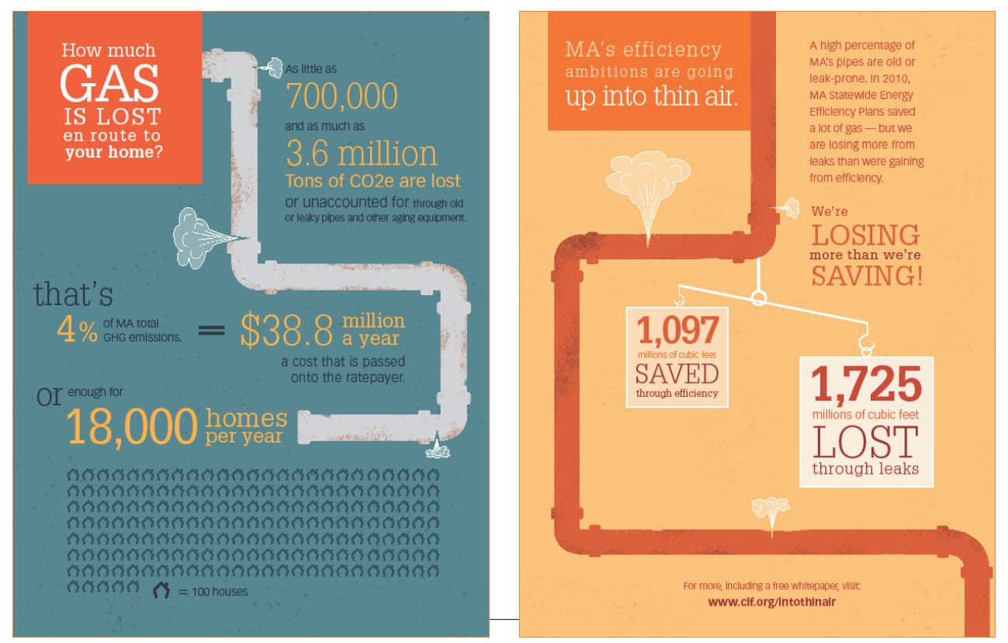
Need to Fix the Leaks…

Slide 16
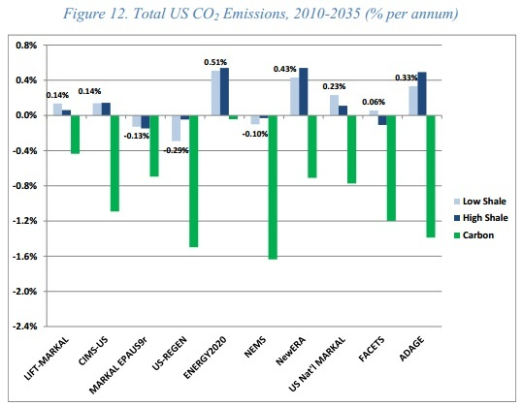
GHG Equation: Recent studies predict CO₂ likely to rise as shale gas production & use continue
(Stanford Energy Modeling Forum – Sept. 2013)

Slide 17
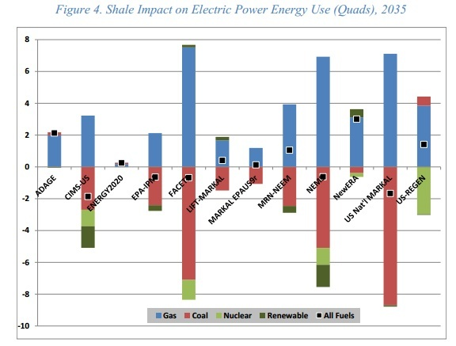
GHG Equation: natural gas displacement of low- and zero-emissions resources (increasing GHGs)
[Stanford Energy Modeling Forum – Sept. 2013]

Slide 18
Questions?
Sue Reid
sreid@clf.org

