Slide 1
New England Electricity Restructuring Roundtable: 150th Gala
May 18, 2016
Raab Presentation

Slide 2
Introductions: Successes and Failures
One minute each person at table
  Name/Organization
  Most important single success over past 20 years in restructuring the electric utility industry, and developing electricity-related policies, programs, and laws
  Most significant single failure/short-coming over past 20 years in restructuring…
  Be succinct
Please just listen to each other—no time for discussion/debate (unless you are done in less than 8 minutes)
One person at table please scribe on sheet provided, and another please keep time (one minute/person)

Slide 3
Stats
Twenty Years/150 Roundtables
Started as Massachusetts Electric Restructuring Roundtable (by MA DOER for 1 year!)
  2006 Electricity Restructuring Roundtable
  2009 New England Electricity Restructuring Roundtable
Since 1999 (when we started website)
  110 Roundtables
  469 different speakers
  Approximately 80 different topics

Slide 4
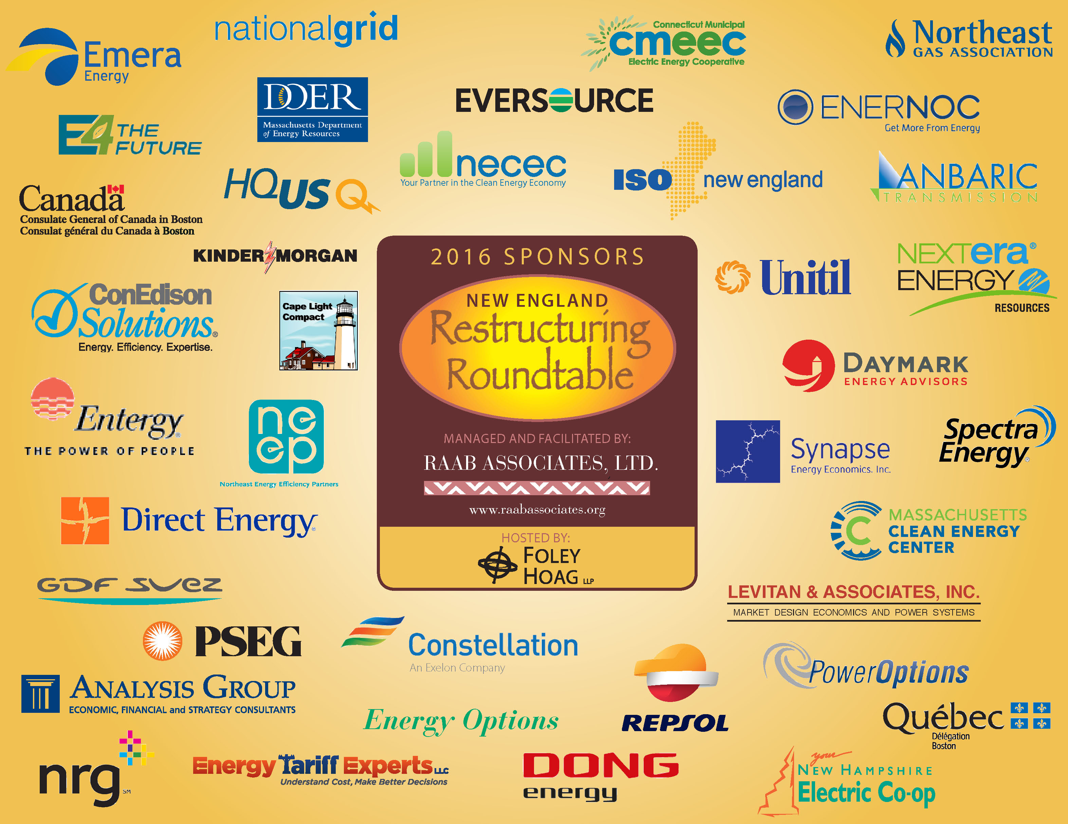

Slide 5
Top Speakers (since 1999)
RunnerS-Up (spoke 5 or 6 times)
Dan Allegretti [Exelon, Constellation, Enron]
Ann Berwick [MA DPU, MA EEA]
David Cash [MA DPU, MA EEA]
Sue Coakley [NEEP]
James Daly [Eversource]
Phil Giudice [Ambri, MA EEA, MA DOER]
Carrie Cullen-Hitt [SEIA, AES-New Energy, Green Mtn.]
Bill Hogan [Harvard]
Harvey Michaels [MIT, Nexus]
George Dean [MA AGO]
Seth Kaplan [CLF]
Larry Reilly [National Grid]
Tom Robinson [National Grid]
Stephen Rourke [ISO New England]
Tom Welch [Maine PUC]

Slide 6
Top 13 Speakers (since 1999)
7 - Janet Besser [NECEC, Nat’l Grid, Lexecon, MA DTE]; Alan Nogee [UCS]; Don Sipe [Preti/Flaherty] & Peter Zschokke [Nat’l Grid]
8 - Steve Cowell [CSG] & Jerry Oppenheim [Democracy & Regulation, NCLC]
9 - Bob Ethier [ISO New England] & Richard Levitan [Levitan & Associates]
10 - Sue Tierney [Analysis Group, Lexecon] & Paul Hibbard [Analysis Group, MA DPU, MA DEP]
11 - BRONZE/SILVER Medals (tie)-Gordon van Welie [ISO New England] & Peter Fuller [NRG, Mirant]
17 - GOLD Medal David O’Connor [MLS Strategies, MA DOER]

