Slide 1
New England Electricity Restructuring Roundtable Special Roundtable on Transmission for Decarbonization
Dr. Raab’s Intro Slides
September 24, 2021

Slide 2
From Princeton University’s Net-Zero America Report

Slide 3
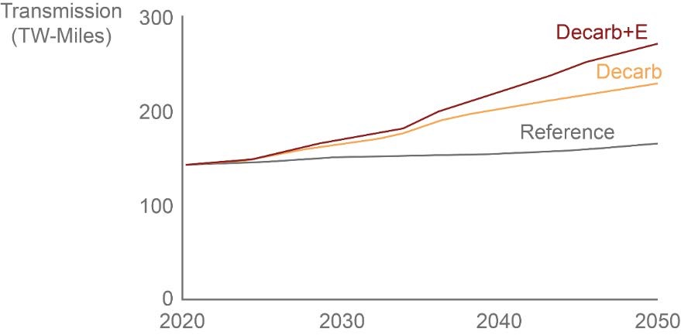
Figure 2 - 5. Interregional transmission expansion under the core scenarios
From U.S. DOE’s Solar Future’s Study (Sept. 2021)
Interregional transmission doubles by 2050 in Decarb/Electrification scenario

Slide 4
Transmission Panel Discussion—Topics & Questions
Transmission Planning/Studies
How do we improve the way we study transmission needs and develop longer-term transmission plans to support clean energy development--including the appropriate timeframe and demand profiles?
Transmission Decision-making & Cost-Allocation
Who should decide what transmission is needed to support clean energy and decarbonization in New England--what should the respective roles be of the states, ISO-NE, FERC, and other stakeholders?
Relatedly, who should decide how to allocate costs associated with those transmission investments, and what reforms are needed to how we allocate costs?
Siting and Permitting for Transmission
What changes are needed in the way we site and permit transmission for clean energy?
Transmission for Off-Shore Wind
How do we develop our on- and off-shore transmission grids to support the New England states’ substantial (and growing) off-shore wind requirements?

Slide 5
Panelists
Judy Chang, Undersecretary for Energy, MA EEA
Gordon van Welie, President & CEO, ISO New England
Dr. Susan Tierney, Senior Advisor, Analysis Group
Bill Quinlan, President Transmission and OSW Projects, Eversource Energy

