Slide 1
Climate Policy and Social Justice: Regional, State and Local
Harvard Law School: Climate Change Justice
Dr. Jonathan Raab
October 6, 2009
Raab Associates, Ltd. (and MIT)
www.RaabAssociates.org

Slide 2
Presentation Outline
Framing
Regional: Regional Greenhouse Gas Initiative (RGGI)
State: Rhode Island
Local: City of Boston
Conclusions

Slide 3
Climate Policy and Social Justice Framing
Exposure to risks from climate change (e.g., flooding, extreme heat)
Inclusion in process to formulate policies and programs
Impacts of climate policy
  Participation Access
    Mitigation measures
    Adaptation measures
  Indirect impacts (e.g., prices, hot spots)

Slide 4

Major Northeast Electricity-Related Matters Using ADR: (2000-2006)
RI GHG Process RI VT MA New England RGGI (9 States) | PJM Contract Disputes (Med./Arb.) RES (GHG) NTA DG LICAP/FCM
RGGI (Regional Stakeholders) Restructuring Roundtable | Cape Wind
CONSENSUS SEEKING
MEDIATION
CONSENSUS BUILDING
FACILITATION
UPSTREAM
Forming Policies & Laws
DOWNSTREAM Applying Policies & Laws

Slide 5
New England Governors Goal/Target
August 2001 New England Governors and Eastern Canadian Premiers commit region to reduce greenhouse gas emissions
  Back to 1990 levels by 2010
  10% below 1990 levels by 2020
  75-85% below 1990 levels in the long term (has come to mean 2050)

Slide 6
Regional Greenhouse Gas Initiative History
April 2003, NY Governor George Pataki sends invitation letter to governors in northeast to join RGGI
All 6 New England states join, along with NY, NJ, and DE—equal to world’s 4th largest economy (bigger than Germany)
MD and PA (the two big coal states) send staff to observe but don’t formally join.

Slide 7
RGGI Goals
Cap and trade for electricity sector, other sectors to follow eventually.
Uniformity across the participating states;
Building on existing successful cap-and-trade programs;
Allowing other states or jurisdictions to join in the initiative;
Focusing on reliable offset protocols (i.e., credits for reductions outside of the power sector).

Slide 8
RGGI Structure
Staff Working Group—Partnership of environmental and energy agencies
SWG agrees to form Regional Stakeholder Group as “sounding board” (Raab Associates, Ltd. hired for process design and facilitation—possible mediation SWG)
Extensive modeling
  IPM electricity sector model (ICF)
  REMI economic impacts model

Slide 9
Regional Stakeholders
23 members
  Environmental (8)—ENE, PIRG, CLF, PACE, NRDC, ED, UCS, ACEEE
  Energy related companies (8)—AES, Constellation, Dominion, Entergy, Keyspan, National Grid, NEGT, NU
  Business (5 )—International Paper, UTC, NE GHG Coalition, NY Coalition, NE Council
  Consumer Advocates (2)—ME, PA

Slide 10
Regional Stakeholder Process
Run in parallel to SWG deliberations
Met for 9 day-long sessions between April 2004 and September 2005
SWG presented proposals and posed questions
Stakeholders provided structured feedback
Usually around 100 people in room for each meeting, let public speak as time allowed

Slide 11
Topics Covered in
Stakeholder and SWG Processes
Cap level—initially and over time
Apportionment of allowances among states
Allocation
  Auction vs. free distribution
  Auction proceeds—energy efficiency vs. rebates to customers
Flexibility Mechanisms
  Temporal mechanisms
  Offsets—which to include, when, and how much offsets to allow
Impacts (modeling)—price, environment, economy
Compliance and enforcement
Leakage

Slide 12
Seven States Sign RGGI MOU
Signed December 20, 2005—NY, NJ, DE, CT, NH, ME, and VT
MA and then RI back out last minute
Lays out specific agreements on each of major topical areas
Commits to put out “model rule” –issued August 15, 2006
Commits to have implementing laws, regulations or both in place by Dec. 31, 2008 for 1/1/09 start

Slide 13
Cap Level
Stabalize at current levels from 2009 to 2015
10% reduction by 2019
Applies to all generators > 25 MW
Regional base cap 121 million short tons:
Cap stays same thru 2014, then declines 2.5%/year

Slide 14
Apportionment Among States
Apportionment “negotiated” among the states, largely based on average emissions over several years (millions of tons)
  CT 11
  DE 8
  ME 6
  NH 9
  NJ 23
  NY 64
  VT 1
MOU specified that if and when MA joins gets 23, and if and when RI joins gets 3 and whole regional cap is raised by that much.

Slide 15
Allocation of Allowances
At least 25% to be auctioned for consumer benefit or strategic energy purposes (up to each state)
All states subsequently decided to auction close to 100% for consumer benefit

Slide 16
Flexibility Mechanisms
Offsets
  Allowable offsets—landfill gas; SF6; gas, oil, and propane energy efficiency; afforestation; methane capture from farming.
  More types to be added later
  If allowances <$7 can use offsets from anywhere in U.S. (w/cap and trade)at 50% discount to meet 3.3% of emissions.
  If allowances >$7 at 1:1 ratio to meet 5% of emissions.
  If allowances >$10 can use international offsets up to meet 10% of emissions.

Slide 17
Flexibility Mechanisms (continued)
Demonstration of compliance every 3 years
Early reduction credits
Banking allowed for allowances, offsets, and early reduction credits

Slide 18
Modeled Impacts
Numerous modeling Stakeholder calls—often somewhat contentious (e.g., natural gas price forecast, renewables from RPS)
IPM modeling found
  2021 allowance prices $2, rate impacts 1%, but imports increase by >25% reducing GHG savings (“leakage”).
  If assume can double energy efficiency through auction $, all 3 factors reduced substantially.
REMI modeling found
  Very small rate impacts and impacts on economy (positive if double energy efficiency)

Slide 19
Impact on Typical Household Bills
Results for SWG Proposed Package Scenario
Based on annual average HH electricity bills for 2004-2005 from EIA Electric Power Monthly.

Slide 20
Impact on Typical Household Bills
Results for SWG Proposed Package Scenario
under High Emissions Case
Based on annual average HH electricity bills for 2004-2005 from EIA Electric Power Monthly.

Slide 21
Post-MOU RGGI Developments
Maryland Legislature passes law to join RGGI
August 15, 2006 RGGI puts out 163 page model rule
2006 Vermont Legislation requires auctioning of 100% of allowances for “consumers”, NY follows with similar requirement
January 18, 2007 Massachusetts Governor Patrick signs RGGI
February 5, 2007 Rhode Island Governor signs RGGI

Slide 22
RGGI GHG Auctions
States auctioning virtually all their allowances
States primarily using $ for energy efficiency, but can use for renewables, rate reductions…
Auctions began 9/08, and 5th auction held 9/9/09
Clearing price 9/9/09 was $2.19/ton, over 100 bidders
$433 million raised thus far in auctions

Slide 23

Rhode Island Greenhouse Gas Stakeholder Process
2001-2007

Slide 24
Sponsors/Hosts
RI Department of Environmental Management
RI State Energy Office
Facilitators/Mediators
Raab Associates, Ltd.
Consultants/Modelers
Tellus Institute
Other Independent Consultants
Funders
U.S. EPA (convening $)
IECR (early plan/implementation $)
RI Department of Environmental Management and State Energy Office
RI Foundation (small education grant)
)

Slide 25
Original Stakeholders
Apeiron Institute for Environmental Living
Associated Builders and Contractors
Audubon Society of Rhode Island
Brown University
Business Roundtable
Conservation Law Foundation
Department of Administration
Narragansett Electric
Nat. Fed’n of Independent Businesses
New England Gas Company
Northern RI Chamber of Commerce
Oil Heat Institute
Providence Chamber of Commerce
RI Builder's Association
RI Dept. of Environmental Management
RI Dept. of Transportation
RI Economic Development Corp.
RI League of Cities and Towns
RI Petroleum Institute
RI Public Interest Research Group
RI Public Transit Authority
RI Division of Public Utilities and Carriers
RI Society of Environmental Professionals
RI State Energy Office
RI Statewide Planning
Save The Bay
Sierra Club
Sustainability Coalition
The Energy Council of Rhode Island
Ex-Officio
Governor's Policy Office
RI House, Policy Office
RI Senate, Policy Office
US EPA
US DOE

Slide 26
Projecting a Baseline by Sector
Notes: This chart shows energy sector emissions with emissions from electric generation allocated among the four tertiary sectors (industry, transport, commerce and residential) based on the electricity consumed in those sectors.

Slide 27
RI GHG Original Structure

Slide 28
Projecting a Baseline by Sector
Notes: This chart shows energy sector emissions with emissions from electric generation allocated among the four tertiary sectors (industry, transport, commerce and residential) based on the electricity consumed in those sectors.

Slide 29
Selecting Targets
Selected NE Governors’/ Eastern Canadian Premiers’ Targets for now.
2020 Levels must be ~ 1/3 below 1990 levels.
By 2010: reduce to 1990 levels
By 2020: 10% below 1990 level
Beyond: Reduce to non-threatening levels

Slide 30
Developing Options
52 Options Generated
49 Consensus
3 Non-consensus
All options include estimated Carbon Saved, Cost of Saved Carbon, and Co-benefits

Slide 31
Comparing Options to Baselines and Targets

Slide 32
Contribution of Options to GHG
Savings vs. Baseline in 2020
“All Other” Measures
Design 2000
Efficient Residential Cooling
Tax Credits for Energy Efficiency
Retrofit Program
Efficient Lighting & Appliances
Compact Floor Space
Fuel Switching: Electric to Fossil
Public Facilities Initiative
Local Govt. Vehicle Fuel Efficiency
Convert Croplands to Wetlands
Solar Water Heating
Solar Water Heating
Low Input Agric
Energy Star Homes
Solar PV Cells Program
Gas Air Conditioning

Slide 33
Net Economic Benefits
and GHG Savings vs. Baseline

Slide 34
Short Energy Efficiency Spot Light Detour

Slide 35
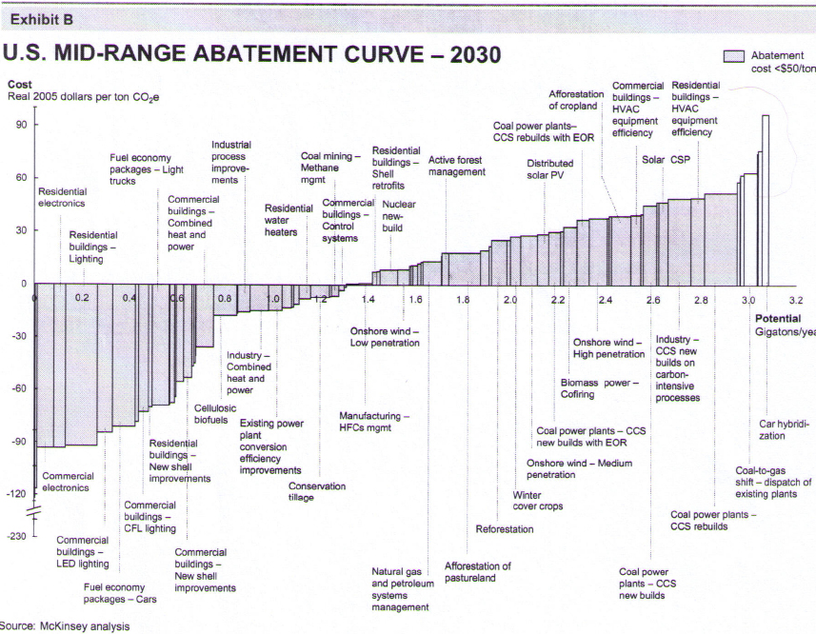

Slide 36
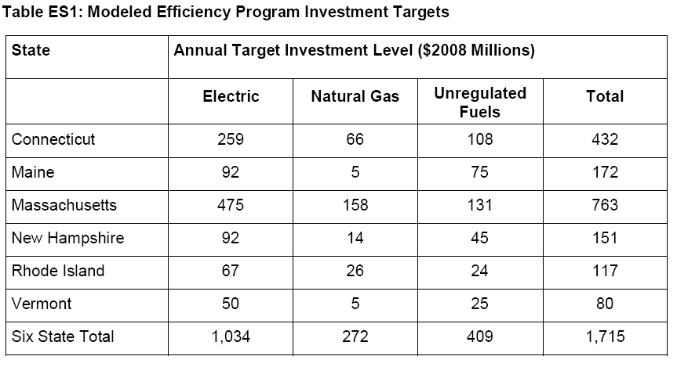
Environment Northeast (Oct. 2009)
Energy Efficiency: Engine of Economic Growth

Slide 37
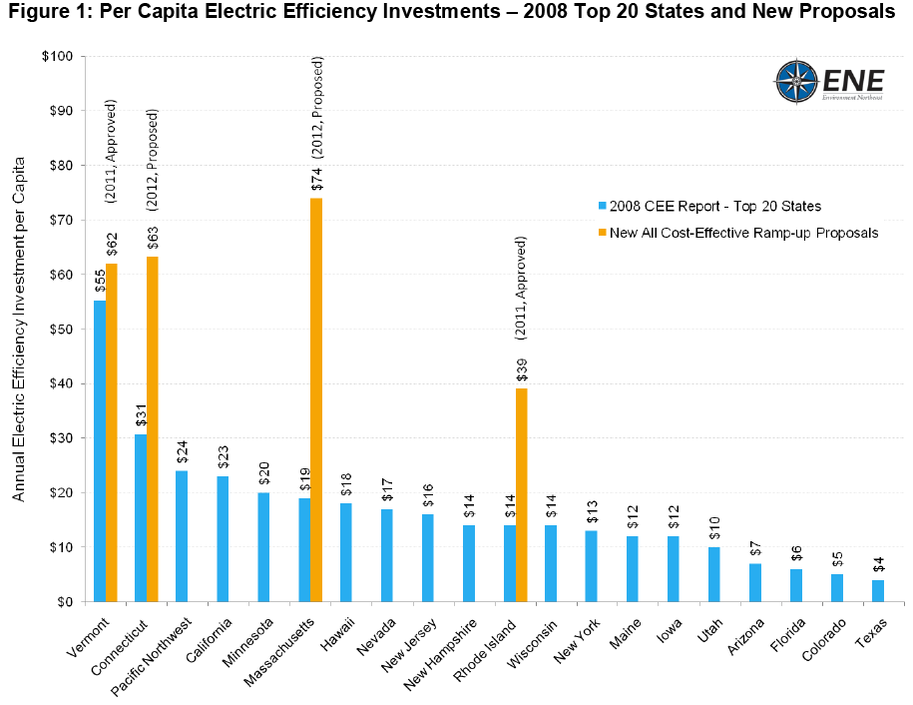
Changes in EE Investment

Slide 38
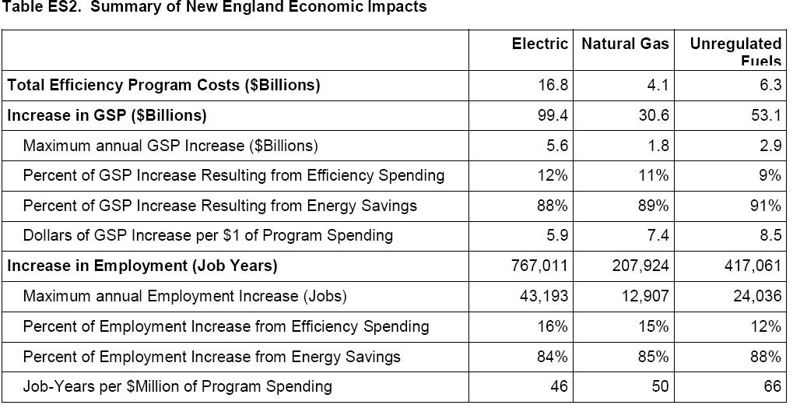
Environment Northeast (Oct. 2009)
Energy Efficiency: Engine of Economic Growth

Slide 39
Environment Northeast (Oct. 2009)
Energy Efficiency: Engine of Economic Growth
Energy efficiency can be very cost-effective
For every $1 spend on efficiency in New England, $6-8.50 back into the local economy
If $27.2 billion spent in NE over next 15 years, $180 billion reinvested in local economies
Avg. 38,000 new annual jobs
Approx. 90% of economic and job gains from energy savings and only 10% from efficiency spending
Thus this has the potential for huge equity benefits if keep eye on distributive issues

Slide 40
Low Income Energy Efficiency
Main Barriers to Participation
  Access to information
  Access to capital
  Split incentives—landlord/tenant

Slide 41
Low Income EE Funding in MA
Prior to restructuring—low income customers subsidized EE of other customers
Post-restructuring-reversed, other ratepayers subsidized low income EE
MA Green Communities Act now requires low income customers to get back what they pay in –
  “a substantial achievement given the barriers to reaching and serving the low-income sector” Jerrold Oppenheim (Democracy and Regulation, low income advocate 10/6/09)

Slide 42
Back to Rhode Island

Slide 43
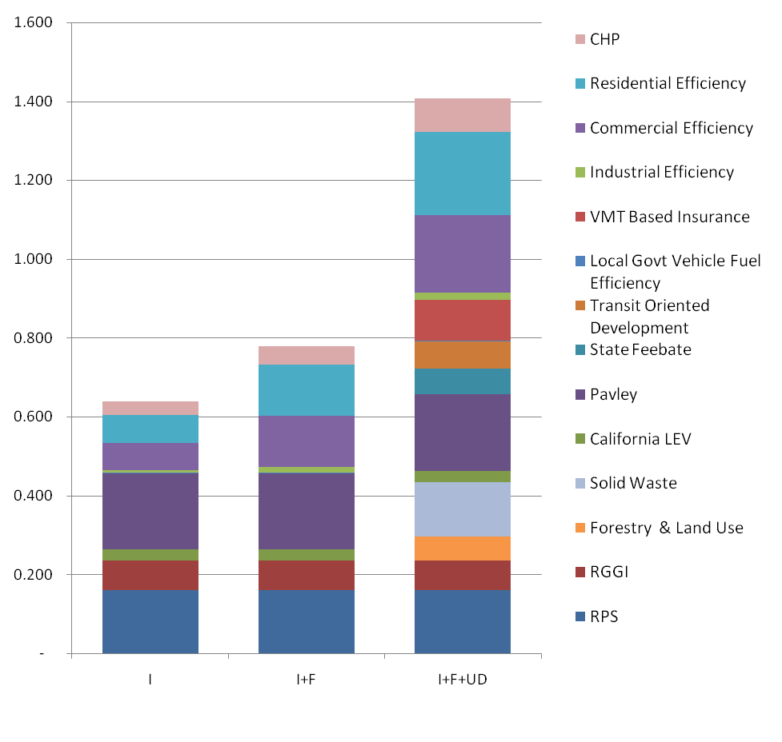
RI GHG Savings By Option in 2020 vs. Baseline
Million Short Tons C eq.

Slide 44
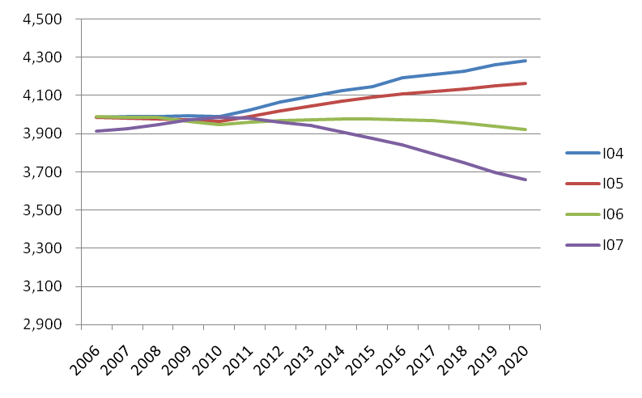
Comparison of Implemented
Scenario GHGs for 2004/5/6/7
Thousand Short Tons C eq.

Slide 45
EPA Award
On May 4, 2005 the US EPA gave the RI GHG Stakeholder Group its “Outstanding Climate Protection” Award in a ceremony in Washington D.C.

Slide 46
Boston Climate Action Plan

Slide 47
Mayor Menino
Leadership Committee
Technical
Advisory
Panel
Community
Advisory
Committee
Facilitation/Coordination Team

Slide 48
Community Advisory Committee
More than 70 nominations of more than 60 individuals from all over Boston
Mix of neighborhoods, ethnic and racial groups, age/generations
Mix of invested lay people and individuals with professional experience on climate-related issues

Slide 49
City of Boston Climate Action Plan Update Process
GHG Inventory
GHG Reduction Goals
City of Boston
2010
Climate Action Plan
Adaptation Strategies
Mitigation Strategies
Green Economy Plan
Community Engagement Plan
Notes:
49

Slide 50
GHG Emissions per Capita Comparison
U.S 24
MA 15
Boston 12
NYC 7
Chicago 12
Copenhagen 5

Slide 51
Boston 2007 GHG Emissions:
Buildings (Residential and C&I) relative to other sectors
Notes:
51

Slide 52
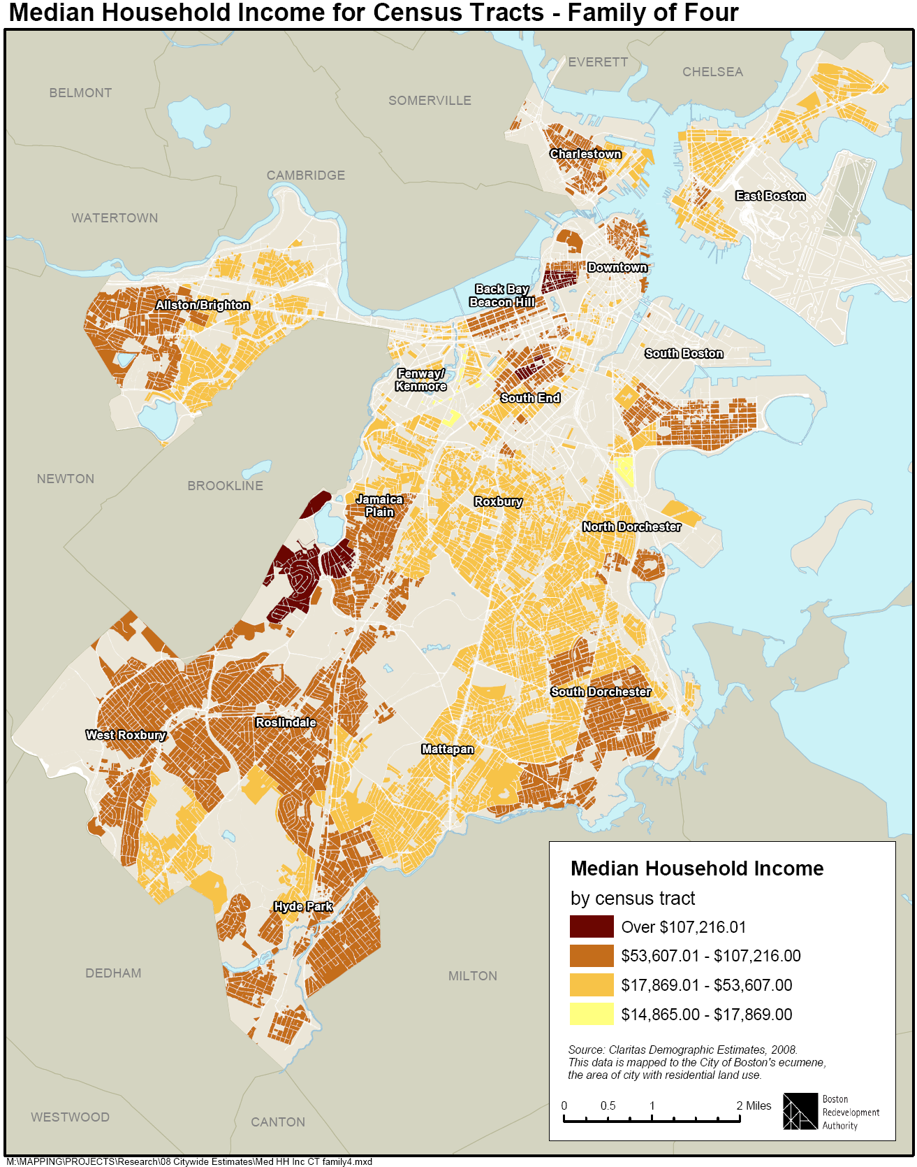

Slide 53
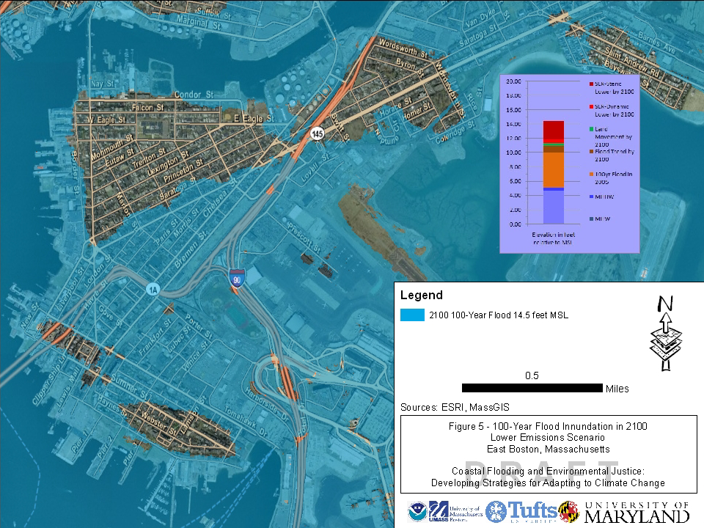

Slide 54
Conclusion
Low income likely have great risk exposure to extreme heat, and depending on location to flooding
GHG stakeholder processes could do better on inclusion and representation of low income interests, Boston could set new standard
Mitigation strategies can be very cost-effective in near term, and if well designed greatly benefit poor
Adaptation is still TBD, but climate change likely to disproportionately impact poor

