Slide 1
RGGI
(aka Regional Greenhouse Gas Initiative)
Dr. Jonathan Raab, Raab Associates
ww.raabassociates.org
AEC Conference, NYC
April 22, 2016

Slide 2
RGGI History
2003, NY Governor George Pataki invites Northeast and Mid-Atlantic Governors to join RGGI
Nine states join (plus MD/PA observers)
Establish regional stakeholder process as “sounding board”
2005 MOU; 2006 Model Rule
2009 RGGI kicks in (New England, NY, DE, MD, & NJ (NJ drops out in 2012))
2013 States agree to reduce cap 45%
2016 Undergoing 2nd 3 year review

Slide 3
Original RGGI Policy Development Structure
Staff Working Group—environmental and energy agencies in each state
Regional Stakeholder Group as “sounding board”
  23 Members—Energy Companies; Enviros; Business; & Consumer Advocates
  Facilitator: Raab Associates
Resource Panel
  ISOs and other experts
Extensive modeling
  IPM electricity sector model (ICF)
  REMI economic impacts model

Slide 4
RGGI Original Agreement
Regional Cap: Caps emissions; declines 2.5%/year after 2014; 10% reduction by 2019
Apportionment of Cap: “negotiated” among states, “largely” based on average emissions over several years
Allocation of Allowances: At least 25% to be auctioned for consumer benefit or strategic energy purposes (% up to each state)
Other Features:
  Applies to all generators > 25 MW
  Limited offsets
  Flexibility mechanisms (banking, etc.)

Slide 5
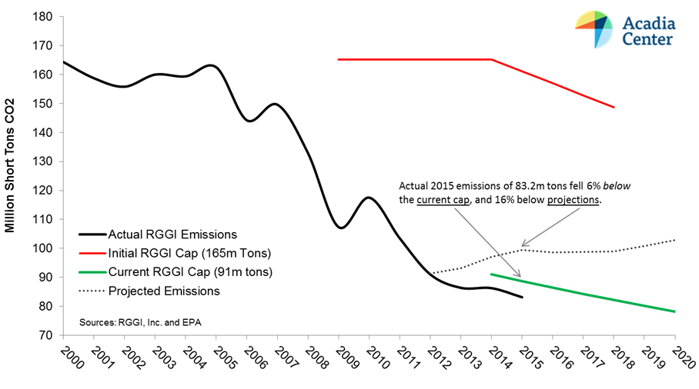
RGGI Environmental Performance

Slide 6
RGGI Allowance Auctions
(31 Quarterly Auctions 9/08 to 3/16)
State | Allowances Sold (millions) | Proceeds ($ million)
Connecticut | 53 | $160
Delaware | 27 | $88
Maine | 25 | $77
Maryland | 167 | $506
Massachusetts | 133 | $404
New Hampshire | 34 | $105
New York | 306 | $926
Rhode Island | 15 | $50
Vermont | 6 | $18
Total Participating States | 767 | $2,336
New Jersey (pre-withdrawal) | 48 | $113
Total | 816 | $2,449

Slide 7
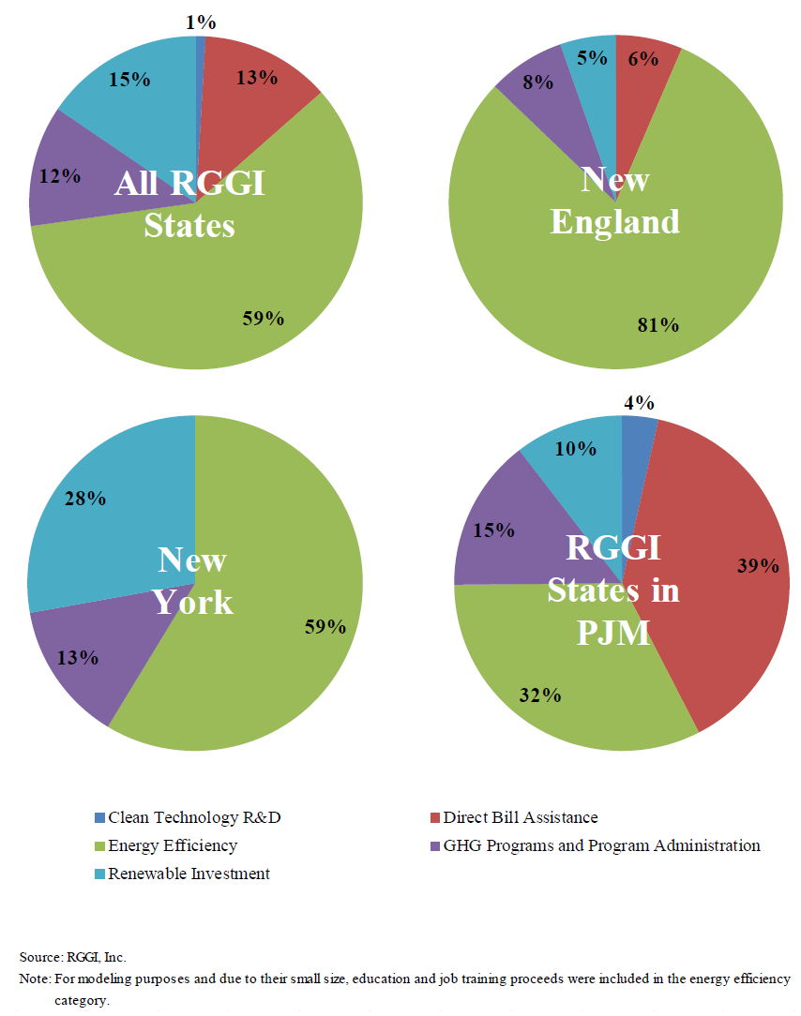
How the 9 RGGI States used the proceeds of RGGI auctions 2011--14 ($983 million):
From Analysis Group evaluation for RGGI States

Slide 8
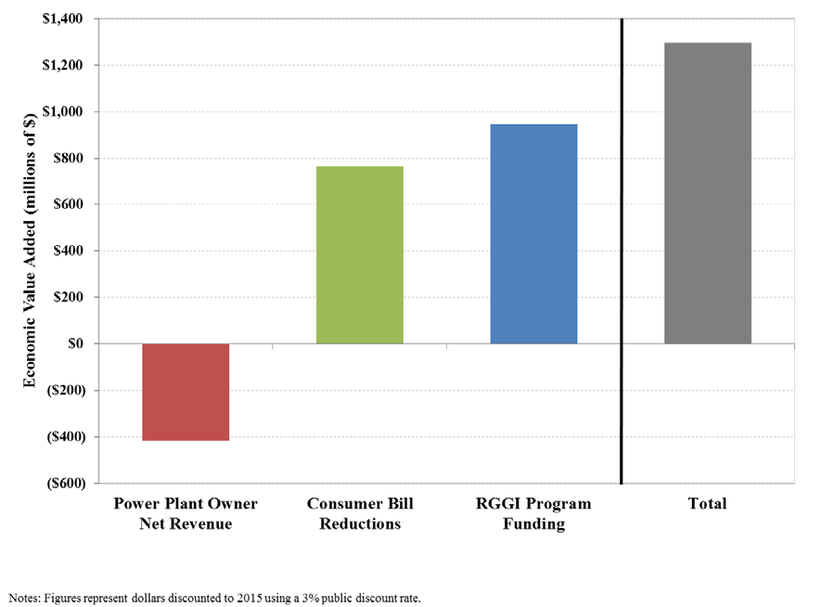
Net Economic Benefits 2012-14
(Analysis Group for RGGI States)

Slide 9
RGGI Part of Broader GHG Policy Context in Northeast
New England Governors & Eastern Canadian Premiers GHG Reduction Goal Agreements
  2001—10% by 2020 and 75-85% by 2050
  2015—35-45% by 2030
  All sectors
State GHG Reduction Plans
  Most states have comprehensive mitigation plans across all sectors for 2020
  Beginning to plan for 2030 (not just forward from 2020 but now must think back from 80% by 2050)

