Slide 1
New England Electricity Restructuring Roundtable
Special Roundtable on Transmission for Decarbonization
Bill Quinlan
September 24, 2021

Slide 2
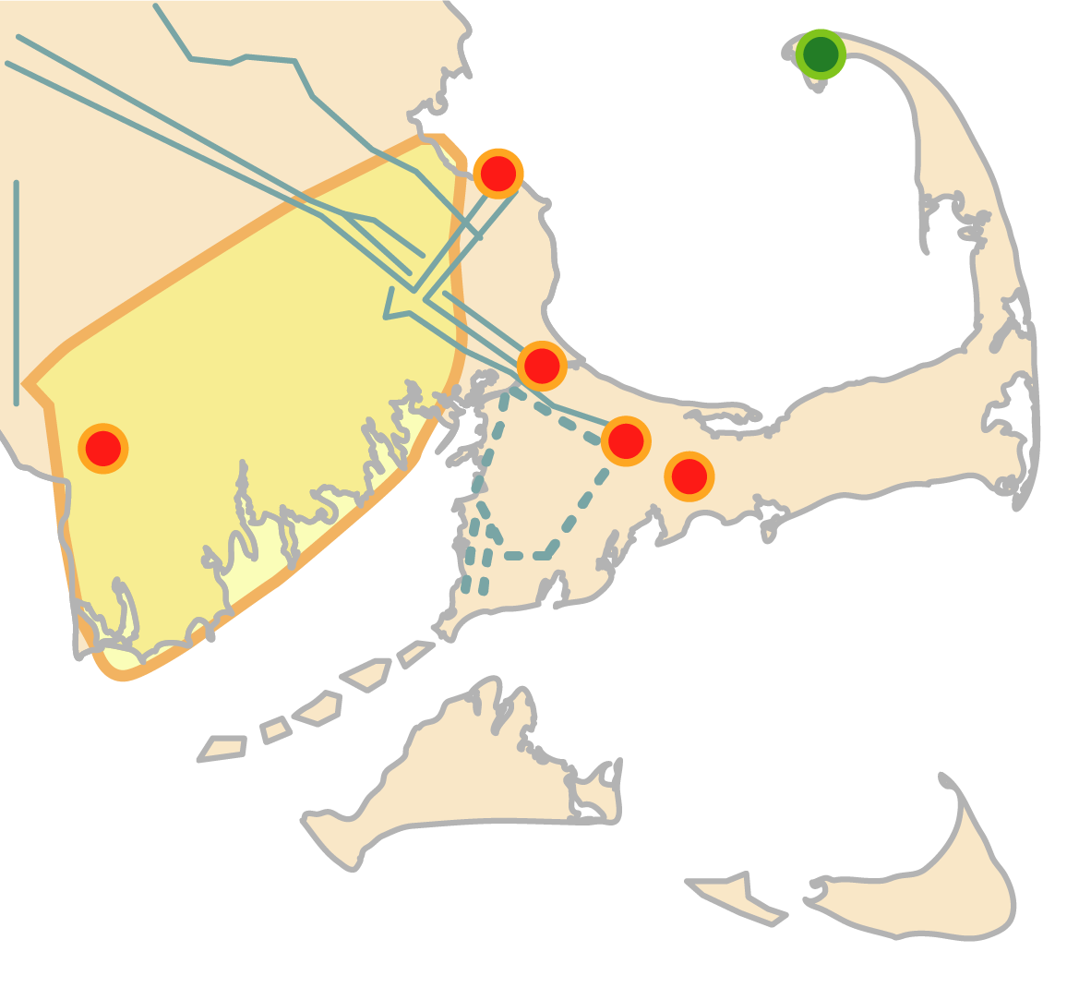
Combining Grid Reliability, Resiliency and Clean Energy
Co-optimized transmission solutions to address reliability needs and interconnect offshore wind Energy storage solution to provide essential back-up power for resiliency Proactively planning for clusters of distributed generation and integrating with local transmission projects
Reliability Upgrades
Areas of High DER Penetration
345-kV Loop and Substation Upgrades
1600 MW
Interconnections
Offshore Wind Interconnection Points
Additional potential interconnections
Battery Storage Project

