Slide 1

Preserving Nuclear Power:
Roles of States and FERC
Ari Peskoe
Senior Fellow in Electricity Law
apeskoe@law.harvard.edu
@aripeskoe

Slide 2
How to Regulate Generation
After Industry Restructuring?
Challenge: Plant revenue not regulated by PUC
Possible Workarounds:
Restrict new generators with environmental regulations or siting rules
    e.g., emission performance standards, CO₂ tax
Induce new generators with utility procurement rules and/or financial products/incentives
    Problem: Legal risk

Slide 3
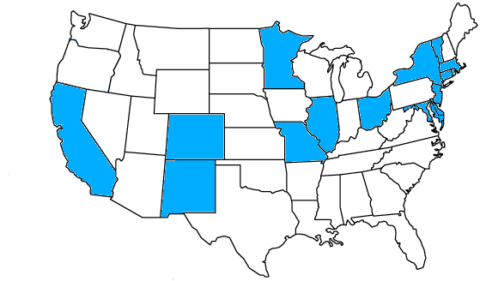
Legal Risks for State Policies
FPA Preemption and dormant Commerce Clause challenges to state electricity policies
www.StatePowerProject.org

Slide 4
Legal Risks for State Policies
Three legal claims about challenged state actions:
Regulate wholesale rates, intruding on FERC’s exclusive jurisdiction (field preemption)
“Stand as an obstacle” to FERC regulation of just and reasonable rates (conflict preemption)
Favor in-state businesses in violation of the dormant Commerce Clause

Slide 5
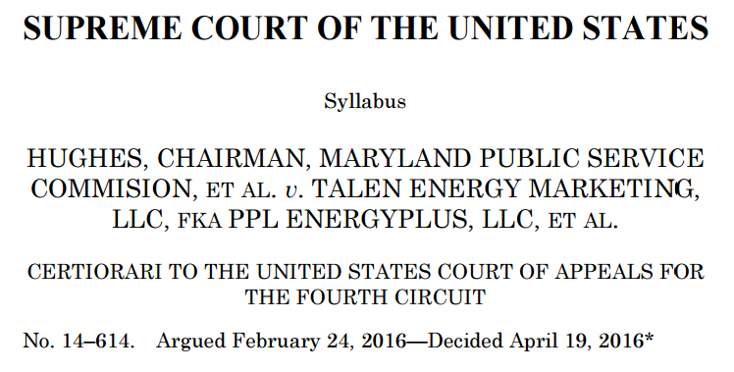
Do ZECs/PPAs Regulate
Wholesale Rates?
Dormant Commerce Clause

Slide 6
Do ZECs/PPAs Regulate
Wholesale Rates?
Dormant Commerce Clause
Our holding is limited: We reject Maryland’s program only because it disregards an interstate wholesale rate required by FERC.
. . .
So long as a State does not condition payment of funds on capacity clearing the auction, the State’s program would not suffer from the fatal defect that renders Maryland’s program unacceptable.

Slide 7
Do ZECs/PPAs stand as an obstacle
To FERC Regulation?
Dormant Commerce Clause
FERC can set RTO rules to counteract the effects of state policies
Plaintiffs have not articulated a limiting principle

Slide 8
Do ZECs/PPAs Discriminate?
Discrimination Against Out-of-State Economic Interests
ZEC qualifications are even handed
Preferring in-state businesses to spur local economic development is prohibited but not always fatal when the state has other aims too

Slide 9
Is There a Legally Sustainable
Path Forward?
FERC’s Post-Technical Conference Notice:
Accommodation of State Actions
Pricing State Policy Choices (“Achieve”)

Slide 10
Is There a Legally Sustainable
Path Forward?
FERC facilitated restructuring without new authorization from Congress:
Market-based rates
Open-access transmission
ISO/RTO Guidelines
Approvals of ISO/RTO formation
Approvals of Energy market rules
Approvals of capacity market rules

Slide 11
Is There a Legally Sustainable
Path Forward?
Just and Reasonable rates:
Balance consumer and investor interests
Enhance competition
Are consistent with the statute’s “principal purpose”

Slide 12
Is There a Legally Sustainable
Path Forward?
In response to a jurisdictional challenge:
FERC’s rationale for market reform must be “all about, and only about, improving the wholesale market”
Court “will not read the FPA, against its clear terms, to halt a practice that so evidently enables the Commission to fulfill its statutory duties”

Slide 13
Conclusions and Questions
ZECs: Legality TBD, probably 2018
  If ZECs are preempted, are RPS laws or RGGI next?
Nuclear PPAs: Weak preemption argument (2nd Circuit decision to come), Commerce Clause concern depends on details of law
  If nuclear PPAs fall, are MA offshore wind, hydro procurements vulnerable?
Integrating public policy in wholesale markets: Will an RTO propose an “achieve” strategy?

