Slide 1
Clean Energy Strategies in the Impending Era of NG Restructuring Roundtable June 15, 2012
N. Jonathan Peress
njperess@clf.org

Slide 2
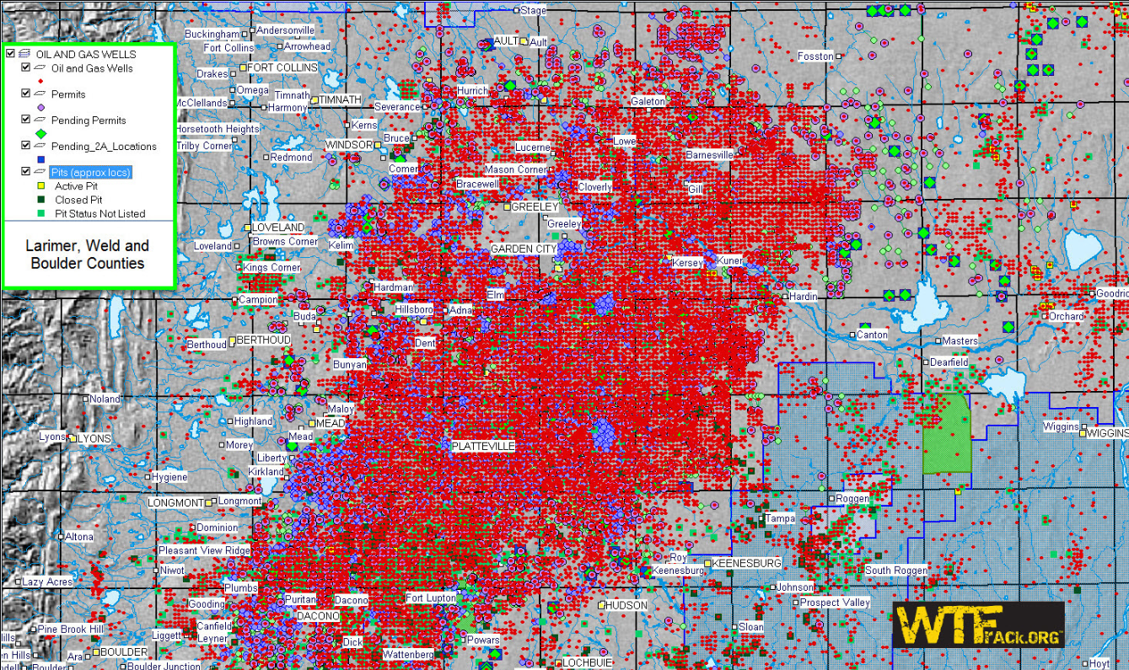
Irrational Exuberance – No Barrel Left Behind

Slide 3
Niche Fuel – Not a Bridge Fuel Near term: Replace the Coal

Slide 4
Longer Term, Support Variable Renewables European Climate Foundation Roadmap 2050 http://roadmap2050.eu/ (Mike Hogan)

Slide 5
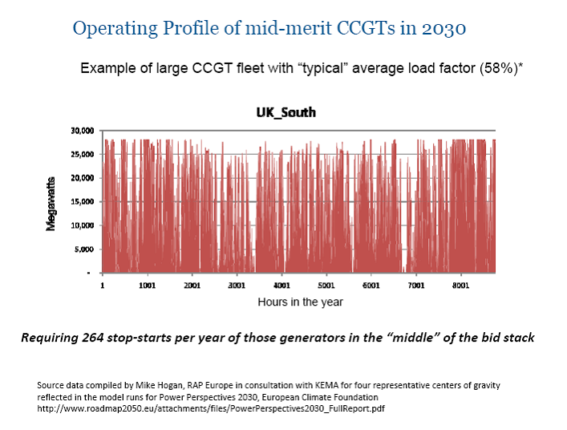

Slide 6
Lower Gas Costs Create System and Policy Challenges
Electricity Market Refinements – to support balancing
Wind Dispatch
FCM – Support market entry by flexible resources
Hourly offers into DAM
Gas Markets – New transportation/pipeline capacity; new products and services to support flexible resources
New gas demand creates reliability challenges
Alters cost effectiveness test for EE and renewables
Notes:
Blended PPA discussion

Slide 7
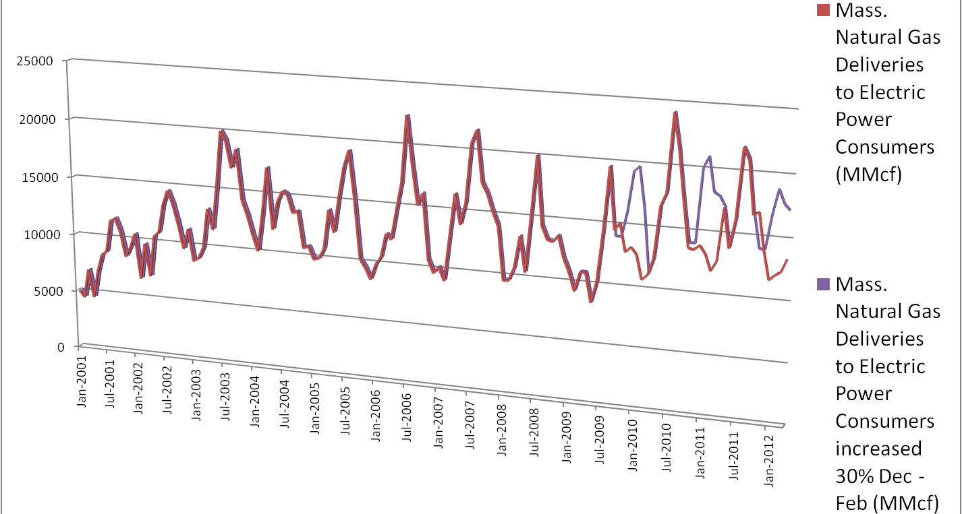
If gas saved by 30% residential efficiency used in power plants Dec – Feb it would raise gas use in those plants up to levels usually seen in July. Back of the envelope confirmation that gas efficiency can “free up” gas that might be needed to meet peak winter electric demand.
In a world where gas is electricity - gas efficiency is electric reliability
Notes:
Also leaks

Slide 8
Renewable Policy Refinements
Long Term Contracting
Optimize to RPS Requirements
Bundling and blending
Regional Procurement
RFP’s based on RPS
Optimize FCM to Policy Objectives (njp)
Infrastructure/Pipeline Expansion Dialog/Proceedings

