Slide 1
New England: Center of Energy Innovation with Big Challenges Ahead
Dr. Jonathan Raab, Raab Associates, Ltd.
www.RaabAssociates.org
February 16, 2015
University of Pennsylvania

Slide 2
New England States: History of Coordination Organizations on Energy/Air Issues
New England Governors Conference
Colonial Days (informally); 1937 formalized
NE States Coordinated Air Use Mgt. (NESCAUM)
(6 NE States 1967; NY 1970; NJ 1979)
NEPOOL and ISO New England/RTO
1971 and 1997/2005
NE States Committee on Electricity (NESCOE)
2007

Slide 3
NE Stakeholder Energy/Climate Engagement Timeline: 1988-2000

Slide 4
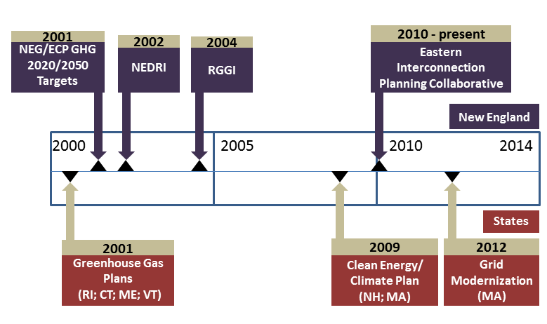
NE Stakeholder Energy/Climate Engagement Timeline: 2001-Present

Slide 5
NE Electricity Restructuring Roundtable
Substance
All NE states except VT restructured in 1990’s (utilities DO NOT own generation anymore—wires only companies)
Unique forum to discuss “current” energy and now climate policy related issues in New England.
Multiple perspectives shared, new ideas often road-tested.
Process
Panels and keynote speakers on current issues/challenges
143 Roundtables held so far! Have been meeting 5-10 times a year for 18+ years in Boston.
Roundtable now averages over 200 participants per session plus 100 live streaming, with listserv of over 3,000 New England stakeholders.
September 2014 Roundtable included US EPA Secretary Gina McCarthy; FERC Chairman Cheryl LaFleur; and ISO New England CEO Gordon van Welie

Slide 6
New England Demand Response Initiative (NEDRI)
Substance
Developed 38 major recommendations for incorporating demand response into retail and wholesale markets in New England.
Covered short-term price-responsive load, retail pricing and metering strategies, reliability-driven DR, and longer-term energy efficiency investments.
Process
Included representative from 45 state and federal agencies, suppliers, consumers, and environmental organizations.
Met for 19 days in plenary session in 2002-2003 (June); included several work groups—developed “consensus” report
Funded by US EPA, US DOE, ISO-New England, the New York ISO, and the Energy Foundation
Regulatory Assistance Project managed technical team (including LBNL/ORNL); Raab Associates facilitated the stakeholder process.
6

Slide 7
Regional Greenhouse
Gas Initiative-(RGGI)
Substance
Developed a greenhouse gas cap and trade system for electricity sector in 10 Northeast and Mid-Atlantic states
Reduces GHG emissions 10% below 1990 emissions by 2020, allows for offsets, and establishes a public benefits fund
2012 review resulted in decreasing 2014 cap 45%, with additional decreases of 2.5%/year 2015-2020
Held over 20 auctions of allowances, and raised over $1.75 billion for public benefit investments (mainly EE)
Process
Original RGGI Process: 24-member regional stakeholder group to provide “advice” and act as “sounding board” for states. Included separate resource panel; ICF and REMI ran energy system and economic modeling; Raab Associates facilitated—9 day-long meetings;
Meanwhile, states negotiated MOU in separate, parallel process, signed in December 2005 by seven states (NY, NJ, VT, NH, CT, DE, and ME) and later joined by MD, RI, and MA but NJ withdrew; PA active observer
7

Slide 8
NE States Develop 2020 Greenhouse Gas Plans Using Stakeholder Processes
Substance
NE Governors & Eastern Canadian Premier agreement to reduce GHG cross all sectors by at least 10% 2020 and 75-80% eventually (now assumed by 2050)
NE States develop comprehensive plans covering buildings, transportation, electricity supply, solid waste, etc.
Reduce GHG emissions by 10-25% below 1990 levels by 2020
Process
States used stakeholder processes to develop plans in different ways—generally includes steering committee, working groups, extensive state involvement, technical consultants, and facilitation
RI (2001-6); CT (2002-4); ME (2003-4); VT (2008); NH (2009); and MA (2010)

Slide 9
Energy Efficiency: ACEEE 2014 State Rankings

Slide 10
Growth in MA Energy Efficiency Savings and Benefits 2008-2013

Slide 12
NE PV, Wind, & EE: Existing & Proposed

Slide 13
Renewables: Policies
Renewable portfolio standards (RPS)
Increasing % of electricity each year must come from new qualifying renewables—most NE states have this
Net metering
Distributed electricity generation (e.g., rooftop solar) is sold back to the utility at retail rates
Additional state incentives
Renewable systems benefit charges
Solar Renewable Energy Credits (SRECs)
Challenges
Solar/wind are intermittent resources—need traditional generation, hydro, or storage to back up
Safety concerns related to interconnection and feeding grid
Relatively high cost (compared to EE) and revenue erosion for utilities related to selling back at retail

Slide 14
Renewables: PV/Solar
New England:
500 MW already installed in all of NE; and ISO New England estimates 1,800 MW by 2023
Massachusetts
Goal of 250 MW by 2017, but reached goal in 2013 and now almost 700 MW installed
Installations in 350 of 351 MA cities & towns
4th nationally in new capacity being added
Former Governor Patrick upped goal: 1,600 MW by 2020
But what will new Governor Baker do? Still relatively expensive energy, and rates are high.

Slide 15
Renewables: Wind
On-Shore
800 MW installed, and over 3,000 MW in interconnection queue
But most will not likely be built
Mainly in northern NE and need transmission to get to population centers in MA, CT, and RI
Plagued by visual impact and noise battles
Off-Shore
Cape Wind was first off-shore proposal in U.S. (over 300 MW), but after 10 years of legal battles apparently died last month
Nonetheless NE considered Saudi Arabia of off-shore wind, and late January over 700,000 acres of off-shore wind auctioned by BOEM off MA/RI

Slide 16
Grid Modernization
Focus on grid- and customer-facing modernization
Building a new platform (think smart phone) for private sector and customers to innovate (think apps, think Nest thermostats)
Integrating distributed resources and electric vehicles, and handling two-way power flow
Demand response and smart appliances
Likely need Advanced Metering Functionality—can be very expensive
Time Varying Rate
MA Basic Service will be Time of Use Rate with Critical Peak price and opt out to peak time rebate

Slide 17
Change in NE Electric Mix: 2000-13

Slide 18
Energy Infrastructure
NE at end of gas pipelines
Reliance on natural gas increasing substantially
Gas-fired electric generation increased from 15% to 46% between 2000 and 2013
Conversion from oil to gas space heating (e.g., 1/3 of Boston’s oil heat converted to gas last decade)
Challenge:
Gas generated electricity doesn’t have firm gas contracts so supply not guaranteed
Electricity rates increased 60-70% this winter due to these constraints

Slide 19
Summary: Major NE Energy Challenges
Building a major new gas pipeline (or two) into NE to reduce gas/electricity prices and enhance reliability in short-run, without undermining GHG goals
Building transmission through Northern NE to bring low-carbon, less expensive resources to Southern NE
Continuing to ramp-up EE, when already paying most per customer in U.S. (MA over 1 cent/kwh)
Continuing to develop solar, when rates are high and its still relatively expensive
Harnessing off-shore wind
Modernizing the electric grid, and exposing customers to time varying rates

