Slide 1
New England Electricity Restructuring Roundtable Discussion
June 15, 2012
Rich Paglia
Vice President

Slide 2
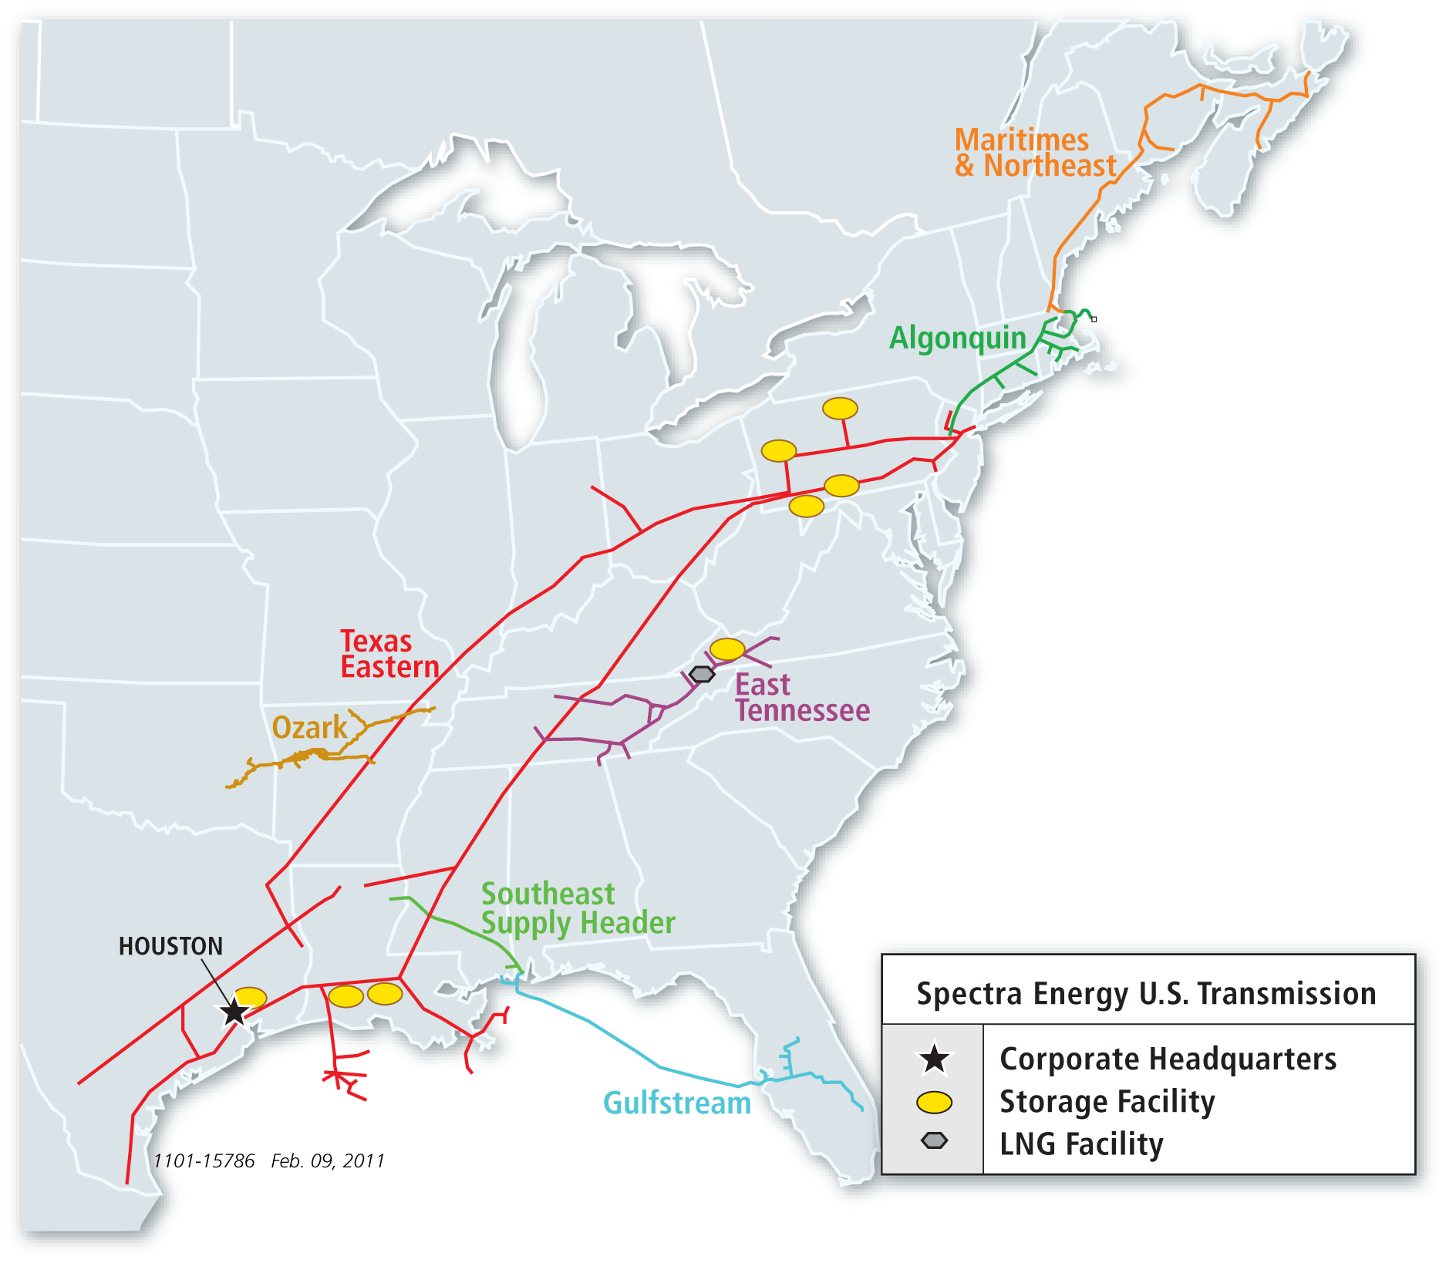
Spectra Energy U.S. Transmission Map
Miles of Pipe 14,007
Number of Compressor Stations 125
Total Horsepower 1,962,667
Storage Capacity 158 Bcf

Slide 3
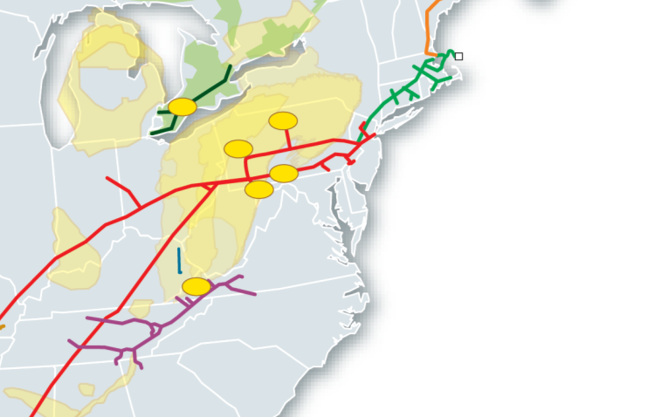
New Infrastructure in Response to Increase in Northeast Shale Supplies
Connecting Marcellus & Utica Supplies to Our Diverse Markets
Texas Eastern Appalachia to Market TEAM 2014
Providing producers access to diverse Texas Eastern markets
TORONTO
BOSTON
Union Gas
AIM
Ohio Pipeline Energy Network
OPEN (2014)
Connecting Utica production to diverse Texas Eastern markets
NEXT
NEW YORK
OPEN
PHILADELPHIA
Northern Expansion Transmission NEXT (2016/2017)
Providing Appalachian producers access to Eastern Canada LDC & power markets
TEAM 2014
Algonquin Incremental Market
AIM (2015)
New England market pull combined with Northeast PA supply push
$2 – $4B in expansion
opportunities in 2014-2017
Renaissance
Renaissance Gas Transmission
Renaissance (2015)
Appalachian supply to Northern Georgia & Atlanta markets
ATLANTA

Slide 4
The Need for Additional Algonquin Gas Transmission (“AGT”) Capacity
Algonquin City Gate demand is growing
  LDC’s projecting moderate growth
  ISO New England is projecting substantial growth
Abundant supplies pushing to the doorstep of AGT
  Producers investing in infrastructure upstream of AGT
  Lower upstream prices reflect an abundance of natural gas supply
Pipeline restrictions have increased despite record warm winter
  Lower priced supply on the west end of the system is chasing demand at the city gate
End users without firm capacity are at an increased risk for interruption
New England needs additional pipeline capacity to benefit from lower energy costs

Slide 5
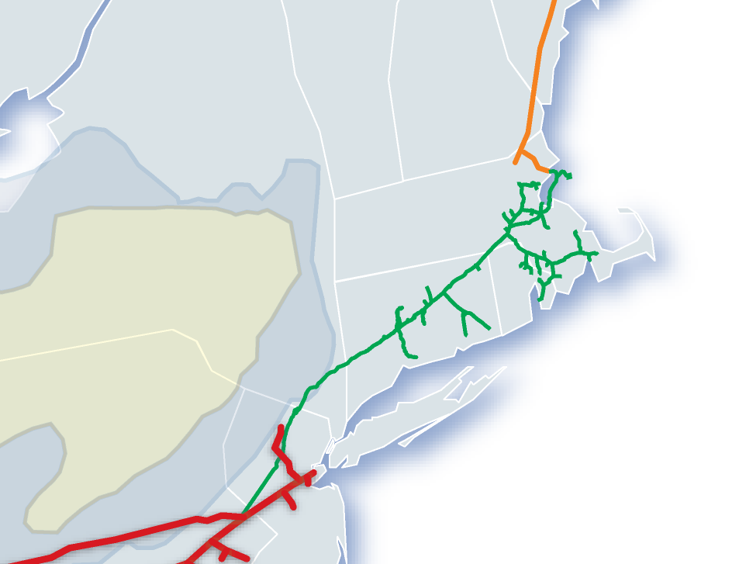
Algonquin Pipeline – Critical Fuel Delivery System for ISO New England Power Plants
Texas Eastern
Algonquin Has Greatest Share of ISO New England Generation
(Over 40% of Gas Fired Generation)
Algonquin
Maritimes & NE
Millennium
Iroquois
Tennessee Gas
Pipeline
19
BOSTON
21
11
Power Plants currently served by AGT
# | Plant Name | (MW) | ~ MDth/d
Natural Gas Only
1 | ANP Bellingham | 523 | 105
2 | Bellingham | 337 | 67
3 | Dartmouth Power | 68 | 14
4 | Dighton Power | 177 | 35
5 | Kleen Energy | 620 | 124
6 | Lake Road | 564 | 113
7 | Manchester Street | 510 | 102
8 | Milford Power | 171 | 34
9 | Ocean State Power | 635 | 127
10 | Genconn Power | 197 | 39
11 | Fore River | 837 | 167
12 | Tiverton | 279 | 56
13 | Wallingford Energy | 241 | 48
Total Natural Gas Only: |  | 5,157 | 1,031
Natural Gas / Oil Cogeneration
14 | Brayton Point | 446 | 89
15 | CMEEC - Pierce Power | 96 | 19
6 | Lake Road | 281 | 56
16 | Middletown | 365 | 73
17 | Mirant Canal | 561 | 112
18 | Montville | 82 | 16
19 | Potter Street (BELD I) | 92 | 18
20 | TMLP | 110 | 22
21 | Watson Generating (BELD II) | 115 | 23
Total Cogeneration: |  | 2,148 | 430
Total Gas Only & Cogeneration: |  | 7,305 | 1,461
8
1
9
2
4
20
17
6
7
14
12
3
5
10
MARCELLUS
SHALE
13
16
18
15
NEW YORK

Slide 6
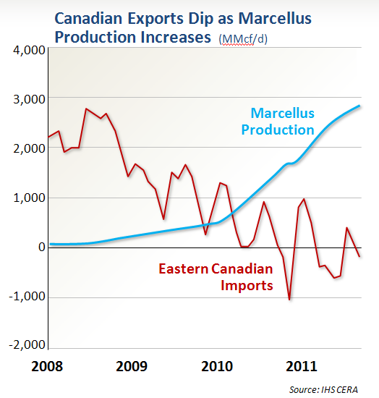
Algonquin Expansion Necessary to Transport New Supplies to New England Power Markets
Waddington
Texas Eastern
Algonquin
(~700) MDth/d
(Supply Reduction)
Maritimes & NE
Millennium
Iroquois
Tennessee Gas
Pipeline
BOSTON
New Infrastructure needed to move gas to market
MARCELLUS
Wright
~ 700 MDth/d
~ 500 MDth/d
Current Pipeline Bottleneck
Ramapo
~ 900 MDth/d
Mahwah
NEW YORK
~ 300 MDth/d

Slide 7
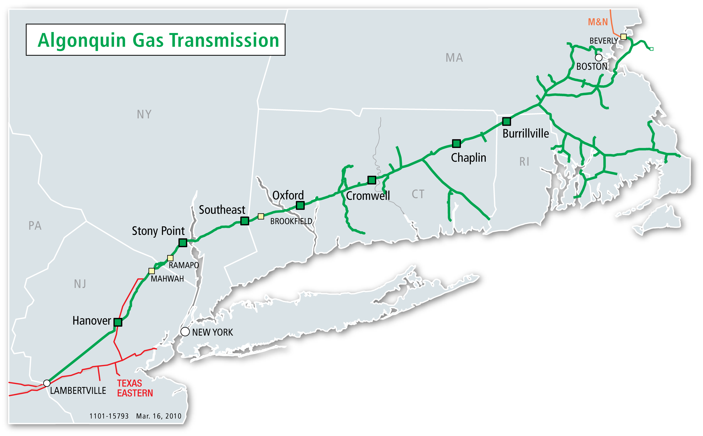
Algonquin Incremental Market Expansion (AIM)
271 MDth/d
Marcellus
512 MDth/d
Project Details:
Pipeline expansion designed to move emerging production to AGT city gates
512 MDth/d from Ramapo to Brookfield
271 MDth/d from Brookfield to AGT City Gates
2016 In-service
Next Steps:
Identify anchor shippers
Binding Open Season
Finalize PA’s
IROQUOIS

Slide 8
Benefits of Infrastructure Expansion
The time is right for infrastructure investment
  Upstream parties have made significant investments to get supplies to AGT receipt points
  Supplies will chase demand in other regions if New England doesn’t come to the table
Additional pipeline infrastructure is the key to reliably securing natural gas fuel supplies
  Firm shipper demand is expected to grow
  Prior pipeline flexibility may not be representative of future operations
  Majority of power generators still opting for non-firm, or interruptible pipeline capacity/supply given that the electric market does not provide a proper valuation for such services

Slide 9
Benefits of Infrastructure Expansion (cont.)
Cost savings
  Additional pipeline capacity could lower natural gas costs in New England
  Concentric Energy Advisors estimates $600 MM + in savings for New England
    ~$300 MM direct benefit from additional pipeline infrastructure
      Assuming $150 MM cost of service, $1 investment yields $2 savings
($ millions) | Total Benefit (i.e., New England Infrastructure and Access to Increased Northeast Shale Gas Production) |  |  | Direct Benefit of New England Infrastructure
Electric Segment
1. Reduction in New England Price Premium | $122 | to | $162 | $122 | to | $162
2. Reduction in Mid-Atlantic Prices | $256 | to | $305 | $94 | to | $112
3. Oil Generator Displacement | $6 | to | $28 | $6 | to | $19
Total Electric Segment | $384 | to | $495 | $223 | to | $293
LDC Segment | $38 | to | $138 |  | $21
Total Cost Savings | $422 | to | $633 | $243 | to | $313

