Slide 1
150th New England Electricity Restructuring Roundtable
May 18th, 2016
Thoughts from the MIT’s Utility of the Future Study
Prof. Ignacio J. Pérez-Arriaga
CEEPR Center for Energy & Environment Policy Research, MIT
IIT Institute for Research in Technology, Comillas University
Notes:
I agree with the major items that you suggest, but I would place them (as I think now, I might change my mind until I write the presentation) in a different order and with different emphasis:
1. Evidence of the presence and significance of DERs. What happens in power systems with DERs. Reaction of regulators, incumbent industry and new business models.
2. Let’s facilitate the participation of DERs:
- in wholesale markets
- providing local services in the distribution network
- creating adequate structure of the power sector
3. The need for a comprehensive system of prices and charges
- the response of DERs to prices & charges
- the impact of the response of DERs on networks & provision of services in general
- economies of scale versus locational benefits, for some types of DERs
- grid defection
4. END

Slide 2
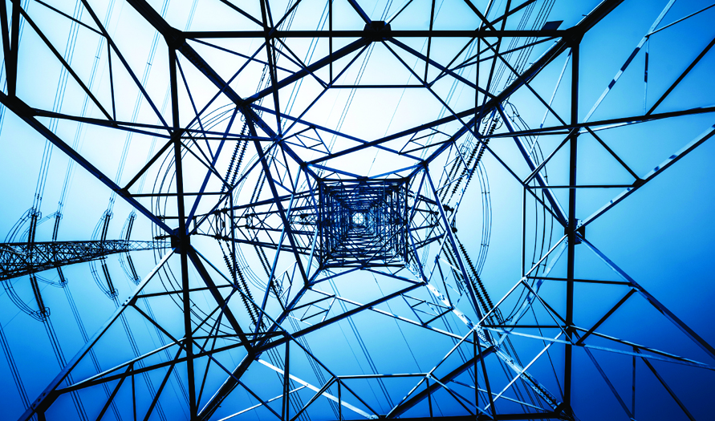
The MIT Utility of the Future Study
INFORMATION NOT FOR PUBLIC DISTRIBUTION – CONTAINS PRELIMINARY, UNPUBLISHED RESEARCH RESULTS
May 18th, 2016

Slide 3
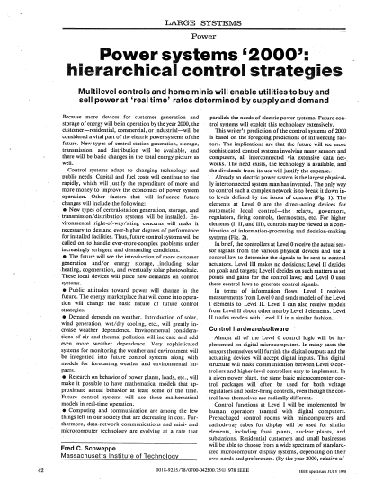
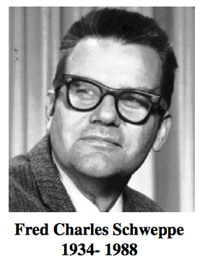
This is what Prof. Fred Schweppe anticipated in 1978

Slide 4
What does the MIT study say about how to price renewables?
This is a question that a journalist asked me recently. My answer was: “nothing”

Slide 5
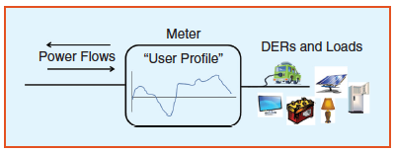
We want to understand what happens (& examine the consequences) if we are technology neutral

Slide 6
Reality requires a change of mentality...

Slide 7
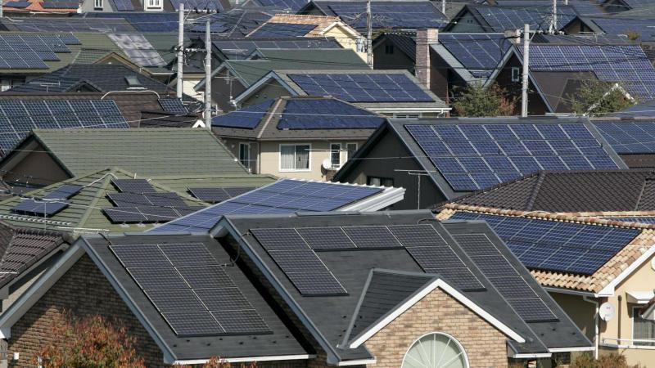
Sunday, August 23rd, 2015, solar PV (24 GW) & wind (18 GW) covered 42 GW out of the 55 GW of peak demand in Germany, thus more than 75% of demand was covered by intermittent renewables
Notes:
2015-08-31-El Periodico de la Energía
El número de instalaciones de almacenamiento de energías solar subsidiadas se ha incrementado en más de un 35% en un año en Alemania. La caída de los precios y el deseo de independencia energética están impulsando esta alta demanda.
En los primeros siete meses de 2015, el banco de desarrollo alemán KfW ha apoyado un 35% más de proyectos de almacenamiento de energía solar que en el mismo periodo en el 2014. Desde que el gobierno federal alemán puso en marcha el programa de apoyo al sistema de almacenamiento de energía fotovoltaica en 2013, se han instalado más de 12.000 sistemas de almacenamiento de fotovoltaica.
La Asociación de la Industria Solar Alemana (BSW-Solar) considera que las principales razones de este importante crecimiento son la fuerte caída de los precios de los productos de almacenamiento, unos incentivos atractivos y el deseo de los clientes de reducir su dependencia de las compañías eléctricas. En total, hay aproximadamente 25.000 soluciones de almacenamiento de energía solar en operación, de los que casi dos terceras partes se encuentran en los estados de Renania del Norte-Westfalia, Baviera y Baden-Württemberg.
El KfW está apoyando las instalaciones de almacenamiento fotovoltaico con ofertas de préstamos a bajo interés. Por otra parte, hasta el 30% de los costos de instalación puede optar a la prima de amortización. También se apoya la modernización de las instalaciones siempre que éstas hayan entrado en funcionamiento antes del 1 de enero de 2013. El programa de apoyo continuará al menos hasta el final del año, según declaraciones del portavoz de KfW que recoge el portal pvmagazine

Slide 8
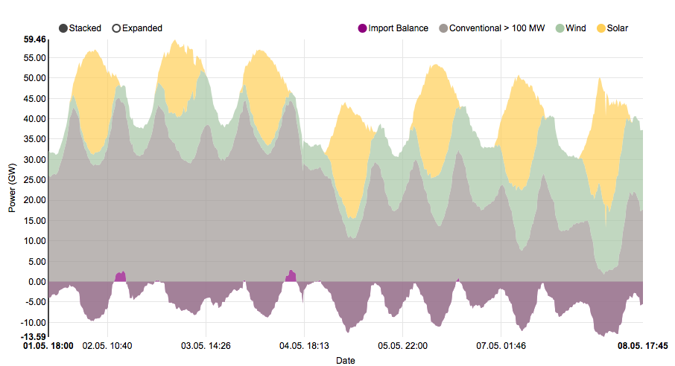
https://www.energy-charts.de/power.htm

Slide 9
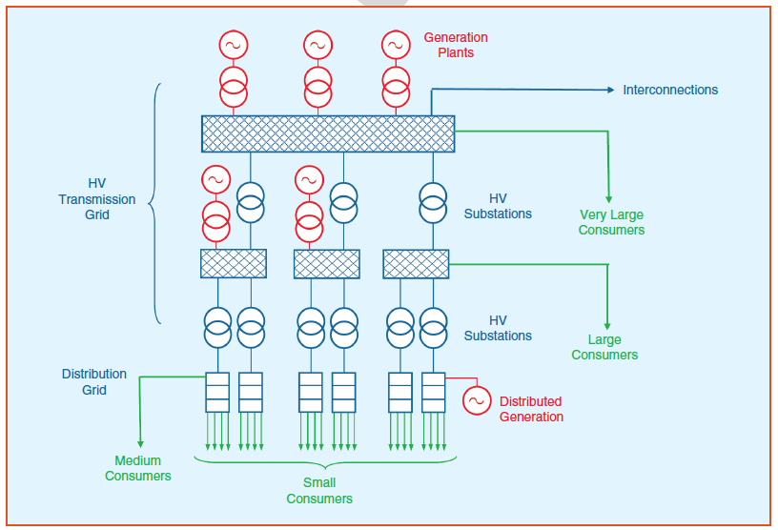
The presence of DERs is forcing us to abandon the customary “electricity trickling down” mind set…
Notes:
The extension of LMPs to distribution begins to blur the traditionally neat delineation between bulk power and distribution (wholesale and retail) as service provision, market participation, and pricing principles are applied more symmetrically across transmission and distribution system users

Slide 10
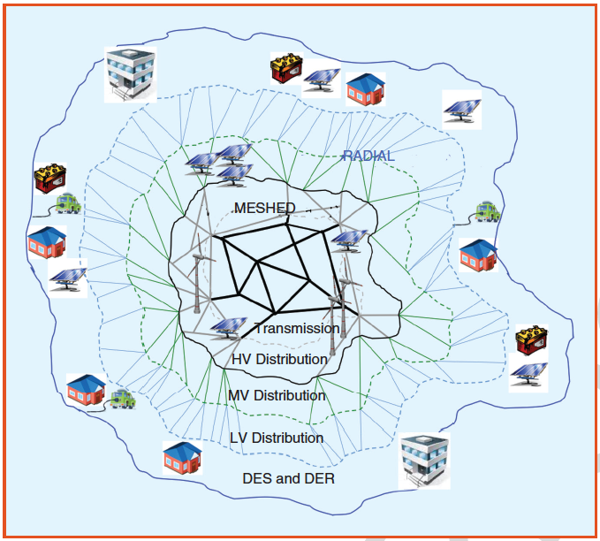
… & replace it by one where DERs could be on an equal footing with centralized resources in providing services…
Notes:
The extension of LMPs to distribution begins to blur the traditionally neat delineation between bulk power and distribution (wholesale and retail) as service provision, market participation, and pricing principles are applied more symmetrically across transmission and distribution system users

Slide 11
… with immediate implications
A new world opens at distribution level
The border meshed/radial becomes most meaningful than T/D
From LMPs to DLMPs? Just DLMPs?
Network-wide cost allocation?
& many more issues & questions

Slide 12
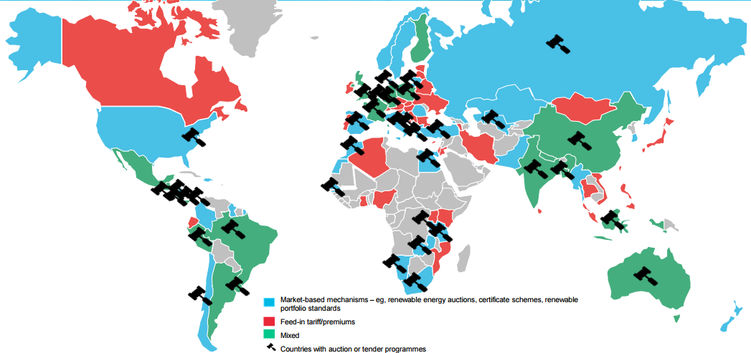
New technologies are emerging, driven by policy intervention…
Market-based mechanisms (auctions, certificates, RPS, etc.)
Feed-in tariffs/ premiums
Mixed
Source: Michael Liebreich, In search of the miracles, Bloomberg New Energy Finance Summit
Auctions or tenders

Slide 13
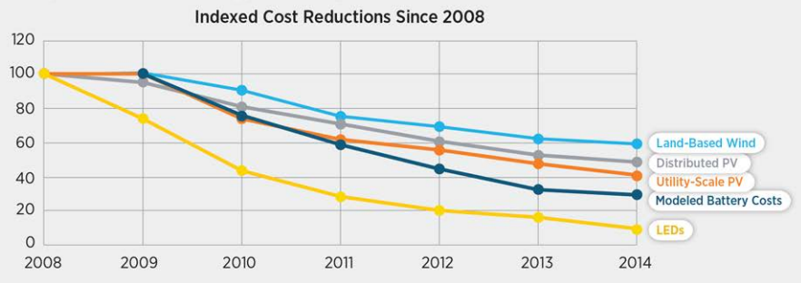
New technologies are emerging, driven by policy intervention… AND innovation!
Deployment and innovation have created a virtuous cycle that has driven massive cost reductions
Source: U.S. DOE, Revolution… Now: The Future Arrives for Five Clean Energy Technologies – 2015 Update

Slide 14
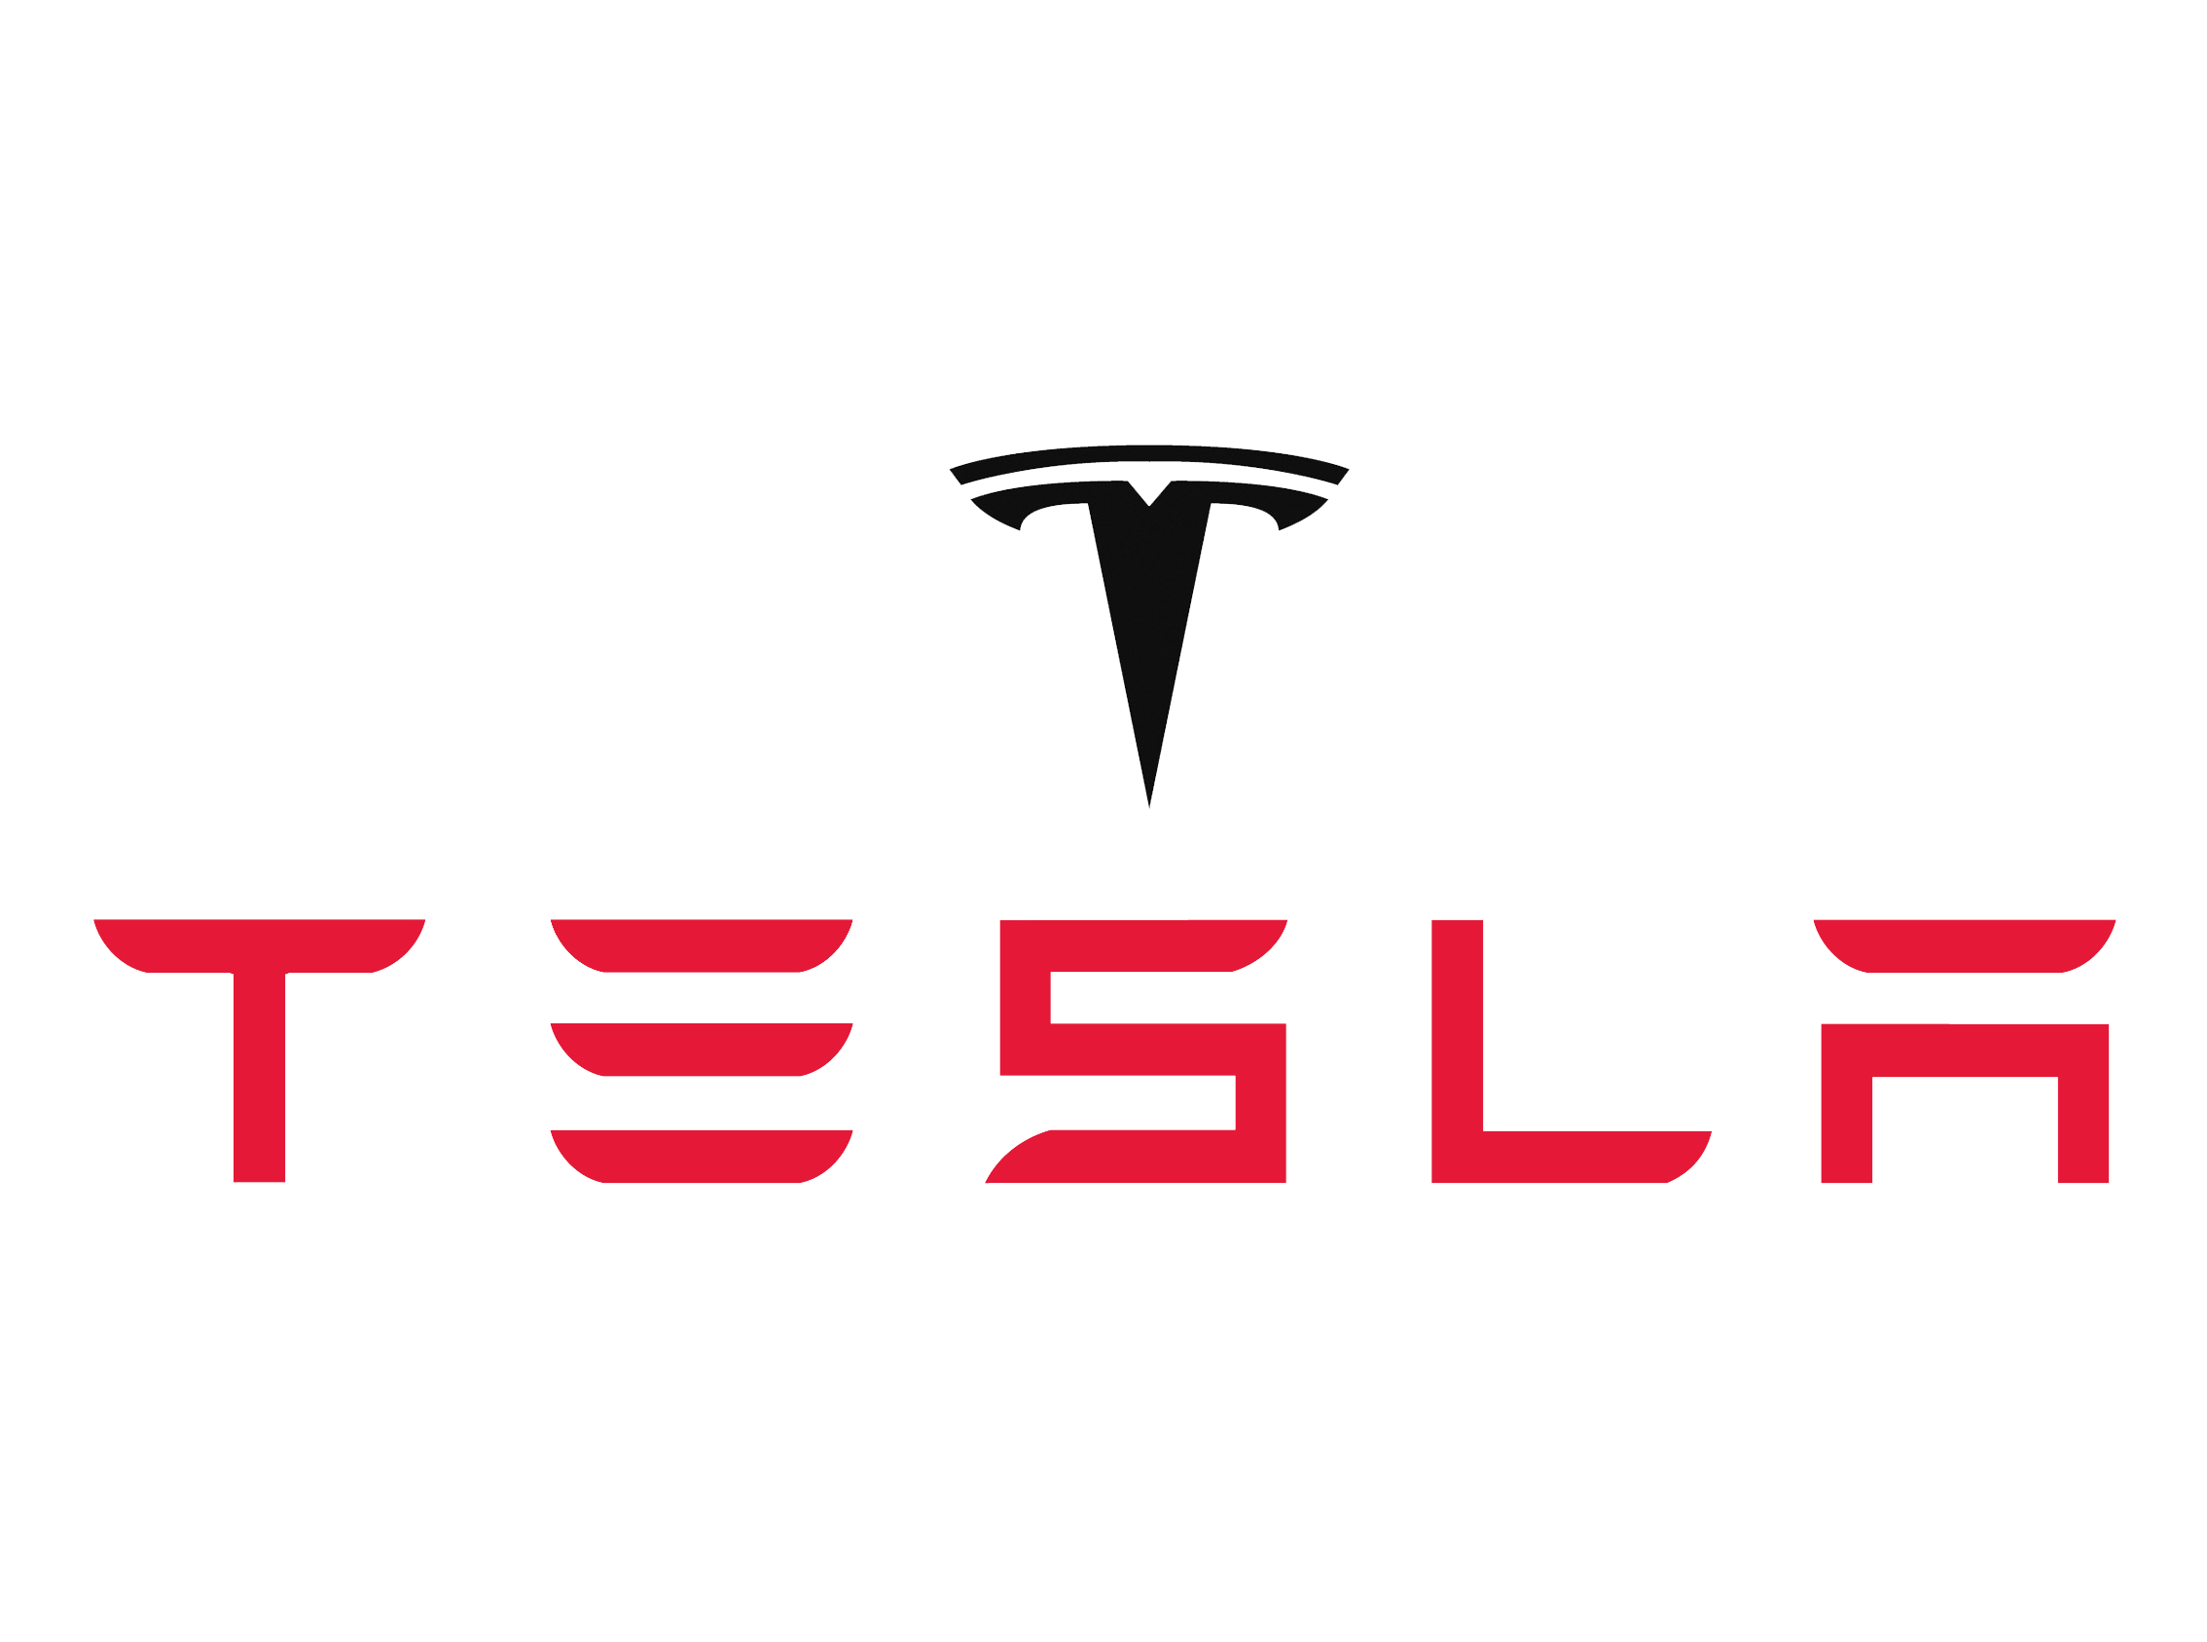
And industry is responding… in BIG ways…
Major utility restructurings
Major acquisitions and investments
Billion dollar companies and bankruptcies

Slide 15
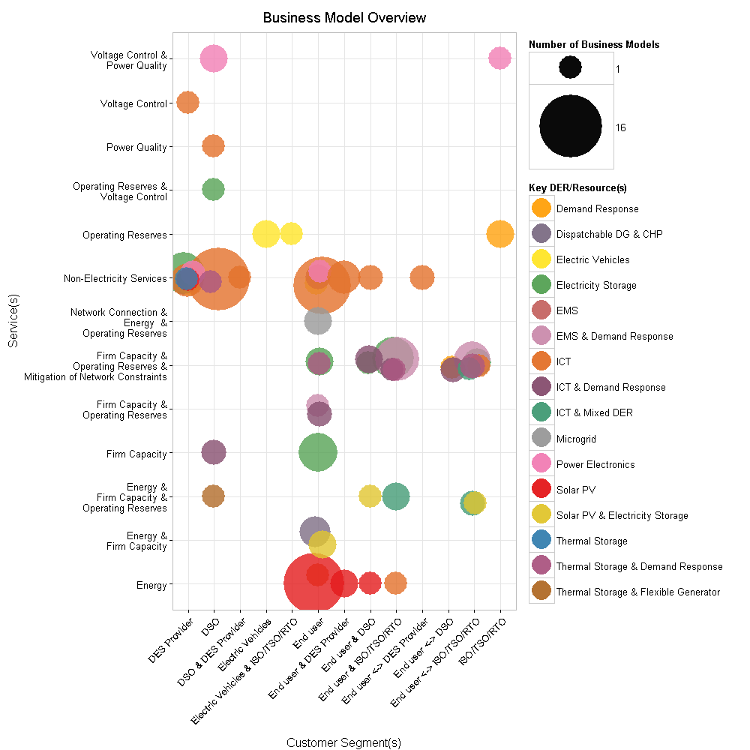
… and with countless business models

Slide 16
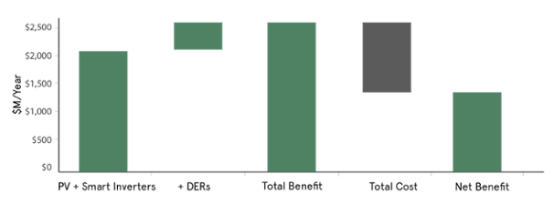
Some say that these changes are massively beneficial…
SolarCity believes distributed solar provides a $1.4B per year net benefit to California
$1.4B in net benefits?
Source: SolarCity, A Pathway to the Distributed Grid

Slide 17
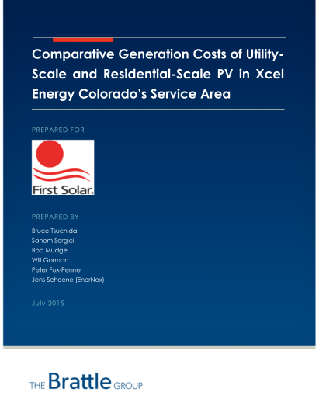
While others say that these changes are massively detrimental…
The Brattle Group believes distributed solar costs a net $800M per year to Colorado
$800M in net costs?
Source: The Brattle Group, Comparative Generation Costs of Utility- Scale and Residential-Scale PV in Xcel Energy Colorado’ s Service Area

Slide 18
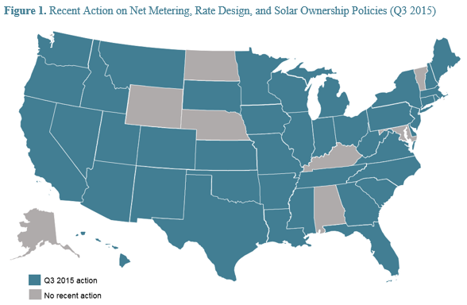
Policy and regulation are attempting to respond, but slowly so far…
42 of 50 U.S. states are taking policy or regulatory action on DERs
Source: The 50 States of Solar: A Quarterly Look at America’s Fast-Evolving Distributed Solar Policy Conversation, North Carolina Clean Technology Center

Slide 19
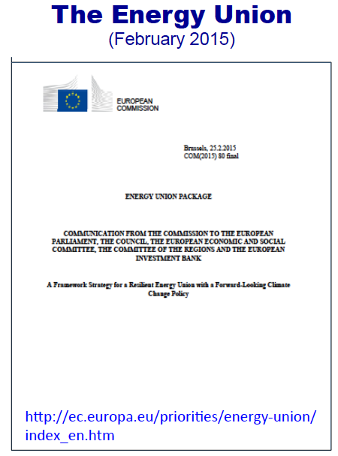
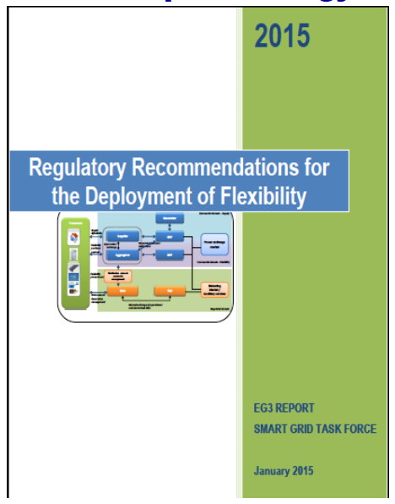
… & regulatory action is taking place on both sides of the Atlantic & also everywhere

Slide 20
In the MIT Future of Solar study we evaluated the impact of solar PV at bulk & distribution system levels…

Slide 21
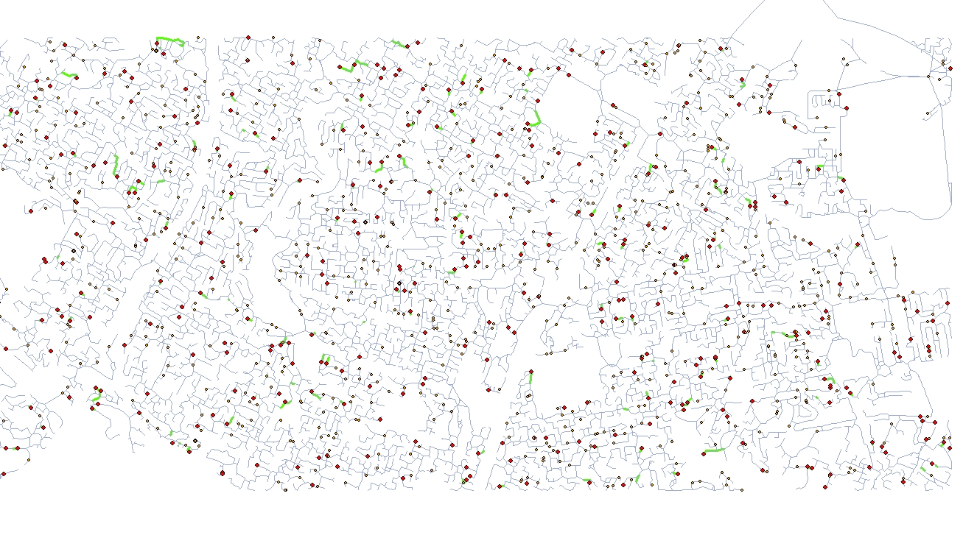
Reference Network Model
3% Penetration
Source: MIT Solar Study
(*) Model RNM developed by IIT-Comillas University

Slide 22
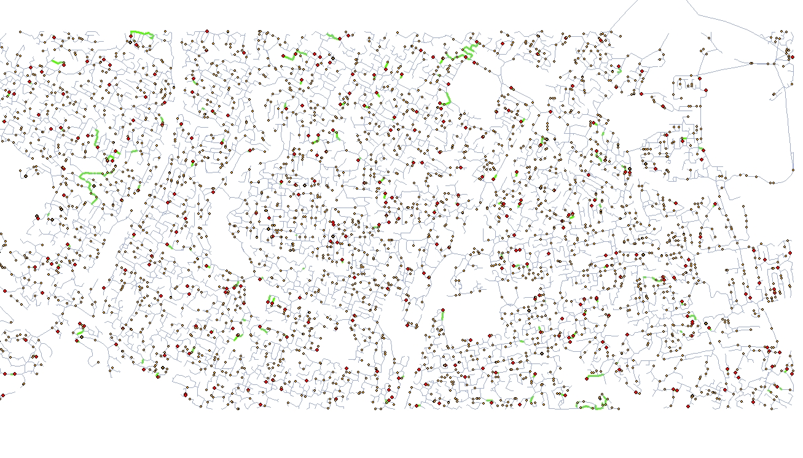
Reference Network Model
8% Penetration
Source: MIT Solar Study

Slide 23
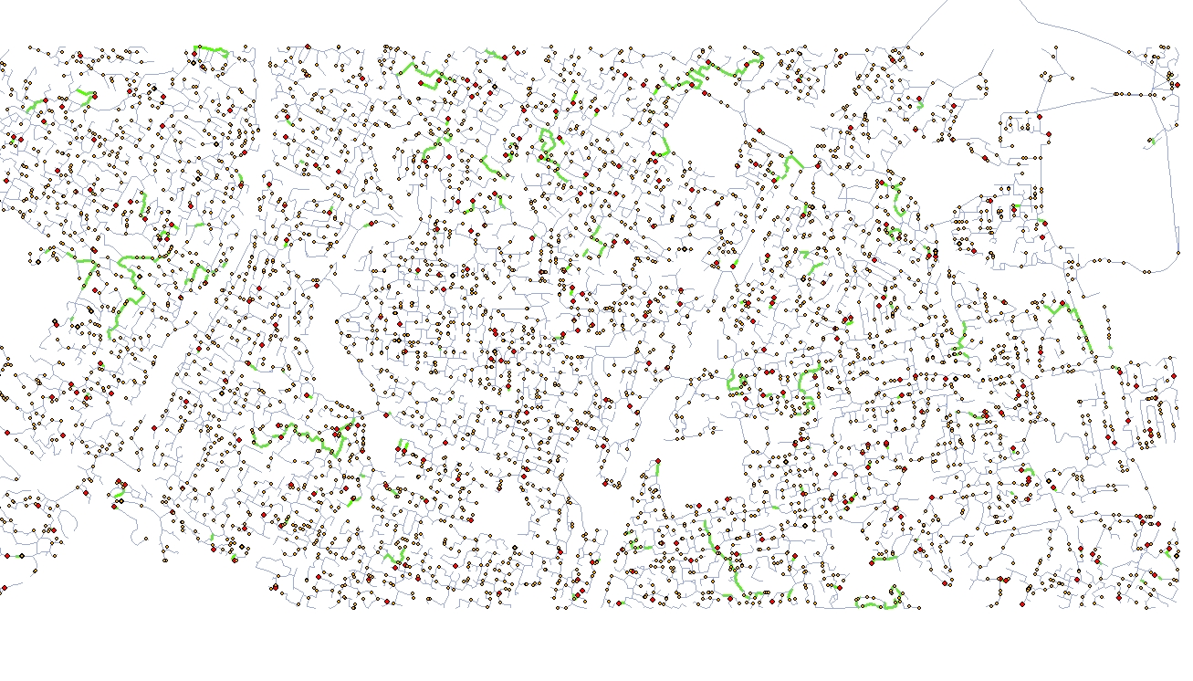
Reference Network Model
11% Penetration
Source: MIT Solar Study

Slide 24
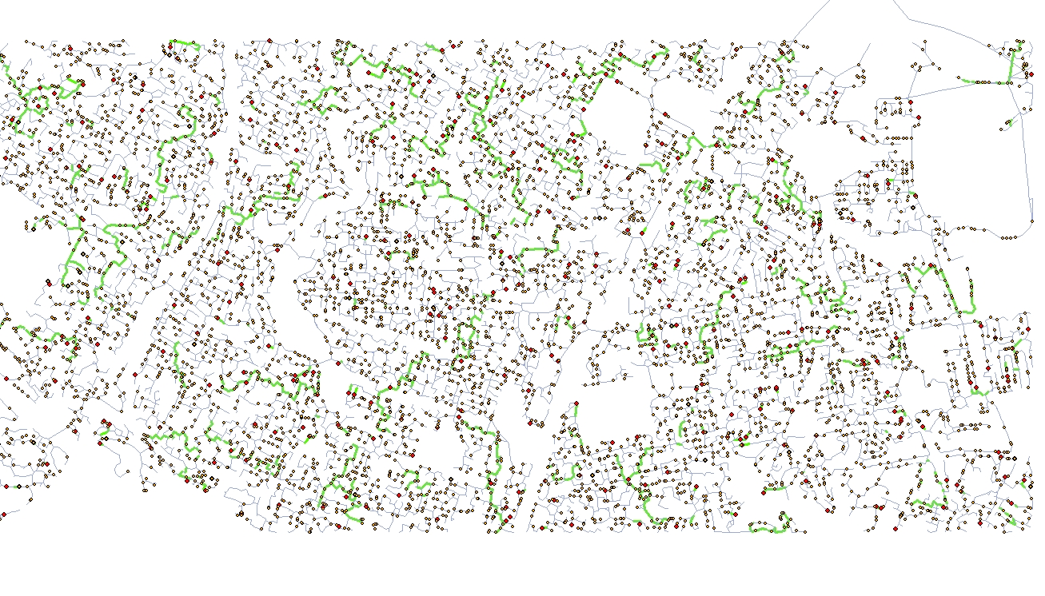
Reference Network Model
14 % Penetration
Source: MIT Solar Study

Slide 25
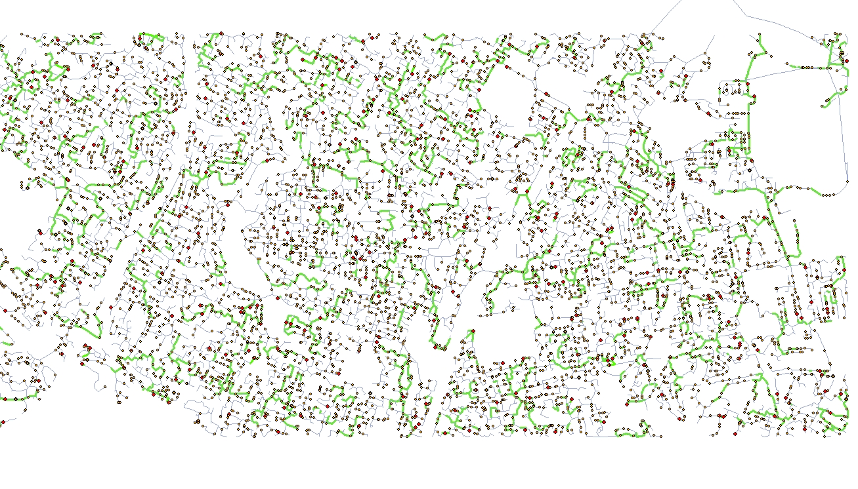
Reference Network Model
17% Penetration
Source: MIT Solar Study

Slide 26
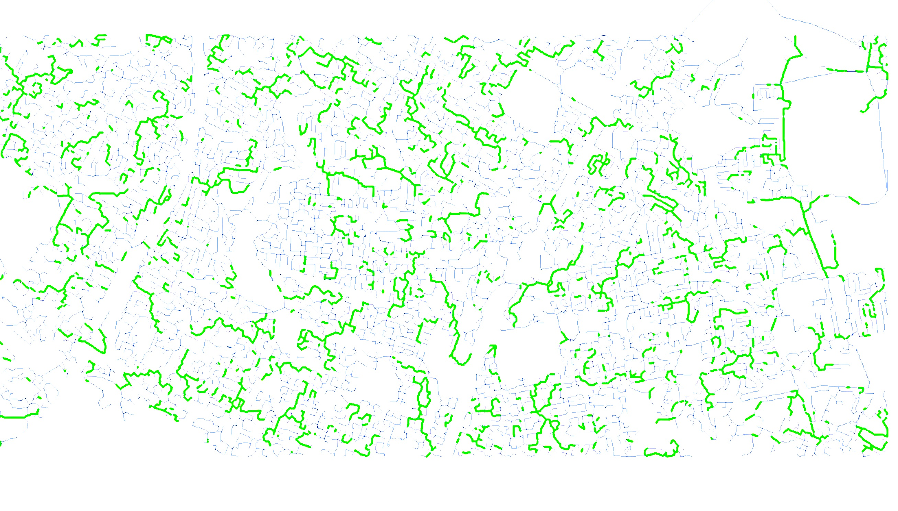
Reference Network Model
Distribution network reinforcements &their their associated costs can be significant
17 % penetration
Source: MIT Solar Study
Notes:
At 30% penetration of distributed solar

Slide 27
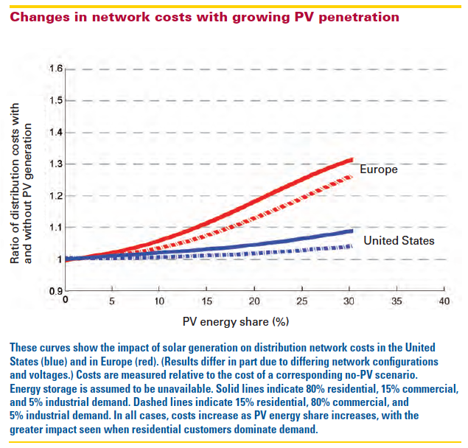

Slide 29
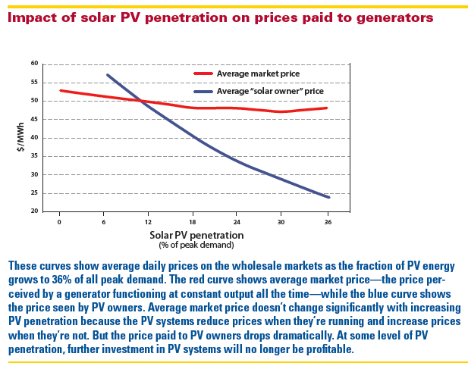

Slide 31
In the MIT Utility of the Future study we go beyond “impact” & explore “living with a strong presence” of DERs at bulk & distribution system levels…
The MIT Utility of the Future Study

Slide 32
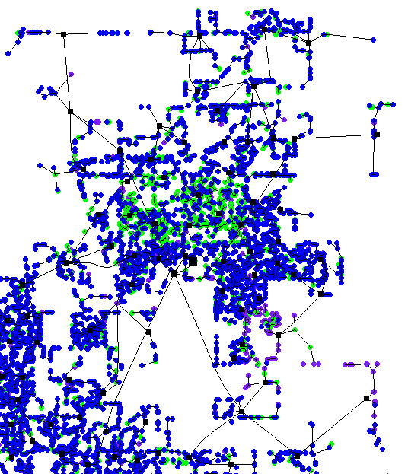
Examining the DERs – grid interaction

Slide 33
The MIT Utility of the Future study

Slide 34
Why this MIT study?
There is ample evidence that distributed energy resources (DER) must be taken seriously
There is very high penetration in some systems now,
the power sector believes in & experiences changes
& the regulators promote & are getting ready for these changes

Slide 35
Why this MIT study?
… but it is uncertain
the economic viability of DER
the extent of their future relevance,
how the power sector would be structured & would function with a large presence of DER
& the regulation that would be needed in a future with DER

Slide 36
Implications
Future power systems with DERs may behave differently & have a different mix of technologies
Future electricity services might be provided differently, by new agents with new business models ➔ the structure of the power sector may change
Present regulation of markets & networks seems inadequate to deal with a system with DERs
Barriers impede the full participation of DERs in the provision of services
DERs do not receive the right economic signals that allow them to participate efficiently

Slide 37
Questions
Do (any of the) DERs make economic sense? Any other sense? How much penetration of the diverse DERs is economically viable?
What happens in a power system (at distribution & bulk levels) with lots of DERs?
What future mix of centralized & decentralized resources makes economic sense?
How should the regulation of markets & networks be adapted to guide in this situation?

Slide 38
Our approach
First, in-depth understanding of the fundamentals…
Services, prices & charges, trading platforms, evaluation of technologies & business models
… while being aware of the present situation of the power sector, under different regulatory frameworks, its shortcomings & any existing trends
Formulation of questions & hypotheses
Then, use computer models to test some of our hypotheses
And finally produce some findings & recommendations

Slide 39
The computer models that we have used
Portfolio of models covering the entire power system
DR DRE & DER-CAM (price-taker DER optimization) & PEV AG (electric vehicles): Operational
RNM (Distribution network planning): Operational
D-Sim (Distribution network simulation for DLMP calculation): Development
ROM+ (UC & ED with network representation): Operational
PSO (UC & ED with network representation): Operational
GenX (capacity expansion with DERs): Development
Trans.
GenX
PSO
In development
Gen.
ROM+
Complete
Dist.
RNM
D-SIM
DER
PEVAG
DER-CAM
DR DRE
Level of detail of the physical system

Slide 40
Findings & recommendations
Reduce the barriers that impede an efficient & effective DER participation
In the remuneration of distribution networks
In the wholesale market rules
In the structure of the power sector
All resources (including DERs) should be exposed to correct economic signals (prices & charges)
For the DERs to respond to system conditions
For system conditions to depend on DERs response
For efficient siting of DERs
To prevent inefficient grid defection
… & we have proposals on how to do it

Slide 41
The barriers

Slide 42
DERs participation at distribution level
Upgrade regulation of networks to account for new cost drivers & innovation opportunities, & allow DERs to provide network-related services
Make use of state-of-the-art regulatory instruments to remunerate distribution & to promote innovation
Make sure that network charges reflect network reinforcement needs
Facilitate the efficient provision of network services by DERs

Slide 43
The primary electricity services
Primary Services
Energy-Related
Network-Related
Energy
Operating Reserves
Firm Capacity
Black-start
Network Connection
Voltage Control
Constraint Management
Loss Reduction
Power Quality

Slide 44
DERs participation in wholesale markets
Existing barriers to the participation of DERs in wholesale markets should be removed
Get the time & location prices right
Allow adjustments in market positions while getting closer to real time
Make sure that scarcity situations are duly reflected in prices

Slide 45
The power sector structure matters
There is much to be learned from the past experience of restructuring at bulk power system level, while being aware of the significant differences between the transmission & distribution worlds
The difficulties & maybe inconvenience in introducing structural changes are acknowledged
There are advantages for DERs integration in a structure based on a Distribution Network Owner that is also Distribution System Operator & is fully (i.e. ownership) unbundled from downstream retail & upstream generation market.

Slide 46
Technology barriers?
How much should the toaster know?
Is it worth sending prices & charges to it?

Slide 47
TSO
PEX
OPERATING RESERVES
BLACK START
VOLTAGE CONTROL
CONGESTION MANAGEMENT
ENERGY LOSS REDUCTION
DSO
FIRM CAPACITY (CRM)
NETWORK CONNECTION
VOLTAGE CONTROL
CONGESTION MANAGEMENT
ENERGY LOSS REDUCTION
?
?
?
ELECTRIC ENERGY PRICE
How to make use of the potential of DERs?
METER + ENERGY BOX
EMERGENCY LIMIT

Slide 48
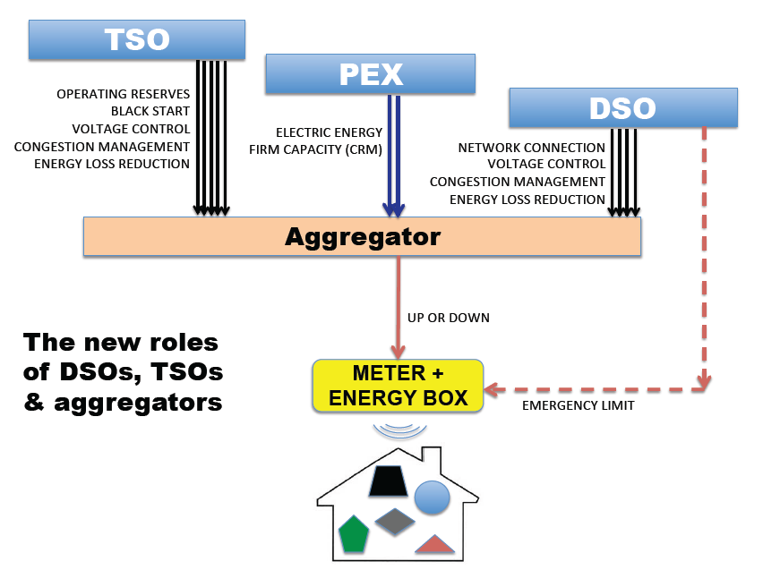
What is the value (if any) of aggregation?

Slide 49
Values of aggregation
System Value
Fundamental Aggregation
Economies of scale
Economies of scope
Risk management
Competition and innovation
Transitory Aggregation
Management of complexity
Closing information gaps
Engaging power system agents
Coordinating agents for system operations
Opportunistic Aggregation
Inadequate regulations for procurement of balancing services
Flaws in the allocation of balancing costs
Inefficient locational prices & network charges
Private Value
Today’s regulations
Advanced regulations
Today’s technology
Advanced technology

Slide 50
Cyber Security & Resilience Summary
No “magic bullet” stops all cyber attacks or incidents or cyber vulnerabilities in Distributed Energy Resources (DERs)
Cyber Security Risks are Real and Complex
Cyber Standards for Distribution/DERs are needed
Information Sharing and Response Plans are needed

Slide 51
The economic signals

Slide 52
Improve design of prices & charges
The design & the level of time & locational differentiation of electricity prices & charges have a substantial impact on the efficiency of DERs response & their impact on networks & centralized generation
This also applies to the volume & format of allocation of policy charges in electricity tariffs, which can be a contributing factor to grid defection
Any cost-reflective component of prices & charges should be exclusively based on the individual injection & withdrawal profiles at the network connection point

Slide 53
Improve design of prices & charges
All economic consequences for the power system agents must be derived from the individual profile of injections & withdrawals at their connection point (no matter what is behind the meter)

Slide 54
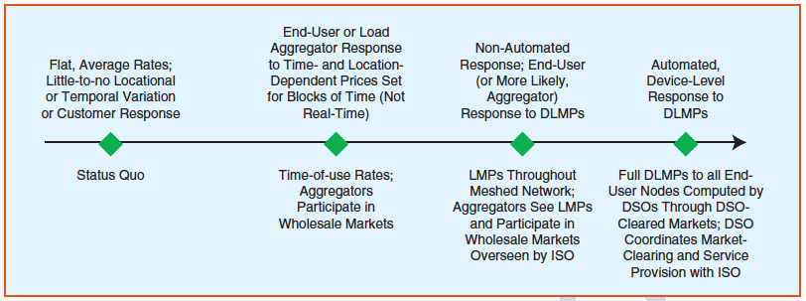
Improve design of prices & charges
How far to go in time & location differentiation will depend on the trade-off between loss of efficiency & implementation cost

Slide 55
Model #1 to examine tariff design impacts

Slide 56
Model #2 to examine tariff design impacts

Slide 57
Distribution network charges
DLMPs are used to price energy consumption/ injection at each node.
The surplus is used to partially recover part of the network costs.
(implicit in energy charge €/kWh)
Network charges
DLMP Surplus
Allocate to network users following cost-causality principle
€/ kW (at critical hours)
Incremental Network Cost (INC)
Total Remaining Network Cost (TRNC)
Allocate as a common good (some “Ramsey-like” approach)
€/ Network User
Residual Network Cost (RNC)

Slide 58
Policy costs
Avoid interference of policy charges on energy & market signals
We need to remove them from tariffs &/or be “very creative”
Breakdown of residential electricity bills in different jurisdictions in 2014-2015

Slide 59
Grid defection? Policy & networks costs outweigh energy costs in many countries
How these costs are allocated can significantly impact grid defection decisions

Slide 60
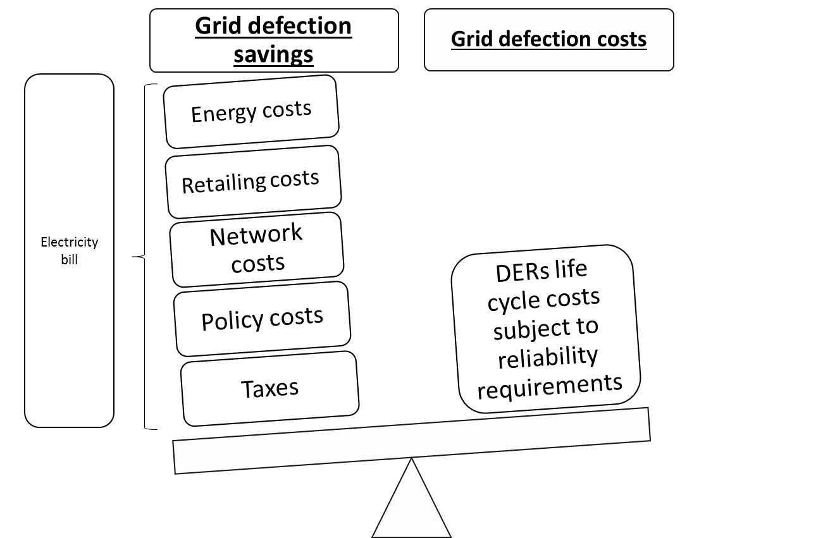
Grid defection: The consumers viewpoint Cost / benefit analysis

Slide 61
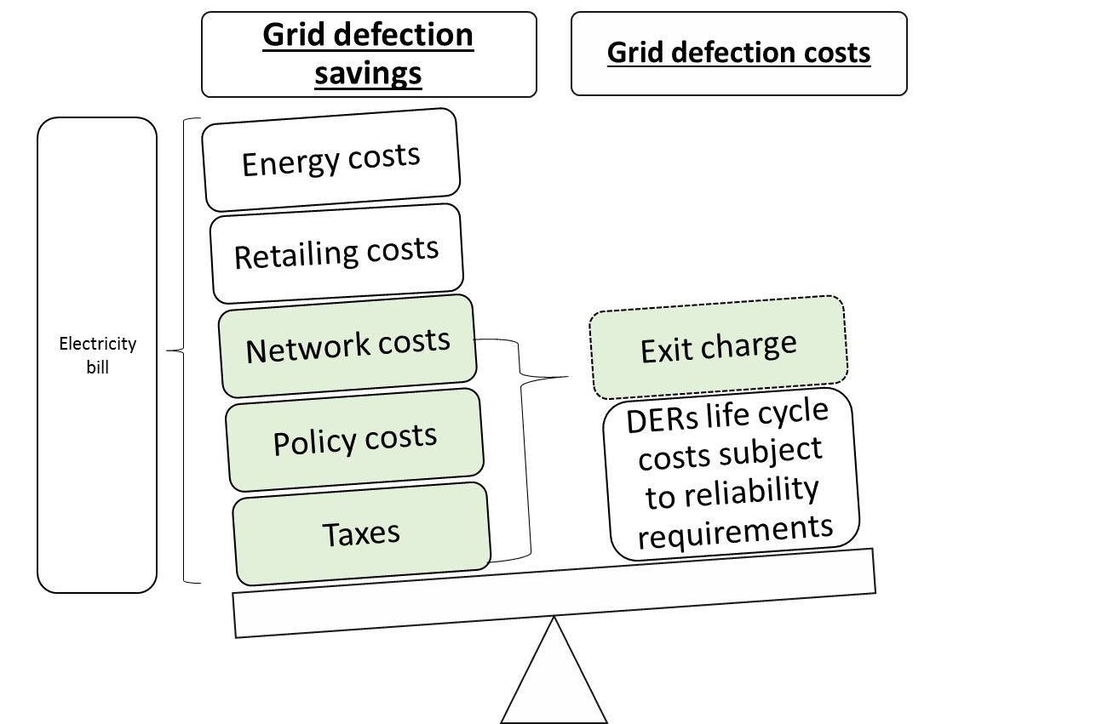
Grid defection: Adding an exit charge
Cost / benefit analysis to promote efficient grid defection from the system point of view
An exit charge must include the fixed system costs which are not reduced by grid defection

Slide 62
Why distributed?
Is there any advantage in being connected in a given voltage level? Even within the same technology? How to evaluate the “locational advantages” versus the economies of sclae?
HV
MV
LV

Slide 63
DERs provide locational benefits
 | Locational | Non-locational
Power system benefits | Network capacity Constraint mitigation Loss reduction Voltage control Power quality Reliability and resiliency | Energy Firm capacity Operating reserves Price suppression Price hedging
Other public benefits | Land use Employment | Emissions mitigation Energy security
63

Slide 64
Economies of scale in solar PV
Sources: MIT Analysis; Barbose et al. (2015). “Tracking the Sun VIII: The Installed Price of Residential and Non-Residential Photovoltaic Systems in the United States.” LBNL (August, 2015). Bolinger & Seel (2015). “Utility Scale Solar 2014: An Empirical Analysis of Project Cost, Performance, and Pricing Trends in the United States.” LBNL (September, 2015).

Slide 65
Economies of scale in storage
Sources: MIT Analysis; Akhil et al. “DOE/EPRI 2013 Electricity Storage Handbook in Collaboration with NRECA”, 2013.

Slide 66
Economic trade-offs in decentralization analysis
Locational advantages in the provision of electricity services by DERs in general do not presently outweigh, & are not expected to outweigh with current technologies, the cost reduction brought by economies of scale of more centralized options when they exist (e.g. solar PV or storage)
This fact should be acknowledged by policy-makers & the public in general when factoring other considerations in the design of support schemes or in making individual choices of technology adoption

Slide 67
In summary…

Slide 68
Exploring & using the potential of DERs
DERs in buildings, vehicles or as devices connected to the grid, being there for whatever reason, & enabled by ICT, have a wide range of possibilities of providing electricity services in multiple new forms, & should be given the opportunity of doing so
The recommendations on prices, charges, network regulation, market rules & sector structure should create the necessary level playing field
But note that the markets for some electricity services may have a small volume & low liquidity

Slide 69
Predicting the future? Rather a tool-kit
The Study will provide a toolkit of policy & regulatory measures to facilitate an effective & efficient incorporation of DERs to the future functioning of the power sector, where they can reveal their actual value
Computer simulation & optimization models will be most useful when employed to evaluate the significance & robustness of hypotheses, rather than trying to predict the future under very specific conditions

Slide 70
Thank you for your attention

