Slide 1
Negotiation Exercise
Dr. Jonathan Raab, Raab Associates (and MIT)
Chicago EIPC—SSC Meeting
July 15, 2010

Slide 2
Agenda
8:00 Introduction
8:10 Oil Pricing Exercise
      preparation
      play
      debrief
9:40 Negotiation Theory and Practice
10:00 Adjourn

Slide 3
Oil Pricing Game—Set Up and Logistics
Oil ministries from A and B set their own oil price each month $10, $20, or $30
Profit for each dependent on price selected by both A and B
Game played for 8 rounds (3 minutes per round—if fail to come up w/price--$20)
Bids simultaneously revealed
Goal is to maximize profits for your country!

Slide 4
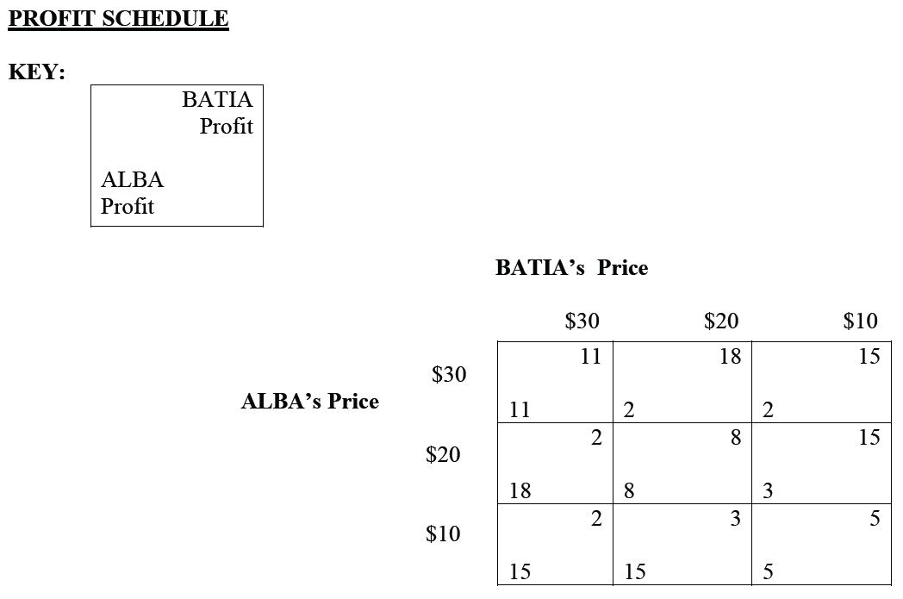

Slide 5
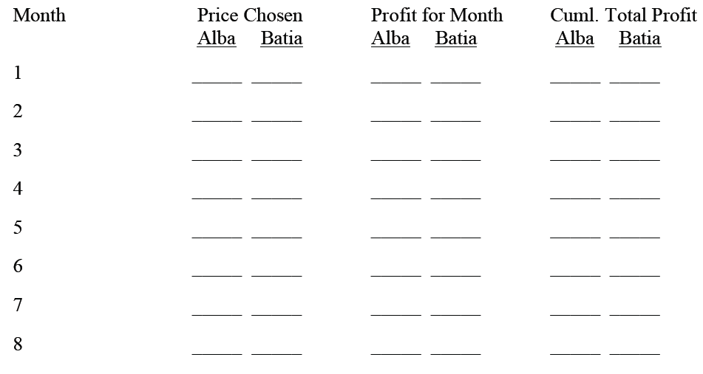
Oil Pricing Game Scoring Matrix

Slide 6
Oil Pricing Game Debrief
NOTE: Show excel spreadsheet w/bids for both teams for all 8 rounds, plus final score for each team

Slide 7
Key Debriefing Questions
What was your goal?
What was your strategy, and did it change over time?
How did you respond to breach of trust by other team (if it occurred)?
How did you deal with disagreement within your own group on which price to bid?
What was it like to represent your group in the face-to-face negotiations?
What would happen if we now made you play 4 more rounds?
What did you learn—what guidelines would you recommend for facilitating wise and efficient group decision-making?

Slide 8
Axelrod’s Computer Simulations on Prisoner’s Dilemma—Winning Strategy
Be Clear
Be Nice
Be Provokable
Be Forgiving

Slide 9
Negotiation and Consensus Seeking: The Conventional Wisdom
Negotiation is Win/lose - Zero-sum situation:
  Their gain is my loss (tug-of-war)
  The size of the pie is fixed
Negotiation is a Test of Will
You get what you want by ensuring others don’t get what they want

Slide 10
Mutual Gains vs. Conventional Wisdom
  The Mutual Gains approach assumes you get what you want by making sure that the other side’s needs are met -- at the lowest possible cost to you
  Pie is not fixed, but can be expanded providing opportunity for everyone to benefit

Slide 11
Key Elements of the
Mutual Gains Approach
Know your BATNA and assess theirs (Best Alternative to a Negotiated Agreement)
Focus on Interests, Not Positions
Invent Options for Mutual Gains
Insist on Objective Criteria
Separate the People from the Problem
From Getting to Yes—Fisher and Ury

Slide 12
Invent Options for Mutual Gain
A
D
F
Gains to
Party A
G
A’s
BATNA
E
C
B
Gains to Party B
B’s BATNA
Doing the Dance to the Pareto Possibilities Frontier Curve

Slide 13
Focus on Interests, Not Positions
Interests are needs, concerns, desires -- What’s truly important to you.
Analyze your interests and theirs
Communicate
  Share your interests and concerns clearly
  Listen and ask probing questions
Don’t make offers until you explore interests

Slide 14
Create Mutual Gains
Explore ways to expand the pie before focusing on how to split it
Recognize that almost all negotiations have multiple issues
Remember that parties usually value issues differentially - allowing for mutually beneficial trades
Split the pie by using objective criteria, rather than reverting back to tug-of-war

Slide 15
Negotiating Styles
Asse r t i veness
Competing
The Effective Negotiator
Accommodating
Avoiding
Empathy

