Slide 1
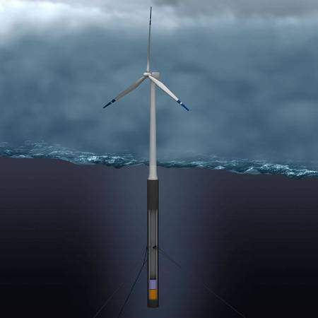
Policy Matters:
Maine Promotes Ocean Energy
New England Electricity
Restructuring Roundtable
September 18, 2009
Beth A. Nagusky
Director, Office of Innovation & Assistance, Maine DEP
Co-chair, Ocean Energy Task Force

Slide 2
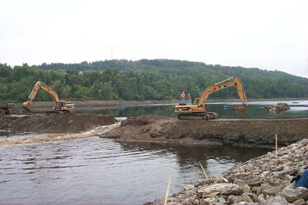
The Challenges
Electric Industry Restructuring
Oil/Natural Gas Price Instability
Failure to Include Externalities
Economics & Financing
Transmission & Distribution
Siting &Environmental Permitting

Slide 3
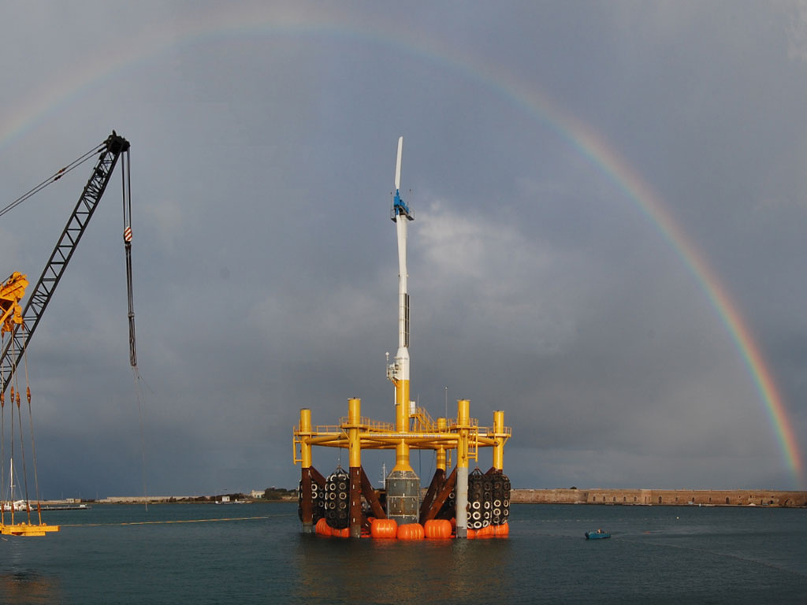
Maine’s Ocean Energy Task Force
November ‘08 Executive Order
Legislation: 60 Day Permit Process
Test Site Identification/Public Outreach
Regulations for Commercial Scale Projects
Tidal: MOU with FERC
Report due October ‘09

Slide 4

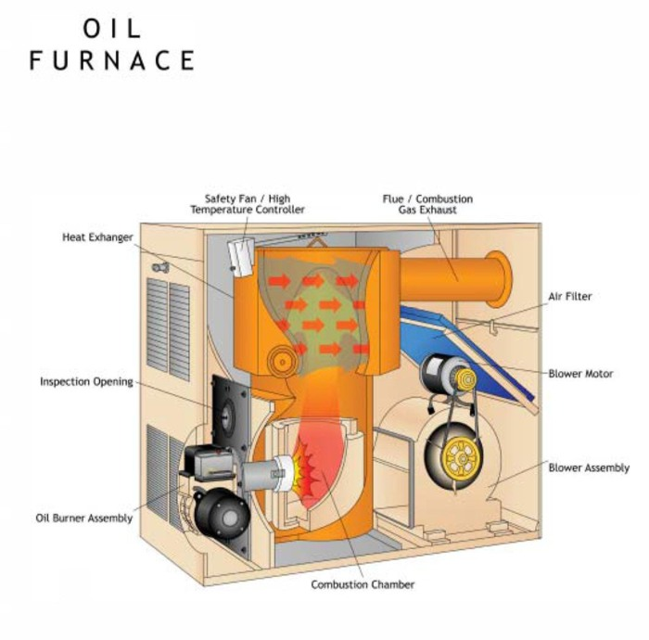
The Past

Slide 5
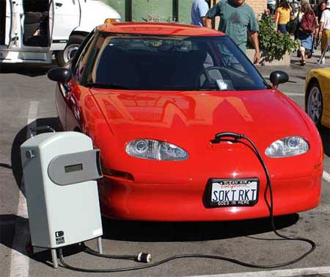

The Future

Slide 6

Electrification: Cut Energy and CO2
80% Maine Homes heat with oil
  $2.50/gal x 900 gal = $2,250
  Electric Heat Pump @$0.15/kWh= $1,465/yr.
  Conversion Cost: + $15,000
  Cut CO2 2-3x
Electric vehicles
  Gasoline Vehicle 20% efficient
  50% efficiency for delivered electricity
  20% losses for charging/discharging batteries (?)
  Net efficiency 40% + ½ the fuel consumption

Slide 7


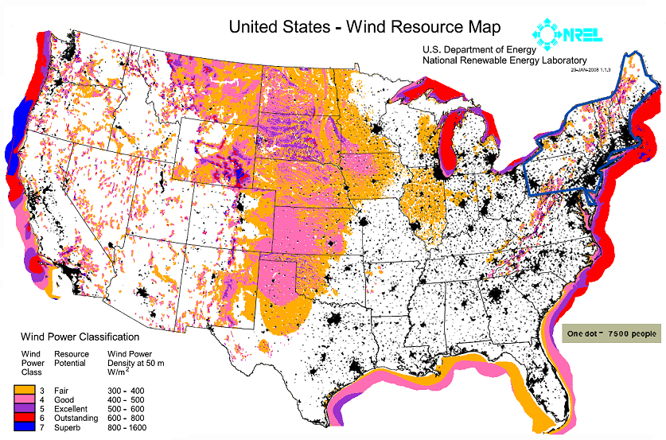
Oceans: A Source of Green Energy for the Northeast U.S.
55 million people
18% of US population
7
Notes:
7

Slide 8
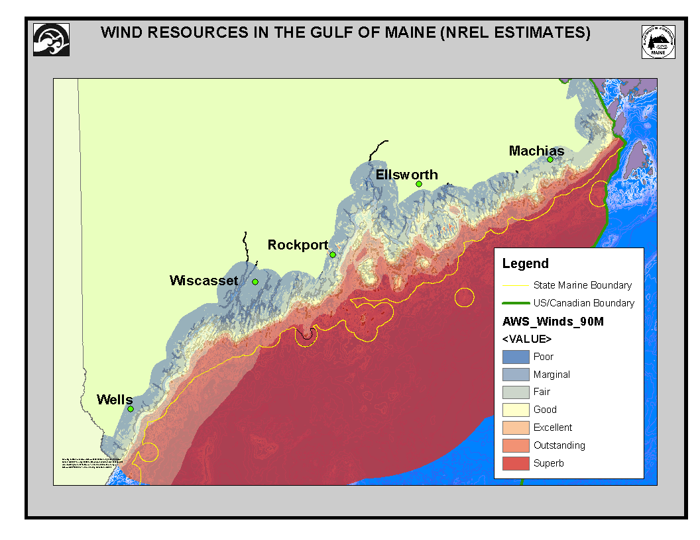

Slide 9
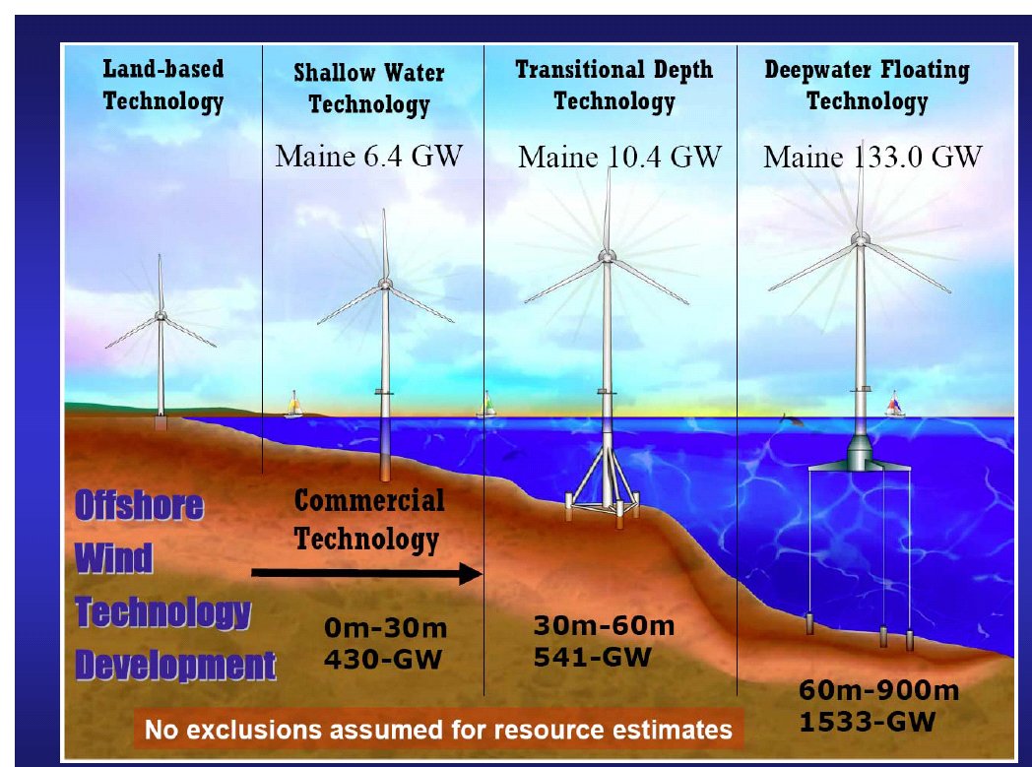
WIND TURBINE EVOLUTION
Diagram Courtesy of MIT

Slide 10
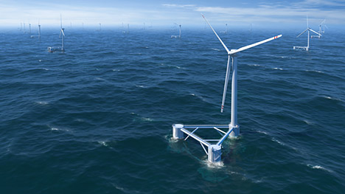
Maine Test Sites
Within State Waters
At least 200 Feet Deep (30 Fathoms)
Average Annual Wind Speeds of >17 MPH
No Obstructions
Limit Ecological/Human Impacts

Slide 11
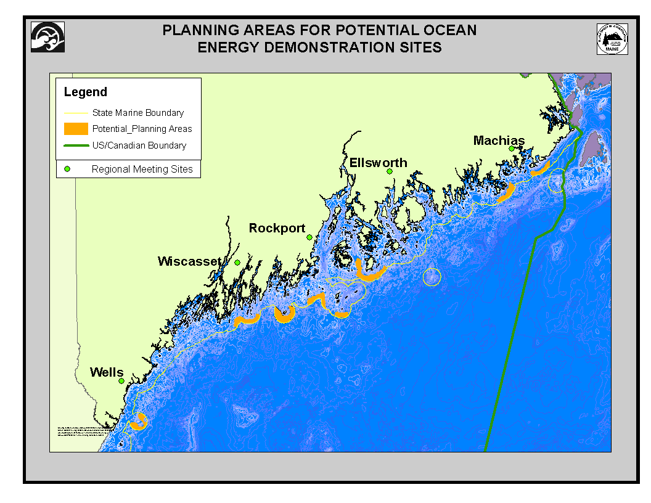
ALL PLANNING AREAS

Slide 12

What’s Next
Regulations for Commercial Scale Offshore Wind/Tidal
Coordination with Federal Agencies
Recommendations to Overcome Hurdles
  T&D Infrastructure
  Economics
  Intermittency

Slide 13
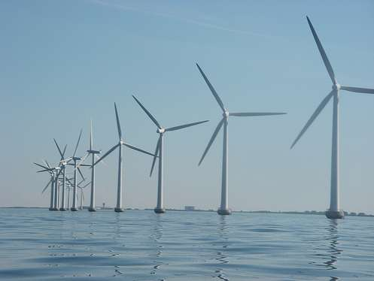
Questions??
Beth.A.Nagusky@maine.gov 207.287.5869

