Slide 1
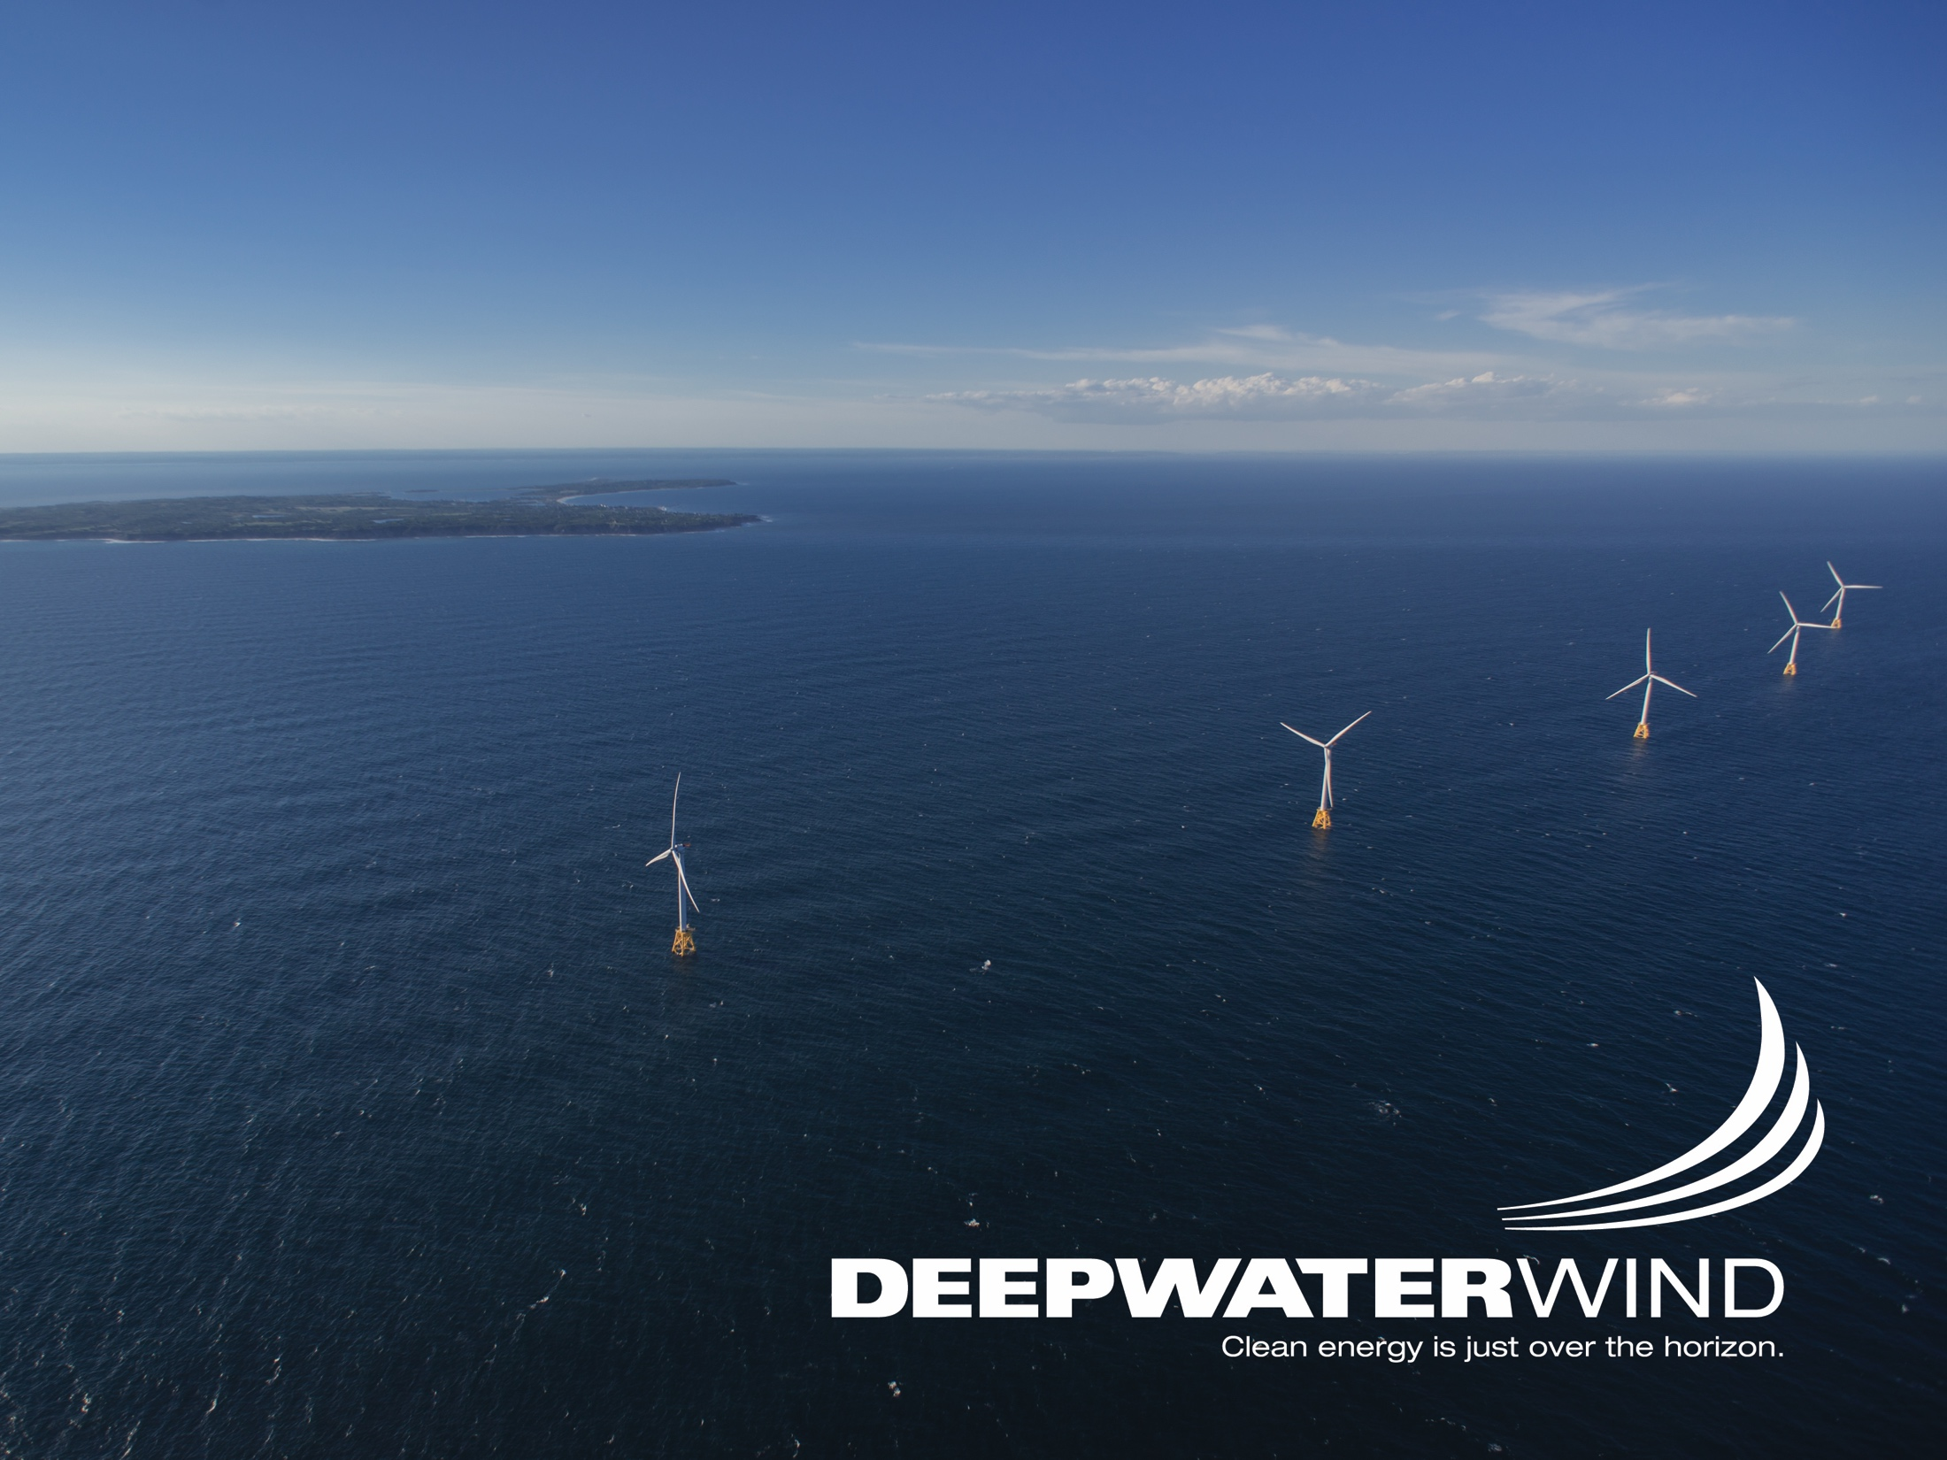
New England Restructuring Roundtable
Resilience and Fuel Security; & Offshore Wind in the Northeast: on the Near Horizon?
March 16, 2018
Foley, Hoag and Elliot

Slide 2
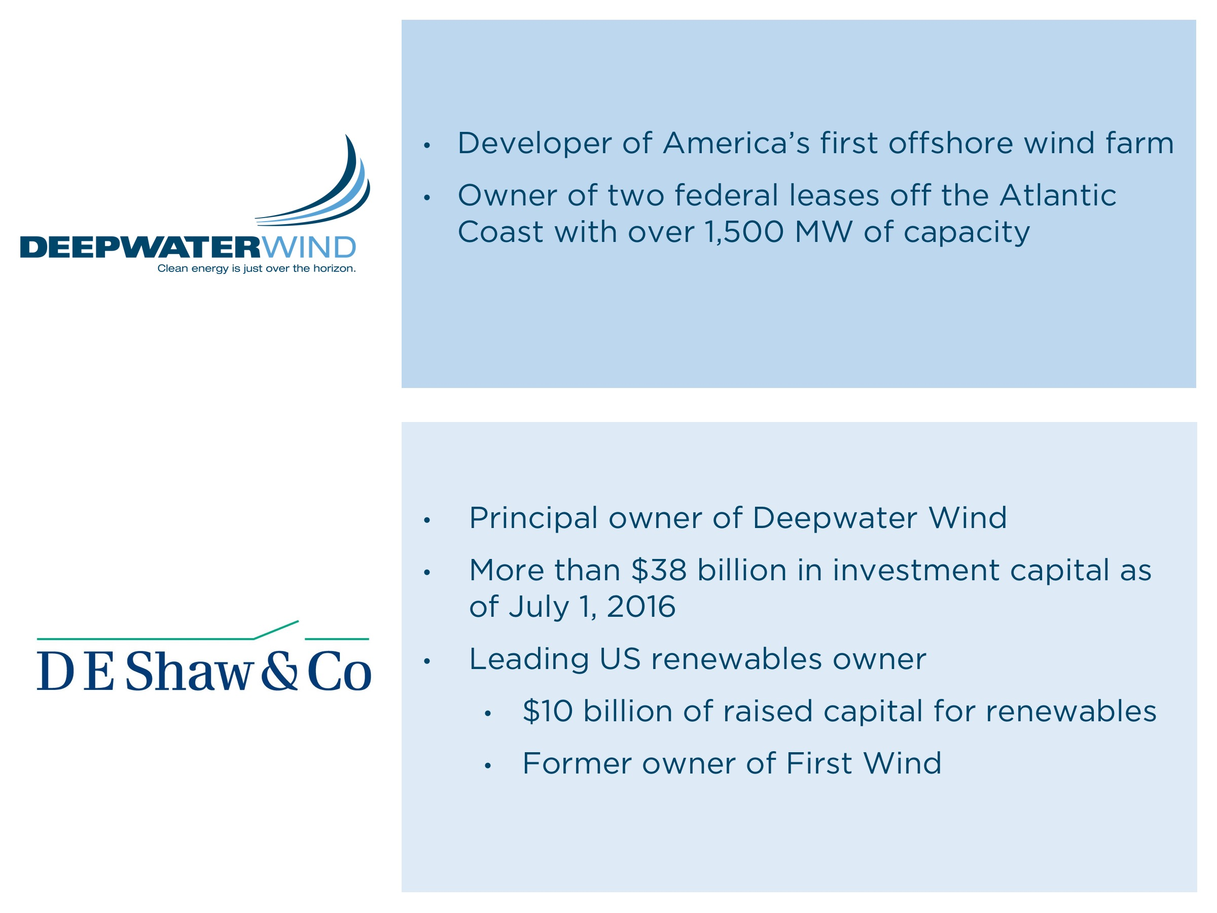
Only developer In America with two awarded contracts: Maryland, Long Island

Slide 3
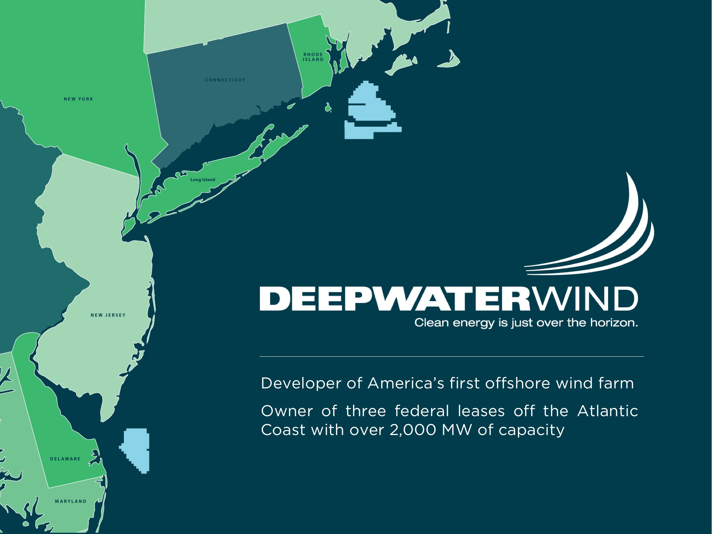

Slide 4
“Wind power even when the wind
isn’t blowing”

Slide 5
Project Overview
400MW (50 Turbines) and 200MW (25 Turbines)
Innovative Expandable Transmission System
Hydroelectric Pumped Storage System Pairing
2700 jobs and $300 Million in economic impact
Delivering power in 2023

Slide 6
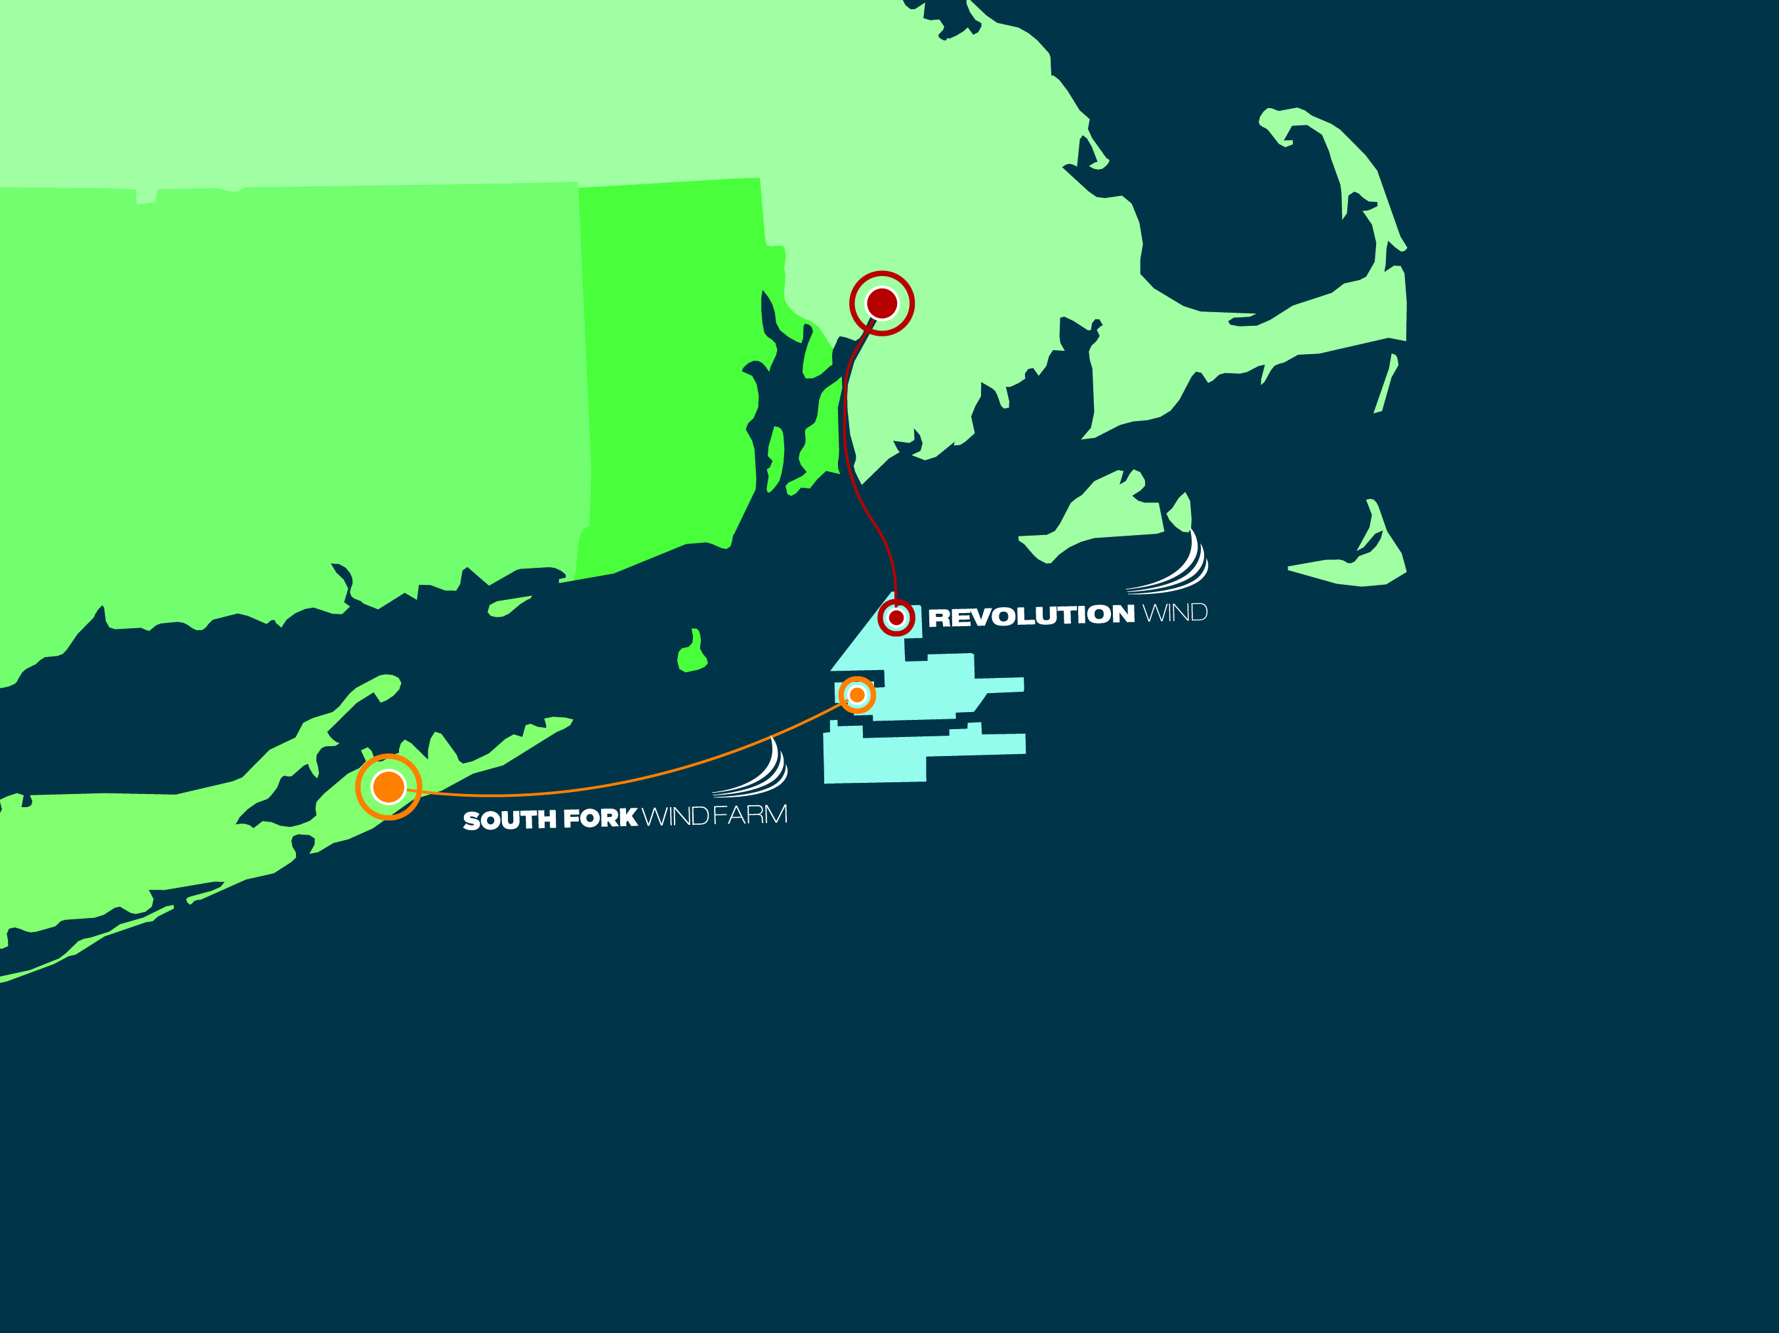
Building Offshore Wind Now
Deepwater’s federal lease is large enough to accommodate 2,500 MW
The first phase of construction is South Fork 15 Turbines
The second phase is Revolution Wind 25-50 Turbines

Slide 7
Expandable Transmission
Interconnection Brayton Point
Expansion capability as development advances in the WEAs; HVAC submarine cable systems;
Transmission rights (or access to the routes) available to multiple wind developers;
Consolidated transmission routes, or corridors, from the WEAs to one or more mainland interconnection points; and
Coordinated and expedited state permitting for transmission routes

Slide 8
Energy Storage Solution
Northfield Mountain, largest hydroelectric storage facility in New England.
A 5-billion-gallon battery.
The Largest pairing of offshore wind and storage in the world.
1500 MWH- 300,000 homes 6 hours per day.
Save the energy Rev Wind produces at night when demand is low use it in afternoon when demand is high. Near Baseload!

Slide 9
Direct Economic Development
2,700, direct, indirect and induced jobs, with a total economic impact to the Commonwealth of $300 Million dollars;
O and M facilities for all our MA work in New Bedford;
All our crew vessels built in MA
Commitments to local contractors and suppliers priority for DWW and all major subs.
Use of New Bedford Marine Commerce Terminal $6 Million + annually;
NBHDC Port Services agreement of $500,000 annually;
.

Slide 10
Market Development
Research: UMass Marine Fisheries Institute, Blue Economy Initiative- $1 Million.
Workforce: Mass Maritime Academy -Deepwater Wind Scholars- $1 Million.
Market philosophy: Mid-sized projects, retain market competitiveness, multiple projects in development, enhance and local competition, increase local supply chain know-how, transparency and engagement, continue to drive down costs.

Slide 11
Long Term Cost-Effectiveness
400MW or multiple 200MW project sizes gets to cost competiveness and market scale;
Retaining competition is critical at each level of supply chain;
Minimizes ratepayer impact in the near term, by buying smaller quantities when prices are relatively higher;
Allows the local supply chain and labor force to develop and mature, which creates sustained local job growth, as opposed to a boom/bust cycle;

Slide 12
