Slide 1
Solar Opportunities and Challenges in New England
September 16, 2011

Slide 2
Overview
Introduction
Solar Opportunities & Challenges in Massachusetts
Net Metering Caps
SACP Schedule
Tax Issues
Solar Carve Out Formulas
Connecticut Solar Opportunities & Challenges
Vermont Solar Opportunities & Challenges
Questions

Slide 3
Constellation Energy Background
FORTUNE 200 company
A leading supplier of competitive power and natural gas, customer-sited solar, energy efficiency, and demand response
Customers in 38 states and Washington, D.C.
Developing solar across utility scale-commercial-residential spectrum
12,000+ megawatts of generating capacity
Revenues: $14.3 billion (2010)
10,000+ employees

Slide 4
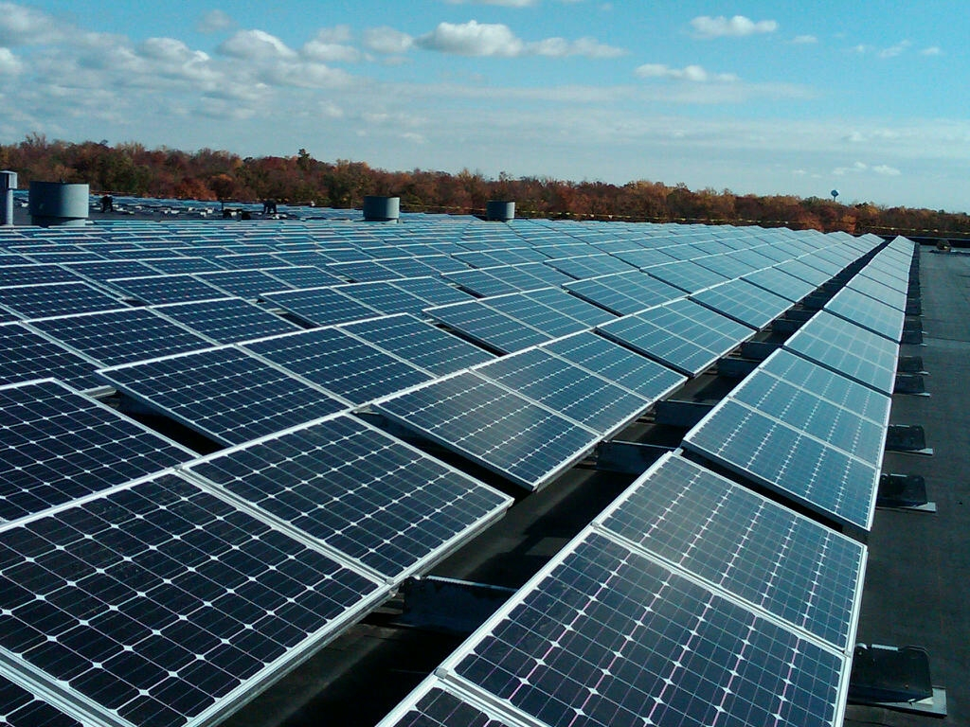
Massachusetts Opportunities and Challenges
400 MW of Solar supported by the Department of Energy Resource’s solar clearinghouse
Challenges
Clearinghouse Floor Remains Untested
Expiration of 1603
Virtual Net Metering Implementation
Forward SACP Schedule
Tax Exemptions
Minimum Standards Clarification
4

Slide 5
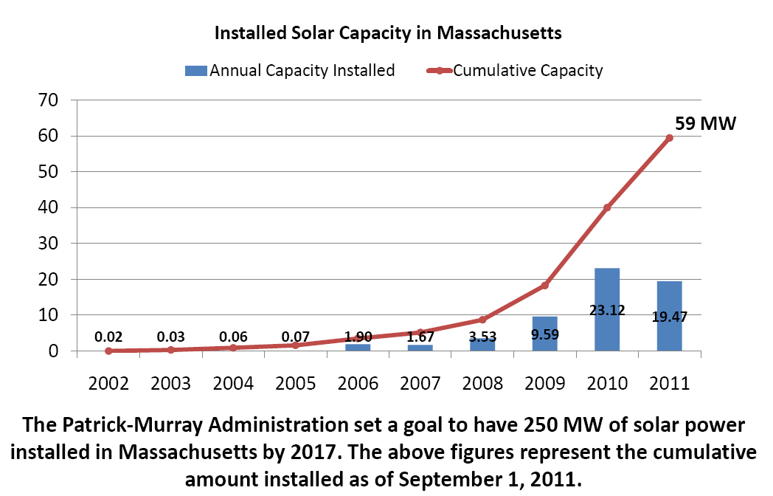
Expiration of the 1603 Grant Program
149 Solar Projects installed under the MA Solar Carve Out Program were awarded DOE’s 1603 Program grant.

Slide 6
Net Metering Caps
Aggregate limit for net metered capacity of 1% of utility’s peak load for non-public entities, 2% of utility’s peak load for net metering by public entities
 | NGRID | NSTAR | WMECO | UNITIL
1% (MW) | 51.31 | 49.78 | 8.1 | 1.02
2% (MW) | 102.62 | 99.56 | 16.2 | 2.04
Installed | 24.62* | 26.64 | 3.83* | .62*
Pending | 44.24 | 105.28 | 10.439 | .32
Caps Already Stopping Some Projects and Threaten to Bring Development to Halt
*as of 8/13/2011
Notes:
Historical energy prices as the chart shows have been extremely volatile. Past performance has no indication of the future; but as you can see energy volatility is real and it is anticipated that it will continue particularly as our economy recovers.

Slide 7
Allocating Net Metering Credits To Multiple Entities
SECTION 27 of 2010 Act added following definition: “Net metering facility of a municipality or other governmental entity”, a Class II or III net metering facility: (1) that is owned or operated by a municipality or other governmental entity; or (2) of which the municipality or other governmental entity is assigned 100 percent of the output.
(Chapter 359 of the Acts of 2010, An Act Making Appropriations for the Fiscal Years 2010 and 2011 to Provide for Supplementing Certain Existing Appropriations and for Certain Other Activities and Projects).
Proposed interpretation of 2010 Act would limit assignment of credits for public entities to Host only, while allowing assignment to multiple entities for private entities.
Notes:
Historical energy prices as the chart shows have been extremely volatile. Past performance has no indication of the future; but as you can see energy volatility is real and it is anticipated that it will continue particularly as our economy recovers.

Slide 8
Green Communities Act specifically allows assignment to multiple entities:
“Section 139. . . . A Class I or Class II wind or solar net metering facility may designate customers of the same distribution company to which the Class I or Class II wind or solar net metering facility is interconnected and that are located in the same ISO -NE load zone to receive such credits in amounts attributed by the Class I or Class II wind or solar net metering facility. Written notice of the identities of the customers so designated and the amounts of the credits to be attributed to such customers shall be in a form as the distribution company shall reasonably require.”

Slide 9
Allocating Net Metering Credits To Multiple Entities
Regulations specifically allow assignment to multiple entities.
(1) For a Class I or II Wind Net Metering Facility, Solar Net Metering Facility, or Agricultural Net Metering Facility; Class III Net Metering Facility; or
Neighborhood Net Metering Facility, each Distribution Company shall allocate Net Metering credits as designated in writing by the Host Customer, to other Customers who are in the Distribution Company’s service territory and are located in the same ISO-NE load zone.
Section 18.05(1)
Notes:
Historical energy prices as the chart shows have been extremely volatile. Past performance has no indication of the future; but as you can see energy volatility is real and it is anticipated that it will continue particularly as our economy recovers.

Slide 10
Allocating Net Metering Credits To Multiple Entities
Schedule Z Specifically Allows Assignment to Multiple Entities.
Please identify each eligible Customer account to which the Host Customer is allocating Net Metering Credits by providing the following information (attach additional pages as needed):
Name:
Billing address:
Account number:
Amount of the net metering credit: (%)
Name:
Billing address:
Account number:
Amount of the net metering credit: (%)
(Repeats 11 times, and instructs to attach additional pages).
Notes:
Historical energy prices as the chart shows have been extremely volatile. Past performance has no indication of the future; but as you can see energy volatility is real and it is anticipated that it will continue particularly as our economy recovers.

Slide 11
Name:
Billing address:
Account number:
Amount of the net metering credit: (%)
Name:
Billing address:
Account number:
Amount of the net metering credit: (%)
Name:
Billing address:
Account number:
Amount of the net metering credit: (%)
Name:
Billing address:
Account number:
Amount of the net metering credit: (%)
Name:
Billing address:
Account number:
Amount of the net metering credit: (%)

Slide 12
Name:
Billing address:
Account number:
Amount of the net metering credit: (%)
Name:
Billing address:
Account number:
Amount of the net metering credit: (%)
Name:
Billing address:
Account number:
Amount of the net metering credit: (%)
Name:
Billing address:
Account number:
Amount of the net metering credit: (%)
Name:
Billing address:
Account number:
Amount of the net metering credit: (%)

Slide 13
Proposed Backsliding would:
Make many small municipalities ineligible
Greatly increase credit risk and cripple financing
Suggested approach of requiring Host to serve on-site needs from facility would eliminate accepted practice of stand-alone projects.
Backsliding on accepted practices would create regulatory uncertainty, and set back entire solar program.

Slide 14
Remove Net Metering Caps
California, New Jersey, Arizona, Colorado (4 of the top 5 states with the most installed solar capacity) do not have an aggregate cap
Benefits of Eliminating Cap:
+ Reduce regulatory uncertainty
+ Eliminate artificial constraints on project locations
+ Promote most efficient use of available space
+ Remove need for complicated net metering queue, along with administrative and financial burdens
+ Overall size cap of SREC program still protects rate-payers
= Accelerate Solar Deployment
Notes:
Depending where you are solar can be a good long-term solution to achieve price stability. Energy prices, incentives, and RPS policies are all key factors which will impact the financial viability of a solar solution for your business.

Slide 15
Establish Forward SACP Schedule
DOER has correctly proposed a 10 year schedule
Provides stability and clarity into the market
Proposed SACP values are modest
Per installed costs from LBNL’s “Tracking the Sun III”, project returns range from 5.91%-8.71% in years 2012-2016 and fall to 1.09%- -.66% in year 2017-2020 due to expiring tax incentives.
Compliance Year | ACP Rate per MWh
2012 | $550
2013 | $550
2014 | $523
2015 | $496
2016 | $472
2017 | $448
2018 | $426
2019 | $404
2020 | $384
2021 | $365
2022 and after | added no later than January 31, 2012 (and annually thereafter) following stakeholder review
1
3
10
6, 7, 8
9
4
5
2

Slide 16
Unintended Taxation of Municipal Solar Systems
Kink in tax code exempts commercial facilities, while taxing public facilities using PPAs or leases:
“Forty-fifth, Any solar or wind powered system or device which is being
utilized as a primary or auxiliary power system for the purpose of heating or
Otherwise supplying the energy needs of property taxable under this chapter;
provided, however, that the exemption under this clause shall be allowed only
for a period of twenty years from the date of the installation of such system or
device.”
Municipalities not “taxable under this chapter,” therefore Department of Revenue has advised that municipal PPAs and leases are taxable.
Limits ability of municipalities to receive lower PPA rates through use of federal tax incentives
Cannot be intent of statute
16

Slide 17
Clarify Minimum Standard Formulas
Solar Carve Out Program has two operating formulas that are meant to work in tandem, but ambiguity exists:
Section 14.07(2)(f) in chapter 225 of Massachusetts code makes clear that Solar Carve-Out Minimum Standard Percentage may not decrease during the life of the program
However, unclear if total Compliance Obligation in MWh may decrease, therefore allowing for potential reduction in SREC demand.
Providing guidance on this issue would promote market stability.
17

Slide 18
Opportunities and Challenges in Connecticut
New ZREC program
New Virtual Net Metering Program
Improvements Needed
Increase the ZREC cap to same
as LREC cap
Institute entity cap to offset risk of few players dominating
Allow municipalities to use PPAs or Leases when virtual net-metering
Property tax exemption
Provide clarity on the available virtual net metering funds
National Renewable Energy Laboratory (NREL) “Open PV Project”
18
Notes:
Two fundamental requirements of where to go are net metering laws for systems larger than 500MW and the state’s RPS includes a standard requirement
We then look at insolation, power prices, regulatory regime, and CEG presence

Slide 19
VT Solar Opportunities and Limitations
“SPEED” Feed-In-Tariff hindered by lack of property tax exemption:
2-3 projects actually being built out of over dozen awarded
Awarded projects being actively shopped/can’t be built under current tax structure
Fixes
Create exemption
Alter tax basis (as has been done for wind and hydro)
Make current corporate tax credit transferable
Grant in lieu of tax credit

Slide 20
QUESTIONS
Bryan Miller
Constellation Energy
Vice President, Energy Policy,
Sustainable Energy
bryan.miller@constellation.com
20

