Slide 1


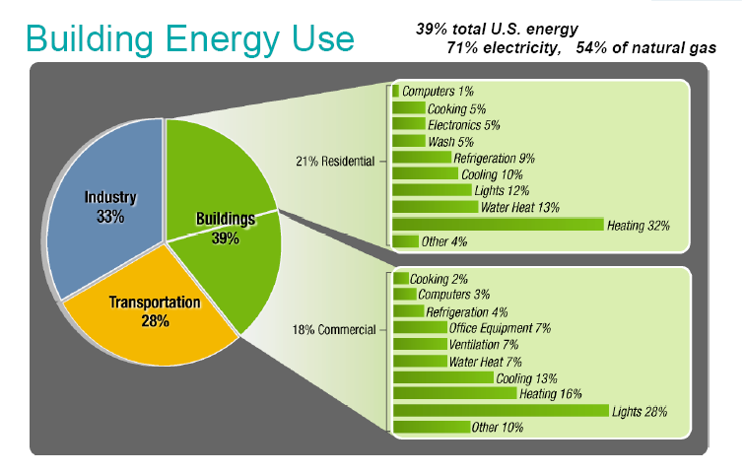
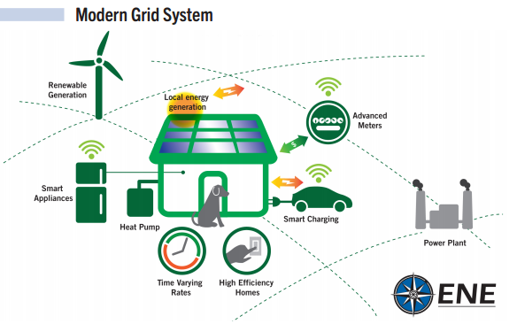
Enabling Energy Consumers at the Crossroads of Buildings, Climate, and Grid
Harvey Michaels, Sloan Lecturer, Research Director Energy Management Strategy
For NE Restructuring Roundtable February 26, 2016
hgm@mit.edu

Slide 2

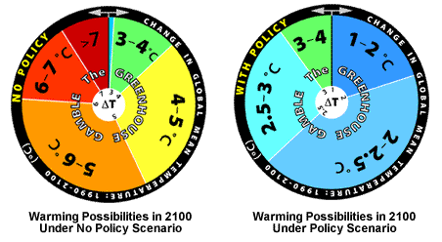


Building Energy Management – 1970’s to Now
1975 V1.0: OPEC → Building Energy Efficiency
1990 V2.0: Soft Energy Path → Integrated Resource Planning
2005 V3.0: Smart Energy → Demand Response, Site Solar, ICT
Next V4.0: Climate Solution → At Scale, All Together
  Truth about Climate Change:
  Its Real, Its Us,
  Its Bad, Scientists Agree,
  There’s Hope
  * A. Lieserowitz, Yale

Slide 3
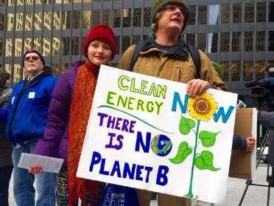
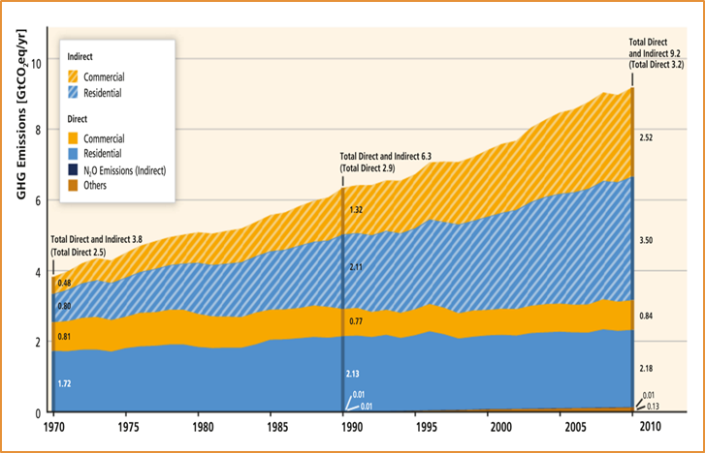
Buildings are at the center of a Climate Solution
1/3 - Buildings account for 1/3 of all GHG emissions.
2X - Business-as-usual, building GHG’s will double by 2050.
Half - of emissions can be saved with positive NPV (at least).
All - buildings need to integrate with intermittent renew. energy
Zero - Alternatives to achieving deep gains in more than 1 billion homes/buildings - a challenging objective.

Slide 4
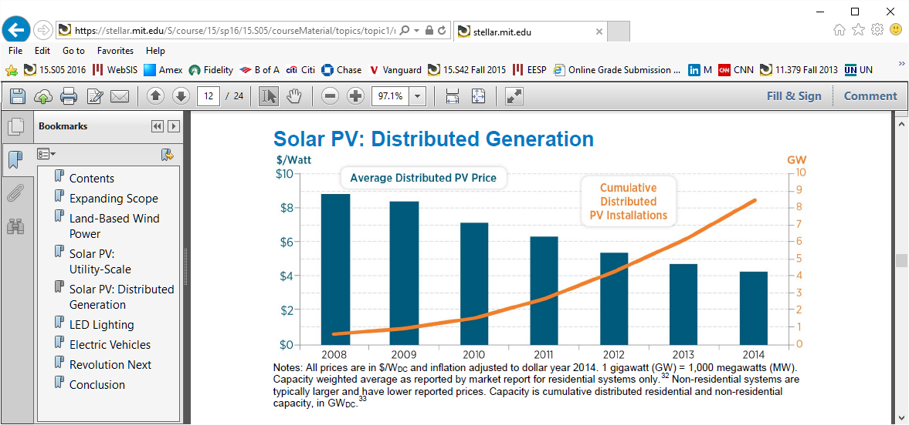
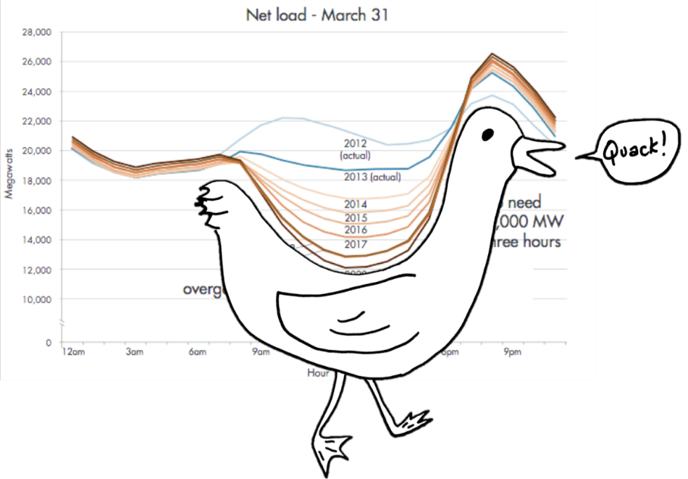
Consumers at Crossroads of Buildings, Climate, and Grid
Climate Change means:
  Intermittent Supply and “Duck curve” demand
  Policy/customer preferences for Site Solar, EV’s, batteries.

Slide 5


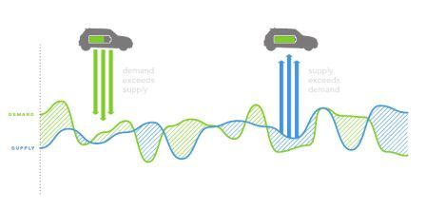

Consumers at Crossroads of Buildings, Climate, and Grid
Internet of Things, comes with everything.
  Energy - sensible, controllable.
  Efficiency and grid stabilization - visible, transactable.
Question: Internet of Things meets Grid of Things: Who owns, who controls?

Slide 6
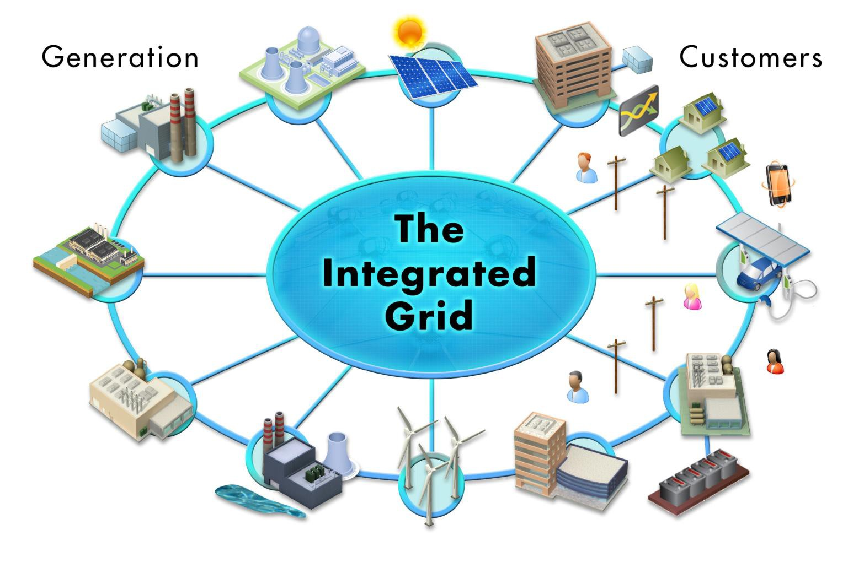
Utilities at Crossroads of Buildings, Climate, and Grid
Distribution Utility Restructuring:
  From Monopolies -> Markets
Question: Where to get backup/insurance energy?
  Utility grid, on-premise, microgrids (real, virtual)?
Most likely answer: All of the Above
Utilities may compete post-monopoly as Comcast does:
  FIOS, Dish/Direct, Apple TV/Amazon Fire
  Comcast Innovates -> Xfinity, X1 : Its Still There
  Utilities who embrace change – power of incumbency.

Slide 7



Business Innovations for:
At Scale, All Together
Building Energy Management → Full Service/Integrated:
  Building efficiency, DR/controls, Solar/batteries, energy
  HVAC install, services, service contracts
  Integrated financing and incentives
  Needs policy to stop forced separations.
Business strategies that Solve the Solvable Climate Problem employ:
  No money down, guaranteed positive cash flow.
  Easy, quick, risk free.
  Social norms, Recognition, Rewards, Guilt.

