Slide 1
Decarbonizing/Electrifying the Building Sector
New England Electricity Restructuring Roundtable
Commissioner J Andrew McAllister, PhD
June 21, 2019
California Energy Commission

Slide 2
Policy Drivers
Double energy efficiency savings by 2030
60% renewable electricity by 2030; 100% by 2045
Provide equitable low-carbon solutions for low-income residents & disadvantaged communities
Electrify transportation
Decarbonize buildings & industry
Carbon-free economy by 2045
Notes:
Energy performance metric will align with GHG (2022)

Slide 3
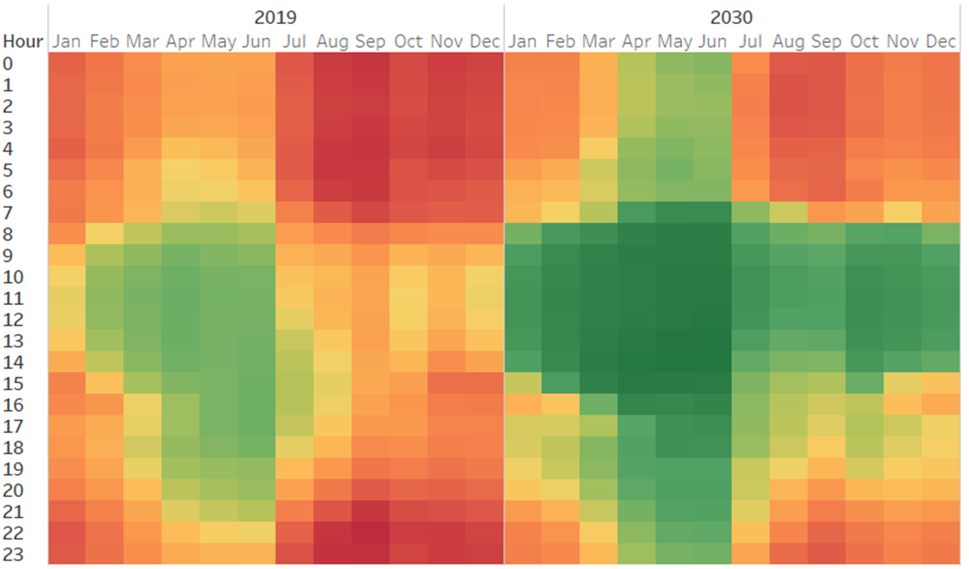

Electricity CO2 Emission Intensities
Tonne per MW

Slide 4
CA EE Action Plan
1. Doubling Energy Efficiency Savings by 2030
3. Building Decarbonization
2. Energy Equity
Reduce GHG 40% below 1990 levels by 2030

Slide 5

2019 Building Energy Code
  High performance envelopes
  On-site PV requirements to offset expected annual electricity
  All-electric performance baseline (optional) for low-rise residential & performance credits for high performance HPWHs
Notes:
Energy performance metric will align with GHG (2022)

Slide 6
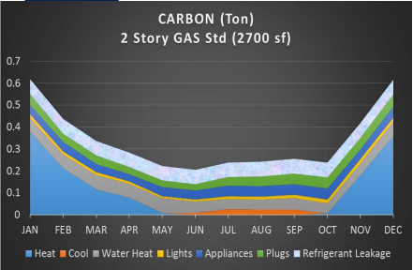
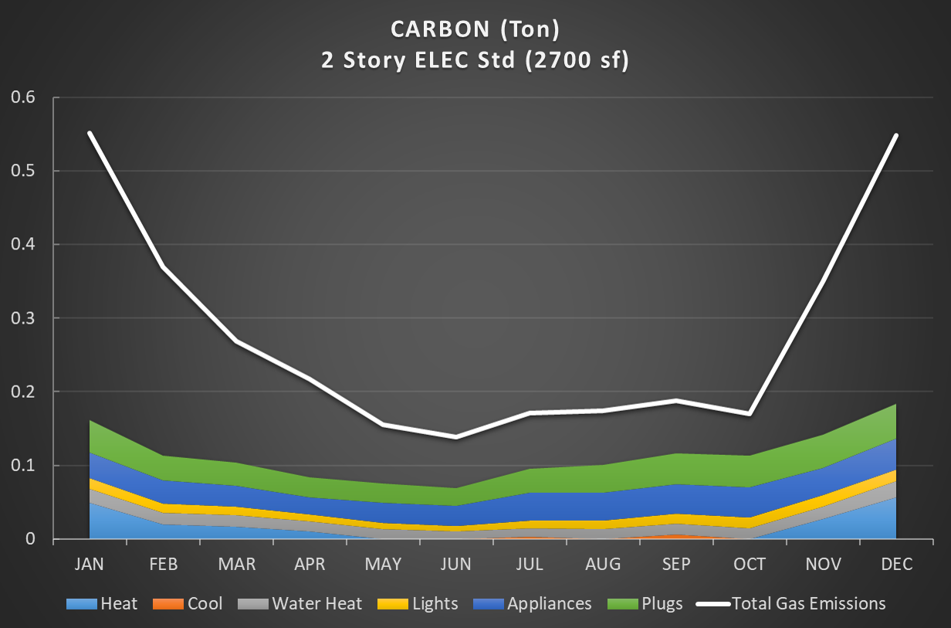
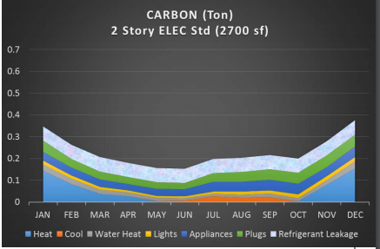
SB 1477: BUILD & TECH
SB1477 allocates $200M over four years to support new construction and retrofitting projects that decarbonize California’s building sector.
BUILD
Incentive program
New residential & non-residential buildings
Low-income housing focus
TECH
Market transformation program
Existing residential buildings
Space and water heating focus
Difference in GHG emissions between gas & all-electric homes

Slide 7
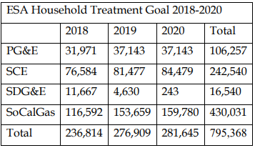
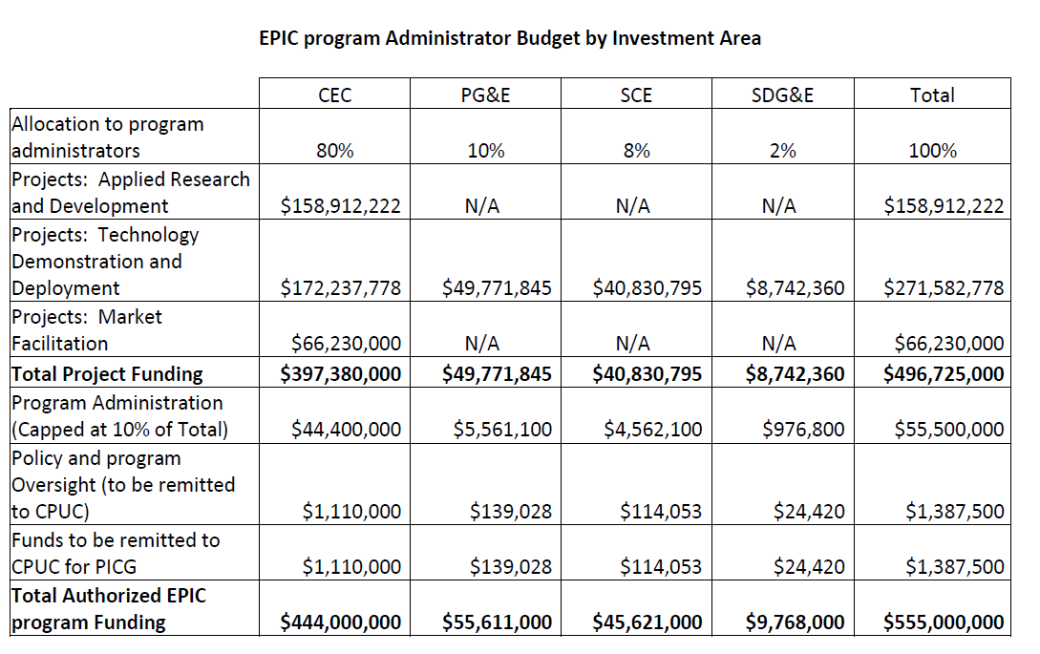
Backdrop: Ratepayer-Funded EE
= ~$1.4B Annually
Overall Efficiency Budgets
Low-Income EE
EPIC Funding
IOUs
IOUs
PG&E | $415M
SCE | $340M
SDG&E | $115M
SoCalGas | $80M
TOTAL | $950M
30%
Of total EE Budget
Research & Development
$160M
POUs
POUs
$225M
$25M
Notes:
eestats.cpuc.ca.gov
Energy Efficiency in California’s Public Power Sector, 12th Edition, ncpa.com

Slide 8
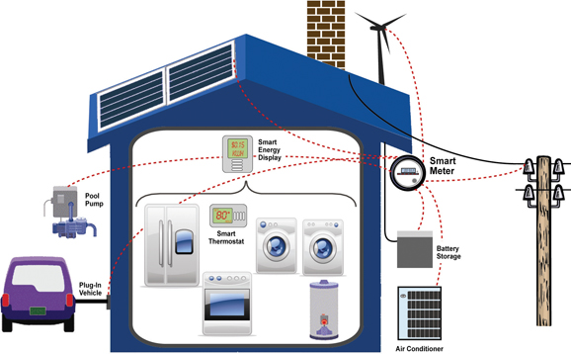
Appliance Standards for Demand Flexibility
Pending Legislation – would expand CEC authority to consider GHG reductions in Appliance Energy Efficiency Standards
Notes:
Also Mention the SCE Clean Energy Optimization Program – partnership with the UC and CSU systems to incentivize C reductions. – Outside the standards ratepayer-funded EE portfolio.

Slide 9
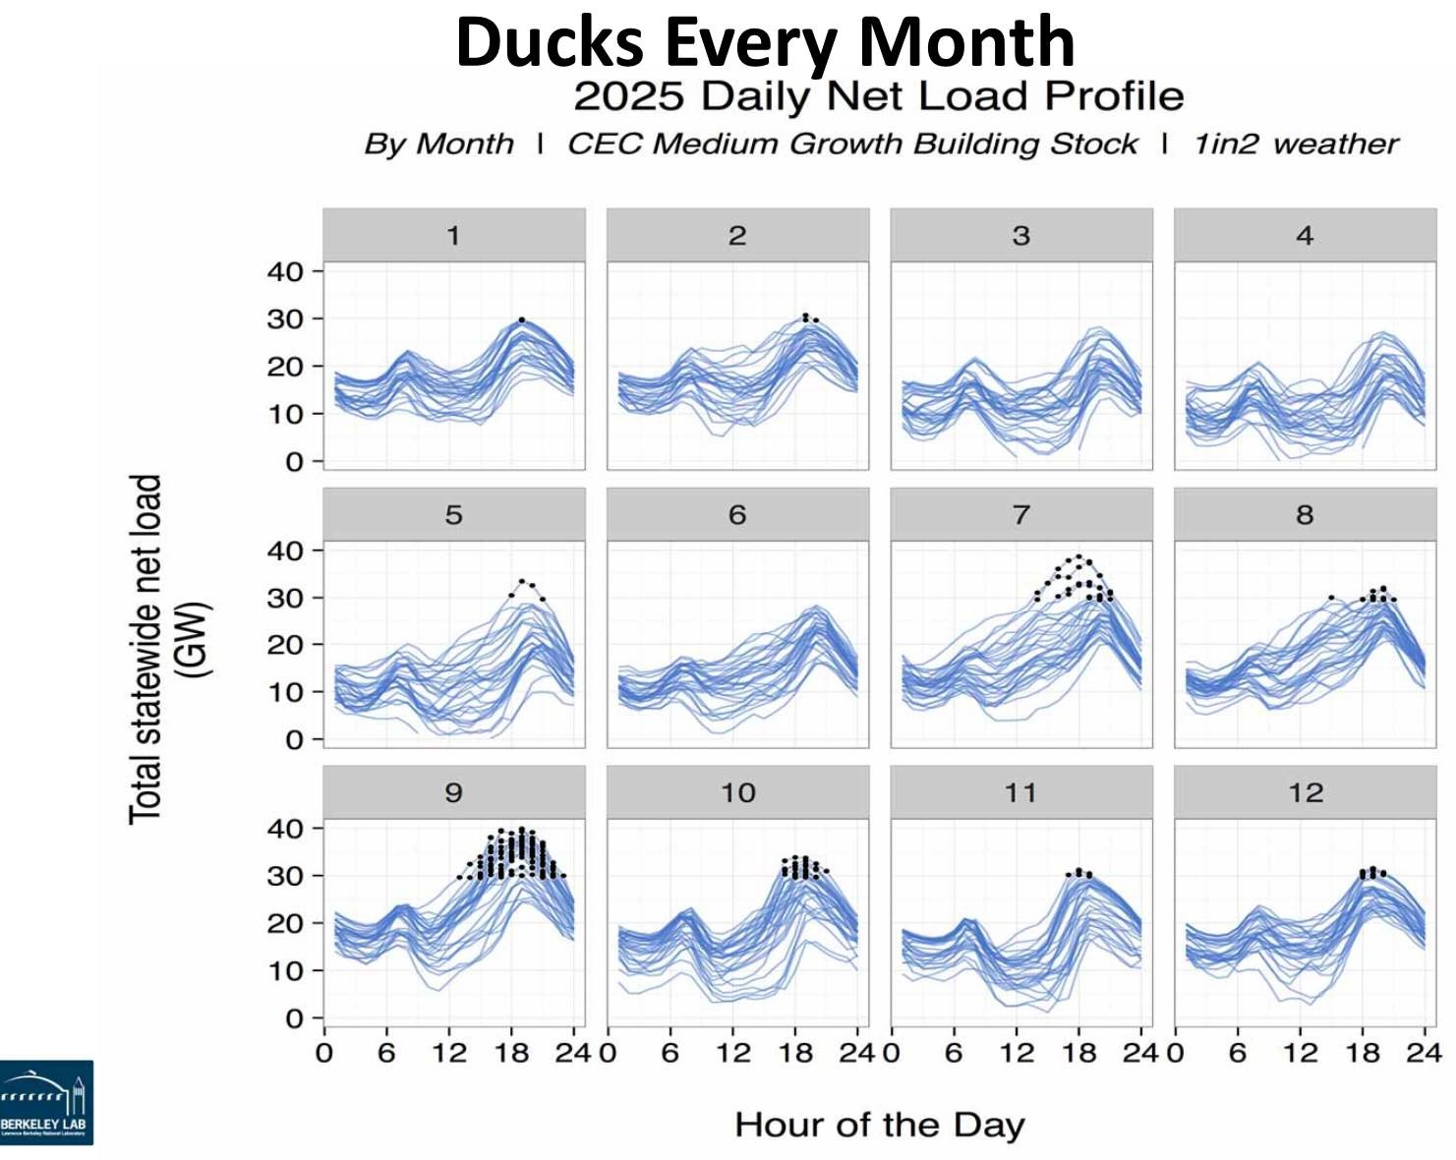
Load Management Standards
  GOAL:
  Performance standards for each Load Serving Entity to meet a portion of generation with energy efficiency and demand flexibility

Slide 10
Summer (May–Oct.) A1 TOU Overlay on GHG
*SCC Value=$48 ($2015), Table 8. Social Cost of Carbon 2020-2030, CARB Proposed Plan January 2017
https://www.arb.ca.gov/cc/scopingplan/app_e_economic_analysis_final.pdf

Slide 11
Thank You!

