Slide 1
Engaging Stakeholders and Citizens More Effectively on Wind (and other renewable energy) Siting and Policymaking
Dr. Jonathan Raab, Raab Associates and MIT
Massachusetts Clean Energy Center
May 20, 2011

Slide 2
Outline of My Talk
Brief Case Studies
  Cape Wind
  Vermont’s Electricity Future
  City of Boston Climate Plan
  Martha’s Vineyard
  Fox Island, ME
U.S. DOE Wind Training
Potential Next Step Options For Better Engaging Stakeholders/Citizens

Slide 3
Cape Wind
Stakeholder Process
2002-2004

Slide 4
Cape Wind Stakeholder Process
Goal of the process was for stakeholders to gain familiarity with the proposed project so they could better participate in formal “notice and comment” process after the draft EIS released by the Army Corp of Engineers, including:
    A better understanding of the potential benefits and impacts associated with the proposed project
    A better understanding of the interests, hopes, and concerns of a broad cross-section of stakeholders responding to the proposed project
Goal was not to reach consensus on the project
Raab Associates hired by the Massachusetts Technology Collaborative to design and facilitate a Stakeholder process

Slide 5

Cape & Islands
Offshore Wind Process
Meeting #3: November 21, 2002
November 21 Panel 1: Visual Impacts
Goal: To better understand what the proposed Cape Wind project might look like.
Agenda:
        Cape Wind (visual model)
        Alliance to Protect Nantucket Sound (visual model)
        Visual Modeling of Other Wind Projects/Proposals
        Video on Offshore Wind Development in Europe

Slide 6
Divergent Views on The Visual Impacts of Proposed Project
“Industrialization of Nantucket Sound”
“Elegant Testimonial to Our Technical Ingenuity”
“One Butterfly is a Beautiful Thing, But If I’m Locked in a Small Closet With 130 of Them, That’s Claustrophobic”

Slide 7
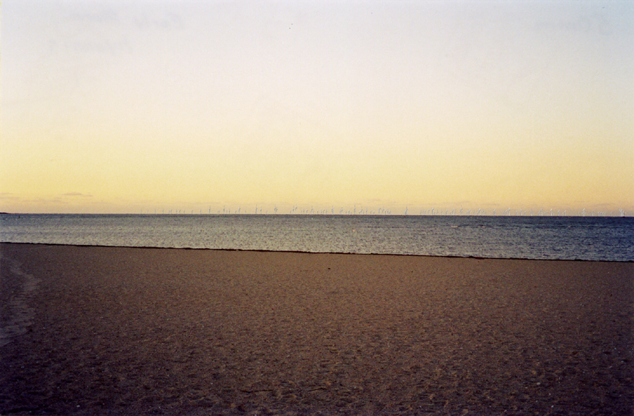
Hyannis – 50 mm Simulation

Slide 8
SEA ST. BEACH, HYANNIS

Slide 9
Proper Viewing of Slides
Standing the correct distance from the screen story
Capturing the Woody Allen true thought bubbles (what are stakeholders and citizens really thinking?)

Slide 10
Interesting Visual Impacts Questions
#1: Which set of simulations paints the project in a more favorable light?
Developers
Opponents
Both about the same

Slide 11
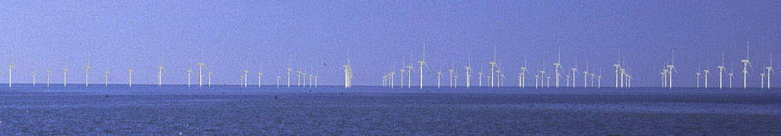
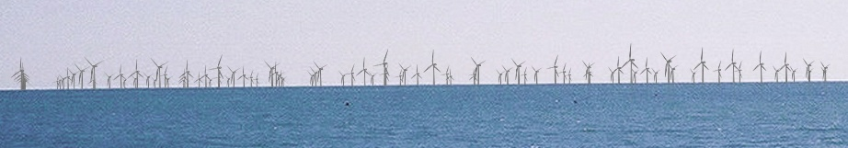
Blade Rotational Alignment
It is very unlikely that 170 wind turbine blades will align at any given time.
Earth Tech – Blades all in the same rotational position
EDR – Blades are all in random positions

Slide 12
Interesting Visual Impacts Questions
#2: How do these visual impacts stack up against your preconceived notions? (worse, better, about the same)
#3: How would you rank the aesthetics of the proposed Cape Wind Project? (1 “Ugly” to 6 “Beautiful”)

Slide 13
Interesting Visual Impacts Questions
#4: How do you compare the visual impacts to the benefits of the project?
A) Adverse visual impacts outweigh the benefits
B) Benefits trump the visual impacts
C) It’s a toss up

Slide 14
Interesting Visual Impacts Questions (Harvard Wind Workshop)
#4: How do you compare the visual impacts to the benefits of the project?
A) Adverse visual impacts outweigh the benefits (9)
B) Benefits trump the visual impacts (55)
C) It’s a toss up (12)

Slide 15
Visual Impacts Discussion
Structuring a difficult, value-based conversation
    Are the aesthetics of wind farms strictly in the eyes of the beholder?
    How do we make the trade-offs between localized visual impacts vs. regional energy/reliability benefits and regional (acid rain, smog) and global environmental benefits (climate change)

Slide 16
Vermont’s
Energy Future Project
2006-2007

Slide 17
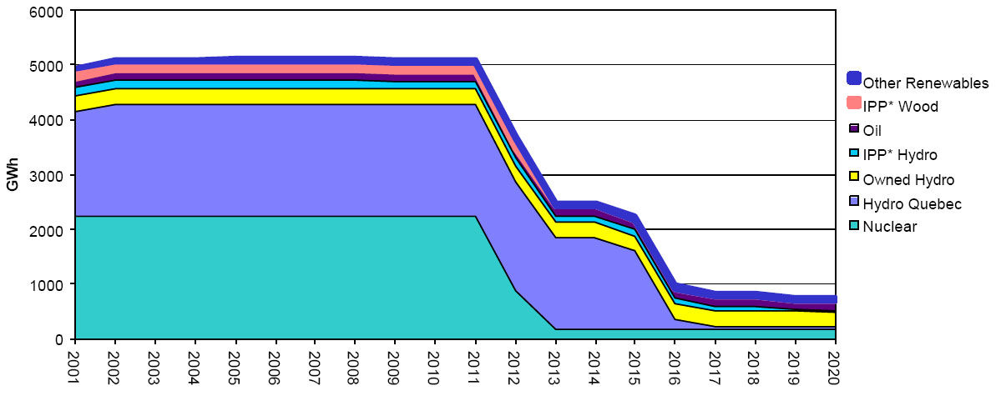

Why Consider the Future Now?

Slide 18
Governor Douglas
Governor Douglas wanted to know what Vermont’s Citizens (not what its lobbyists and traditional stakeholders) think Vermont and its utilities should do
Generally, Governor is
  Supportive of nuclear power
  Skeptical of wind

Slide 19
What was the VT Electricity
Futures Process?
Advisory and Resource panels of diverse interests helped prepare background documents & polling questions (aka traditional stakeholders)
Five regional workshops across the state hosted to gather public input in October from over 650 Vermonters
A Deliberative Polling© event of 140+ randomly selected Vermonters in November
On-line effort to disseminate information and allow for additional input
Notes:
19

Slide 20
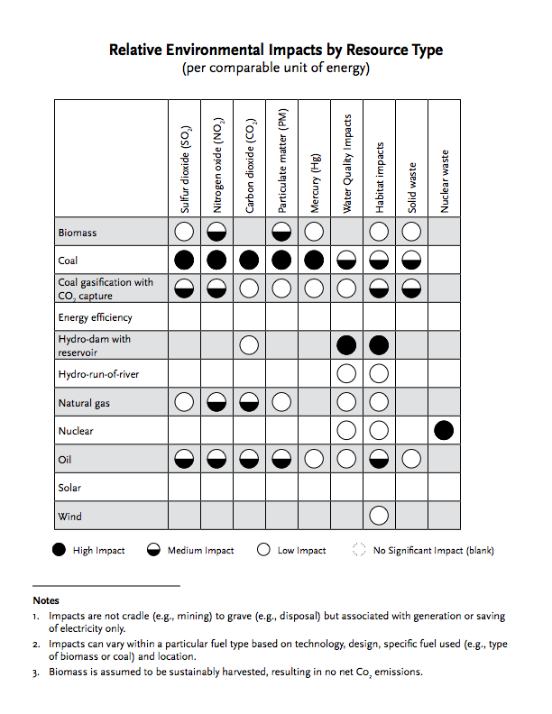
Comparing Environmental Impacts

Slide 21
Regional Workshop Agenda
5:00 Registration and light dinner
6:00 Welcome (Commissioner David O’Brien, VT DPS),
Overview (Jonathan Raab, Raab Associates), and
Demographic Polling (Patrick Field, CBI)
6:20 Presentation: Vermont’s Current Electricity System, Upcoming Challenges, and Future Options (Dave Lamont, VT Department of Public Service)
6:40 Facilitated Discussions: Most Significant Challenges and Promising Options for Vermont, and Additional -Questions for Panel
7:35 Break
7:50 Panel Responds to Questions
8:45 Polling on Most Significant Challenges and Best Options for Vermont (Patrick Field, Moderator)
9:30 Open Mike for Participants to Make Brief Additional Comments
10:00 Adjourn (when comments done)

Slide 22
Deliberative Polling© Process
Draw random sample
Interview and invite to event
Two-day event, alternating between small group discussions (led by trained moderators) and plenary Q & A’s with policy experts and policy makers
Re-administer same questionnaire

Slide 23
How Concerned Are You About Each of the Following?
 | Regional Workshops | Rank | Deliberative Polling | Rank
Greenhouse Gases | 8.5 | 1 | 8.6 | 1
Radioactive Wastes | 8.1 | 2 | 7.8 | 3
Other Air Pollution | 7.8 | 3 | 8.4 | 2
Damage to River Habitats from Hydro | 5.4 | 4 | 6.4 | 4
Visual Impacts of Wind | 1.7 | 5 | 3.0 | 5
0 = not at all concerned
10 = extremely concerned

Slide 24
How Important is Each of the Following Goals in Meeting Vermont's Future Energy Needs?
 | Regional Workshops | Rank | Deliberative Polling | Rank
Minimizing Air Pollution | 8.8 | 1 | 9.3 | 1
Reducing GHG Emissions | 8.8 | 2 | 9.0 | 3
Electricity from Resources that Will Never Be Used Up | 8.6 | 3 | 9.3 | 2
Reducing Dependence on Overseas Energy | 8.5 | 4 | 8.5 | 5
Reducing Radioactive Wastes | 8.3 | 5 | 8.1 | 7
Reliable Supply of Electricity | 8.0 | 6 | 8.9 | 4
0 = not at all important
10 = critically important

Slide 25
How Important is Each of the Following Goals in Meeting Vermont's Future Energy Needs (continued)?
 | Regional Workshops | Rank | Deliberative Polling | Rank
Creating Jobs in Vermont | 7.3 | 7 | 8.2 | 6
Using Power Produced in Vermont | 5.8 | 8 | 7.6 | 8
Stable Electricity Rates | 5.4 | 9 | 6.7 | 9
Low Electricity Rates | 4.9 | 10 | 6.5 | 10
Avoiding Facilities that Detract from Scenic Beauty | 4.4 | 11 | 4.8 | 11
0 = not at all important
10 = critically important

Slide 26
Response Comparisons
 | Regional Workshops | Deliberative Polling
A Wind Farm Visible from Where you Live | 1.6 | 1.4
1 = strongly support
5 = strongly oppose

Slide 27
REGIONAL WORKSHOPS
Which resource options do you think should be the highest or lowest priorities to meet Vermont’s future electricity needs considering all factors (cost, environmental attributes, reliability, etc.)?
Resource | High % | Low % | Difference | Rank
Energy Efficiency | 25% | 1% | 24% | 1
Wind | 22% | 2% | 20% | 2
Hydro | 15% | 0% | 15% | 3
Solar | 16% | 2% | 14% | 4
Wood | 8% | 2% | 6% | 5
Methane from farms or landfill | 7% | 2% | 5% | 6
Natural gas | 1% | 8% | -6% | 7
Nuclear | 6% | 24% | -19% | 8
Oil | 0% | 27% | -27% | 9
Coal | 1% | 32% | -32% | 10
mean n = 507
27
Notes:
27

Slide 28
Figure 12: Continue to Buy from VT Yankee?

Slide 29
Boston Climate Action Plan: Community Workshop Participation
event | Total | Evening | Youth
voters | 461 | 319 | 142

Slide 30
How important do you think it is for the Boston City Government to take action now to make the people who live and work here reduce (mitigate) the greenhouse gases that cause climate change?
(Before and After)

Slide 31
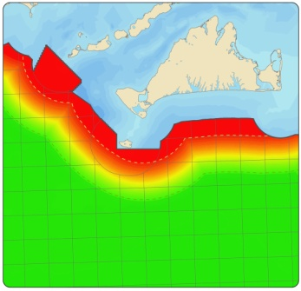
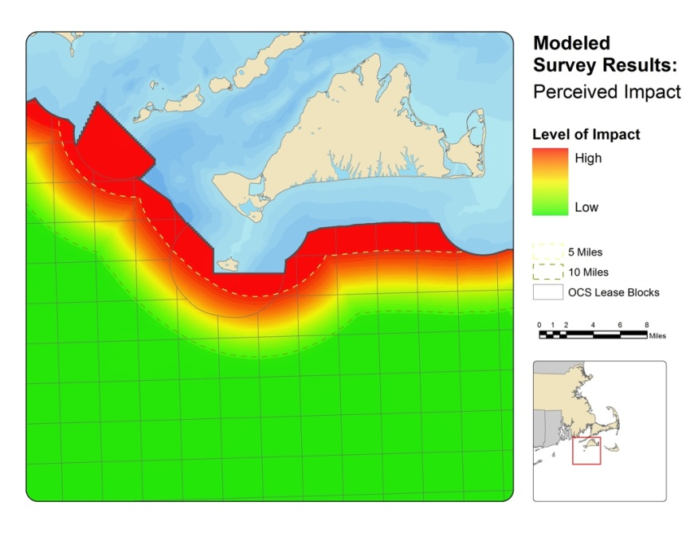
THE MISSING
PEICE:
PUBLIC PREFERENCE IN
WIND ENERGY SITE SELECTION
TYLER STUDDS

Slide 32
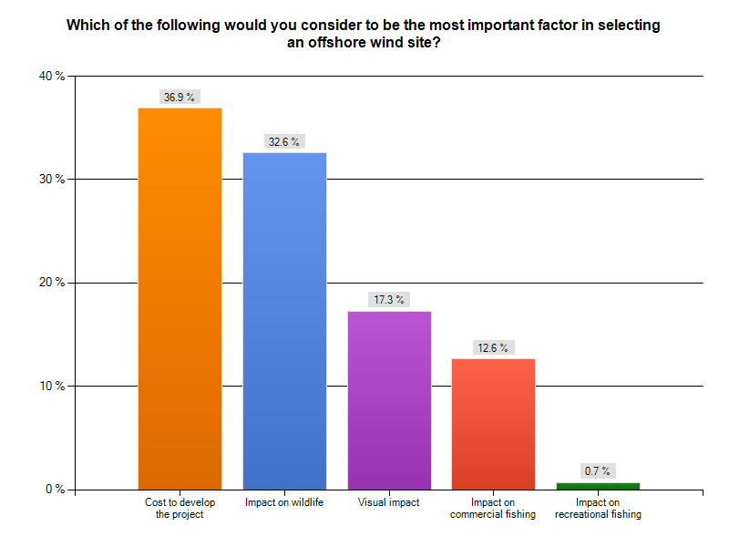

Slide 33
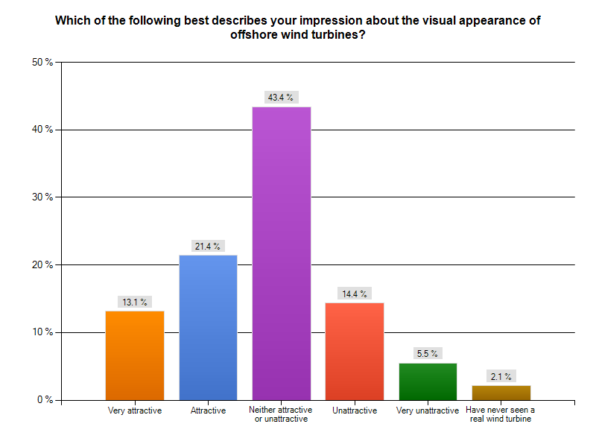

Slide 34
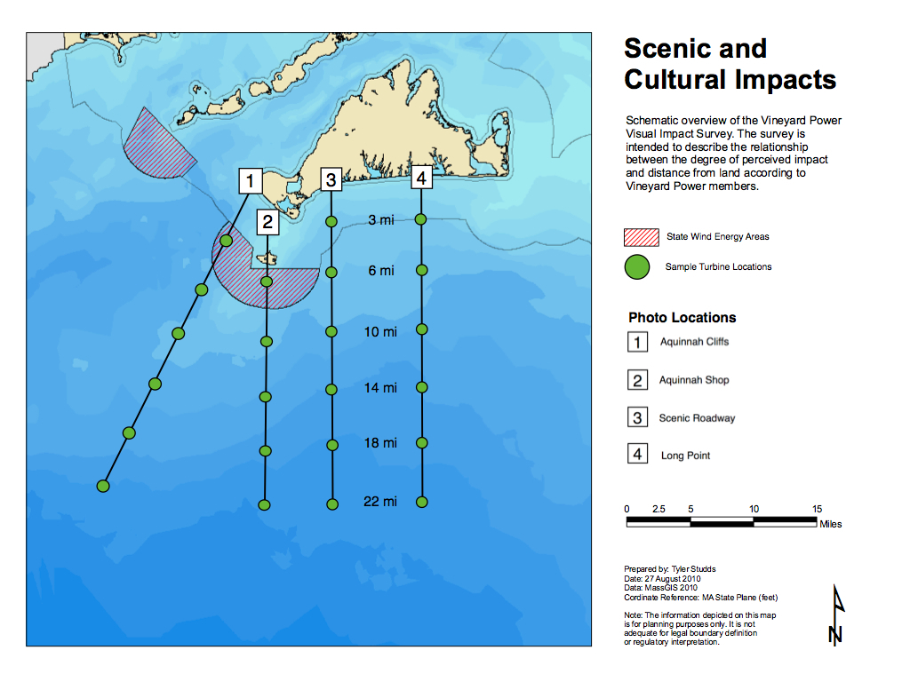
Vineyard Power
Visual Impact Survey

Slide 35
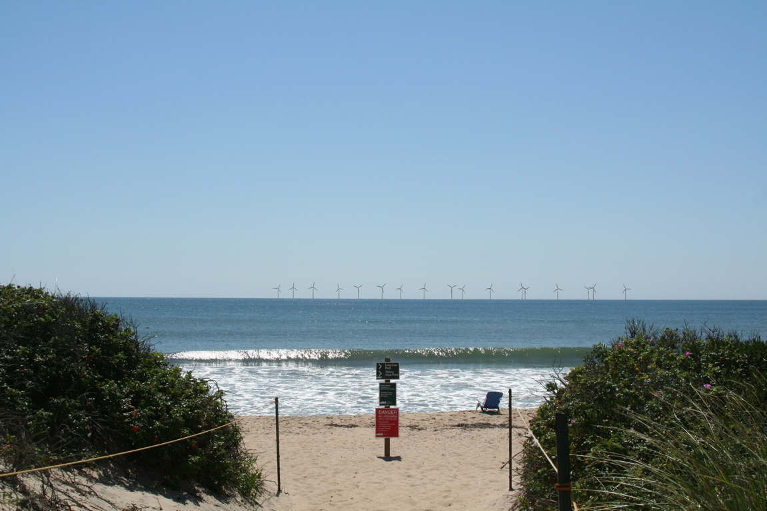

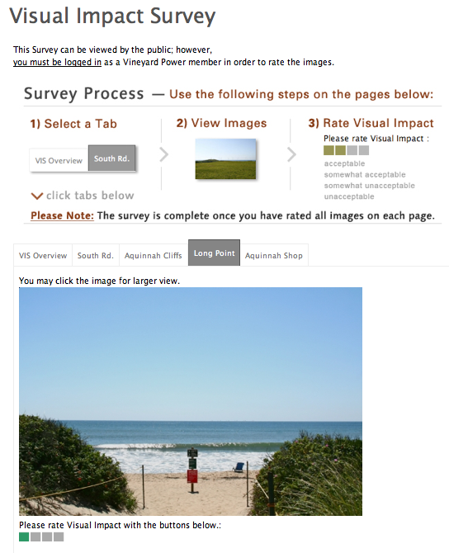
Vineyard Power
Visual Impact Survey
Relate distance to perceived impact
Identify relative importance of viewpoint
Predict potential visual impact of any site
Test web-based survey methods

Slide 36
Relationship between distance and acceptance
90
67
45
% Agreement
22
3
6
10
14
18
22
% Acceptable
Distance (mi.)
% Unacceptable
% Moderately
Acceptable
% Moderately
Unacceptable

Slide 37
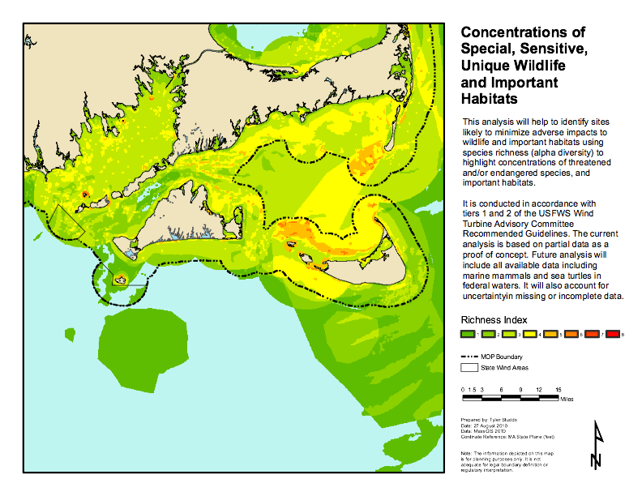
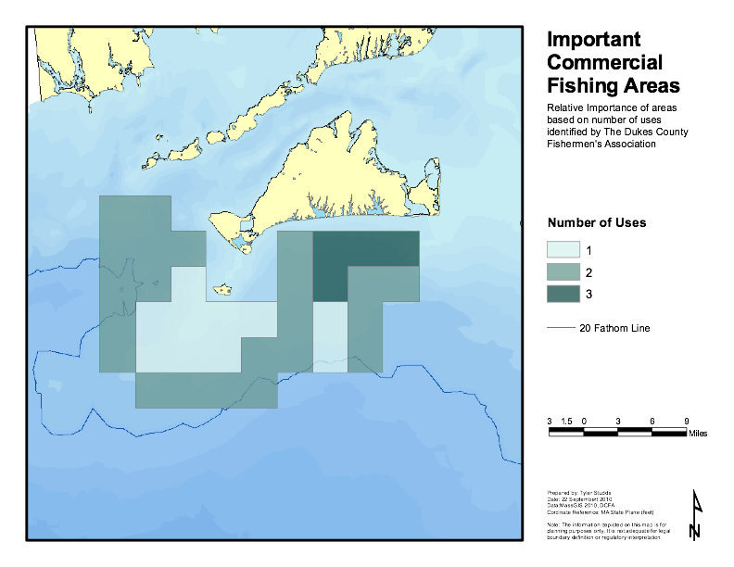
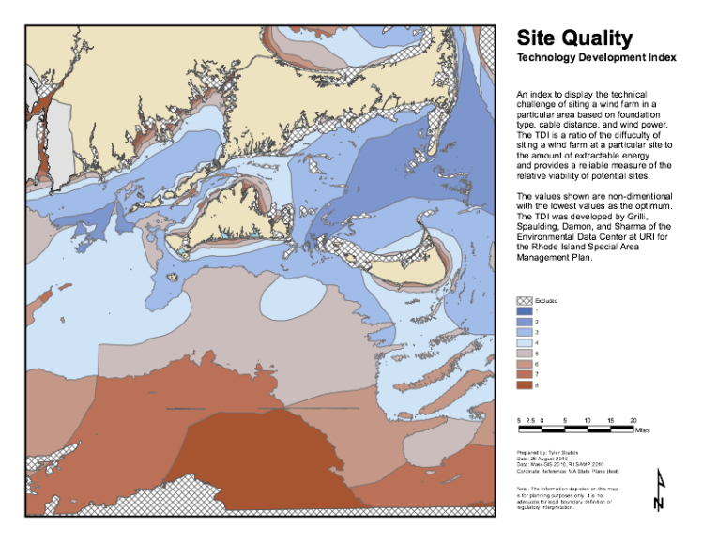

Putting the Pieces Together: Combined Suitability
Wildlife
Commercial Fishing
Cost of Electricity
Visual Impact

Slide 38
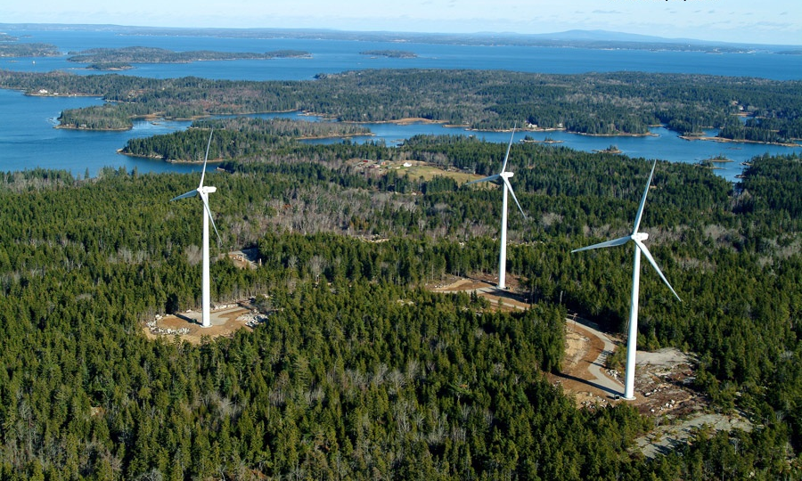
Fox Islands Wind:
A Community Wind Case Study
Suzanne Pude
Community Energy Director
Island Institute
Social Challenge of Wind Energy
November 9, 2010

Slide 39
Three Phase Process
Phase 1
Initial feasibility (November 2007-July 2008)
  Technical/logistical
  Environmental
  Economical/financial
  Community support
      → Community Vote: 382 - 5

Slide 40
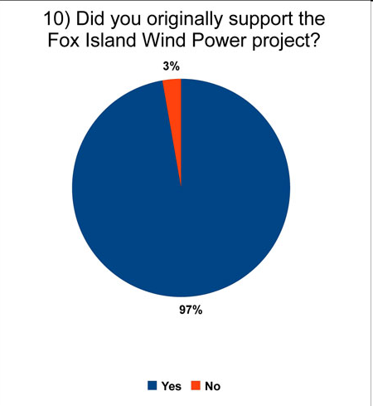
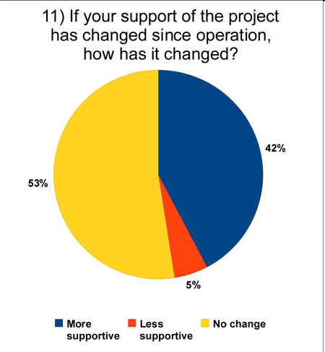
Community Feedback
July 2008
May 2010
http://www.foxislandswind.com/surveyresults_072010.html

Slide 41
Facilitating Wind Energy Siting Workshop/Training
Funded by U.S. DOE
Joint Project CBI and Raab Associates, Ltd.
March 23-25, 2011 at Harvard Law School
Originally pilot for 50 from across the U.S.
Changed to Northeast focus primarily
280 applicants, admitted 105
16 states (and a few countries)
Mix of state/local officials (35%), wind developers (25%), NGOs (30%), and consultants/others (10%)

Slide 42
Agenda
Mutual Gains Negotiation Theory and Practice
Panels on key topics-visual impacts, noise, joint fact finding, engaging communities
Site specific case studies
Negotiation exercises ranging from two-parties and two-issues, to five parties and multiple issues for a half day
End with clinic on real situations raised by participants, small groups on themes

Slide 43
How would you evaluate the overall training (scale of 1-8)?
8 (Excellent) | 18
7 | 24
6 | 8
5 | 0
4 | 0
3 | 0
2 | 0
1 (Unsatisfactory) | 0

Slide 44
How would you evaluate the trainers?
Excellent | 47
Good | 8
Satisfactory | 0
Unsatisfactory | 0

Slide 45
Potential Next Step Citizen Engagement Options for MA and Beyond
TRAINING
  Additional customized “Facilitating Wind Siting and Policymaking Workshops/Trainings” (ala CBI/Raab Harvard)
    Brief or multi-day—local, state, or regional
GENERAL INFORMATION AND EDUCATION
  Workshops on energy choices more broadly with facilitated dialog and keypad polling (ala VT and Boston GHG)
    Background materials and keypad questions developed by diverse stakeholder advisory group
GUIDANCE
  Development of model local siting ordinances and codes
  Other handbooks for local officials, developers, and stakeholders on topic (ala CLF Ventures)

Slide 46
Potential Next Step Citizen Engagement Options for MA and Beyond (continued)
SITE-SPECIFIC
  Site-specific stakeholder/citizen engagement assessment by neutral assessor
  Professionally facilitated site-specific stakeholder/citizen engagement process on specific project proposals or pre-proposal stage
    Intent could range from information to developing joint options to seeking agreement on conditions around a particular project
  Consider an easy access pool of dollars and contracting to access neutral help easily

Slide 47
Potential Next Step Citizen Engagement Options for MA and Beyond (continued)
POLICY
  Regional or state Joint fact finding on key topics of import (noise, wildlife, etc.)
  State-based negotiated rulemaking on renewable facility siting laws or guidelines; or renewable policy (FITs, net metering, RPS, interconnections standards)

