Slide 1
Energy Storage For A Municipal Utility
Roger Lin
Senior Director, Product Marketing
NEC Energy Solutions
rlin@neces.com
Notes:
How are micro-grids likely to fit in as part of the evolution of LDCs? Depends on the economics, and the perceived value of energy independence and resiliency…
Can they be a part of LDCs and an alternative to LDCs at the same time? Yes… efficiency/economy of scale should be better at the municipal/regional level as opposed to individual sites’ backup gensets or PV+storage, but if LDC’s do not move fast enough to incorporate what their ratepayers want (*if* they want microgrids that is) they may be left behind
Do they represent a viable market for generation and storage? At the moment microgrid functionality for LDC’s appears to be outweighed by the economic value of generation and storage resources even in areas where resiliency/independence is desired… but costs are coming down
What kinds of steps should LDCs consider to reflect the new realities? Ask if resiliency offered by microgrid is worth anything to the ratepayers that would be affected, surrounding areas/electrical neighbors, or government organizations. Start planning for or enabling critical/non-critical load electrical separation or isolation in your distribution circuits. Microgrids are a local phenomenon and therefore logically be locally funded – but could they also have systemwide benefits that could then be funded “remotely”? Refer to Massachusetts “State of Charge” report for systemwide benefits quantification for the Massachusetts grid...

Slide 2
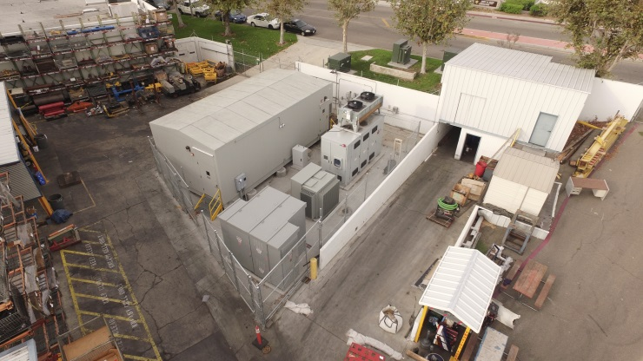
The GSS® grid storage solution
An Integrated System
The GSS® grid storage solution is a fully integrated, turnkey, AC energy storage plant ready to interconnect to the grid
Configured-to-order from factory-assembled, standard modular components
Designed and manufactured by NEC Energy Solutions:
AEROS® controls, a complete energy storage command and controls software package
GBS® grid battery systems; energy storage with BMS and controls hardware in outdoor-rated enclosures (standard containerized, but custom enclosures possible)
Includes necessary equipment from third-parties, engineered to work with all NEC ES equipment
Power conversion hardware (inverters) from leading manufacturers around the world
Thermal management units (air conditioning or water chillers) for battery cooling
Custom enclosure GSS® grid storage solution
Standard containerized GSS® grid storage solution

Slide 3
Global GSS® Grid Storage Solution Installations
8 MW/2 MWh
2011
400 kW/100 kWh
2010
2 MW/500 kWh
2008
20 MW/5 MWh
2013
350 kW/700 kWh
2013
1 MW/2.8 MWh
2014
2 MW/500 kWh
2013
2.5 MW/5 MWh
2013
2.5 MW/3.9MWh
2015
2 MW/2 MWh
2014
32 MW/8 MWh
2011
1 MW/3 MWh
2013
500kW/1.2MWh
2016
11 MW/4.4 MWh
2012
4 MW/1 MWh
2011
500 kW/125 kWh
2013
12 MW/4 MWh
2009
Frequency Regulation
1 MW/1 MWh
2013
2 MW/500 kWh
2013
280kW/135kWh
2014
Renewable Integration
20 MW/5 MWh
2011
Primary Reserve
T&D Support

Slide 4
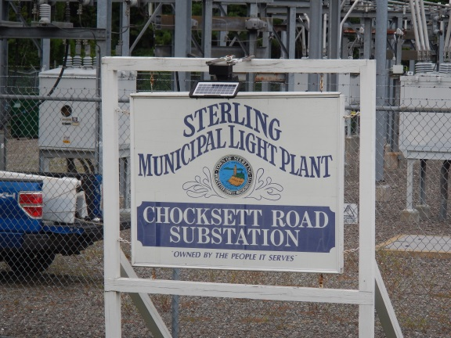
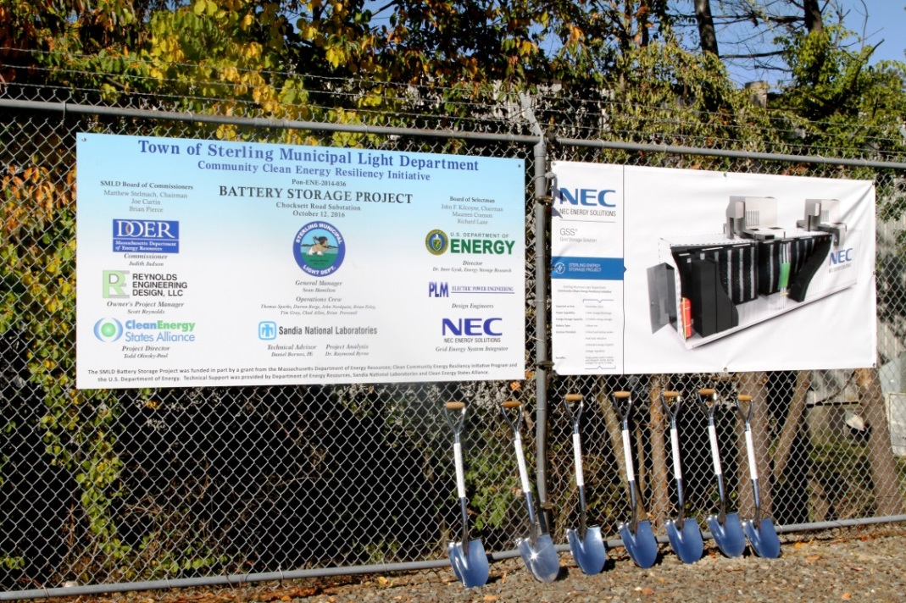
Sterling Energy Storage Project
Sterling Energy Storage Project
Town of Sterling, Massachusetts
Sterling Municipal Light Dept
3MW of PV in Sterling
Among highest per capita PV generation in the country
Desired additional resiliency and better integration of existing PV
Now installing energy storage
2MW, 3.9MWh GSS® grid storage solution
Groundbreaking was on Oct 12
Multiple benefits
Provide power for Sterling Police and Dispatch Center during outages
Provides electricity cost savings to ratepayers
Firms the value of PV
Enables future microgrid capability

Slide 5
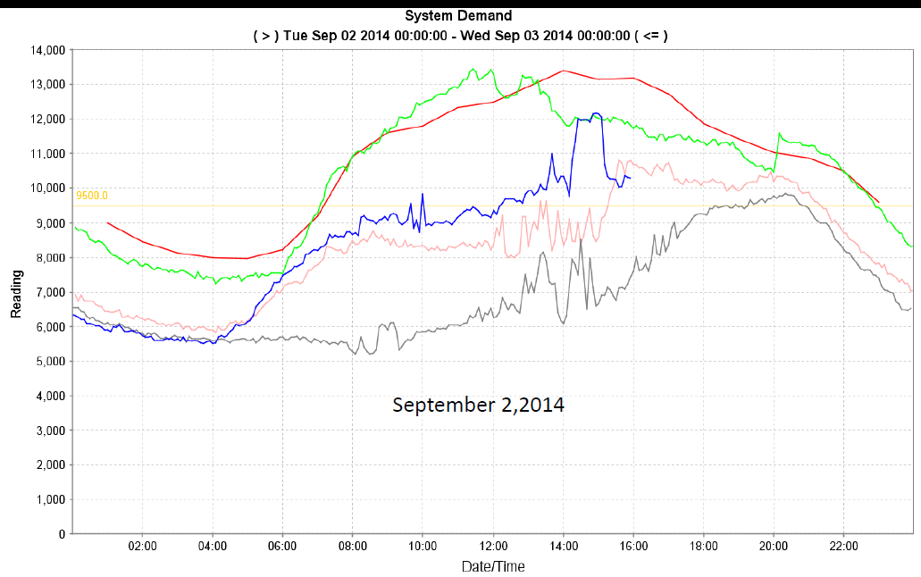
Value to Sterling Municipal
System Peak
Sterling Load
Avoid instances like this!
September 2,2014

Slide 6
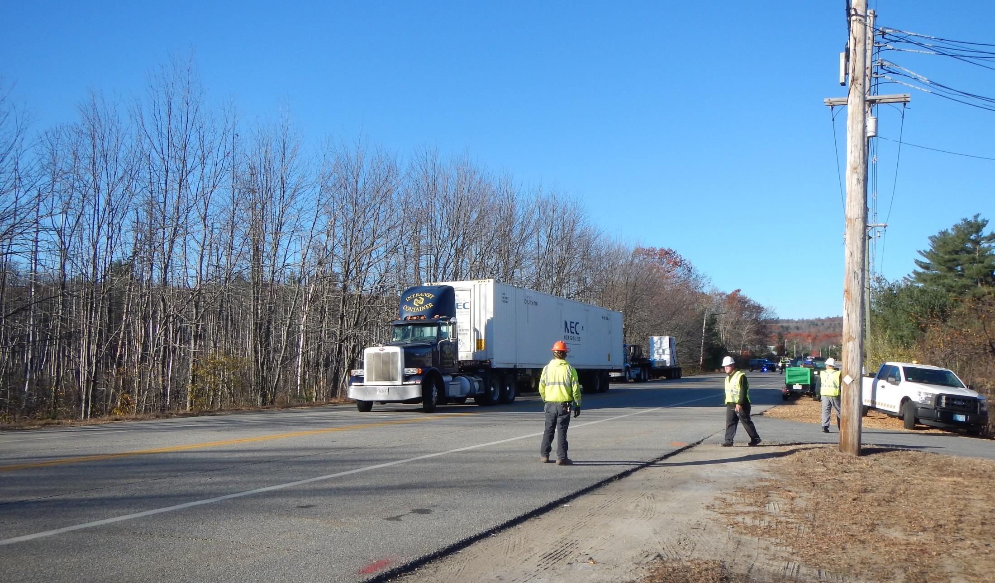
Sterling Energy Storage Installation Nov 14 2016
Energy storage container arriving on-site November 14

Slide 7
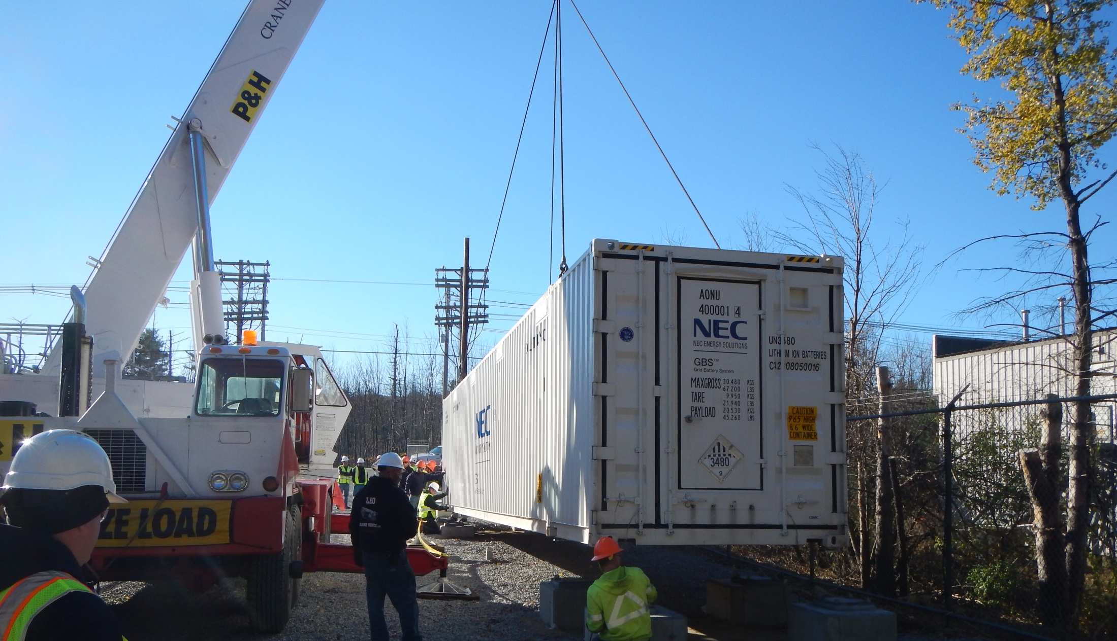
Sterling Energy Storage Installation Nov 14 2016
Energy storage container placement onto concrete footers

Slide 8
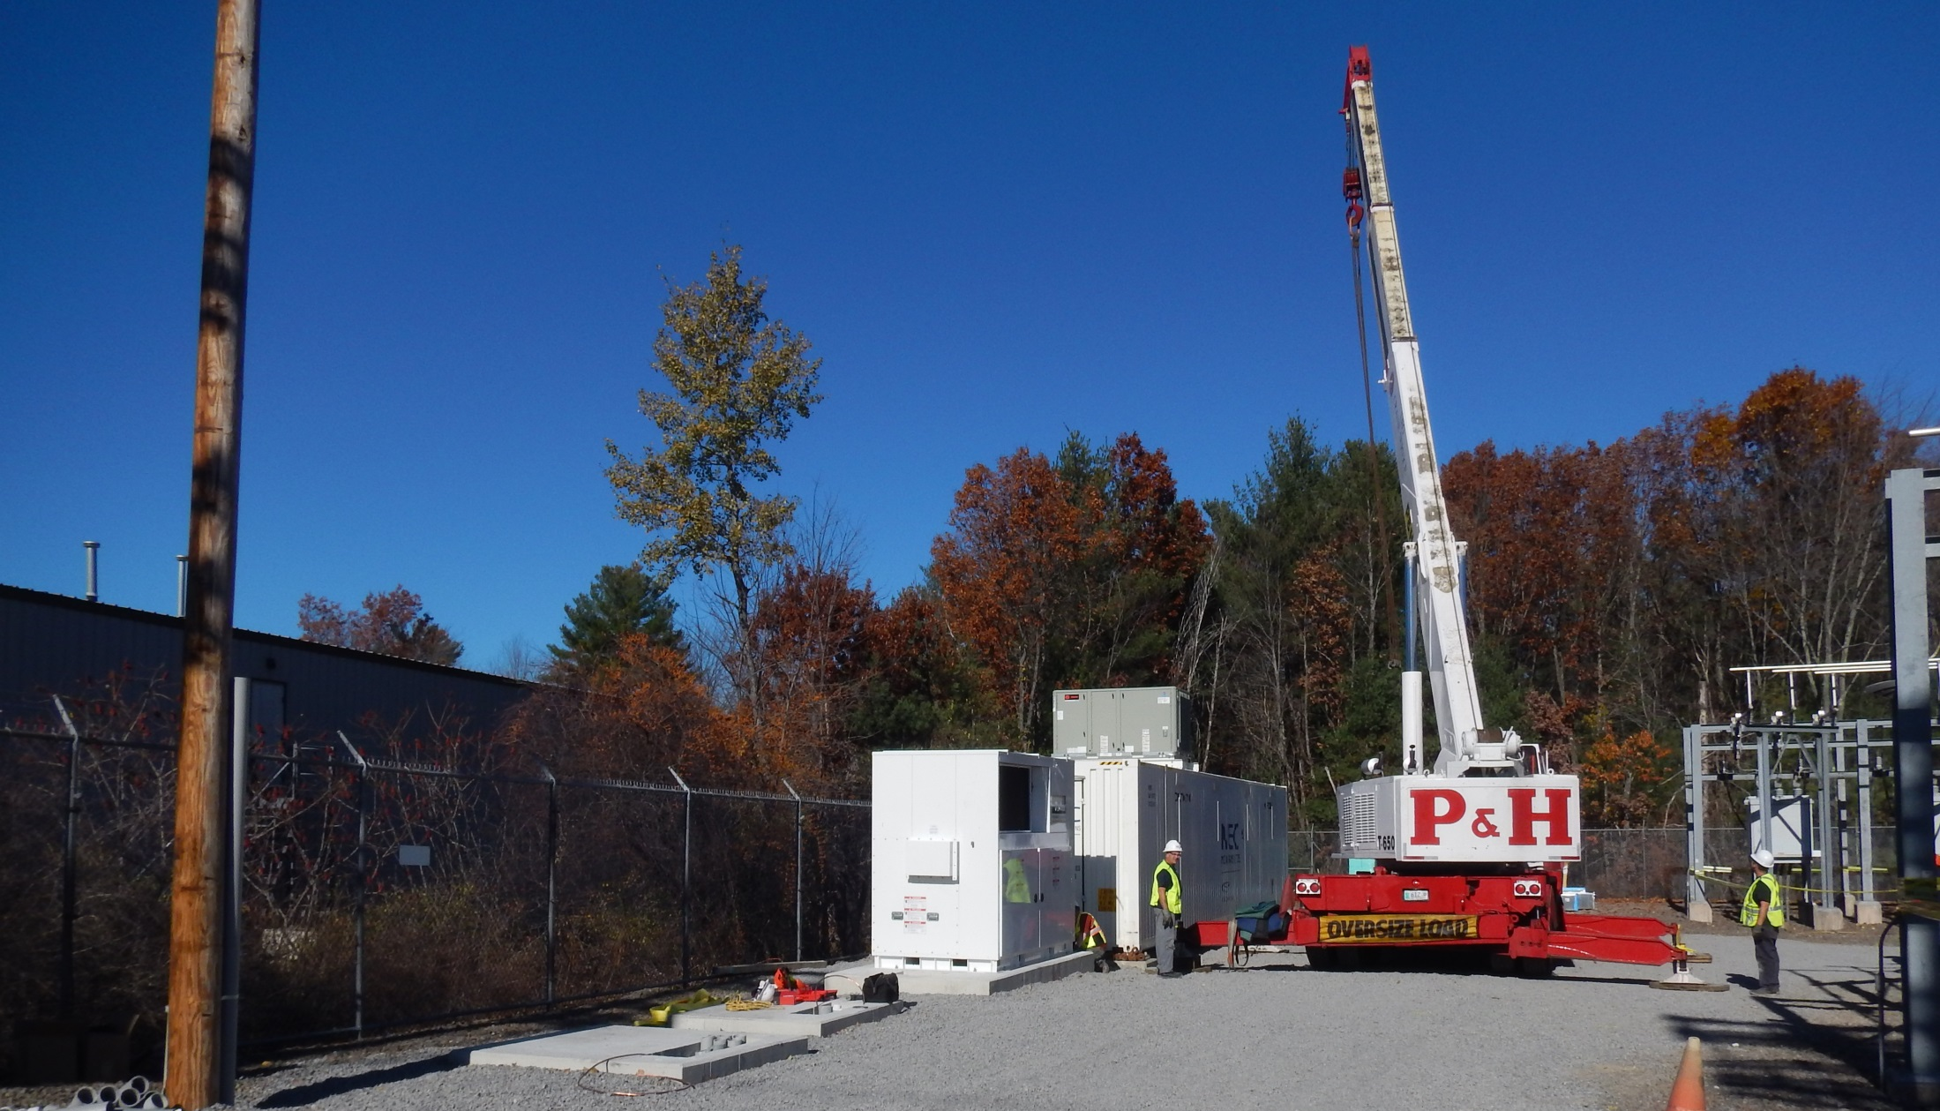
Sterling Energy Storage Installation Nov 14 2016
Energy storage and inverter in place…

Slide 9
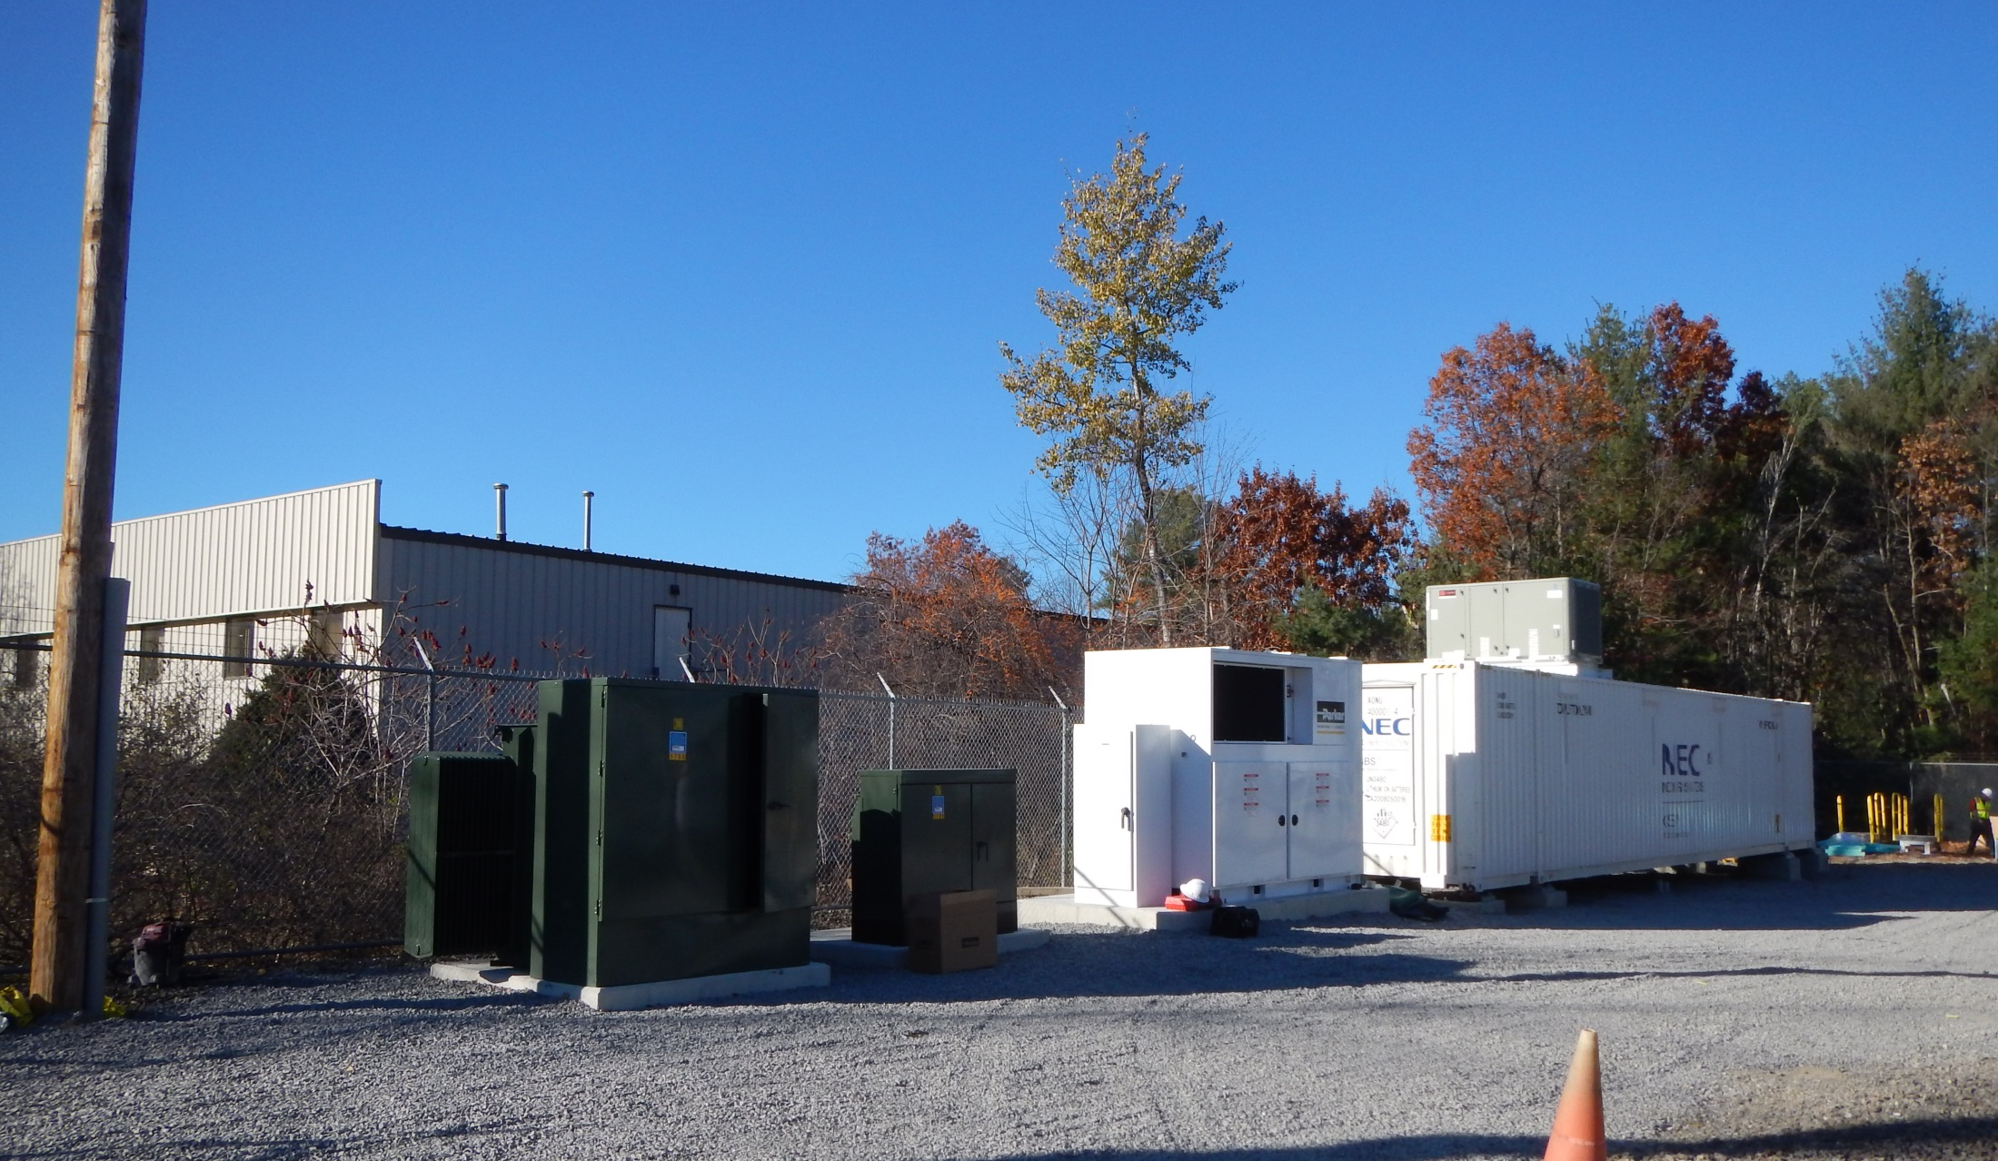
Sterling Energy Storage Installation Nov 14 2016

Slide 10
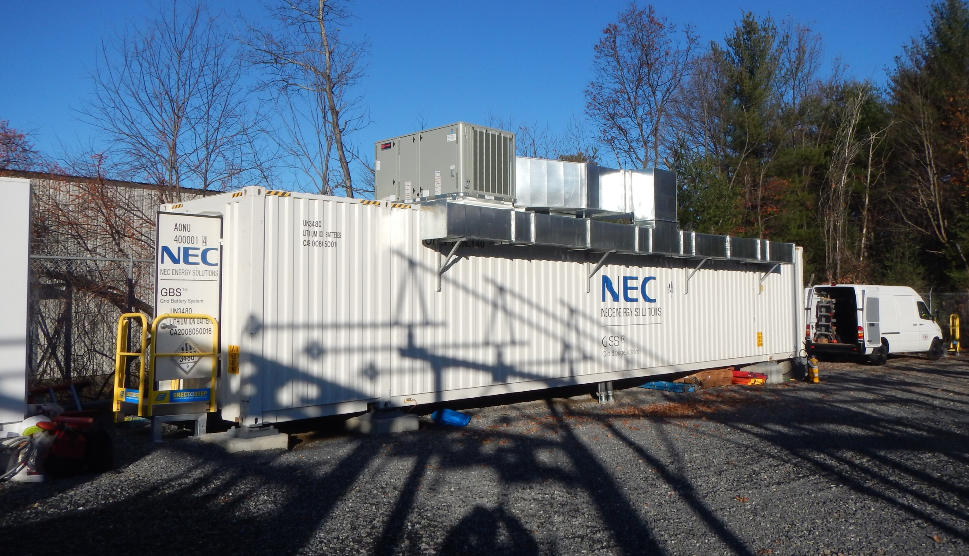
Sterling Energy Storage Installation Nov 14 2016
Air conditioning ductwork installed…
2MW, 3.9MWh lithium ion energy storage system
Groundbreaking on Oct 12, equipment installation on Nov 14….
Final commissioning expected to be complete this month

Slide 11
Other Real (and Diverse) Energy Storage Projects
Sample NEC Project Portfolio

Slide 12
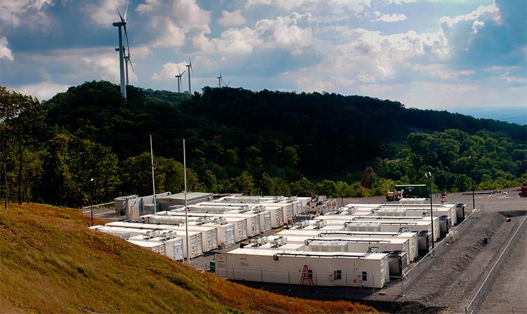
Energy Storage in PJM Frequency Regulation
Located at Laurel Mountain wind farm in West Virginia
32 MW lithium ion energy storage
Operational since 2011
Notes:
This site in West Virginia, USA, was installed for our customer next to its wind farm in 2011. One of the largest installations of the GSS grid storage solution at 32MW / 8MWh using our HR (high-rate) high power energy storage technology, we supplied the energy storage equipment, power conversion, and chiller systems and performed the installation and commissioning services. This site was operational in approximately eight weeks from arrival of the equipment on-site. Our customer was awarded the 2012 Excellence in Renewable Energy Award for Wind Project of the Year by Renewable Energy World for the Laurel Mountain site, and today operates in the PJM Regulation market.

Slide 13
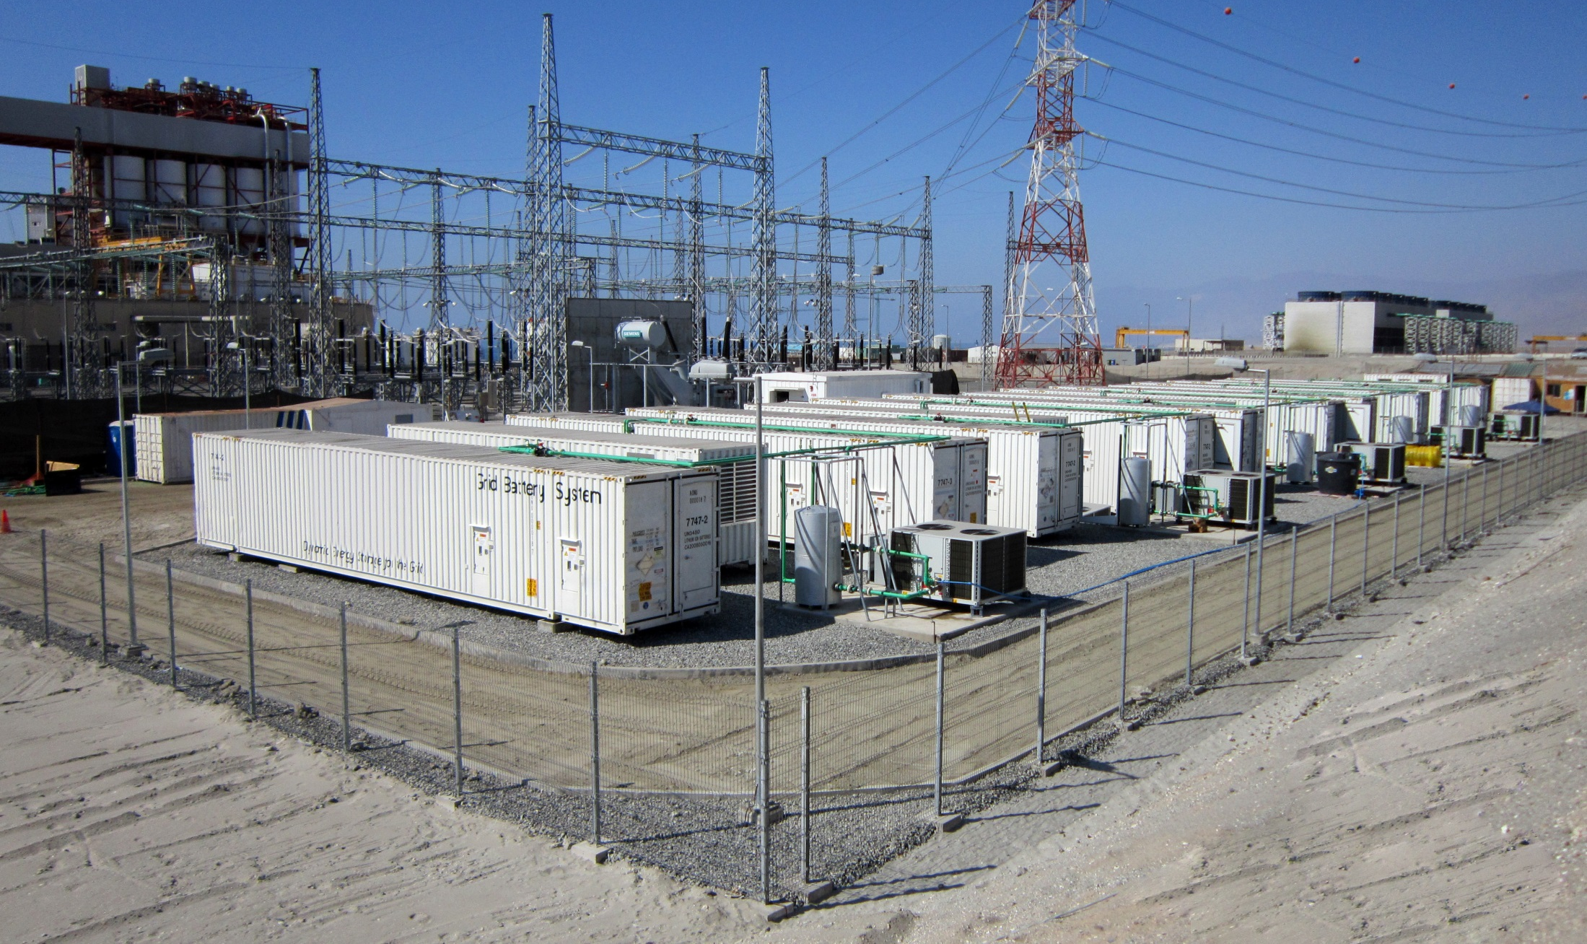
Energy Storage in Primary Reserve
Located in Chile, South America 1,400km north of Santiago
20MW lithium ion energy storage facility
Operational since 2011
Notes:
Our customer in Chile, building upon success with its first installation of our equipment in Los Andes, procured another 20MW of our GSS grid storage solution using our HR (high-rate) high power energy storage technology. We manufactured and delivered the energy storage equipment, performed all of the site work, and achieved operation in approximately eight weeks equipment arrival, which was sited next to our customer’s coal-fired generation plant in Angamos, Chile. In addition, for this project our customer won the prestigious “EEI Edison Award” in 2012. Like its sister installation Los Andes, the Angamos installation also operates in primary reserve and frees generation capacity of the coal-fired plant, increasing revenue for our customer.

Slide 14
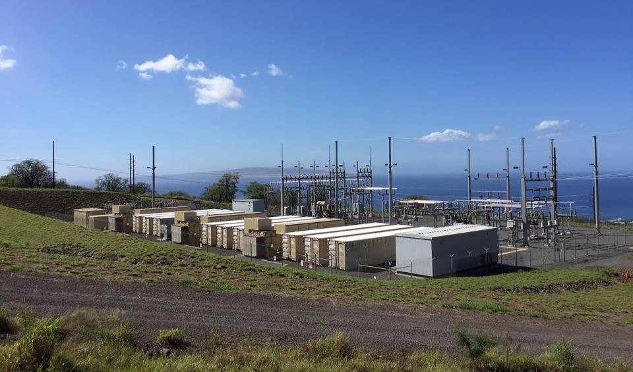
Energy Storage in Ramp Rate Management
Located on Maui, Hawaii
11MW lithium ion energy storage working with a 21MW wind farm
Operational since December 2012
Notes:
The Auwahi project in Maui, Hawaii was installed for our customer, Sempra Energy. As one of our largest GSS installations with renewable generation, it provides wind ramp management, essentially smoothing the output of the 21MW wind farm there using our HR (high-rate) energy storage technology. For this project we provided full turnkey engineering, procurement, and construction service within the scope of supply, including switchgear. Operational in approximately 8 weeks from equipment delivery to the site, the Auwahi project enables the 21MW wind farm to provide more consistent and less variable renewable electricity to the island of Maui.

Slide 15
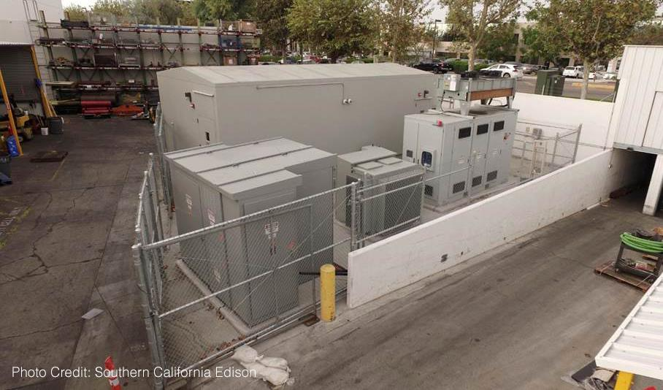
Energy Storage in Load Limiting/Peak Shaving
Located in California distribution grid for improved power reliability
2.5MW lithium ion energy storage in custom enclosure
Operational since July 2015
Notes:
http://newsroom.edison.com/stories/energy-storage-delivers-electric-reliability-to-a-neighborhood-near-you

Slide 16
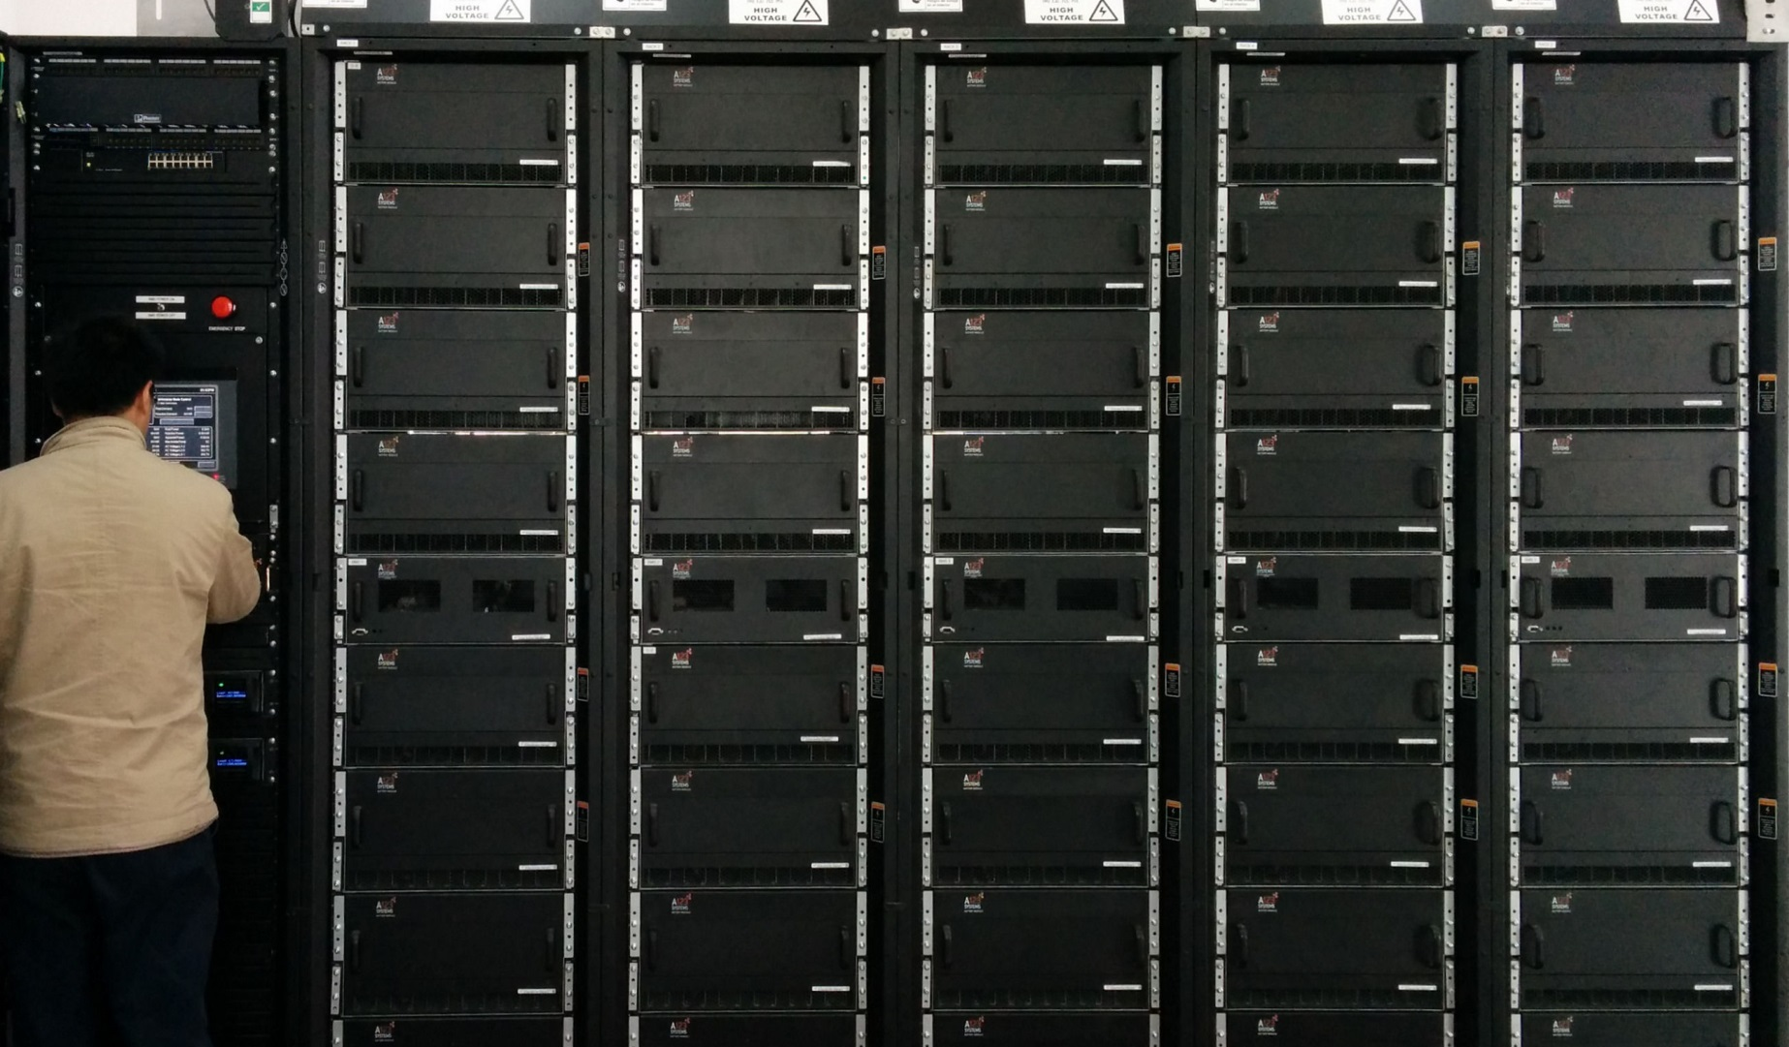
Energy Storage in Microgrid Support
Located in China installed in pre-existing building with local wind, solar, and thermal generation
500kW lithium ion energy storage
Operational since March 2014

Slide 17
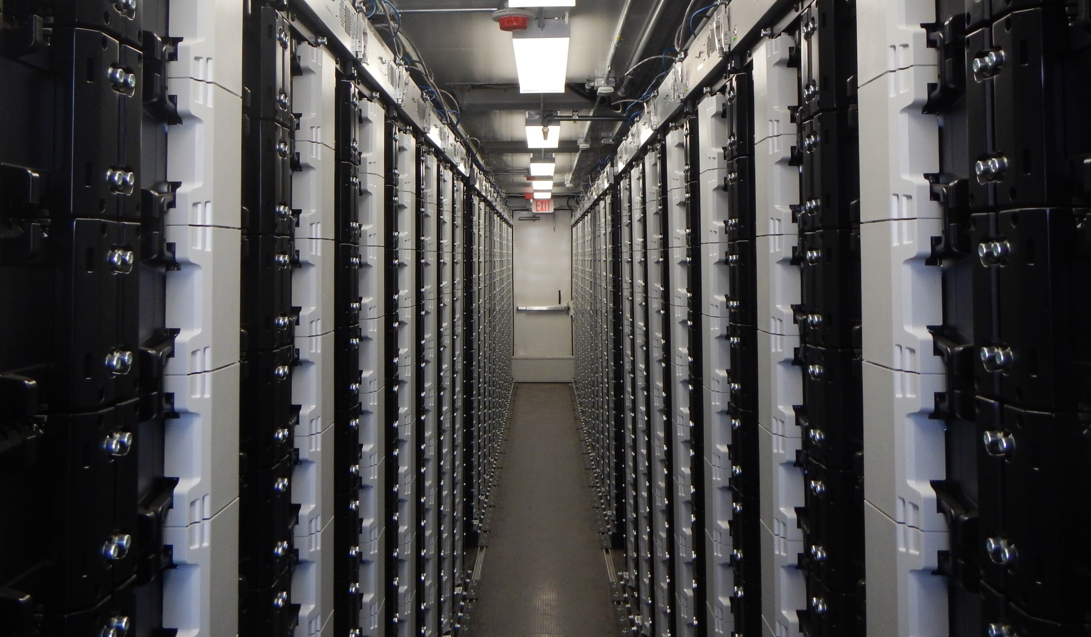
Other Energy Storage Case Studies
Other applications…
Frequency Regulation in PJM?
Primary Reserve in Chile?
Ramp Rate Management (Wind) in Hawaii?
Load Limiting (Peak Shaving) in California?
Microgrid Support in China?
Other applications not mentioned?
Thank you!
Roger Lin Senior Director of Product Marketing NEC Energy Solutions, Inc. 155 Flanders Road | Westborough, MA 01581 Direct +1 (508) 497-7261 rlin@neces.com

