Slide 1
New England Roundtable
Gas Supply & Electricity Rates in New England
November 21, 2014
Richard Levitan, rll@levitan.com

Slide 2
EIPC Gas-Electric Coordination Study Region

Slide 3
EIPC Gas-Electric Coordination Study Highlights
Target 1: Delineate natural gas-electric system interfaces and interaction effects
Target 2: Evaluate the frequency and duration of pipeline congestion over a 5- or 10-year horizon
Target 3: Identify and test contingencies on the natural gas system that adversely affect electric system reliability
Target 4: Review the operational / planning issues affecting fuel assurance
http://www.eipconline.com/Gas-Electric_Documents.html

Slide 4
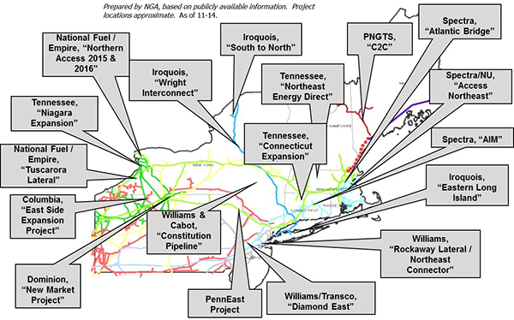
Proposed Northeast Expansion Projects
Source: Northeast Gas Association
Notes:
Window of opportunity for new pipeline capacity to bring supply from the Marcellus is closing
New pipe in New England is expensive and difficult to site
Lack of shippers willing to pay the FT rate necessary to support new capacity
Proposed pipeline expansions to the Mid Atlantic, South East, Mid West, Canada and to export through Cove Point to take up supply
Producers willing to sponsor new capacity through 15–20 year FT contracts
These markets offer easier ANG cheaper access to larger more rapidly growing demand

Slide 5
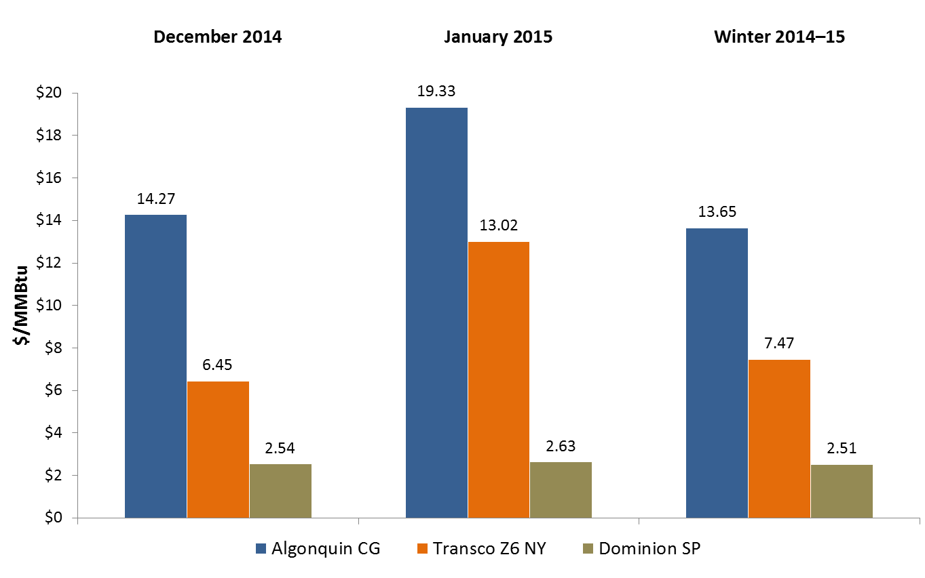
Forward Gas Prices – Key Pricing Points
October 30, 2014

Slide 6
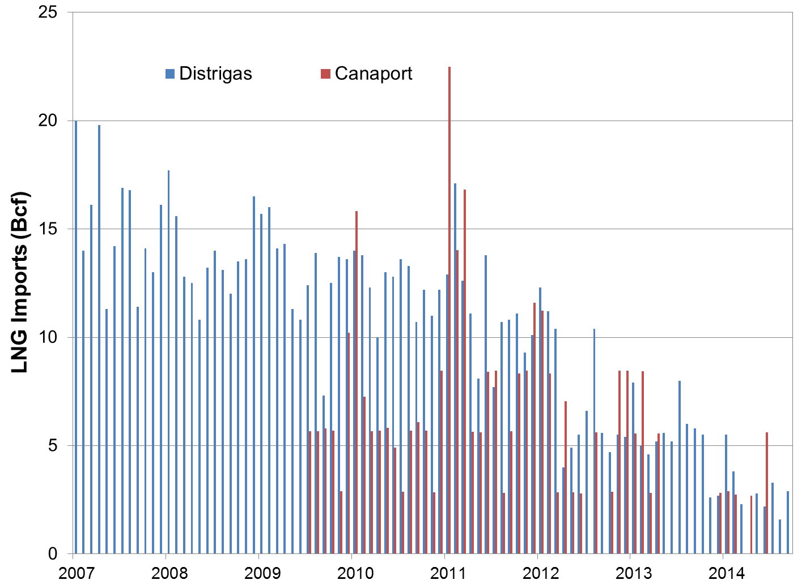
LNG Imports: Distrigas & Canaport

Slide 7
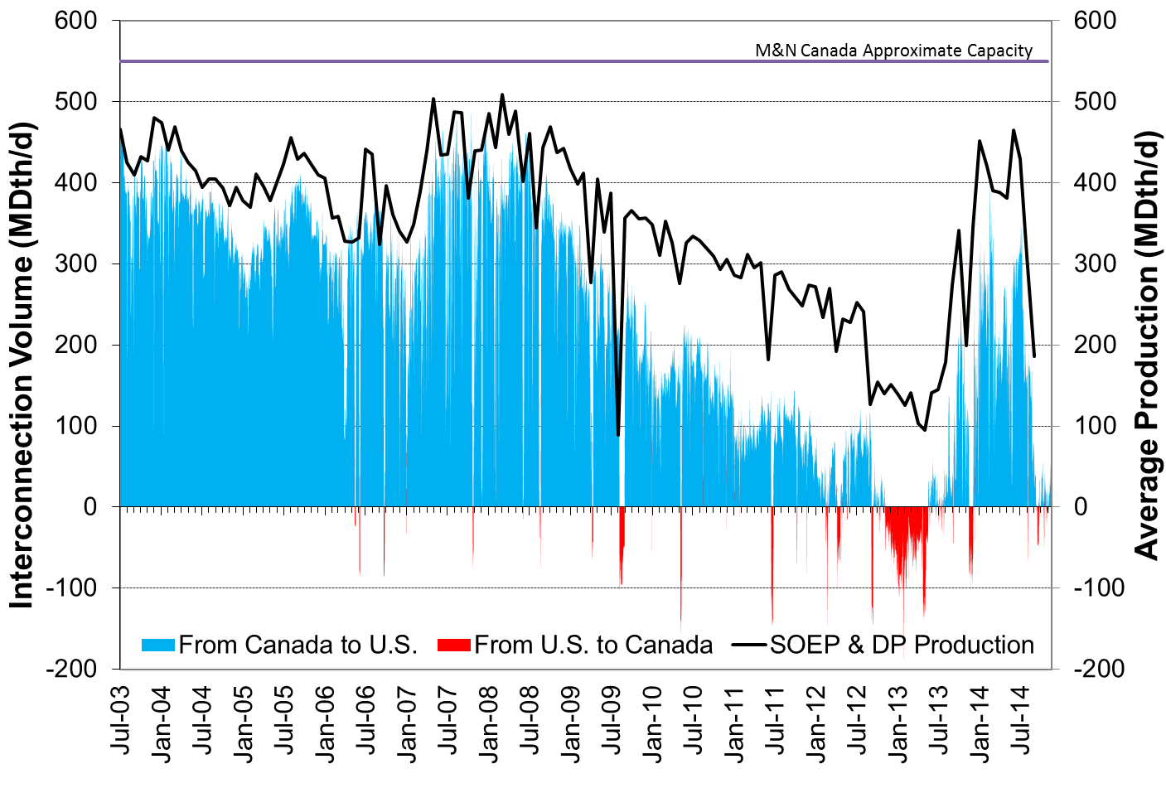
Canadian Receipts: Baileyville

Slide 8
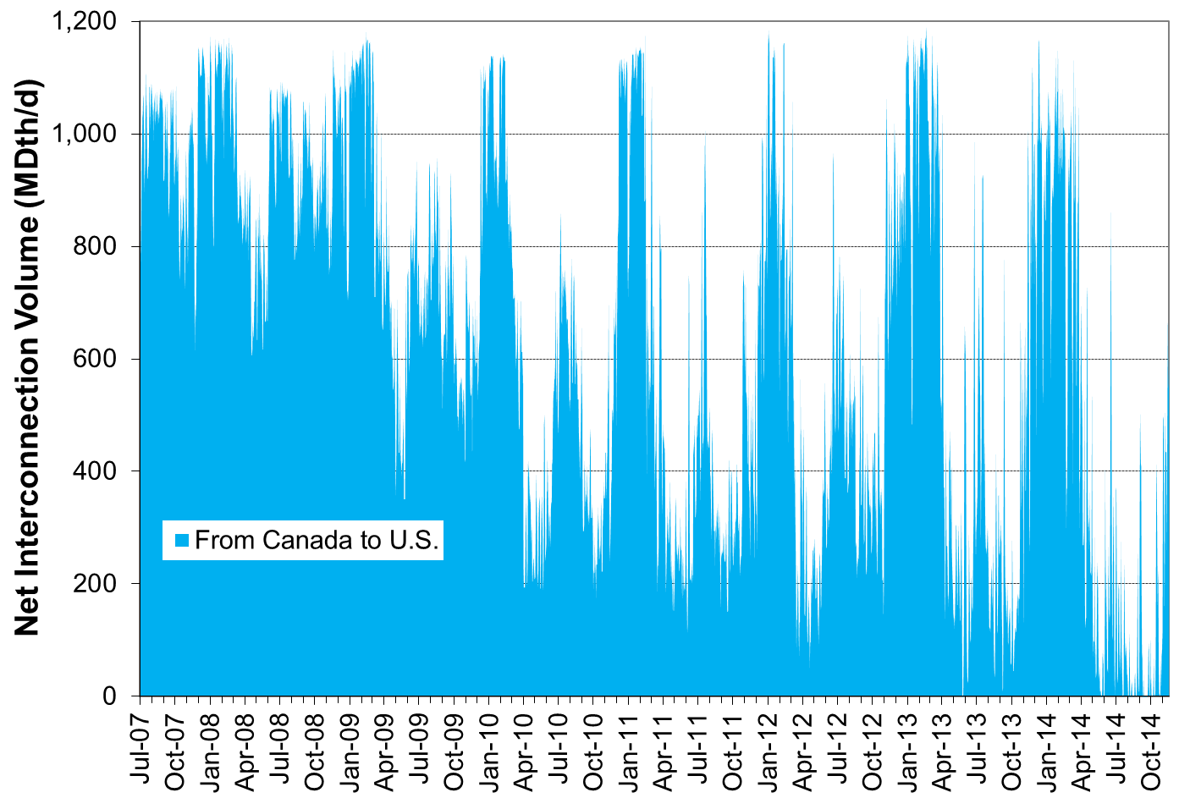
Canadian Receipts: Waddington

Slide 9
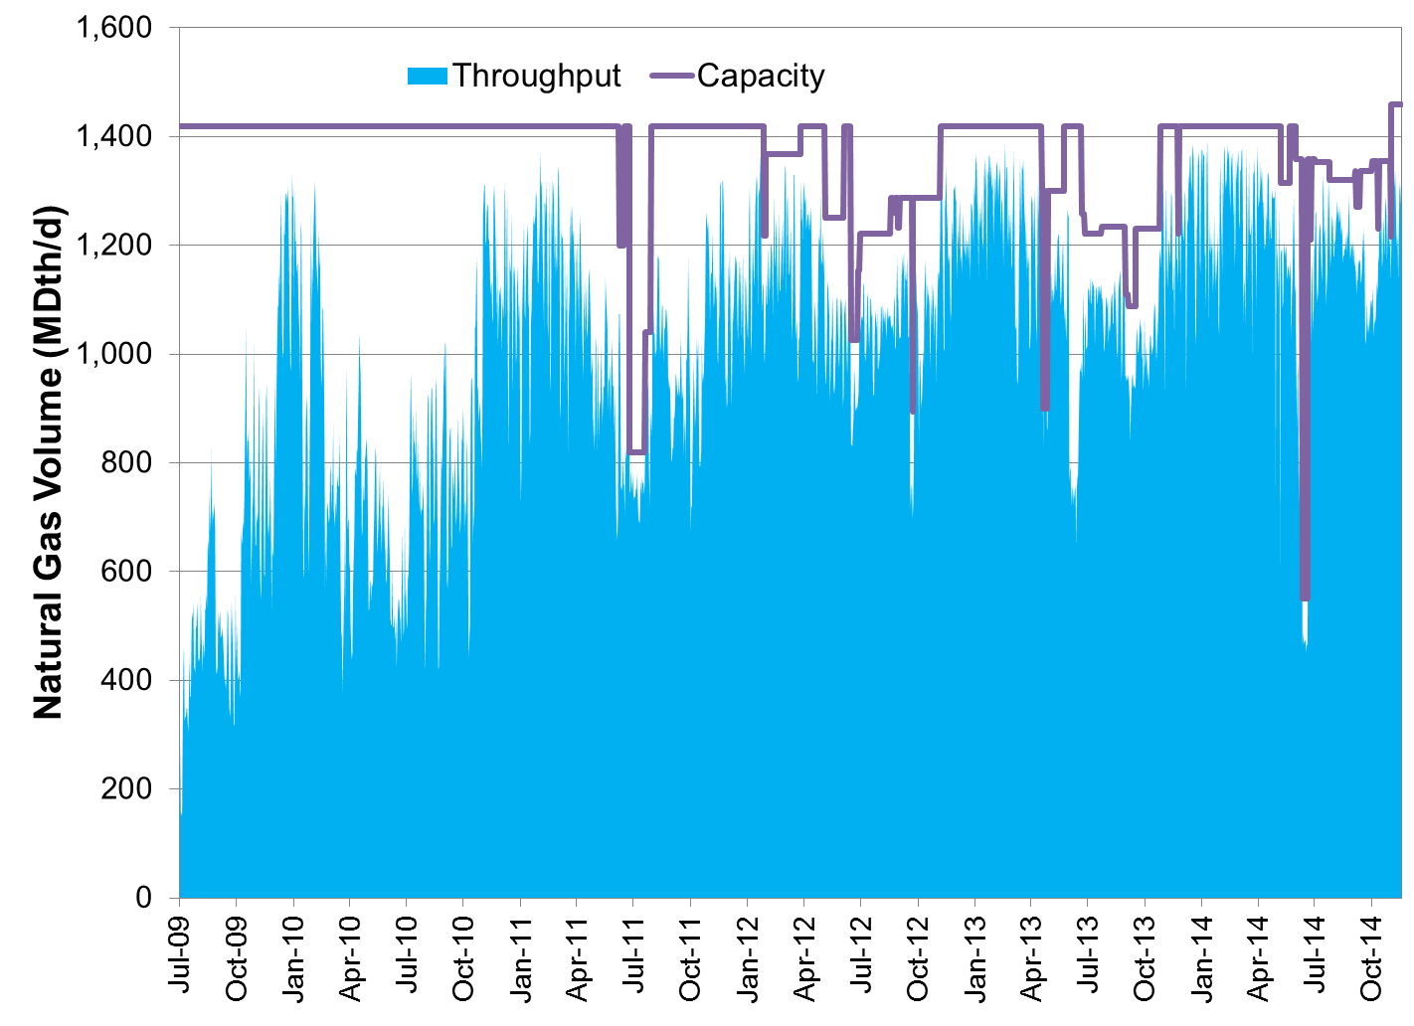
West to East Flow: Algonquin (Southeast CS)

Slide 10
Main Observations – ISO-NE
New England's gas infrastructure is plagued with economic obsolescence
Heavy gas reliance causes pipeline congestion during the heating season, peak cooling season, pipeline maintenance season
Absent major new pathways or expansions into the region, pipeline congestion in New England will be frequent and long duration
Wealth transfer through avoided cost is not a bankable proposition for new pipeline entry

