Slide 1
Restructuring Roundtable: The Future of Solar in New England By Dan Leary September 2011

Slide 2
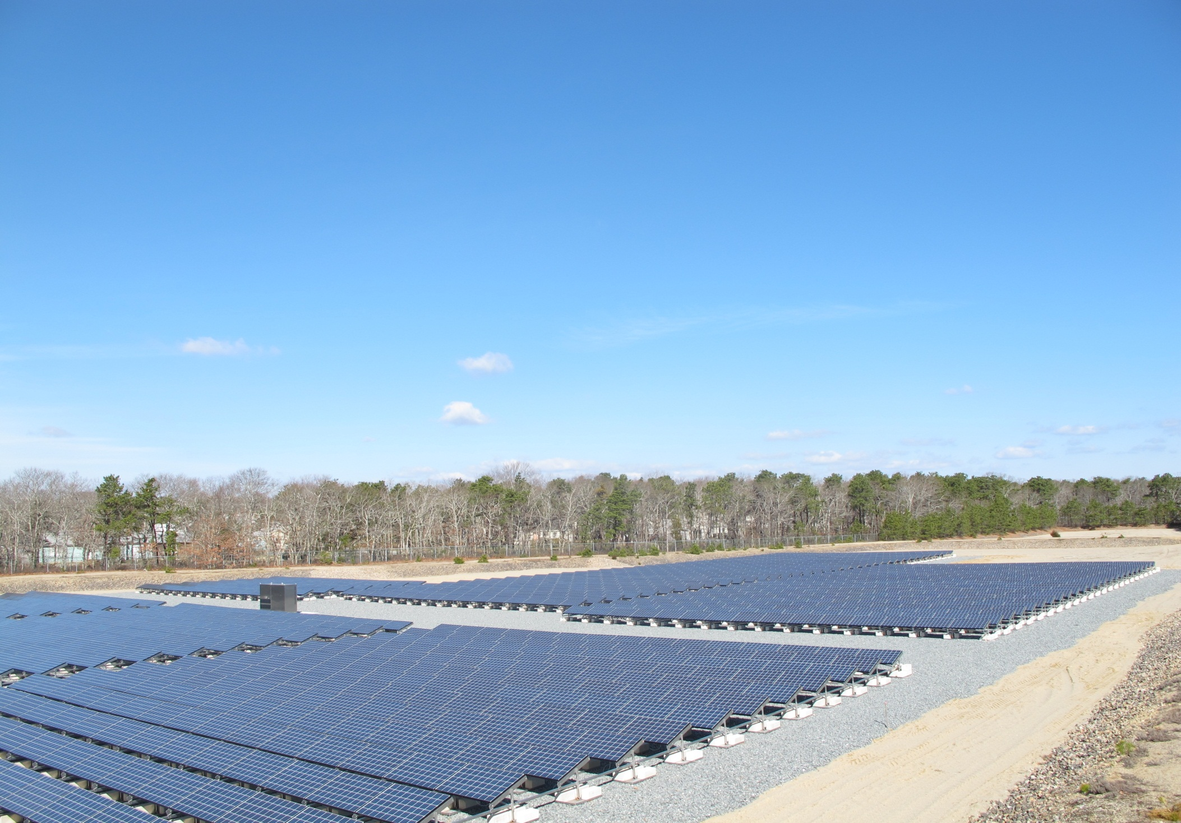
Agenda
New England Markets Overview
Massachusetts Landscape
Developer’s Perspective

Slide 3
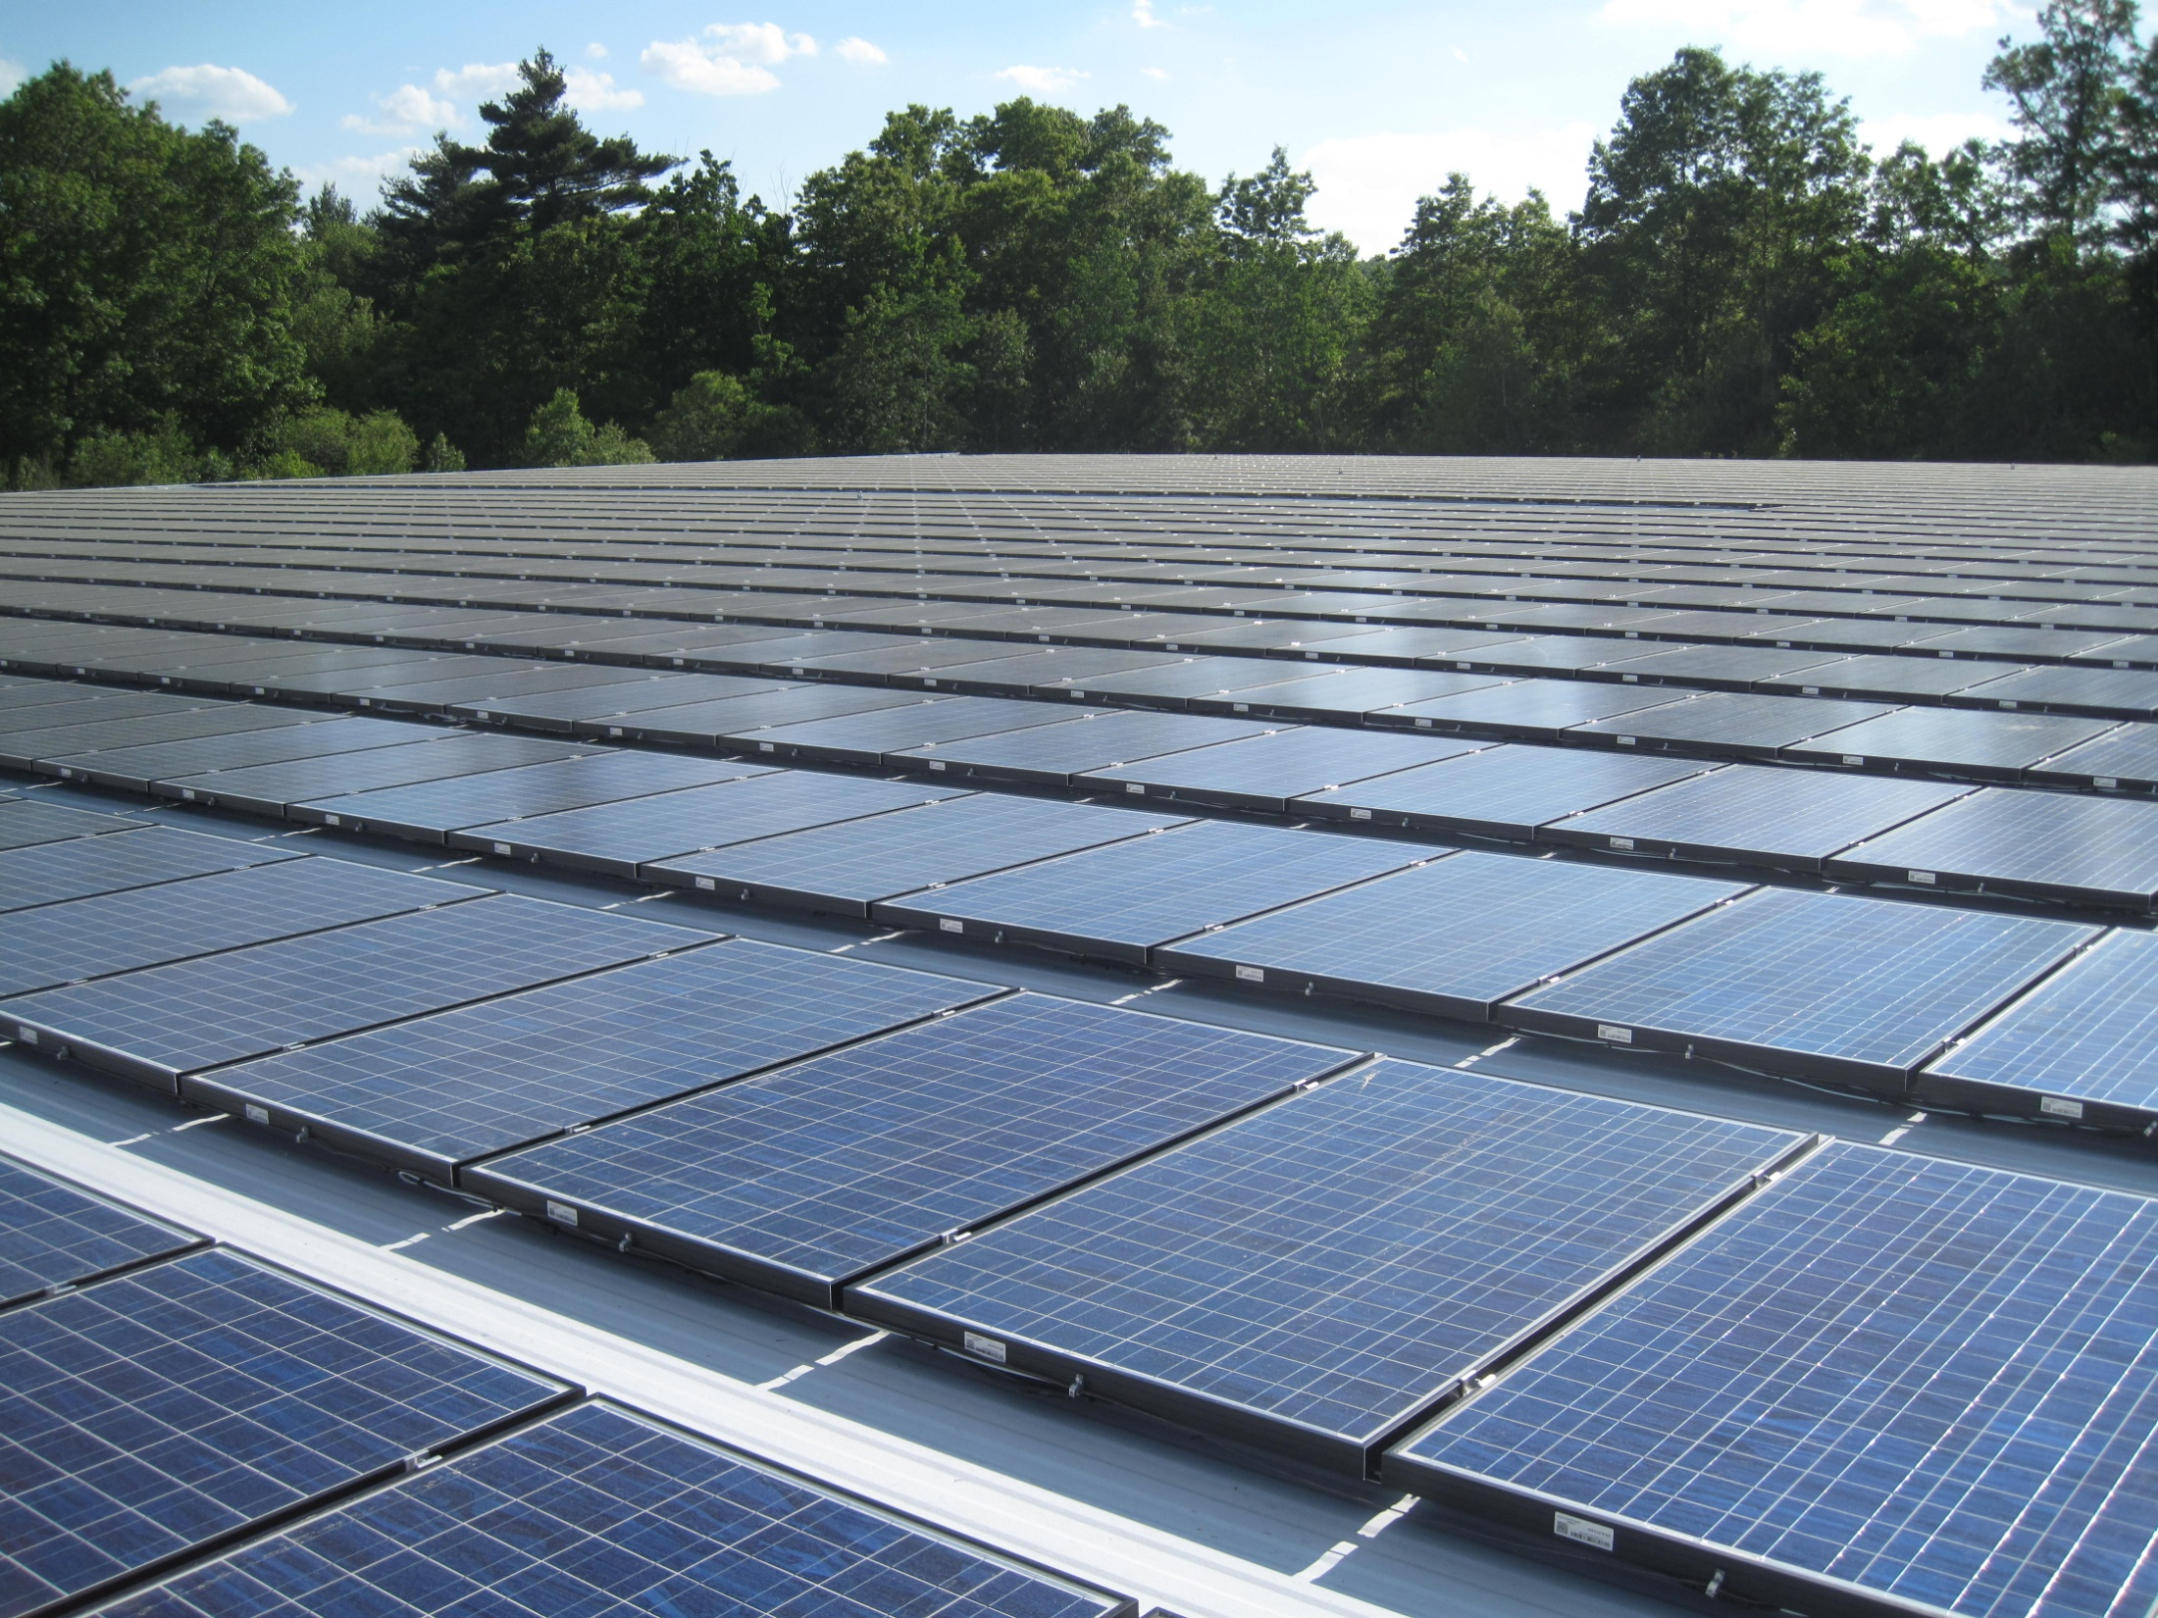
New England Market Overview
 | Relative Activity
MA | High
VT | Moderate
CT | Watch
NH | Low
RI | Watch
ME | Low

Slide 4
MA Market Landscape
59 MW of installed PV capacity
~23 MW SREC Eligible
353 MW in interconnection queue
Over 200 solar installation/development companies
Many flavors: Manufacturers, developers, GCs, electricians, roofers, etc.
Current undersupply of SRECs—None registered to last Clearinghouse Auction
2012 SREC Compliance Obligation relatively flat over 2011

Slide 5
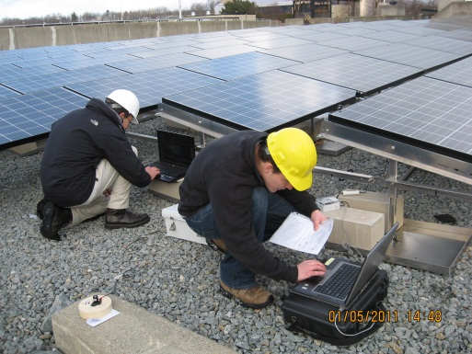
MA Developer’s Perspective
2010 was a “transition year”
Finalized regulations for SREC
2011 1H was a “bumpy ride”
Net Metering uncertainty
ACP adjustment
SREC uncertainty
2011 2H is (hopefully) beginning momentum
Development deals are breaking ground
Rooftop activity heating up
SREC trading remains focused on spot market transactions vs. multi-year contracts

Slide 6
MA Developer’s Perspective
Current Net Metering and SREC program will support growth as outlined, BUT:
Net Metering Credit Value has some uncertainty
Cap increase to 3% not yet promulgated; Proposed rules may need adjustments
Cap levels must be addressed
System of Assurance of Net Metering Eligibility needs finalization
ACP: DOER proposed forward schedule to fix rate
Long Term Contracts with LSEs is limited
Uncertainty over Total Compliance Obligation growth

Slide 7
SEBANE
The Solar Energy Business Association of New England is a business association of solar energy companies based, or doing business, in New England. Our mission is to promote the use of solar energy and the development of the solar energy industry in the region.
Manufacturers
Developers
Installers
Engineers
Educators
Utilities

Slide 8
Thank You
Dan Leary
Founder and Chief Development Officer
978.688.2700 x706
dleary@nexamp.com
www.nexamp.com
Nexamp develops, builds, owns, and operates renewable energy projects.
With a proven track record of award-winning engineering, procurement and construction, and extensive energy market/finance expertise, Nexamp makes renewable energy projects simple and profitable for our clients and partners.

