Slide 1
(Re)building New England's Grid for Cleaner Electric Energy
Ed Krapels
April 17, 2015
Notes:
Clean Energy Grid
(Presentation to the Raab Round Table)
Ed Krapels, Anbaric April 17, 2015

Slide 2
Notes:
Despite the record-setting snowfall we’ve had here in the Boston area, the National Oceanic and Atmospheric Administration reported that “the year 2014 was the warmest year across global land and ocean surfaces since records began in 1880. This also marks the 38th consecutive year that the global temperature was above average. Including 2014, 9 of the 10 warmest years in the 135-year period of record have occurred in the 21st century.”

Slide 3
Notes:
I’m pleased that we live in a region whose citizens are not, by and large, climate change deniers. Our states have committed to renewable portfolio standards that will transition the region from dirty to cleaner electric energy.
We all know that as a region we made commitments to promote energy efficiency, and to develop clean energy supplies, in large quantities. Using Massachusetts as an example, we’re supposed to get 15% of our electric energy from renewable sources by 2020.
While we’ve made a lot of progress on solar energy, we need substantial amounts of wind energy too. And here is where we are falling behind.

Slide 4
Notes:
While definitions of what counts as clean energy differ from state to state, we’re all in agreement that wind and solar energy are in a class by themselves– “fuels from heaven.”
Heavenly as it may be, Off-shore wind at a large scale appears for the moment to be uneconomical. The Cape Wind project appears to have lost its contracts, and smaller scale projects indicate the cost of offshore is 2 to 3 times the cost of onshore wind.
Meanwhile, the cost of onshore wind is a much brighter story. The last procurements (by Massachusetts and Connecticut utilities in 2013) showed there are affordable wind projects in Maine and New York.
If we want thousands of MWs, however, there are transmission bottlenecks that are very difficult to resolve with normal AC transmission upgrades

Slide 5
?
Notes:
The hydro story is a bit more complex. Some New England states put hydro in the same renewables category as wind and solar, others do not, reflecting a conundrum in which we have been stuck for many years.
Nevertheless, M. Vandal has confirmed once again that HQ has hydro power. There’s a number of MWs available for which the capital has been sunk, and there’s more where new capital would have to be deployed. Similarly, the development of both Muskrat Falls and Gull Island in Labrador is – like the development of Churchill Falls by HQ 50 years ago – not child’s play. It’s a major undertaking and we are fortunate that NALCOR and its partner Emera have taken it on. In the long run, I’m sure New England consumers would benefit from access to that resource, too.
It is reasonable, therefore, to believe that we can import several thousand MWs of hydro into New England, if we have the will to do so and can structure a deal that works both for us and for our Canadian neighbors.
In this setting here at the Raab Round Table today, I would say to both Quebec and to Newfoundland/Labrador: we want your hydro, we’ll structure a fair deal, let’s work together to optimize the value of both our wind and your hydro.

Slide 6
Notes:
Meanwhile, existing environmental regulations and market forces are shutting down oil, coal, and nuclear plants, and we have become more and more dependent on natural gas. So, we’re faced with the urgent question of how to increase the supply of clean energy, and in so doing, contain the region’s ever-growing dependence on natural gas. It’s not unreasonable to say that in order to meet our RPS obligations, and our desire to reduce the carbon footprint of the electric sector, we need to talk in terms of big numbers – 3,000MW or more.
As environmental concerns close down coal and oil plants, we’re quickly becoming more dependent on natural gas. From a carbon perspective, gas is an improvement over oil and coal, but there is a consensus among those who run and regulate the power system that we must diversify New England’s sources of power supply. Just as a family should not rely on one stock in its retirement portfolio, New England should not depend on just one energy resource.
In facing this challenge, we have to tackle something even more esoteric than electricity itself, and that’s its infrastructure. And that, of course, includes transmission. Large-scale wind and hydro resources are available to New Englanders, but they’re a good distance away from our large urban and suburban areas.
It’s clear to me that, in the past, we built a grid for dirty power. But we’ve learned so much in recent decades, and now we must build a grid for clean energy.

Slide 7
Notes:
It’s time, I believe, to take action to meet these commitment to clean energy. It’s time to THINK BIG… and, in the next ten minutes, I’d like to propose a GRAND BARGAIN that allows us to transcend old arguments about wind versus hydro and talk instead of an historic coordination of wind plus hydro.

Slide 8
Notes:
Given that energy projects appear to be stuck in permitting hell, what can actually get built? The landscape is littered with failed energy and infrastructure projects. So which infrastructure projects or strategies should we select to take on these questions as efficiently as possible?
Let’s review the landscape. In New England, four strategies have been proposed to bring substantial new clean energy into the New England grid:
(1) Develop offshore wind.
(2) Rely on Canadian large-scale hydro;
(3) Develop onshore wind;
(4) Combine onshore wind and hydro together;
Offshore wind for the moment appears to be a more distant, albeit very promising, prospect.
Canadian Hydro can be imported via the Northern Pass or the New England Clean Power Link.
Onshore wind is available in large quantities and at affordable prices in places to which we have to build major new transmission facilities.

Slide 9
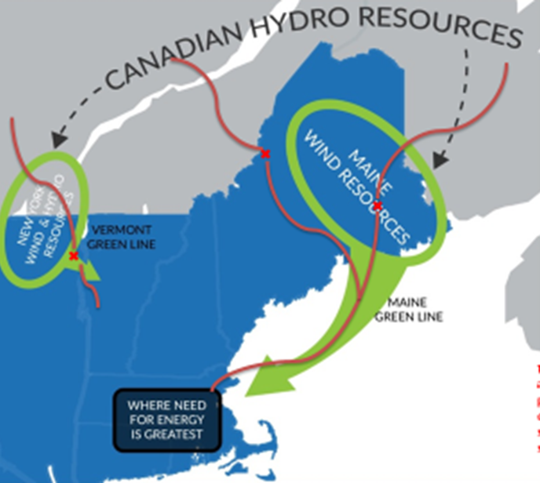
CANADIAN HYDRO RESOURCES
MAINE WIND RESOURCES
VERMONT GREEN LINE
NEW YORK WIND & HYDRO RESOURCES
MAINE GREEN LINE
GREATEST ENERGY NEED
Notes:
Finally, my company and others are proposing projects that combine onshore wind and hydro together into a strategy that could bring up to 3000MW of clean energy into the region.
Onshore wind costs have declined dramatically over the last decade. In New England, recent awards in competitive RFPs for large scale wind were given to projects at $70-$80 per MWh. Future RFPs for even larger wind procurements may result in prices even lower than that. But, new large-scale wind from northern Maine or upstate New York must be brought to market with new transmission lines, and their cost must be factored into the equation. Moreover, wind in Maine and New York blows best in the winter and worst in the summer, which interestingly is the mirror image of the situation with Canadian hydro, where high winter demand puts pressure on supply!
Based on this review, you won’t be surprised to hear that I have been an advocate of developing wind and hydro together. My friends in the utility business point out that in Massachusetts, hydro doesn’t qualify for Renewable Energy Credits. As a result, if an all-hydro transmission line were selected and financed by the ratepayers, a separate large-scale wind transmission line would still have to be built. That seems grossly inefficient. Moreover, as you may have noticed, it’s not easy to permit large transmission projects, so why do twice as much of it if you don’t have to?

Slide 10
Notes:
This, then, is the key question: why build one transmission system for hydro, and another for wind? That is why the Green Line Infrastructure Alliance to which my company belongs with National Grid will respond to the upcoming clean energy solicitations with transmission proposals that harvest the onshore wind in northern Maine and New York, and – since the wind doesn’t blow all the time – offer hydro producers a chance to fill the line when the wind isn’t blowing.
Remember, in Massachusetts, Connecticut and Rhode Island, wind is the primary REC-eligible renewable resource, while hydro is a welcome resource. If the two work together, the states and their customers are the winners. They get a “two-fer:” REC-eligible wind, carbon-free hydro, both affordable. Together, wind and hydro are a formidable combination.
It stands to reason that a compromise between “all hydro imports” and “all wind” is the right selection at this time: wind-plus-hydro will be the Green Line Infrastructure Alliance’s entry into the competitive procurement process that is getting started in 2015 with the 400MW procurement that will be issued soon by the utilities of Massachusetts, Connecticut and Rhode Island. Our Vermont Green Line is “just right” for this initial, welcome step towards a substantially cleaner energy future.
Our Maine Green Line will be “just right” when the much larger clean energy procurements come after the required legislation is passed here in Massachusetts. With that, the Green Line Infrastructure Alliance will offer to develop transmission projects that provide access to up to 2800MW of wind-plus-hydro.

Slide 11
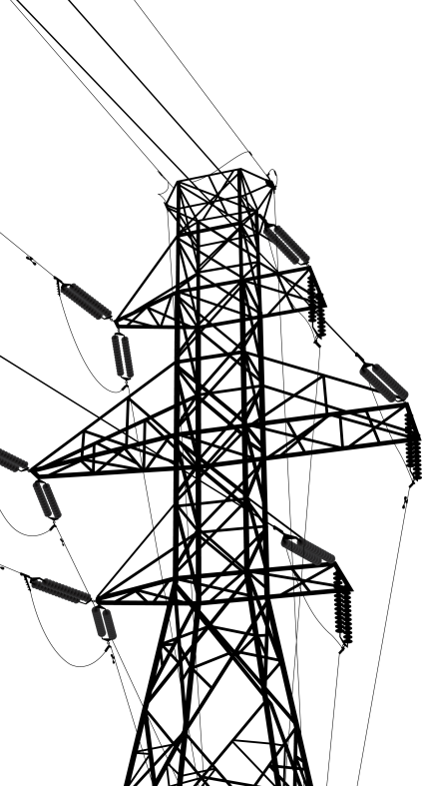
Notes:
In conclusion, the need to build out the Grid for clean energy is clear. Remember that we, the ratepayers, collectively paid for the grid to which coal, oil, nuclear, and natural gas plant conveniently connect. It’s time to extend the same courtesy to clean energy.
I know it’s inconvenient to build infrastructure to enable clean energy to meet the next 3000MW of our electric supply needs. But if we do it right, we can build it efficiently, with one system for both wind and hydro. If we do it right, it can be economic. If we do it right, New England States and Eastern Canadian Provinces can develop infrastructure that provides economic, energy, and environmental benefits to all, at the most efficient cost.
If we do it right, infrastructure can be permittable and buildable and not the locus for conflict. It’s never easy, but I still get chills down my spine when I remember the words of John F. Kennedy, in reference to another challenging project, “we do this not because it’s easy. We do this because it’s hard.”

