Slide 1

New England Electricity Restructuring Roundtable
Decarbonizing the Transportation Sector in New England: The Emerging Vision in Connecticut
June 15, 2018
Commissioner Robert J. Klee
Connecticut Department of Energy and Environmental Protection

Slide 2
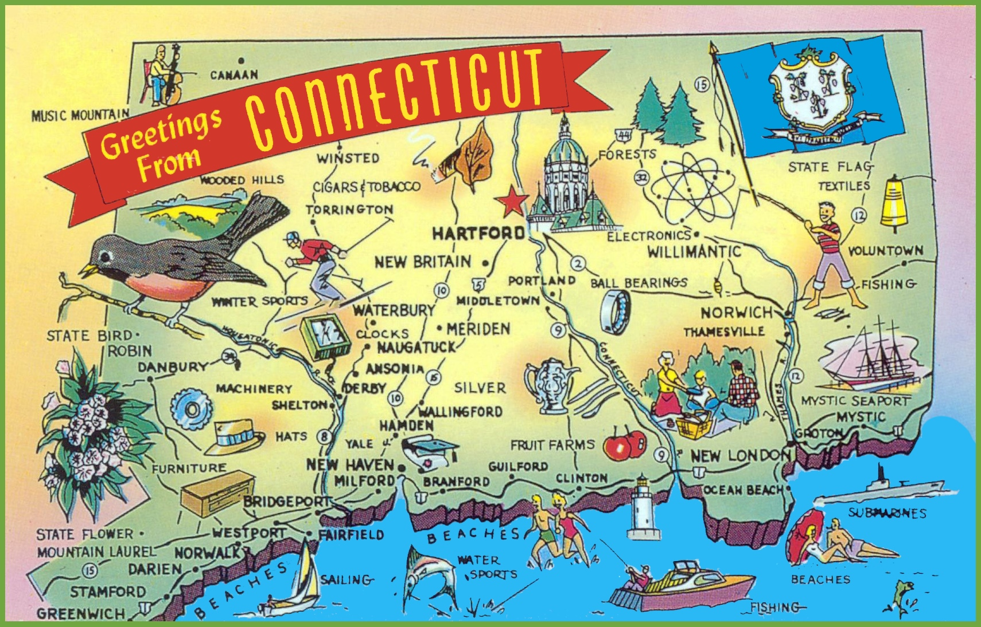
New England Electricity Restructuring Roundtable
June 15, 2018
Commissioner Robert J. Klee
Connecticut Department of Energy and Environmental Protection
Notes:
This is often what people think of when they think of Connecticut.
As it turns out, my agency is responsible for many of the things from this postcard. From wildlife, fishing and state parks, to the forests, the clean water and air and more recently the energy policies that protect those things that make Connecticut’s way of life so special.

Slide 3
Connecticut Still Revolutionary
Governor’s Council on Climate Change (GC3)
  Establish interim GHG targets & plan to achieve them
Connecticut Green Bank
  Deploy clean energy at scale
Public Act 18-82 (Senate Bill 7)
  Planning for up to 20 in./50 cm of sea level rise by 2050
  Interim target of 45% reduction in economy-wide GHG emissions below 2001 levels
Public Act 18-50 (Senate Bill 9)
  40% RPS by 2030
  Statewide shared clean energy program
  Sustainable deployment of behind-the-meter resources for residential & commercial/industrial
Notes:
The GC3, created in 2013 Governor Malloy, through executive order, created the Council, which is comprised of 15 members from state agencies, quasi-state agencies, businesses, and nonprofits.
As its first task, the council was charged to make a mid-term GHG reduction target recommendation that puts the state on a sustainable path to meet its Global Warming Solutions Act, which mandates the state reduce economy-wide emissions 80 percent below 2001 levels by 2050.
After a thorough review of a variety of mitigation scenarios that drive down greenhouse gas emissions in the electric, building, and transportation sectors, the GC3, through consensus, recommended an economy-wide GHG reduction target of 45 percent below 2001 levels by 2030. The General Assembly adopted this recommendation when it passed Senate Bill 7 in the legislative session that just ended.
This mid-term reduction target will place Connecticut on a linear downward trajectory from today’s GHG emissions to the 2050 target.
The GC3’s attention has now turned to recommending policies that ensure the state meets its mid- and long-term greenhouse gas emission reduction targets.
CT Green Bank
Before I get too much further – I cannot talk about revolutionary ideas without talking about the Connecticut Green Bank…
The Connecticut Green Bank is the nation’s first green bank and has spurred the creation other green banks in other areas of the country.
It is has lead to increased deployment of renewables, support job growth and economic development.
Won Harvard Kennedy School Award for Innovation in Government.
Nation’s First Green Bank
Supports Energy Strategy to Achieve Cleaner, Cheaper and More Reliable Energy
Supports Creating Jobs and Local Economic Development
Winner of Harvard Kennedy School Award for Innovation in Government
SB 9 – is a complimentary bill to SB 7 – focused on our energy future.

Slide 4
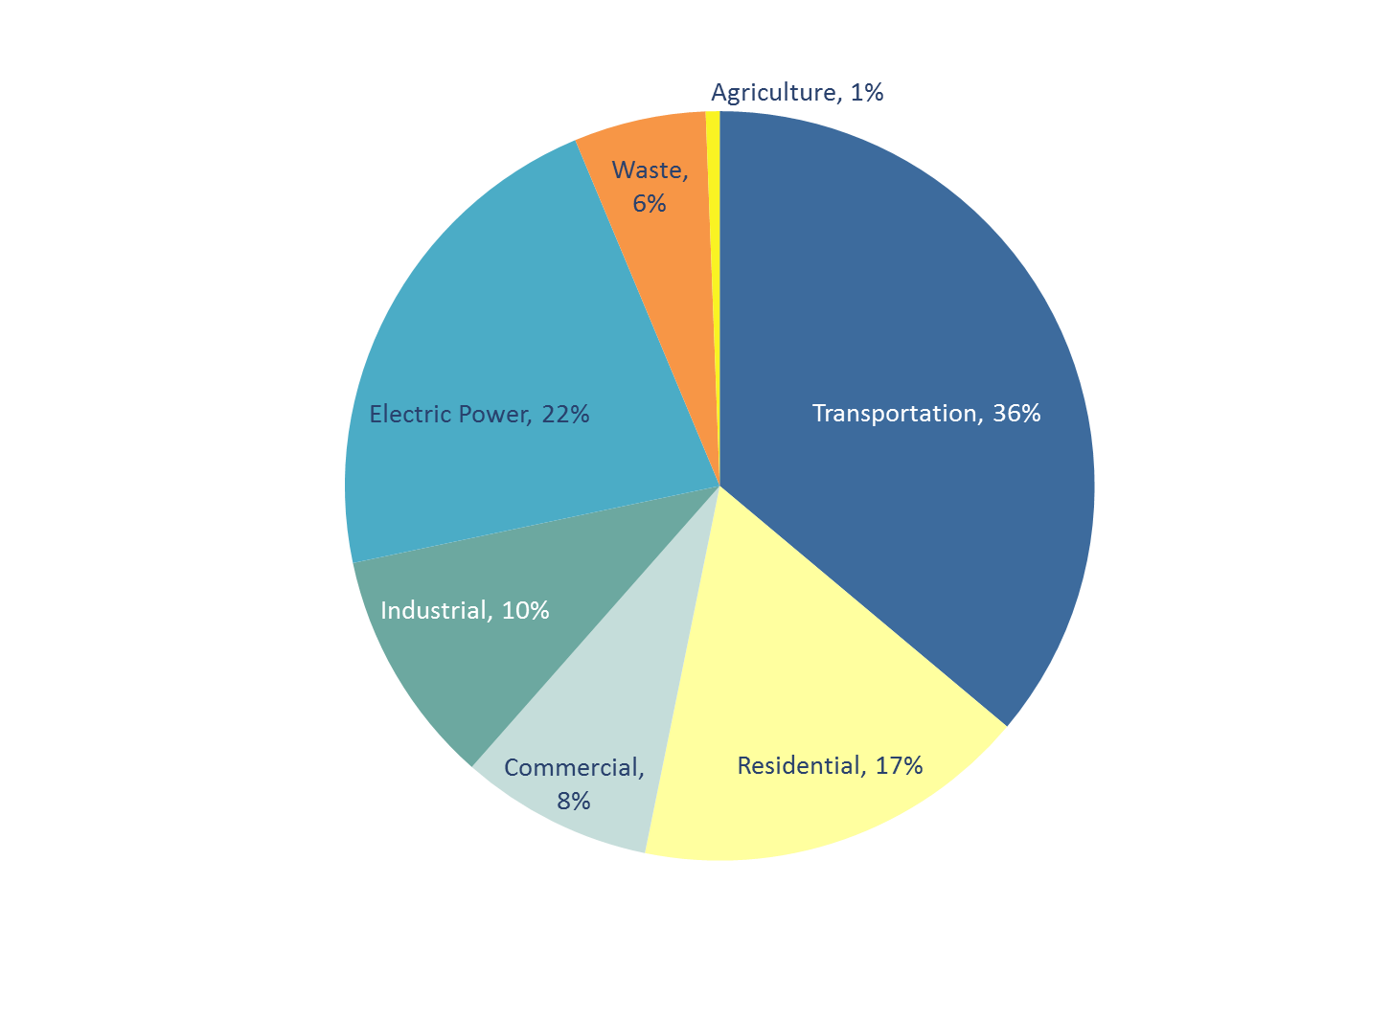
Connecticut GHG Emissions by Sector
Notes:
As shown in these pie charts, the transportation sector is the single largest source of emissions in the state, contributing 36 percent, principally from the use of fossil fuels in passenger cars and light-duty trucks.
And based on an analysis completed by the GC3 transportation sector emissions will continue to be the largest source of emissions in 2050, if we pursue a business as usual strategy.
In order to bend this curve down to achieve both our mid- and long-term targets, it is essential that we develop policy solutions that lead to meaningful emission reductions in the transportation sector.
In working to develop transportation sector policy solutions it is also essential that we work collaboratively with our regional partners to develop policy approaches that support and advance regional economic activities, adequately fund current and future transportation infrastructure, and provide our residents with sustainable and affordable travel options.

Slide 5
Connecticut Hydrogen and Electric Automobile Purchase Rebate Program (CHEAPR)
“On the hood” incentives to drive down costs of BEV, FCEV and PHEV
Incentive Amount | EPA Rated Electric Range
$5,000 | Any fuel cell electric vehicle
$3,000 | BEV: 175 Miles or Greater
$2,000 | BEV: 100-174 Miles PHEV: 40 Miles or Greater
$500 | BEV: Less 100 Miles PHEV: Less than 40 Miles
Notes:
One way we are addressing this in Connecticut is our CHEAPR program
On the vehicle incentives which helps to drive down the cost of electric and hybrid vehicles.
Over 2000 vehicles have been purchased using the CHEAPR program
We are working with auto manufacturers – in a brand neutral way – to increase awareness of these vehicles. They are super techy, with the latest gadgets and incredibly fun to drive.

Slide 6
Critical clean transportation infrastructure investments in Connecticut
New transit
  CT Fastrak (New Britain to Hartford)
  CT Rail – Hartford Line (New Haven-Hartford-Springfield)
H₂Fuels Program
  Up to $840,000 to develop and operate a retail hydrogen fueling station in the greater New Haven area.
VW Settlement
  Recently announced Round 1 – $7.5M of CT’s ~$54M
  Eligible projects must reduce nitrogen oxide (NOx) emissions across the state
Notes:
Three additional ways Connecticut is working to reduce GHG emissions resulting from transportation – through investments in modern clean transportation infrastructure
New bus rapid transit system with remarkable ridership; launch of new commuter rail line TODAY!
Deployment of hydrogen fueling stations – we currently have an open RFP – but hope to make that announcement shortly
Governor Malloy and DEEP has announced that Connecticut is making available $7.5 million dollars from the national legal settlement in the Volkswagen emissions cheating scandal to fund clean air projects that reduce nitrogen oxide emissions.

Slide 7
Collaboration with other states
California & the 12 Section 177 States
  Active participation in CARB proceedings
Pushing back against federal rollbacks
  OP-ED: We Won’t Abide Selective State Rights
8-State ZEV MOU
  Updated action plan – coming soon
Notes:
CA and Section 177 states
Connecticut cannot do it alone – we are a small state – but by working with other states we can work to reduce GHG by being one of twelve Section 177 states: Connecticut, Delaware, Maine, Maryland, Massachusetts, New Jersey, New York, Oregon, Pennsylvania, Rhode Island, Vermont, Washington
Due to its vehicle regulations that preceded the federal Clean Air Act (CAA) of 1970 and its particularly severe motor vehicle-related air quality air issues, the state of California retains the unique authority as a U.S. state to set emission standards. As a result, under federal law, any California vehicle emissions standards must meet or exceed federal emission regulations. Under the Federal Air Quality Act and Section 209 of the CAA, the State of California is required to request, and be granted a waiver from the US Environmental Protection Agency (EPA) Administrator in order to implement any proposed standards. Under this provision, the California Air Resources Board (CARB) has requested and received over 50 waivers.
Although States besides California are not permitted to develop their own emissions standards, Section 177 of the Clean Air Act authorizes other States to choose to adopt California’s standards in lieu of federal requirements. States are not required to seek EPA approval before adopting California’s standards. There are 12 such “Section 177 States.”
Fighting Federal rollbacks
While there are a dozen plus states trying to do the right thing, we are facing opposition from Administrator Pruitt. Despite the fact that he has more ethical lapses than his boss, what we cannot lose sight of is, that he is actually very good job at rolling back policies. Which is why I joined with some of nearby environmental agency leaders, Martin Suuberg here in Massachusetts, Janet Coit in Rhode Island and Julie Moore in Vermont in writing an op-ed which is critical of Pruitt’s rollback of light-duty vehicle greenhouse gas emissions standards.
I should point out that this is a pretty bipartisan group – so lets not think that this just Democrats who are taking issue with the Trump/Pruitt administration.
“The United States Environmental Protection Agency (EPA), led by Administrator Scott Pruitt, has been talking a great deal recently about “cooperative federalism” as an approach to addressing environmental issues. Under this approach, the federal government recognizes and supports the important role of the states. Unfortunately, a recent announcement by EPA undermines certain states’ rights by threatening to weaken federal clean air standards on vehicles and pressure states to follow this federal retreat…
“If EPA is interested in advancing true cooperative federalism, it must leave in place that which has worked so well for federal and state governments – and the people we all serve. We urge the Trump Administration and Administrator Pruitt not to reverse nearly five decades of precedent. Do not roll back vehicle emission standards and do not revoke the California Waiver. These provisions of the Clean Air Act have worked for decades to improve air quality and to help states meet important environmental objectives. They have done so in a way that recognizes important state interests. Give our agencies and our states a fighting chance of fulfilling our mission to protect public health and address the greatest environmental challenge of our time.”
ZEV MOU
8 states of the ZEV MOU: CA, CT, MD, MA, NY, OR, RI, VT
Original action plan in 2013/2014
New action plan coming soon with lessons learned, and focus on tools for vehicle deployment

Slide 8
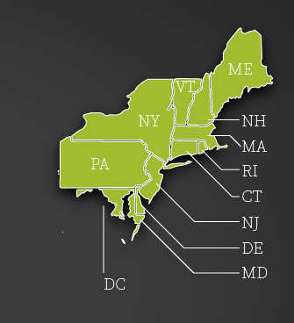
Transportation & Climate Initiative (TCI)
Modernize the transportation system to reduce congestion and improve reliability and resiliency.
Reduce carbon emissions and other harmful pollutants.
Enhance the economic competitiveness of states in the Northeast on a national and global scale.
Notes:
Which leads to me the Transportation & Climate Initiative, which is regional collaboration of the 11 Northeast and Mid-Atlantic States + the District of Columbia, that seeks to improve transportation, develop the clean energy economy and reduce carbon emissions from the transportation sector. This group is facilitated by the Georgetown Climate Center.

Slide 9
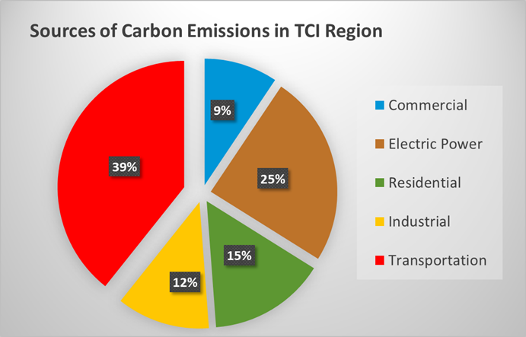
Transportation is the largest source of carbon pollution in the region
2015 EIA Data
Notes:
Why is this important?
Transportation is the largest source of carbon pollution in the region – accounting for 39% of carbon emissions in the region.

Slide 10
GHG Emissions Future Projections
LEAP Projections by Sector, Reference Case
2050 GHG Share
Industrial Processes 6%
Waste 7%
Industrial 10%
C & I 12%
Electric Power 13%
Residential 15%
Transportation 35%
*The agriculture and non-energy sectors represent 1% and 0.3%, respectively, of total emissions in 2050.
Notes:
And, while the other sectors are expected to see their GHG emissions go down in the future, transportation remains relatively steady.

Slide 11
Why modernize our transportation system?
Prosperity
  New markets and technologies
  Leverage our strong workforce, universities & advanced research centers
Efficiency
  Operations and productivity
  Connectivity to jobs, education, services, markets
  Customer-focused
Health
  Improves air quality
  Avoids asthma, other respiratory illnesses and cardiovascular conditions
  Decreases work days lost and provides savings in healthcare costs
Vibrant communities
  Complete streets
  Smart growth
  Connectivity and access
Notes:
Beyond our climate goals – which are substantial and driving forces in many New England states, why else would you modernize and clean our transportation system?

Slide 12
Possible goals for a low carbon transportation policy
Provide incentives for people, companies and governments to choose cleaner transportation options
Encourage investments by the private sector in clean technology innovation and market development
Create a “price signal” so that market prices for transportation reflect damages caused by carbon pollution
Raise funds for states to invest in more reliable, cleaner and resilient transportation systems

Slide 13
Examples of actions identified by stakeholders to date
Congestion pricing - cost to enter specific areas at high-traffic times
Vehicle-miles-traveled fees - cost based on miles driven instead of fuel consumed
Rebates - for use of public transit or purchase of zero-emission options
Electrification zone - a requirement that all vehicles be electric to enter a certain city zone or use a certain travel corridor
Cap-and-invest system - a pollution cap that levies a cost on fuel suppliers to generate revenue for investment
EV-ready codes - building codes requiring new construction to have a certain quantity of installed EV charging
Green Bank - public funding to support private investments in new technologies and services

Slide 14
On the need for “bolder action”
…without bolder action, our children won’t have time to debate the existence of climate change; they’ll be busy dealing with its effects: environmental disasters, economic disruptions, and waves of climate refugees seeking sanctuary. Now, we can and should argue about the best approach to the problem. But to simply deny the problem not only betrays future generations; it betrays the essential spirit of innovation and practical problem-solving that guided our Founders.
– President Barack Obama
Notes:
I will leave you with this quote – which I use fairly frequently when discussing climate change – it is from President Obama’s farewell address to the nation in Chicago on January 10, 2017:
…without bolder action, our children won’t have time to debate the existence of climate change; they’ll be busy dealing with its effects: environmental disasters, economic disruptions, and waves of climate refugees seeking sanctuary. Now, we can and should argue about the best approach to the problem. But to simply deny the problem not only betrays future generations; it betrays the essential spirit of innovation and practical problem-solving that guided our Founders.
Bold action, and innovation and problem solving are hallmarks of the transportation sector…. In many ways, I am most optimistic about this sector and its ability to mitigate greenhouse gas emissions, because of the truly spectacular technologies that are on the horizon, and people’s love of the latest and greatest cars.

