Slide 1
Climate Change in the Age of Trump:
Threats and Opportunities

Slide 2
Obama policies, Worst case under Trump
US GHG emissions, million metric tons net CO₂e
Worst case under Trump
Obama policies
ACTUAL
ESTIMATED
17% below 2005 levels
26-28% below 2005 levels

Slide 3
The gap between transportation and electricity CO₂ emissions is growing in RGGI states
Notes:
“In the northeast and mid-Atlantic, direct emissions from the transportation sector represent the largest source of greenhouse gas emissions—approximately 35 percent of regional emissions in 2011. This is in contrast to the United States as a whole, for which the power sector is the largest source of GHG emissions.
RGGI states include: CT, ME, MA, NH, RI, VT, NY, DE, and MD. NJ, who dropped out of RGGI in 2012, is excluded.
Sources:
Historic emissions: 1) EIA, https://www.eia.gov/environment/emissions/state/, 2) RGGI CO2 Allowance Tracking System for electricity sector emissions from 2012-2016, https://rggi-coats.org/eats/rggi/
RGGI electricity sector cap: https://www.rggi.org/design/overview/cap. Assumes 75.1 MMT cap in 2021, declining 2.275 MMT every year thereafter at least until 2030
Transportation emissions: EIA, Annual Energy Outlook 2017, based on data from New England, Middle Atlantic, and South Atlantic Census Regions, excluding non-RGGI states and assuming RGGI states maintain historic share of total regional emissions through 2030.

Slide 4
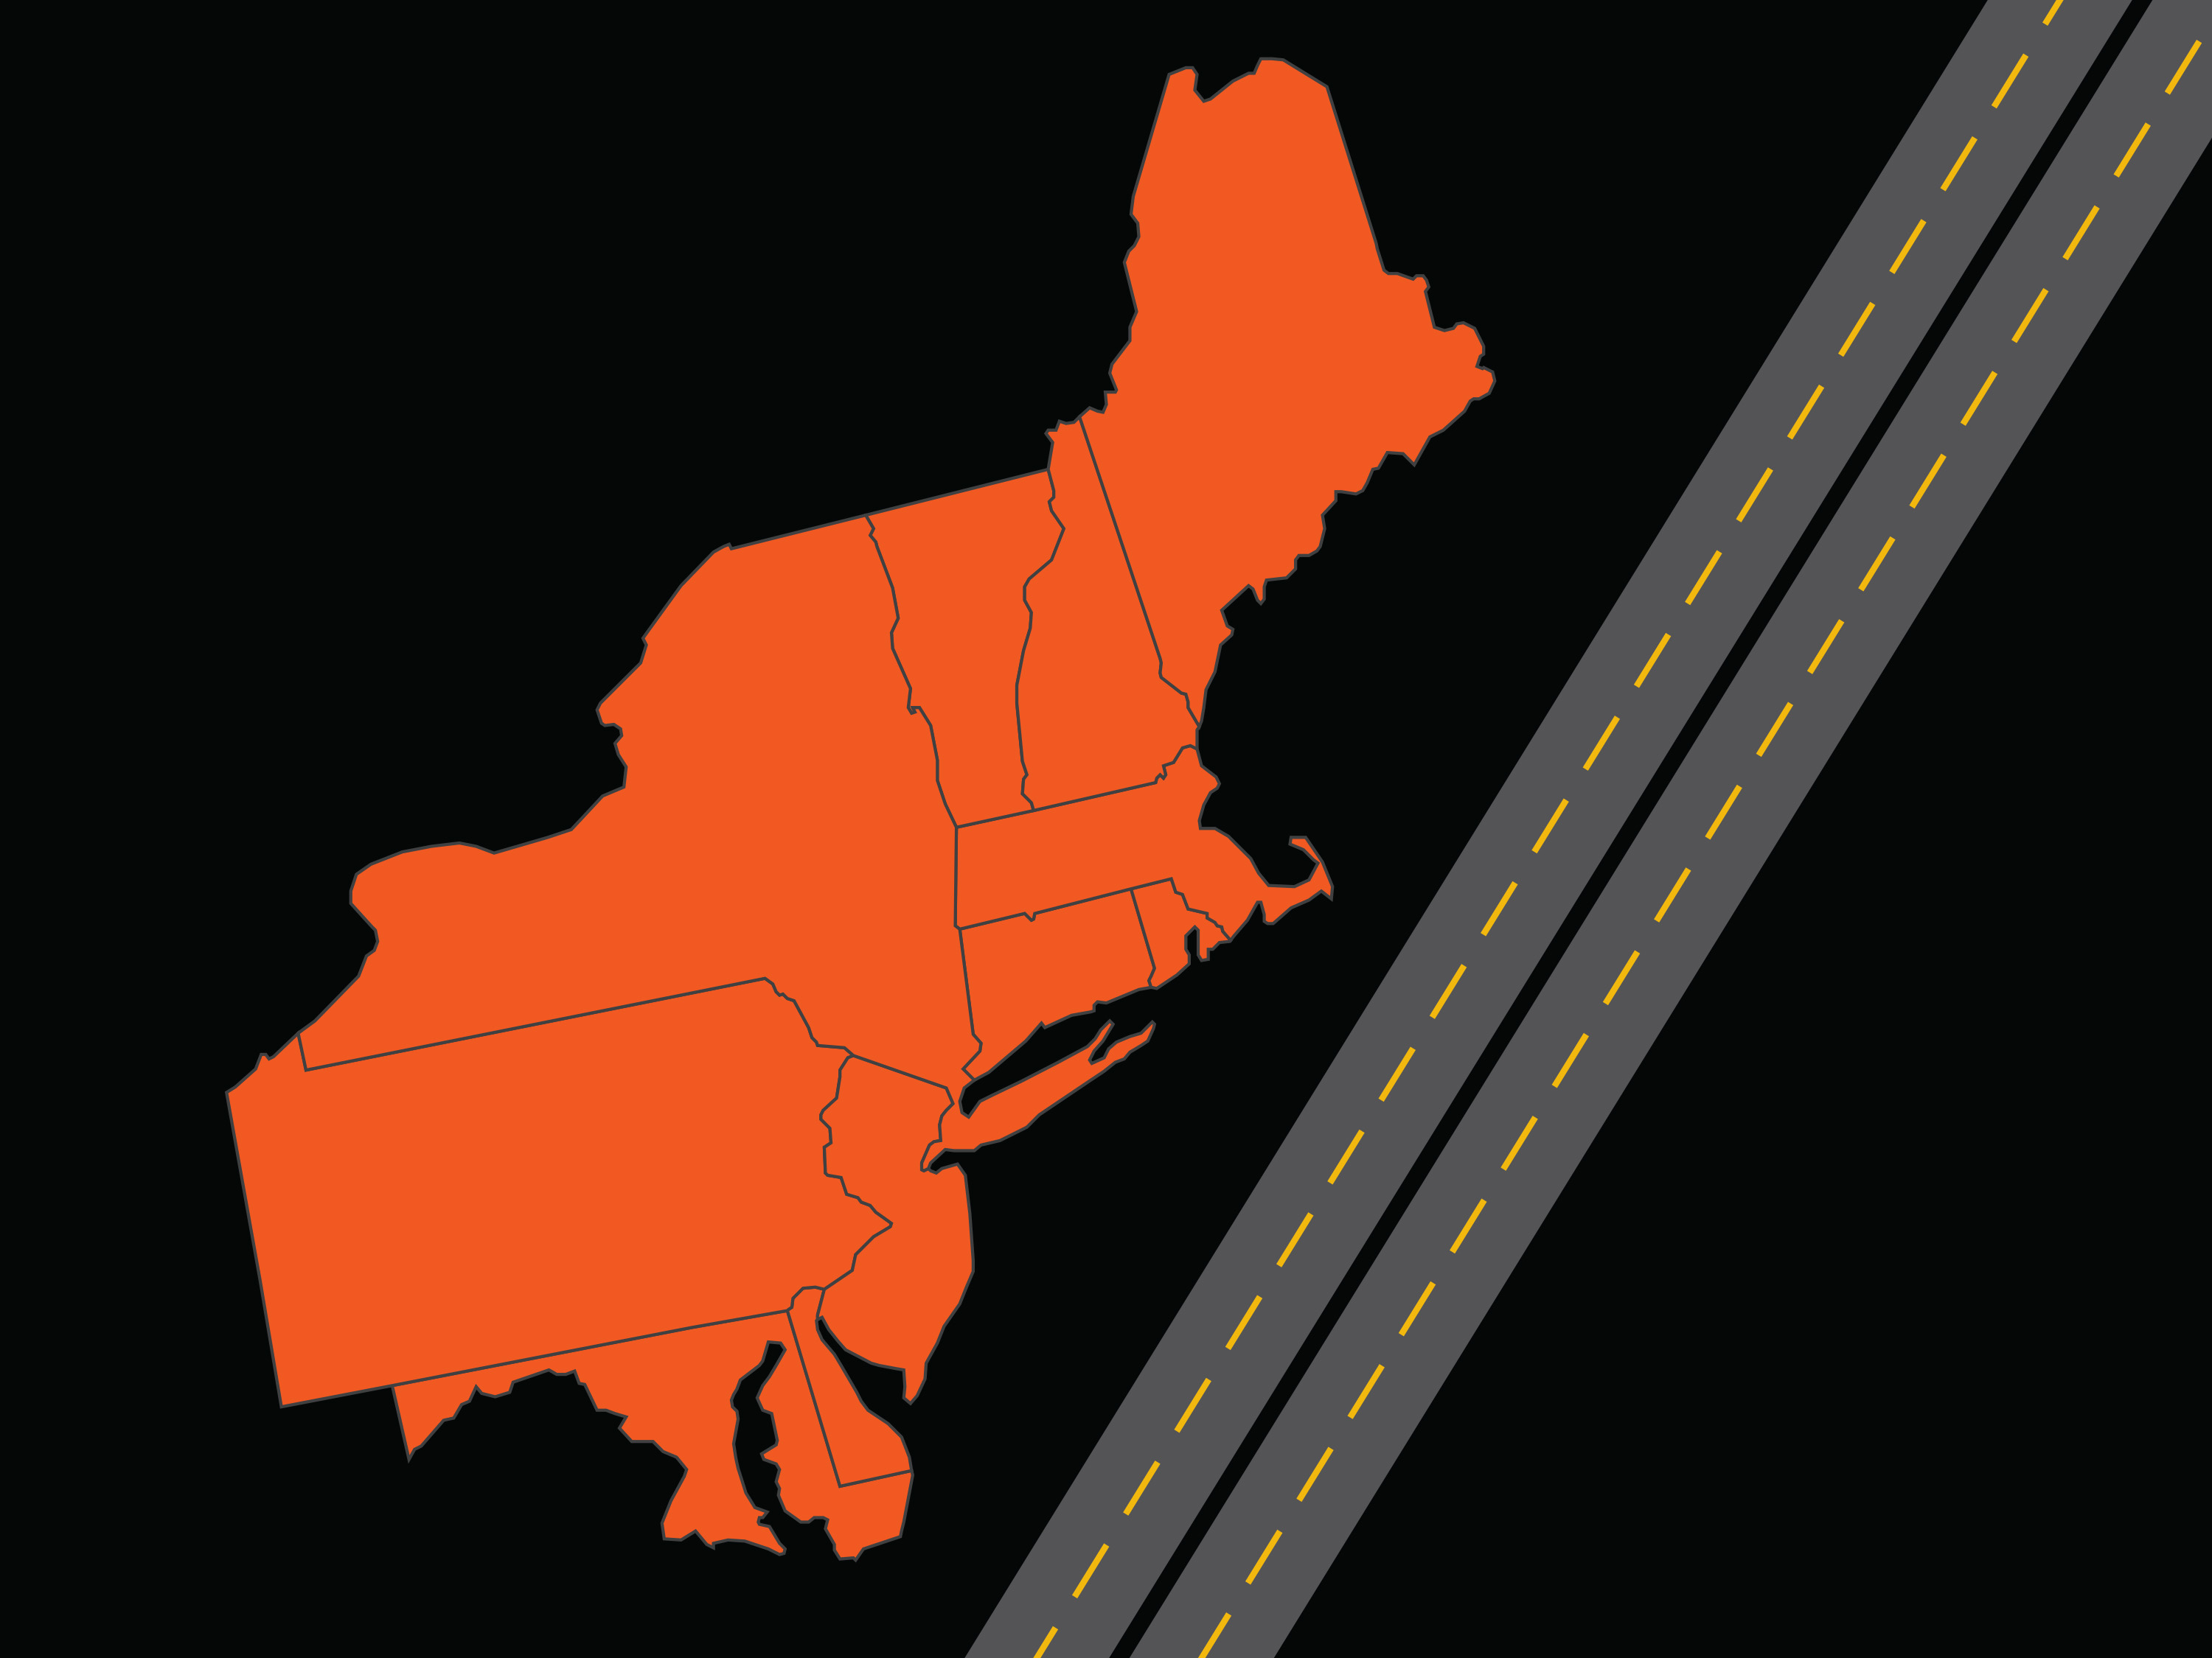
CAP AND INVEST
for
transportation

Slide 5
Clean Energy Leadership

