Slide 1
USDN Microgrids Overview
John Kelly
Green Business Certification Institute
US Green Building Council

Slide 2
USDN Microgrid Overview
  Microgrid architecture – local representation
    Utility microgrids – one city at a time
    Third party microgrids
  CASE 1: District Energy – Foundation for Sustainable Energy
    Efficiency
    Emissions
    Water
    Resiliency
  CASE 2 & 3: Islanding for Resiliency +
    Price response
    Demand response
    Load conservation
    Power quality
    Grid service
Not who builds it but
Why is it not being built
Imagine $4 billion in investment in 2,000 MW of local load response capability for NY, MA, & DC area

Slide 3
Microgrid Architecture
LOCAL MICROGRID
Utility or Third Party
NATIONAL
FERC, ISOs, IPPs, Utilities
STATE
PSCs, Utilities, LDCs
Utility area substations
Local substations
Resilient Facility
Notes:
Imagine a state with no cities or local governments. Microgrids, like cities, can provide representation, critical services and islanding assets.
PEER help grid operators adopt a microgrid architecture which mirrors the structure of the US government. The federal or transmission level is represented by the Federal Energy Regulatory Committee and independent system operators, utilities, and independent power producers delivering power to…
<click> The microgrid architecture divides the electricity system into a network of smaller nodes, typically at the local substation level. There’s a state level represented by regulatory commissions and utilities using area substations and high voltage distribution to get power to
<click> a local level represented by utility microgrids. These microgrids serve distinct sets of customers co-located or otherwise operating as a unit with local representation. and
< Click> The final component of the microgrid architecture is the resilient or islandable facility, which can operate for weeks without power.

Slide 4
Leveraging the Microgrid Approach
Capabilities
Islanding
Protected infrastructure
Renewable generation
Demand reduction
District energy
Load shifting
Auto-restoration
Grid services
Performance Outcomes
100% Outages
50% Capital waste
50% Energy waste
25% Peak demand
50% Emissions
100% Resiliency

Slide 5
Microgrid Outcomes
Protect Critical Facilities
Resilient - Islanding, black start, uninterruptable fuel
Power quality
Master controller
Private Investment
Innovation
Economic development
Private capital
Consumer Benefit
Price responsive grid – lower cost
Ancillary service profits
Conservation
Innovation
Utility Benefit
Lower operating cost
Reduce capital cost
New services
Real time load management

Slide 6
Utility Microgrid Components
Microgrid mapping
Distribution Reliability/Resiliency
Critical/Essential Facility Resiliency
Planning with local authority (city)
Leverage third party / customer grid services
  Resilient buildings
  Third party microgrids

Slide 7
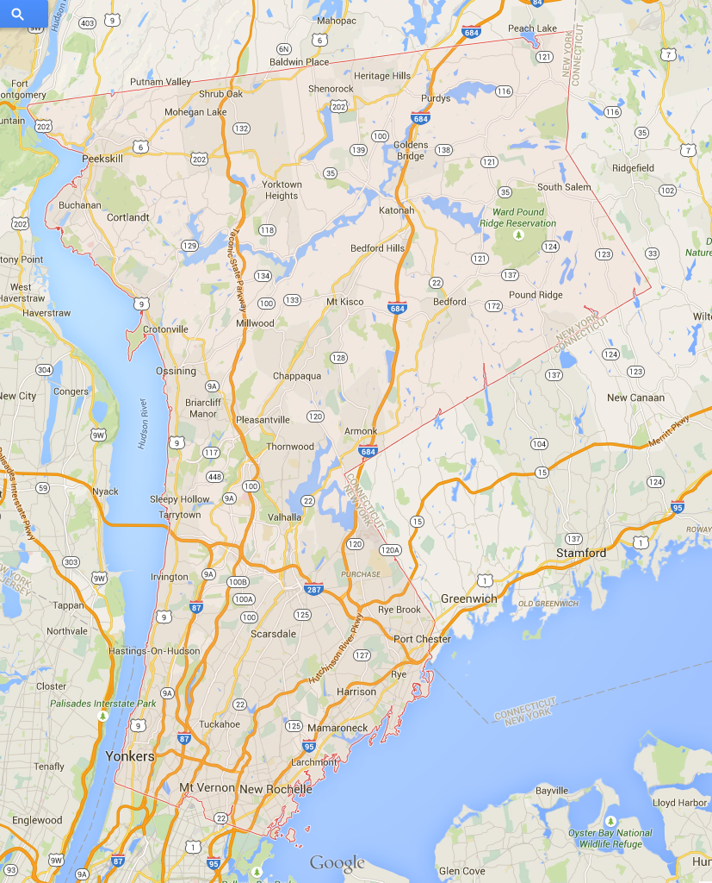
Utility Microgrids
For Each City
Shrub Oak
Shenorock
Purdys
Yorktown
Heights
South Salem
Cortlandt
Bedford
Crotonville
Millwood
Chappaqua
Outage Metrics | Performance
 | City | Utility
Frequency | 2.6 | 1.2
Duration, min | 1,700 | 350
Pleasantville
Armonk
Valhalla
Scarsdale
Rye Brook
Harrison
Tuckahoe
New Rochelle

Slide 8
Benchmarking
Area Sub
SUB
Sources of Supply: 1

Slide 9
Utility Microgrids
Looping/Redundancy

Slide 10
Redundant Supply & Self Healing
Smart Switches
Area Sub
Smart Switches
Area Sub
Sources of Supply: 2

Slide 11
Critical and Essential Service Capability
Critical and Essential Service | Circuits | Address | Resiliency Capability
Local Hospital | W430
Police Station/Coms | D5143
Jackson Storm Station | W6610Y, W668X
Harrison Storm Station | W6610Y, W668X
Convalescent Center | W3509
Lexington Senior Home | W6612
High School (Shelter) | W349, W4564, D4912
Jackson Storm Station | W6610Y, W668X

Slide 12
Utility Microgrids
Leveraging Local Government
City investment – Illinois Rider LGC
Coordinated undergrounding with road and sewer work
Coordinated tree planting, trimming, removal
  Right tree right place, invasive pest control
  Developing greenways Coordinated communications and emergency response
Coordinated identification and action on critical and essential services
Leveraging city resilient facilities for grid service
Coordinated communications and education
City tracking of interruption impacts and costs
Monitoring, trending, and verification

Slide 13
Utility Microgrid Scorecard
Performance Criteria | Performance
SAIDI/SAIFI | 60 min / 0.3
Alternate Supply | 90%
% Protected by Auto Restoration | 80%
% Protected by Distribution Redundancy | 80%
% Underground | 20%
Islanding | 5%
Critical/Essential Service Plan and Protection | 5%
Transparency (e.g. MAIFI, PQ) | Yes
Risk Mitigation | Yes

Slide 14
Third Party Microgrids
Third Party Microgrid

Slide 15
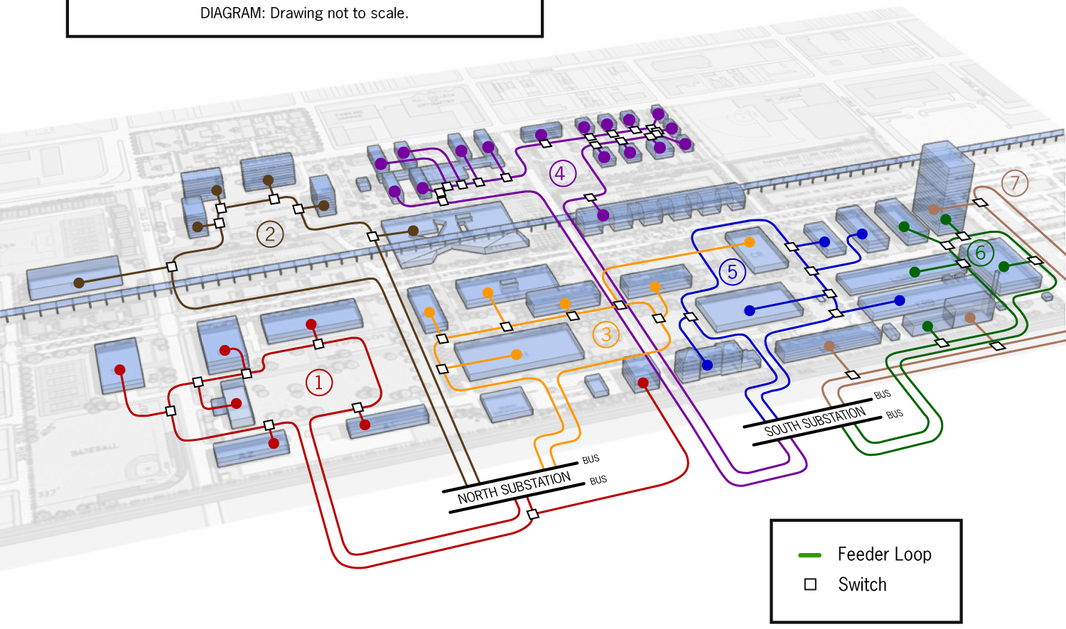
Third Party Microgrids
Solar, UPS, Engines
4 MW
Smart Meter
Smart Switch
8 MW
Generator
Smart Loop
Loops
Smart Switch
Notes:
Campus microgrid deliver resiliency, better reliability, better power quality for 25 to 50% less. Municipal microgrids like Naperville and Chattanooga do the same.

Slide 16
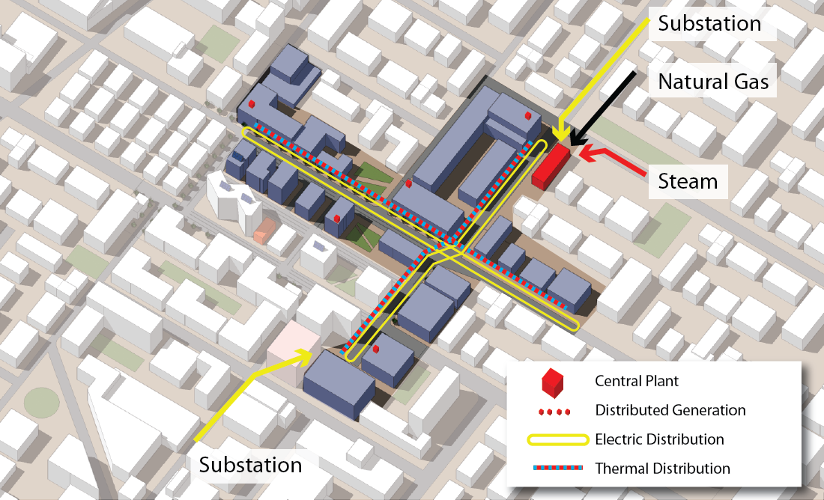
Case Study – Boston, NYC, DC
Multiuser Microgrid
8.8 Million Square Feet
Supply - $70 / MWh
User M sq.ft
Hotel 1.0
Residential 3.0
Office 3.4
Retail 1.4
Peak Demand: 58 MW
Annual: 250,000 MWh
Thermal: 320,000 MMBtu/yr

Slide 17
Third Party Microgrid
Assumptions
Start with district thermal/chilling to:
  Free up building space (increase rents) and noise pollution
  Enable turbine as a boiler and cogeneration
  Enabling large storage
Include automation and load response for conservation and ancillary service payments (e.g. DR)
Initially or over time add on-peak CHP, storage, solar,
Eventually building island capability (natural gas) to:
  Protect critical and essential service
  Price response (hedge for entering the real-time price markets)
  Ancillary service payments (ISO and distribution operators)

Slide 18
Third Party Microgrids
Diesel life safety
3,000 kW
Typically
Assets
Installed
Over a
Phased
Evolution
Load Response
10,000 kW
High Efficiency
Gas Engines
12,000 kW
% Load | 4%
Solar PV
2,000 kW
Capacity (MW)
Storage
6,000 kW
CHP on-peak
20,000 kW
Baseload Tri-generation
10,000 kW
% Utilization

Slide 19
Third Party Microgrid
Scenarios & Assumptions (2014 prices)
 | Description | NY | MA | DC
Assumption | Supply Cost, $/MW | $80 | $80 | $70
Assumption | Natural Gas Cost, $/MMBtu | $5.5 | $5.5 | $5
Case 1 | 10 MW CHP Thermal Only | ☑ | ☑ | ☑
Case 2 | 58 MW Islanding/RTP | ☑ | ☑ | ☑
 | ISO Capacity Charge Avoided |  |  | ☑
 | Distribution Charge Avoided | ☑ | Utility Metered | ☑
 | Ancillary Service/PQ | ☑ | ☑ | ☑☑
 | Conservation Load Response | ☑ | ☑ | ☑
Case 3 | Demand Charge Avoided | ☑ | ☑ | ☑
 | Max Thermal | ☑ | ☑ | ☑

Slide 20
Microgrid Operating Strategies
Annual Load Duration Curve
Utilization = 250,000 MWh / (58MW * 8760) = 50%

Slide 21
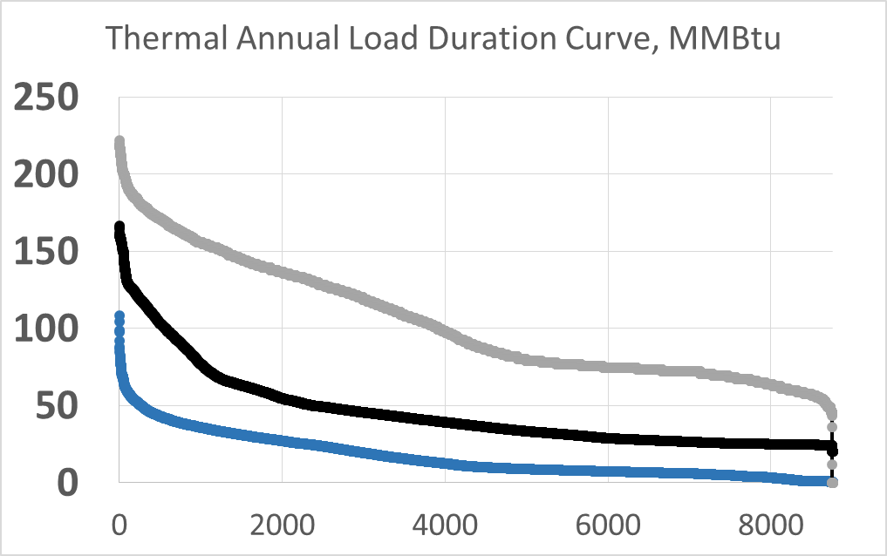
Case 1: Thermal Load Following
10 MW Turbine as a Boiler (Cogeneration)
/ hr.
Med Thermal Case
MW CHP
Utilization
MMBtu
Energy Savings
10
90%
300,000
$1,500K
$6 / MWh
Grid Supplied | 70%

Slide 22
Case 1: District Energy & Thermal Load Following
Establishes the Foundation for Sustainable Energy
Description | NYC | Boston | DC
Flat Supply Rate 2014, $/MWh | $80 | $80 | $70
Savings ($000)
Thermal Energy, $ 000 | 1,500 | 1,500 | 1,500
Supply with Gen O&M | 2,200 | 2,200 | 1,400
Electric Distribution | 1,400 | Utility | 1,300
Recovered Rental Space* | 4,200 | 2,000 | 3,200
Chiller eff. Savings, kw/ton** | 1,000 | 1,000 | 1,500
Carbon offsets***/REC’s | (500) | (500) | (500)
Savings, $ million | 9,800 | 6,200 | 8.400
* Space recovered in building due to the use of a central heating and cooling plant
** Improved cooling system efficiency from 1 to 0.75 kW/ton
*** Assumed $10 / ton or $6/MWh per REC

Slide 23
Case 1: District Energy & Thermal Load Following
Establishes the Foundation for Sustainable Energy
Description | NYC | Boston | DC
Savings, $ million | 9,800 | 6,200 | 8,400
CHP (Turbine as a Boiler) Cost | 30,000* | 30,000* | 25,000
Thermal Distribution | 5,000 | 5,000 | 5,000
Total Cost | 35,000 | 35,000 | 30,000
Simple Payback, wo / w Rental | 6.3 / 3.6 | 8.3 / 5.6 | 5.8 / 3.6
* Includes interconnect, space, and tie-ins for future islanding and storage capability
Other Performance | NYC | Boston | MD
State Average CO2e, lb./MWh | 600 | 980 | 1,300
CHP CO2e, lb./MWh / offset/REC | 660 / 0 | 660 / 0 | 660 / 0
State Efficiency, MMBtu/MWh | 7 | 8 | 10.5
CHP/CCCT Efficiency, MMBtu/MWh | 6.4 / 5 | 6.4 / 5 | 6.4 / 5

Slide 24
Case 2: RTP and Thermal Load Follow
Real-Time Procurement 2013
Real time savings =
NY: $9,900,000 or $40/MWh
DC: $7,800,000 or $31/MWh
MA: $9,700,000 or $39/MWh
Grid Supplied | 70%
Gen RT
> $50
Purchase at RT < $50

Slide 25
Case 2: RTP and Thermal Load Follow
Annual Thermal Load Duration Curve
Med Thermal Case
MW CHP | 20
Utilization | 35%
MMBtu | 60,000
Savings | $300K
 | $1 / MWh
10
80%
300,000
$1,700K
$7 / MWh
20 MW Engine CHP
10 MW Turbine as a Boiler

Slide 26
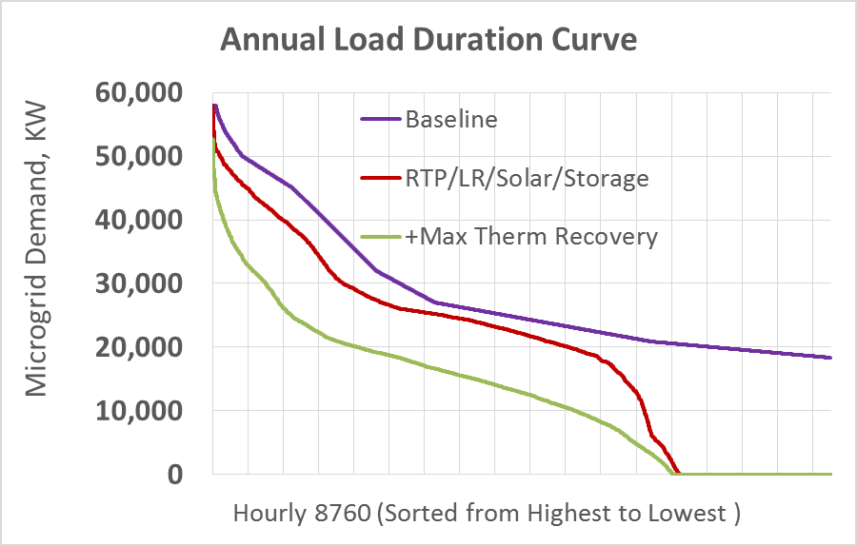
Case 2: RTP and Thermal Load Follow
Thermal savings =
Low: $1,200,000 or $5 / MWh
Med: $2,000,000 or $8 / MWh
Max: $3,400,000 or $14 / MWh
Med
RTP Impact Med Thermal
NY: - $8 / MWh
DC: - $11/ MWh
MA: - $14 / MWh
Notes:
Large mixed use development
Baseline Power Cost = $20 million or $80/MWh
RTP Cost = $11 million or $44/MWh

Slide 27
Case 2: Third Party Microgrid Savings, $/MWh
Description | NY | MA | DC
Thermal Energy | 8 | 8 | 8
Supply with O&M | 32 | 25 | 20
Demand - Standby | 0 | 0 | 0
Capacity | NA | NA | 13
Distribution | 12 | 0 | 9
Ancillary Service/PQ | 4 | 4 | 6
LR/Solar/Storage | 6 | 10 | 5
Carbon Offset or REC | (2) | (2) | (2)
Total, $/MWh | 77 | 52 | 71
% Reduction Cost | 46% | 36% | 63%
40 | 39 | 31 RTP Only

Slide 28
Case 2: Utility Impact
 | Before/After Microgrid |  |  |  | INVESTMENT
 | NY | Boston | DC
Utility Revenue, $M | 22 / 19 | 16 / 16 | 7.4 / 5.2 |  | SCADA + Software
On-peak Demand Served, MW | 58 / 53 | 58 / 40 | 58 / 40 |  | Communications
Distribution | 4.4 / 1.4 | 5 / 5 | 4.2 /2.0 |  | Feeders / Smart Switches
Demand Charges | 18 / 18 | 11 / 11 | 3.2 / 3.2
Operating Costs |  |  |  |  | Advanced Meters
Ancillary Service Benefits |  |  |  |  | System Expansion
Demand Reduction Potential | 58MW | 58MW | 58MW |  | Other
53 | 40 | 40
Assumes demand charge is based on aggregate microgrid load, not building meters

Slide 29
Case 2: Third Party Microgrid Investment
($000)
Investment Components | NY | MA | DC*
Generation (42 MW) | 80,000 | 80,000 | 69,000
Storage | 6,000 | 6,000 | 5,000
Solar | 8.000 | 8.000 | 7.000
Thermal Distribution | 5,000 | 5,000 | 4,000
Metering / SCADA | 5,000 | 5,000 | 4,000
Controller/Automation/LR | 10,000 | 10,000 | 9,000
Total $ (000,000) | ~$114,000 | ~$114,000 | ~$98,000
*Construction costs in DC are about 14% lower, http://laborpress.org/sectors/building-trades/127-new-york-city-construction-costs-continue-to-rise

Slide 30
Case 2: Third Party Microgrid Savings & Payback
Savings ($000) | NY | MA | DC
Supply with O&M | 8,000 | 6,100 | 5,000
Capacity Charge |  |  | 3,200
Distribution Charge | 3,000 | Utility Distribution | 2,200
Thermal Storage / Solar | 450 | 600 | 450
Thermal Recovery | 2,000 | 2,000 | 2,000
Ancillary Services / PQ | 1,000 | 1,000 | 1,500
Load Response Conservation | 1,000 | 1,900 | 800
Added Rental Space | 4,200 | 2,000 | 3,200
Carbon Offsets or REC’s | (500) | (500) | (500)
Total $ (000,000) | ~$19,150 | ~$13,100 | ~$17,850
Simple Payback | 6.0 | 8.7 | 5.5

Slide 31
Case 3: High Thermal Case
Annual Thermal Load Duration Curve
High Thermal Case
MW CHP | 15
Utilization | 43%
MMBtu | 80,000
Thermal Savings | $400K
 | $1.4/MWh
15
99%
600,000
$3,000K
$12/MWh
15 MW Engine CHP
Thermal Savings increases to $3.4 million or $13/MWh
Simple Payback Unchanged
Increased thermal savings offset by reduced RTP savings
15 MW Turbine as a Boiler

Slide 32
Microgrid Operating Strategies
Demand Charge Reduction
Demand charge savings
NY: ~$9,000,000 Payback 6.0 to 4.0
MA: ~$6,00,000 Payback 8.7 to 6.0
DC: ~$2, 00,000 Payback 5.5 to 4.9
Off-peak
Notes:
Large mixed use development
Baseline Power Cost = $20 million or $80/MWh
RTP Cost = $11 million or $44/MWh

Slide 33
USDN Microgrid Conclusion
  Microgrid architecture – local representation
    Utility microgrids – one city at a time
    Third party microgrids
  CASE 1: District Energy/CHP –
  Foundation for Sustainable Energy
    Efficiency
    Emissions
    Water
    Resiliency
  CASE 2 & 3: Islanding for Resiliency +
    Price response
    Demand response
    Load conservation
    Power quality
    Grid service
Imagine $4 billion in investment in 2,000 MW of local load response capability for NY, MA, & DC area

Slide 34
QUESTIONS!
EDUCATION
CERTIFICATION
SPONSORSHIP
peer.usgbc.org

Slide 35
U.S. State Electricity Supply Performance (2012)
Iowa
26% RENEWABLE
New York
27% RENEWABLE
CO2e = 600 lb./MWh
Massachusetts
8% RENEWABLE
CO2e = 980 lb./MWh
POWER SUPPLY PERFORMANCE INDEX
CO2e 1,770 lb./MWh
SEI = 8.2 MMBtu/MWh
SEI = 7.0 MMBtu/MWh
SEI = 8 MMBtu/MWh
71-100
HIGH PERFORMANCE
45
77
66
41-70
21-40
LOW PERFORMANCE
State | SO2 (lb./MWh) | SO2 (Tons)
IA | 4.0 | 110,000
NY | 0.5 | 34,000
CT | 0.5 | 9,000
Notes:
What are you plugging into? North Dakota and Iowa have achieved 21% and 26% renewable generation while still emitting carbon and other harmful pollutants at the highest rates in the world. PEER offers a new performance based scoring system that focuses on outcomes that matter.

Slide 36
Your Choice of Power Matters
Power suppliers must have a contract to put power into the grid
Coal
High Eff.
Gas
Simple
Gas
Nuclear
100 GW
300 GW
Idle
240 GW
Sufficient idle gas and coal to supply twice the current usage
200 GW
Renewable
70%
150 GW
Idle
Idle
You can ask supplier to put a specific type of power into the grid to meet your contract
35%
14%
Customers
Independent System Operator
Source: DOE EIA Annual Energy Outlook
Notes:
Excess capacity is due to overbuilding by the private sector in restructured states, private sector built this capacity at no cost to customers. The private sector now stands ready to invest billions at no cost to rate payers if the state commissions and utilities remove barriers.

