Slide 1

Energy Storage Initiative
State of Charge Study
DOER Commissioner Judith Judson
New England Electricity Restructuring Roundtable
December 9, 2016

Slide 2

Energy Storage Initiative
$10 million initiative launched in 2015
  State of Charge study
  Demonstration projects
Robust stakeholder engagement
  Study details:
    Technology and market landscape
    Comprehensive modeling of the cost and benefits of deploying storage
    Economic use cases of specific storage applications
    Economic development opportunities
    Policy and program recommendations to grow storage deployment and industry in MA
“Massachusetts will continue to lead the way on clean energy, energy efficiency, and the adoption of innovative technologies such as energy storage.”
- Governor Baker, Feb 2016, Accord for a New Energy Future Press Event
“Given the recent advances in energy storage technology and cost-effectiveness, it is hard to imagine a modern electric distribution system that does not include energy storage.”
Utility stakeholder perspective

Slide 3
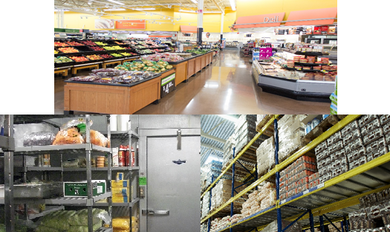

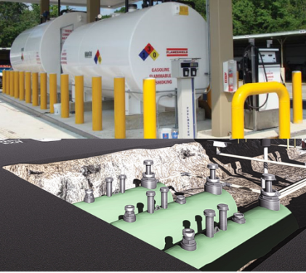

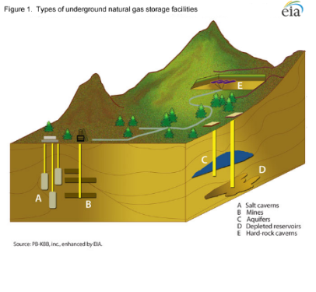

Storage In Commodity Supply Chains
FOOD
Warehouses
Grocery stores
Freezers & refrigerators
WATER
Reservoirs
Above-ground tanks
Water bottles
GASOLINE
Underground tanks Above-ground tanks
Tank trucks
Portable fuel tanks
OIL
Above-ground tanks
Piping
NATURAL GAS
Depleted fields
Aquifers
Salt caverns
Pipelines
Above-ground tanks
ELECTRICITY
Energy Storage Technologies
Currently less than 1% of daily electricity consumption for MA
Storage capacity more than 10% of daily consumption
The electricity market has a fast “speed of light” supply chain and the least amount
of storage. This lack of storage creates a need for additional infrastructure to
maintain market reliability.
3

Slide 4
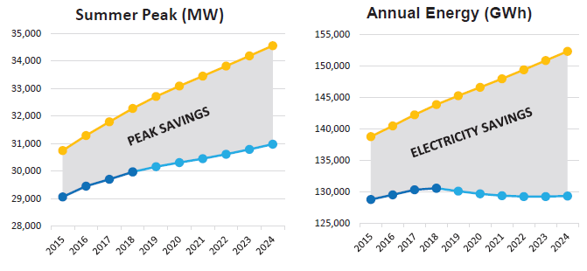
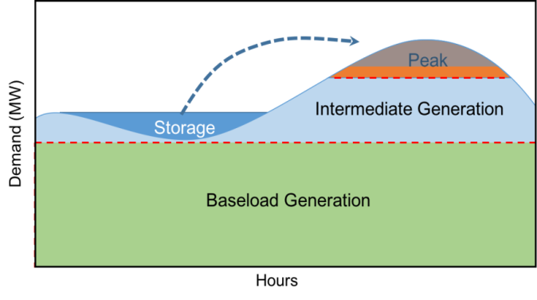
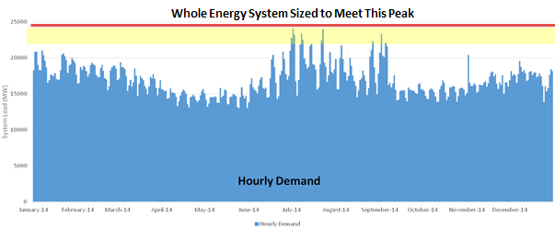
Massachusetts Energy Challenges:
Storage is “Game Changer” for Meeting Peak
ISO-NE State of the Grid 2016 and System Annual Hourly and Weekly Demand
The need to size grid infrastructure to the highest peak usage results in system inefficiencies, underutilization of assets, and high cost
Energy storage is the only technology that can use energy generated during low cost off-peak periods to serve load during expensive peak.
Top 1% of Hours accounts for 8% of MA Spend on Electricity
Top 10% of Hours accounts for 40% of Electricity Spend

Slide 5
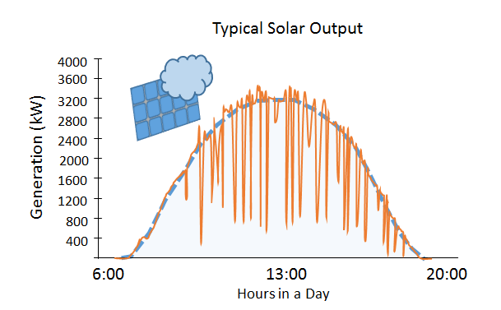
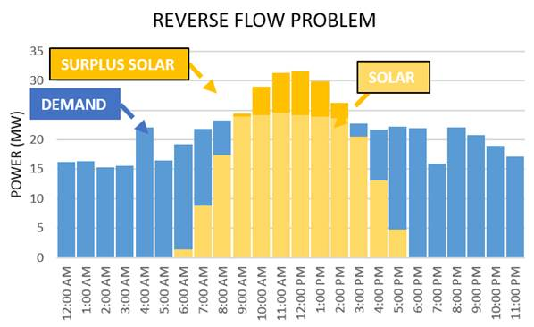
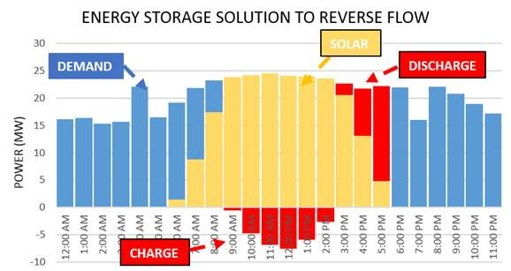
Massachusetts Energy Challenges:
Storage reliably integrates more Renewables
According to ISO-NE “State of the Grid – 2016” more fast and flexible resources will be needed to balance intermittent resources’ variable output.
Storage can provide this flexibility.
With 55,000+ distributed solar projects and growing, storage can manage reverse power flow at substations

Slide 6
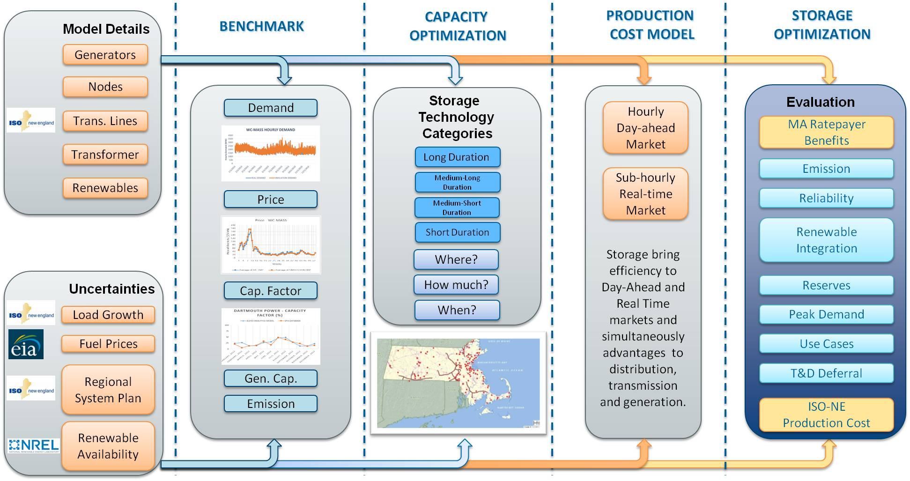
Advanced Storage Optimization Model

Slide 7
Model Results: Significant Benefits and Cost Savings from Optimized Storage
Benefit Categories | Benefit Description
Energy Cost Reduction | Energy storage replaces the use of inefficient generators at peak times causing: 1) reduced peak prices which 2) reduces the overall average energy price. This also benefits the natural gas supply infrastructure. | $275M
Reduced Peak | Energy storage can provide peaking capacity to 1) defer the capital costs peaker plants and 2) reduced cost in the the capacity market | $1093M
Ancillary Services Cost Reduction | Energy storage would reduce the overall costs of ancillary services required by the grid system through: 1) frequency regulation, 2) spinning reserve, and 3) voltage stabilization | $200M
Wholesale Market Cost Reduction | Energy storage can be a flexible and rapid tool that help generators operate more efficiently through: 1) less wear and tear, 2) less start up and shut down costs, and 3) reduced GHG emissions. | $197M
T&D Cost Reduction | Energy storage 1) reduces the losses and maintenance of system, 2) provides reactive power support, 3) increases resilience, and 4) defers investment | $305M
Increased Renewable Integration | Energy storage reduces cost in integrating renewable energy by 1) addressing reverse power flow and 2) avoiding feeder upgrades | $219M
Total System Benefits |  | $2,288M

Slide 8
Study Findings
Opportunities:
Energy Storage has potential to provide benefits to the Massachusetts ratepayers, including:
  Reducing the price of electricity
  Lowering peak demand and deferring investment in new infrastructure
  Reducing the cost to integrate renewable generation
  Reducing greenhouse gas (GHG) emissions
  Increasing the grid’s overall flexibility, reliability and resiliency
  Generating nearly $600 million in new jobs
Barriers:
  Business models for storage in very early stages
  Energy storage systems need a way to be compensated for a greater portion of their cost benefit in order to achieve market viability
Non-Remunerable
Energy Storage Benefits
Cost
Remunerable

Slide 9
Study Recommendations
The Commonwealth can nurture the energy storage industry and grow the deployment of storage in Massachusetts through programs and initiatives
Funding for Demonstration projects
Grant and Rebate Programs
Paired with Clean Energy procurements
Storage in State Portfolio Standards
Establish and Clarify Regulatory Treatment of Utility Storage
ISO Market Rules
Initiatives to Grow Companies
If adopted, the Study recommendations have the potential to yield:
600 MW of new energy storage by 2025
$800 million in cost savings to ratepayers
350,000 metric tons reduction in GHG emissions over a 10 year time span
Equal to taking over 73,000 cars off the road

Slide 10

Clean Energy Legislation
“An Act Relative to Energy Diversity” (H. 4568)
    Governor Baker signed bi-partisan, comprehensive energy diversification legislation on August 8, 2016.
    Utility procurements 1,200 MW hydroelectric; 1,600 MW offshore wind
    Massachusetts is now the third state in the country to have an advanced energy storage procurement authorization.
    Provides a definition for energy storage;
    Clarifies utility ownership of storage;
    Allows storage to be paired with clean energy procurements;
      1,200 MW hydropower, 1,600 MW offshore wind
    Authorizes DOER to set an energy storage target.
      If a target is set, the legislation allows funding flexibility to achieve it – including alternative compliance payments , energy efficiency funds, and refine existing procurement methods.

Slide 11
Clean Energy Legislation
“An Act Relative to Energy Diversity” (H. 4568)
    Storage Next Steps
    Determine whether to set energy storage targets for Massachusetts electric companies
        Currently out for stakeholder comment
        Comments due to Storage.DOER@state.ma.us by December 16, 2016
        Determination will be made by December 31, 2016
    If DOER determines to set a target, it will be adopted by July 1, 2017

Slide 12
Grant Initiatives for Storage
Energy Storage Demonstrations RFP
  $10 million
  RFP to be released by MassCEC in December
Peak Demand Reduction Grant
    $4.5 million
    RFP closed November
    Energy Storage is eligible technology
Community Clean Energy Resiliency Initiative: Round 3
  $14 million
  Announced 9/22/16, includes 3 programs:
    Resiliency Feasibility Studies for State Medical Facilities
    Resiliency Demonstration Projects at public and private hospitals
      $11.5 million Program Opportunity Notice Posted on 12/5/2016
    Resiliency Tool development for community planners and administrators

Slide 13
Storage Integrated with Other Initiatives
  Energy Efficiency Programs
    Peak Demand Reduction was one of 3 key priorities negotiated by DOER in the 2016—2018 Three Year Plan
    All four electric Energy Efficiency Program Administrators have submitted proposals to the DPU to pilot peak demand reduction offerings
    These include:
      Commercial - small business wifi thermostats, software and controls, thermal storage, BTM batteries, and economic curtailment
      Residential - wifi thermostats, behavior, and BTM batteries
    Goal to include at scale demand reduction programs as part of next three year plan 2019 - 2021
Next Solar Incentive program
  DOER currently working with stakeholders on next solar incentive program
  Current structure includes ES incentive for pairing with solar PV

Slide 14
Electric Vehicles: Mobile Energy Storage
Vehicle-to-Grid Electric School Bus Pilot Initiative
  4 towns each awarded grant to procure 1 electric school bus
  Demonstrating vehicle to building energy support
  One town considering inclusion of the bus in ISO-NE’s Alternative Technology Regulation Resource (ATRR) program
Massachusetts Offers Rebates – Electric Vehicles (MOR-EV)
  Up to $2,500 rebate for eligible plug in electric vehicles
  $6 million RGGI funds awarded to-date
  >3,000 rebates issued
  The Baker-Polito Administration is investing $12 million more into the MOR-EV program, doubling it’s historic funding, to continue supporting the adoption of electric vehicles in Massachusetts.

Slide 15
THANK YOU

