Slide 1
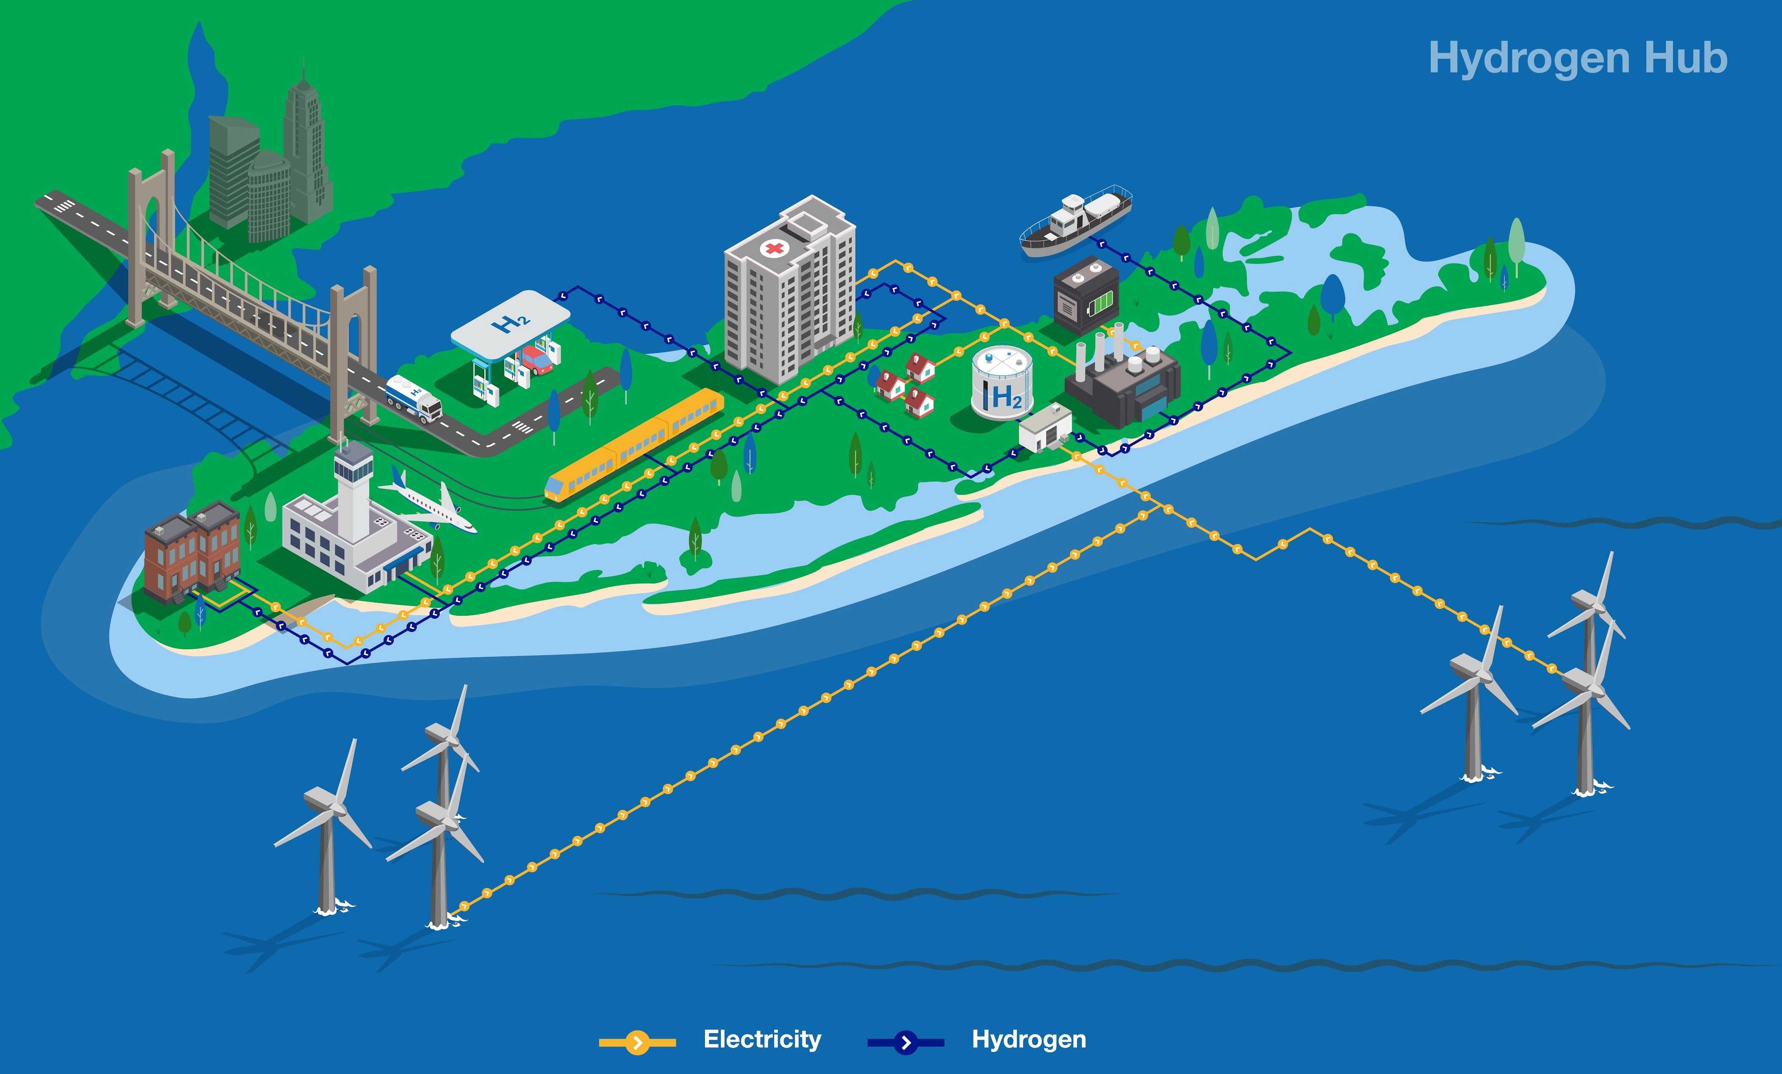
Green Hydrogen
National Grid envisions an integrated net zero energy system with clean electricity and clean fuels like hydrogen meeting demand for power, heat and transport.
Peaker plants transformed to run on 100% Hydrogen
Hydrogen transport
Hydrogen storage
Hydrogen heat
Hydrogen supply
Long Island is well-positioned to become a “Hydrogen Hub” given the high energy demand in the New York City metro area, limited transmission connections, and large offshore wind potential, which could be used to produce green hydrogen.

