Slide 1
MA Grid Modernization Report
Joint Presentation: Jamie Tosches (AGO); Peter Zschokke (NGRID); Camilo Serna (NU); Janet Besser (NE CEC); and David Malkin (GE); Jonathan Raab (Facilitator)
NE Electric Restructuring Roundtable
9/20/13

Slide 2
Part 1: Overview and Joint Fact Finding

Slide 3
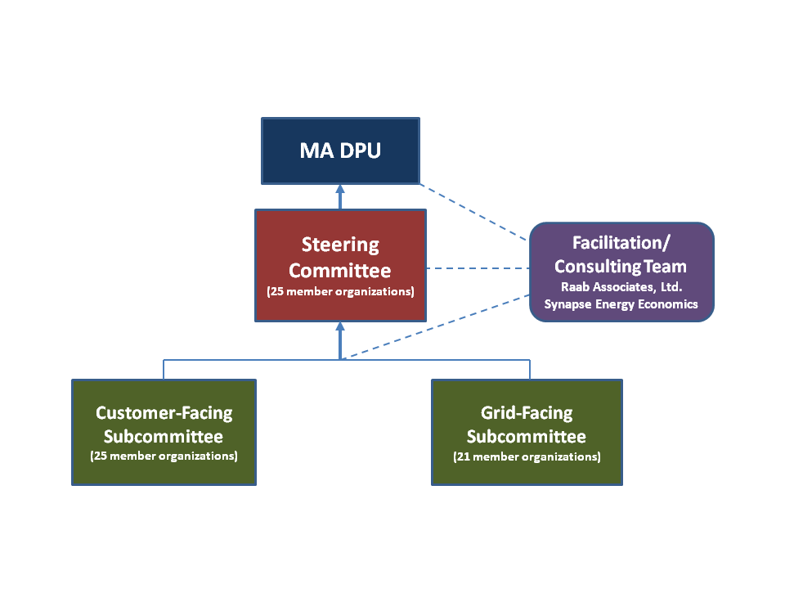
MA Grid Mod Stakeholder Process
Figure 1.1

Slide 4
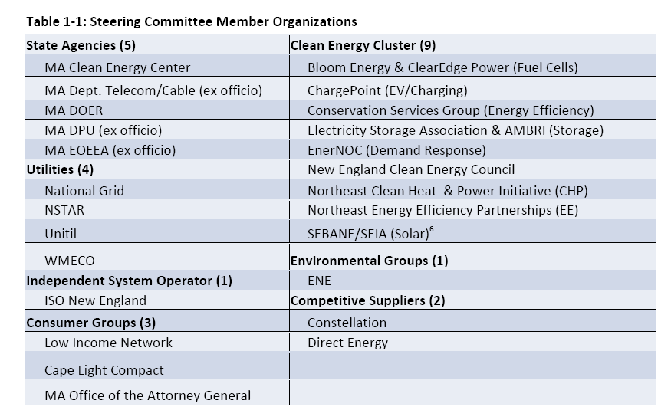
Steering Committee Member Organizations

Slide 5
Final Report to DPU: Outline
Ch. 1: Introduction, Process & Overview
Ch. 2: Goals, Objectives & Barriers
Ch. 3: Grid Modernization Taxonomy
Ch. 4: Background Information & Joint Fact Finding Road-Map
Ch. 5: Principles and Recommendations
Ch. 6: Regulatory Framework Proposals
Ch. 7: Cost-Effectiveness Frameworks
Ch. 8: Next Steps for the Regulatory Framework

Slide 6
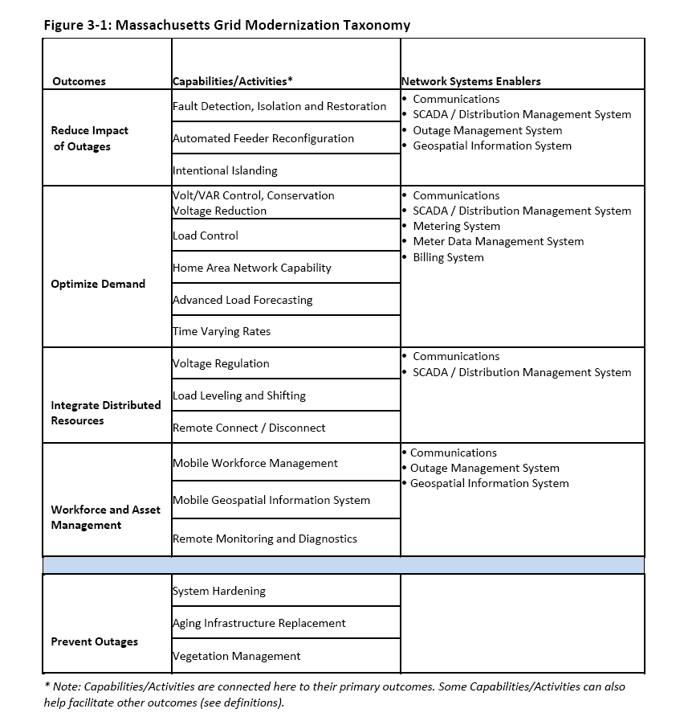
MA Grid Modernization Taxonomy

Slide 7
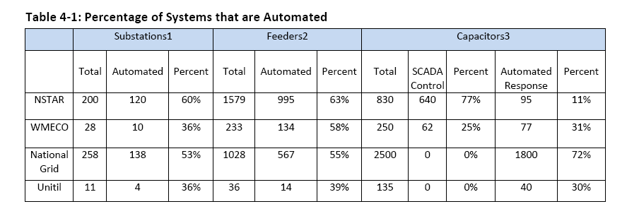
Percentage of Utility Systems that are Automated

Slide 8
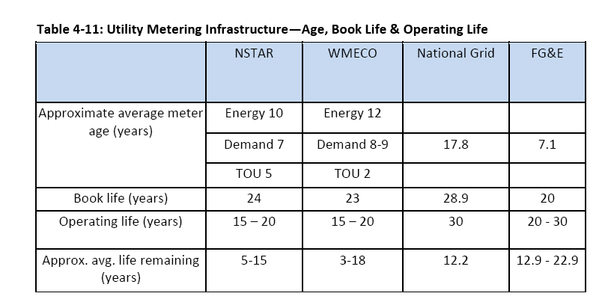

Slide 9
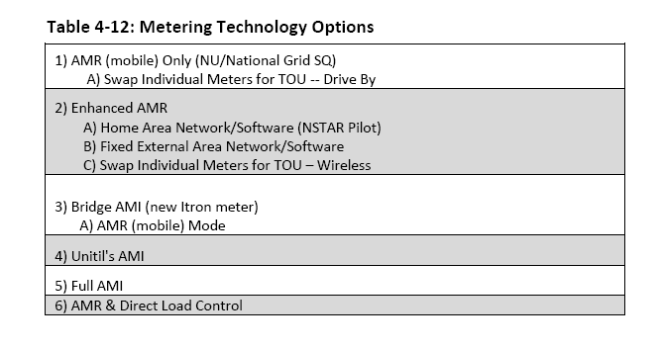
Metering Technology Options

Slide 10
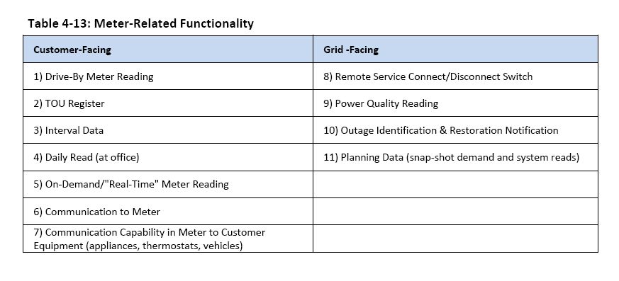
Meter Related Functionality

Slide 11
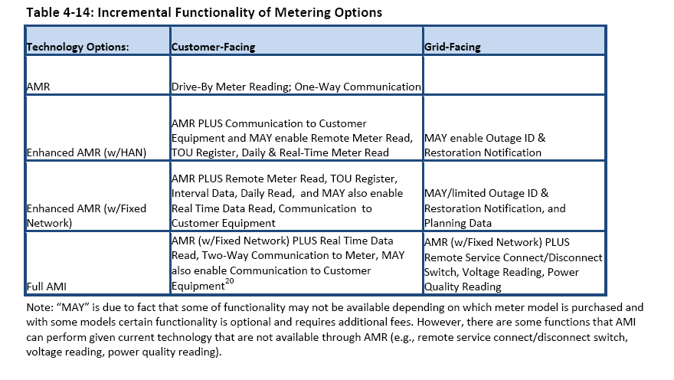
Incremental Functionality of Metering Options

Slide 12
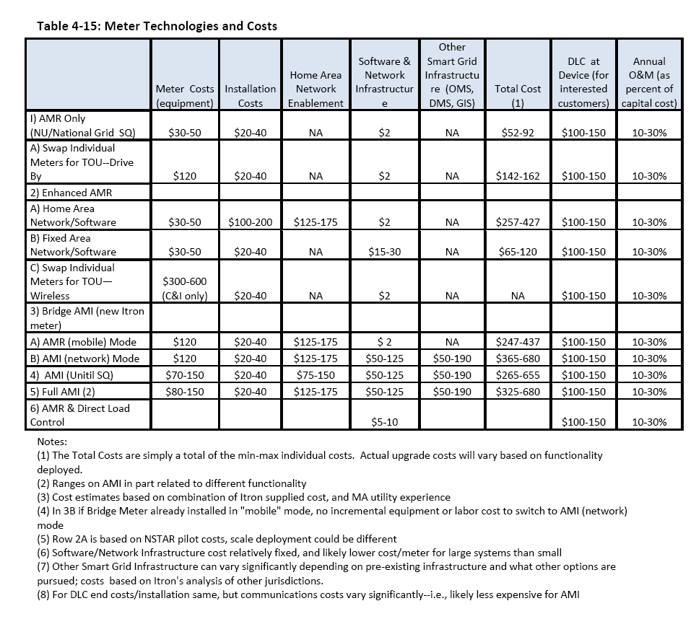

Slide 13
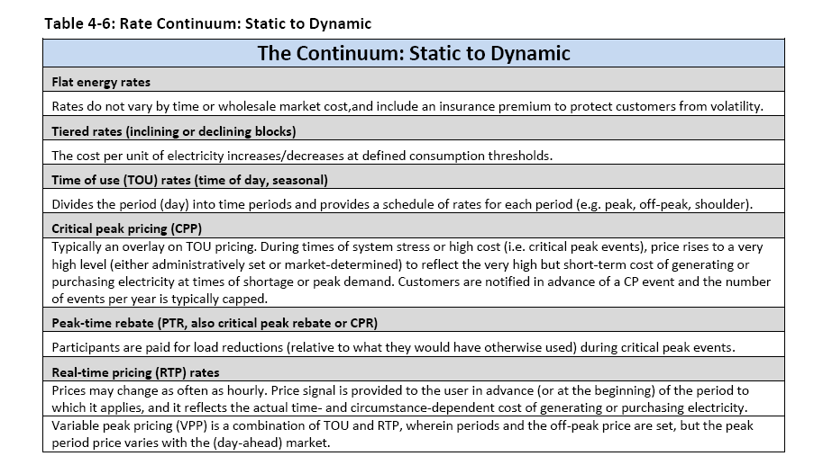
Rate Continuum: Static to Dynamic

Slide 14
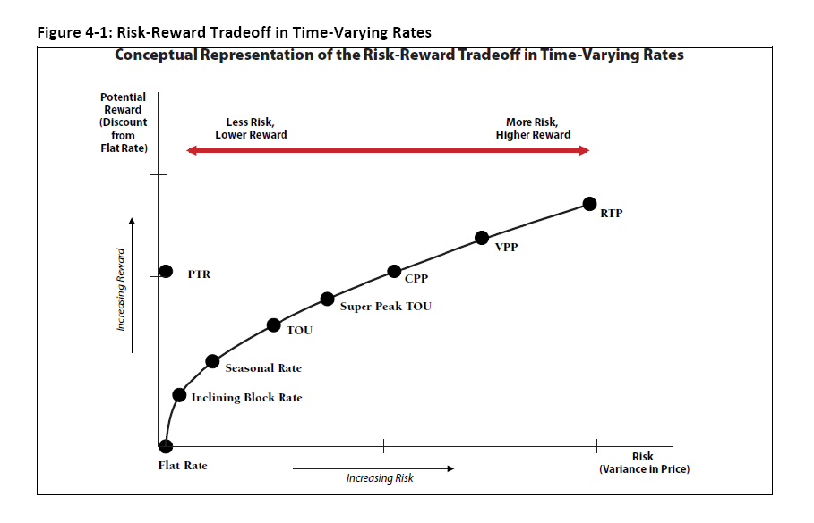
Risk-Reward Tradeoff of TVR Options

Slide 15
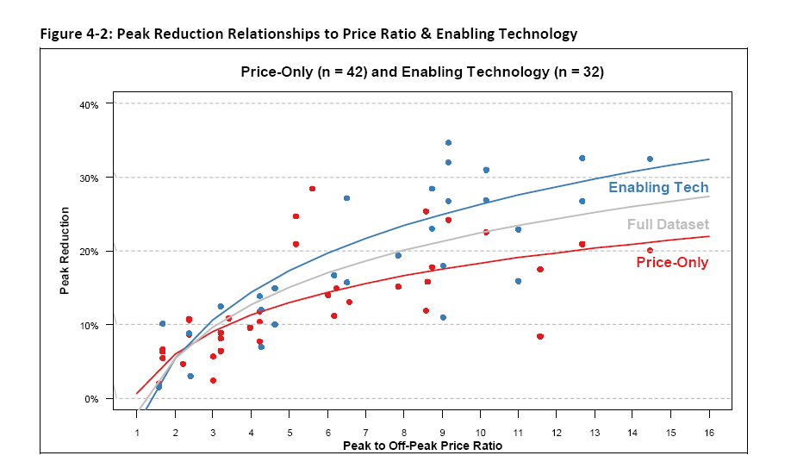
Peak Reduction vs.
Price Ratio & Enabling Technology

Slide 16
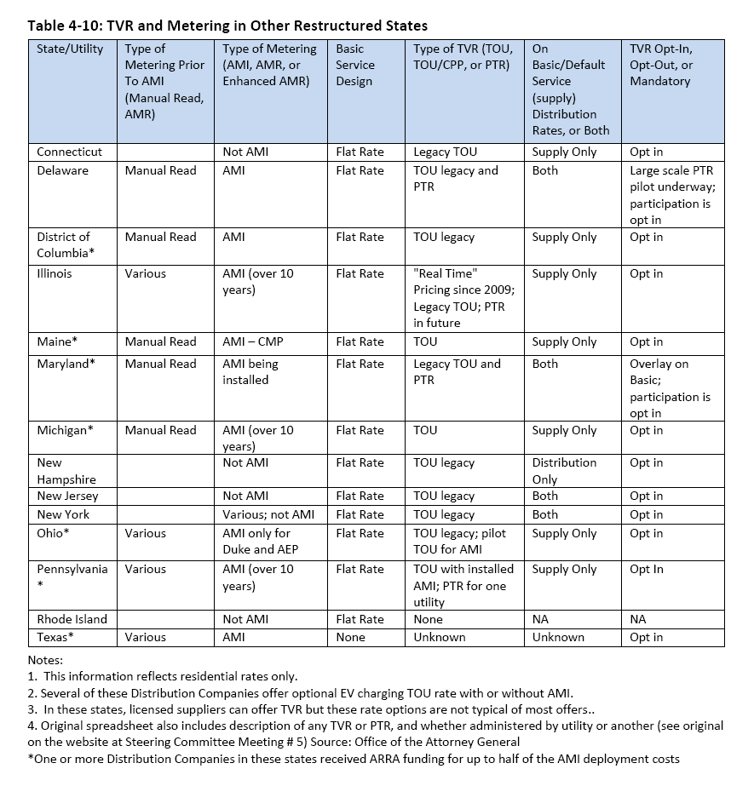

Slide 17
Part 2: Substantive Recommendations

Slide 18
Chapter 5: Principles and Recommendation
Each presenter will present their overall view of grid modernization, and 2-4 of their principles/recommendations on meters, TVR, and/or grid facing issues
  Tosches (AG)
  Zschokke (NGRID)
  Besser (Clean Energy Caucus)
  Serna (NU)
  Malkin (GE)

Slide 19
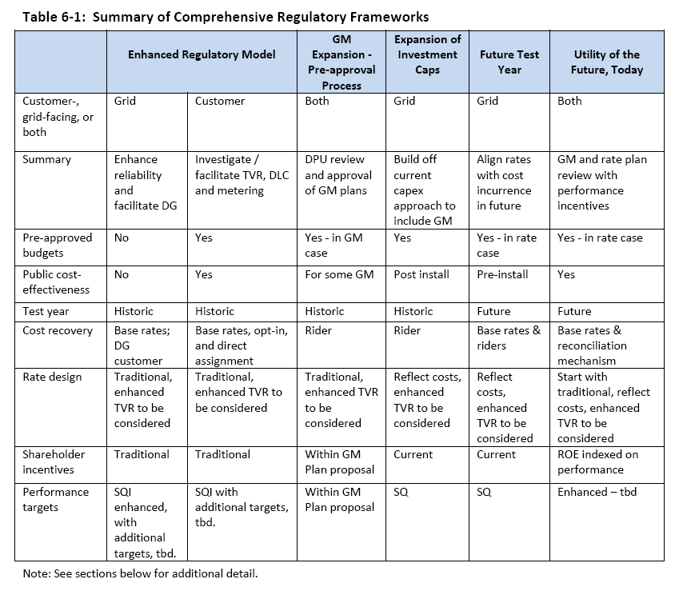

Slide 20
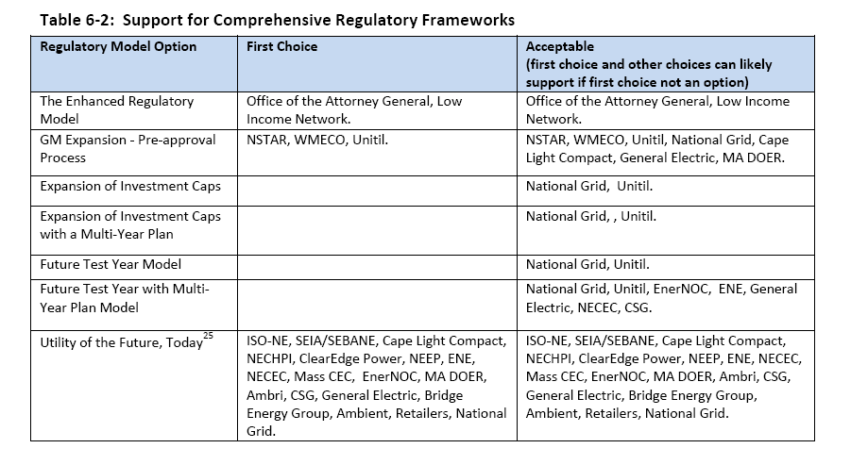
Endorsers of Each Framework

Slide 21
The Enhanced Regulatory Model
Supported by AGO, LIN and AIM.
Comprehensive framework (5 submodels; affordability; market offerings).
Base rate proceedings (least-cost, prudent, U&U, allocation).
Enhancements
  Increase reliability targets for utilities.
  Pre-approval available for metering and time varying rate programs.
  Periodic reporting by utilities (progress and performance).
Costs directly assigned to customers in some instances.
Stakeholders participation in DPU.

Slide 22
The Grid Mod Expansion and
Pre-approval Process
Distribution Companies file proposals with the DPU that meet the DPU’s grid modernization objectives in a manner suitable for the unique characteristics of each system and rate plan
Stakeholders would participate in the DPU review process
Performance targets and cost recovery would be addressed in the context of the DPU proceeding and would be specific to the nature of the investment

Slide 23
Utility of the Future, Today
Forward looking and performance-based model would apply to all utility spending, including grid modernization
Forecasted multi-year (3-5) rate case
Capital investment plan filed by utility showing how it’s consistent with grid modernization objectives
“Business case” required for investment, taking into account benefits, costs, risks and uncertainty
Annual adjustments after DPU review of performance, including service quality
Performance metrics designed for most important, forward looking assumptions; incentives are symmetric

Slide 24
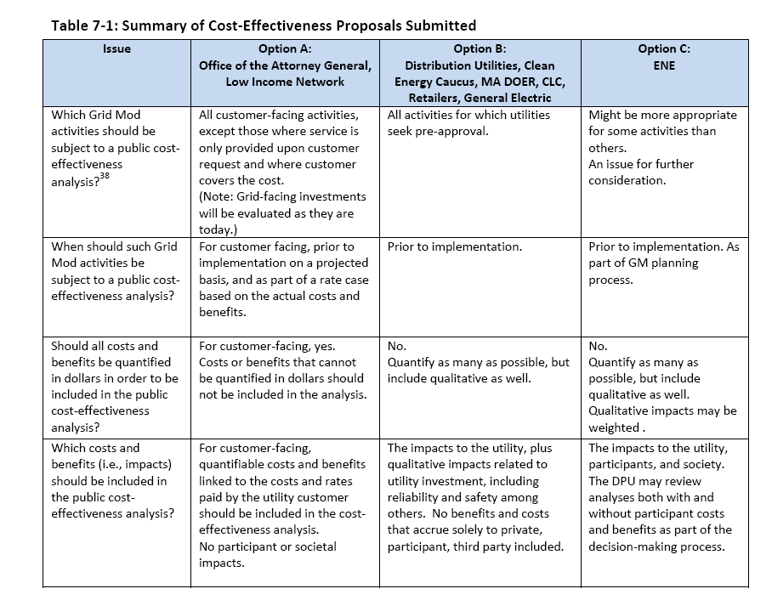

Slide 25
Next Steps
All Steering Committee members recommend DPU use Report as basis for guidance to Distribution Companies on grid modernization
  Clean Energy Caucus/National Grid/DOER – DPU issues guidelines for grid modernization based on Report
  Nstar/WMECO/Unitil/Cape Light Compact/GE – DPU opens Generic Docket, issues straw proposal, takes comment, issues order
  Attorney General and Low Income Network – DPU takes comment on report, may hold hearings, provides guidance for enhancement of distribution system
  Distribution companies can file grid mod plans at any time
Separate proceeding on time varying rates
Separate proceeding on electric vehicles

Slide 26
Appendix

Slide 27
