Slide 1
Restructuring Roundtable September 16, 2011
New England States
Committee ON electricity
On
FERC Order 1000

Slide 2
What is NESCOE?
New England’s Regional State Committee
New England Governors appoint Board
Complicated voting structure, but states seek - & have succeeded in reaching - consensus
Focus: System Planning & Expansion, Resource Adequacy
Information, communications at www.NESCOE.com

Slide 3
What We’ll Talk About Today
Preliminary thoughts on Order 1000
It’s really early in the Order 1000 process
States have a lot of talking to do
More info: http://www.iso-ne.com/committees/comm_wkgrps/trans_comm/tariff_comm/mtrls/2011/order/index.html
Quick updates on
Renewable resource development work
Interstate Transmission Siting Collaborative

Slide 4
Identification of Public Policies
Threshold, not so simple question:
What laws & regulations drive transmission?
States intend to –
identify their collective view of statutes & regulations appropriate to consider in planning
take stakeholder input to inform states’ views

Slide 5
Following Stakeholder Input...
States will provide ISO-NE, stakeholders states’ collective view of those statutes & regulations that are
appropriate to consider in planning
those that are not &
the states’ rationale for both
Identify any transmission needs states believe are driven by public policy requirements & merit evaluation for potential solutions in the planning process (& those that do not)

Slide 6
Evaluation of Potential Solutions
FERC: many ways transmission upgrades can be evaluated – scenario analyses, production cost, etc.
States interested in consumer impact
& in identifying projects that can serve customers reliably at the lowest over all cost
States will look for consumer impact analysis - from ISO-NE, done by states, or from info obtained through competitive process

Slide 7
Cost Allocation
FERC: agreement among states on cost allocation particularly important for transmission driven by public policy
States agree. Projects need to satisfy states to be sited

Slide 8
States’ Goal: Consensus
Per FERC principle - costs not assigned to those that receive no benefit - states anticipate agreement to be achieved by consensus
Lots of open questions:
What does consensus means in this context?
What are the means to achieve final determinations about projects proposed to satisfy state laws & regulations?
Preserve ability to select & pay for projects following competitive process(es)

Slide 9
Quick Updates
Renewable Resource Development
Interstate Siting Collaborative

Slide 10
Look Back: Coordinated Procurement
At Governors’ direction, began exploring - in Blueprint & Coordinated Procurement Report - potential for regionally coordinated renewable procurement
Interest in understanding potential to help meet the region’s renewable energy goals at lowest “all in” cost
2011 Request for Information sought info on size & location of potential projects
Identified large generation potential & representative transmission
Potential benefits from coordinated development
Did not collect cost information

Slide 11
More Recently
In July 2011, Governors expressed continued interest in exploring coordinated procurement
States interested in understanding broadly indicative costs for:
Resources that could supply renewable energy to New England
and
Transmission projects that could integrate those projects
indicative cost information ≠ resource plan

Slide 12
Developing Broadly Indicative Cost Information
Generation (Sustainable Energy Advantages)
Developing cost estimates for renewable resources – on & off shore wind - that could supply energy to New England
Independently estimate resource potential to yield “renewable supply curve” for 2 study years - 2016 & 2020
Initial focus on wind potential in New England & NY
Transmission (RLC Engineering)
Developing cost estimates for transmission that could help integrate energy from such projects
Initial focus on transmission options in northern New England

Slide 13
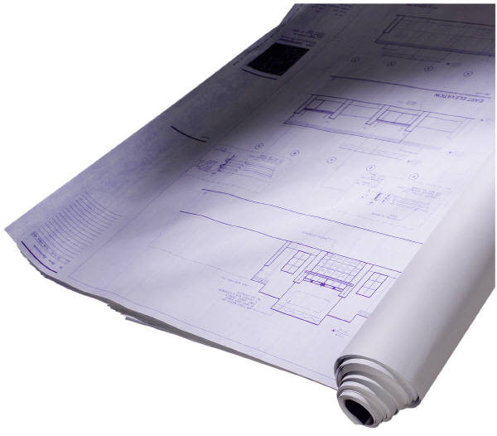
This Is Not A Plan.
What analysis will not indicate:
A best or preferred set of generation or transmission projects
What analysis will indicate:
Relative costs of various wind resources in New England, NY – on & off shore
Cost of transmission to interconnect on-shore wind in northern New England

Slide 14
Interstate Transmission Siting Collaborative
New England does not have a siting problem to solve – we’ve sited $4 B since 2002, with more than that on horizon
However, the Blueprint identified that coordinating siting could help facilitate development of renewable & other resources
Looking at coordination opportunities possible under current law
1st Step: Listening to New England’s transmission owners & developers to identify what the states could do better in the short & long term

Slide 15
Who’s Who: Siting Collaborative
Connecticut: Kevin DelGobbo, Chairman, PURA
Maine: Thomas L. Welch, Chairman, PUC
Massachusetts: Rebecca Tepper, General Counsel, DPU, former Executive Director Energy Facility Siting Board
New Hampshire: Thomas Getz, Chairman, PUC
Rhode Island: Nick Ucci, Principal Policy Analyst, PUC & Coordinator, Energy Facility Siting Board
Vermont: John Beling, Attorney, Department of Public
Service

Slide 16
Thanks.
More information: www.nescoe.com
Or on Facebook:
https://www.facebook.com/pages/New-England-States-Committee-on-Electricity/100576639985710

